Slide 1





2 Project Management -プロジェクト管理
Introduction
Project Management
SRS

Slide 2
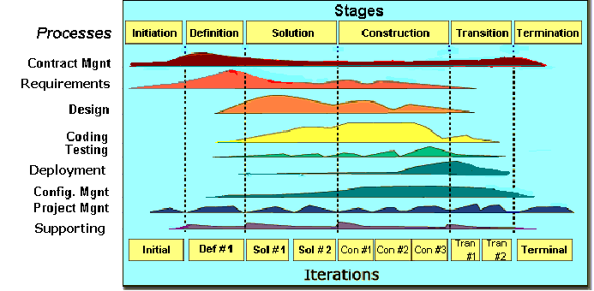
2.1 Software Process Model -ソフトウェアプロセスモデル
Introduction
Project Management
SRS
FPT Software process model

Slide 3
2.1 Software Process Model -ソフトウェアプロセスモデル
Initiation | Identify business functions of the system Determine scope, condition, limitation, project risk List main functions Complete Report #1 (Project Introduction, Project Plan, SRS)
Solution | Complete SRS, Architecture Design and Database Design Complete Report #2 (Architecture Design, Screen Design, Database Design, Class/Component Design), Report #3 (Test Plan, Test Cases)
Construction | Complete Coding and Testing Complete Report #4 (Source codes, UT Cases), Report #5 (Test Report, Quality Report)
Termination | Complete software packages and Report #6 Preparing presentation Complete Project
Introduction
Project Management
SRS

Slide 4
2.2 Project Organization -プロジェクト組織
Nguyễn Văn Sang
Instructor
Đào Trọng Nghĩa
Project Manager
Lê Hồng Nhiên
Technical Leader
Đỗ Văn Tuấn
Developer
Đỗ Văn Tuấn
Tester
Tạ Ngọc Duy
Developer
Tạ Ngọc Duy
Test Leader/QA
Đào Trọng Nghĩa
Developer
Hoàng Anh Tuấn
Developer
Đỗ Văn Tuấn
Design Leader
Đào Trọng Nghĩa
Designer
Introduction
Project Management
SRS

Slide 5
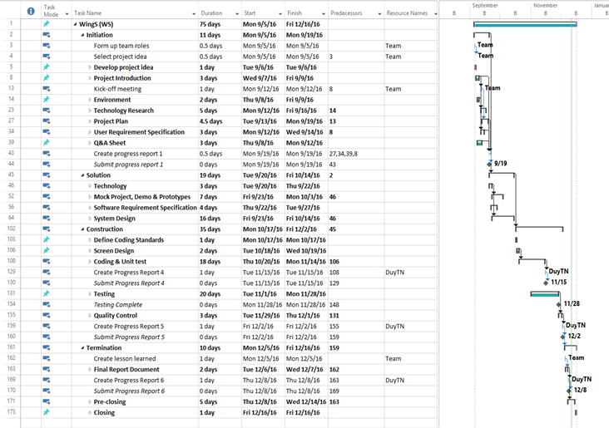
2.3 Project Schedule - プロジェクト計画
Introduction
Project Management
SRS

Slide 6
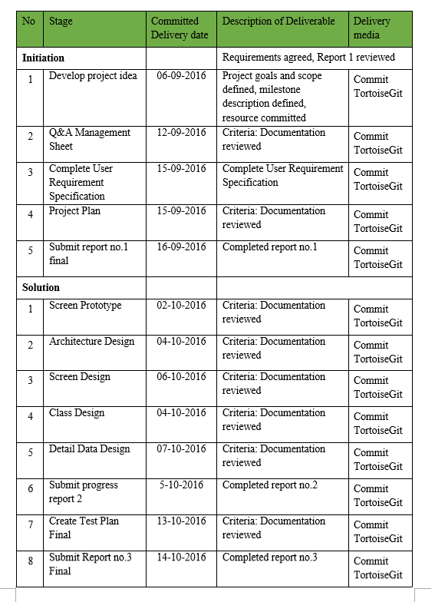
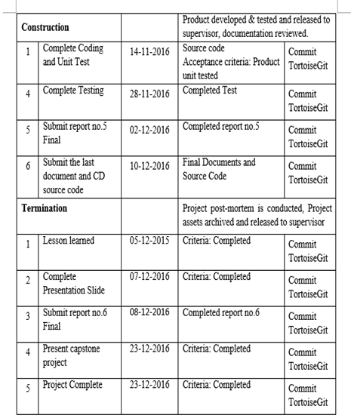
2.4 Objectives & deliverables -目標と成果物
Introduction
Project Management
SRS

Slide 7










2.5 Tools & Infrastructure
ツールと インフラストラクチャ
Tools
Tools for project management
Tools for developing
Introduction
TortoiseGit
Word 2013
Excel 2013
Project 2013
Power Point 2013
Project Management
SRS
Visual studio 2013
Chrome
Firefox
Sublime Text
SQL Server

Slide 8
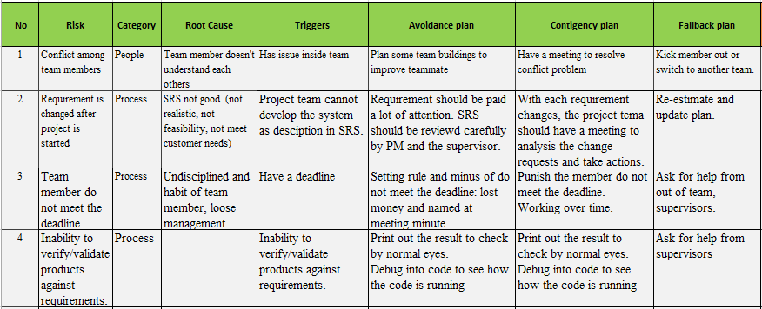
2.6 Risks management -リスク管理
Introduction
Project Management
SRS

Slide 9
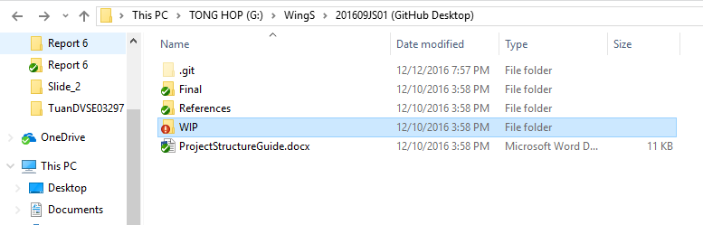
2.7 Configuration management
コンフィグレーション管理
Final: Store sent and delivered documents
References: Store reference documents. For example: templates, technologies document…
WIP: Store documents in progress developing
Plan: Plan of capstone project
Users: Working Folder of Member
Documents: Store whole documents in progress developing
Records: Store documents like Meeting Minutes, Q & A Management…
Introduction
Project Management
Folder structure of project
SRS

Slide 10
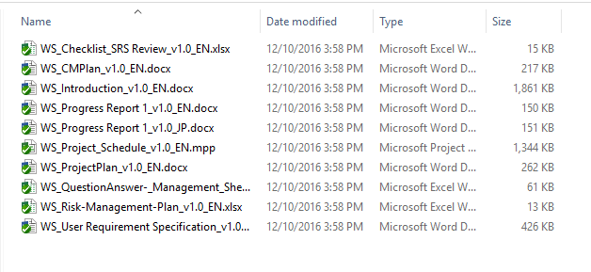
2.7 Configuration management
コンフィグレーション管理
Rule: ProjectCode_Document’s name_v<x.x>_language
ProjectCode: WS{
Document’s name: Architecture Design, Class Design…
v<x.x>: document’s version. For example: v1.0, v1.1,…
Language:
EN: English
JP: Japanese
Introduction
Project Management
Naming conventions
SRS

Slide 11
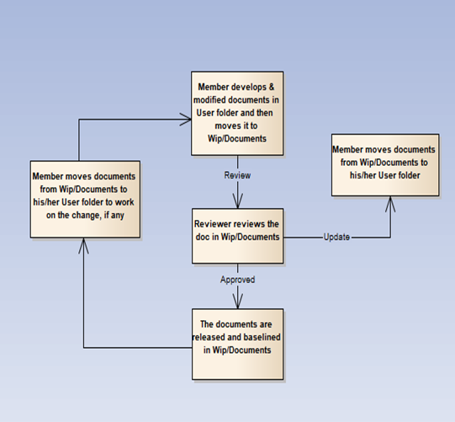
2.7 Configuration management
コンフィグレーション管理
Introduction
Project Management
SRS

Slide 12


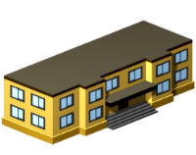





2.8 Communication management
コミュニケーション管理
Time: 5 hours/day, 5 days/week.
Location: school, home
Communication
Meeting minutes
Introduction
Project Management
SRS

