Slide 1

Configuration Management
Version: 1.1
Author: Nguyen Lam Phuong
Jul-2001
Instructor: Nguyen Lam Phuong
Operation Manager
© <year> FPT-SOFT
04e-BM/NS/HDCV/FSOFT
Notes:
Hi everybody,
My name is Dat. I’m the Training manager of FSOFT. Today I’ll introduce to you the HR and Training system of FSOFT. It will take you about 10 min. Pls. feel free to interrupt if you have questions.

Slide 2
Introduction
Course Objective
  The purpose of this course is to explain various terms and concepts related to Configuration Management, and also to describe different best practices as well as how to use version management tool effectively
Duration: 2 hours
Targeted attendees:
  Configuration Controller and Acting PL + to-be PL
Notes:
The system is divided into 3 main parts: recruitment - to attract people, training - to develop people, and HR management - to motivate and retain them. We will go through each of these.

Slide 3
Objectives
After the course, student will achieve (be able to):
Identify CSCI, CI, Baselines
Baseline
Understand and implement the CM processes
Notes:
The system is divided into 3 main parts: recruitment - to attract people, training - to develop people, and HR management - to motivate and retain them. We will go through each of these.

Slide 4

Need for CM
Enables the team to work together in a stable and flexible environment
Maintains the integrity and control of software products throughout the life cycle
Enforces the discipline on the control in the change of the software product and documents
Enhances the productivity in long run
Easy identification of artifacts in case of future maintenance and
Mainly the success of any project depends on the strong CM plan
Notes:
We have 2 main objects of recruitment: those for management posts e.g. project managers or team leaders, and those for developer posts. For the 1st kind of objects we have exciting offers and talent seeking policy. E.g. we have and are continuously developing a database of s/w professionals in Hanoi. In case of need, we can recruit some of them for coming projects.
For developer posts, we have recruitment program for top IT Universities.
Moreover, in long run we have Centers for young outstanding students of IT and Science in Hanoi and HoChiMinh City.

Slide 5

Steps involved in CM
Configuration Identification :
Identification of Items to be put under configuration management
Configuration Control
Provides mechanism to process change requests, to track changes, to distribute changes and to maintain past versions
Status Accounting
Provides formalized recording and reporting of established configuration items
Reviews/Audits
Access Control
Notes:
Each candidate has go through a selection of 3 steps. Only less than 10% of them are successful.
After selection, they need to fulfil 2-month probation period with Initial Training and Pilot project execution.

Slide 6
CI Concept
Software Project Artifacts
Computer Software Configuration Item (CSCI)
  A software item which is identified for configuration management or, an aggregation of software that satisfies an end user function and designated for separate configuration management
Configuration Item (CI)
  A configuration item is a uniquely identifiable subset of the CSCI that represents the smallest portion of the system to be subject to independent configuration management change control procedures. Configuration items need to be individually controlled because any change to a configuration item may have some effect upon the properties of the system
CSCI
CI
CI
CSCI
CI
CI

Slide 7

Categories of CSCI
Project management configuration items
    Project plans
    Schedules
Requirements & design configuration items
    Requirements specifications
    High level design
    Detailed design
    Use case model files
    Test plans
Build configuration items
    Source files
Notes:
Initial training program is to socialize newcomers. They will get familiar with FPT and FSOFT, s/w process, technology used here.
Then they will do a project in team of 4-5 newcomers with team leader from FSOFT team leaders. The project obeys the development process in FSOFT.

Slide 8
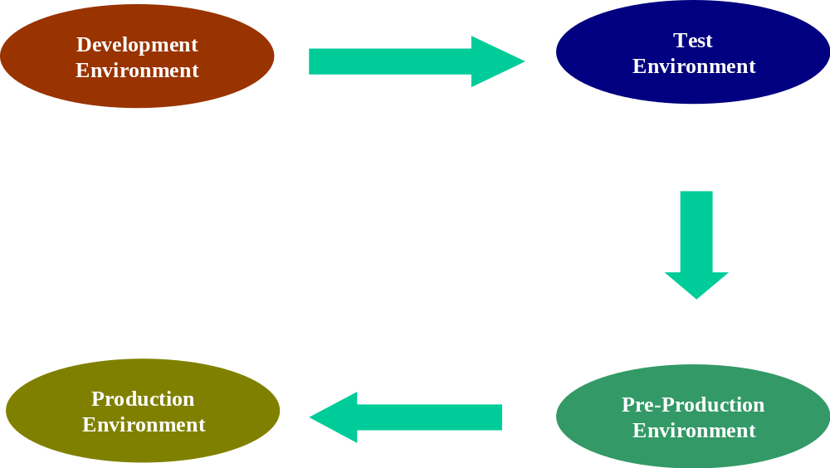
Movement of CSCI

Slide 9
Baseline process
Baseline
Record
Create CI
Config
Register
Baseline
Record
Draft Area
(WIP)
Baseline
Baseline area
(Controlled)
Revise
Release CI
CSCI type
Before Baseline point
At Baseline
Source
Store in a folder of VM Tool
Put under common label inside VM repository
Binary
Store in WIP project directory
Store in FINAL project sub-directory according to baseline ID

Slide 10
Baseline for All Types of CI
Configuration Item | Type | Baseline Point | Directory | VM Label
Documents & Sources before starting the modifications | Both | START-UP | FINAL / BL_DDMM | Startup_DDMMMYY
Requirements specification | Docs | After Requirements specification approval | FINAL / BL_DDMM | N/A
Design documents | Docs | After Design approval | FINAL / BL_DDMM | N/A
Project Plan | Docs | After review and approval. | FINAL / BL_DDMM | N/A
Source Code & related files | Source | Ready for Review | N/A | ForReview_DDMMMYY
 |  | Ready for System test | N/A | ForTest_DDMMMYY
 |  | Ready for release | N/A | ForRelease_DDMMMYY
 |  | WRAP-UP | N/A | Wrapup_DDMMMYY

Slide 11
Proposed directory structure
Project repository directory
  <Domain Name>/<Project Name>
  FINAL
  <BaseLine Names>
  Deliverables + Baseline record
  WIP
  Plan
  Deliverables
  Report
  Minutes
  Temp
  Users
  REFERENCE
  CustomerSupplied
  ProcessTemplate
Workstation control
  Dual boots
Notes:
For developers, we keep training with varied methods, in order to keep pace with technology change. E.g. last year we had a project with new Sun technology called EJB. To prepare for this, we had a 1-week formal training course with specialist from Sun. Along with this, we have team members conduct self-training, online tests and seminars. Then they can successfully do their job and continue on-the-job training.

Slide 12
Access control
Environment | Directory | VM Folder | Role | Access Rights
Development | WIP | DEV_xxx | Development Team | Read, Write, Execute
Test |  | TST_xxx | Configuration Controller | Read, Rights to migrate from Development to test environment
 |  |  | Testing Team | Read, Execute
 |  |  | Release Team | Rights to migrate from test to Pre Production environment
Pre Production | FINAL | PRO_xxx | Release Team | Read, Execute, Rights to migrate from Pre Production to Production environment
Production | (Depend on client) | (Depend on client) | Release Team | Read, Execute, Rights to migrate from Pre Production to Production environment

Slide 13


Configuration Control Process
Create PVCS/VSS archive & directory for the Project, Set appropriate permission
Configuration Controller
Label the sources for migration to testing environment
Testing team checks out the test plan and does the testing
IT PL copies the standard project folder structure under the newly created archive.
Reviewer does the review by using appropriate checklists
IT Development Team
Testing team checks out the test plan and does the testing
Checks in the newly created sources & documents
Checks in the sources with proper description of changes and labeling it before handing it for review or testing
After testing the code is released to production
Checks out the sources to be modified so that lock is put in PVCS/VSS

Slide 14
Seting up the CM
Trace the flow of work in the project. Identify the outputs in each of the life cycle stages
Define what your computer software configuration items (CSCIs) are: individual modules, subsystems, etc.
For each CSCI, determine its lowest level of decomposition, i.e. configuration items (CIs). For example. the set of all project related documents will be one CSCI, while each element of this set like the project plan, the CM plan etc. will be a CI
Determine a method to identify and categorize your CIs and their revision level
Baseline the current code at some meaningful point in the development and start change control on baselined items
Document your baseline with a version description document (or baseline record)
Implement access control and maintain up-to-date config-register

Slide 15
Change control
Control the changes of approved CIs (baselined & released or delivered to the customer)
The chang should be logged in the ChangeRequest form
Each change of a CI is a small software-developing project that needs analyzing, impact estimating and approving by the CCB
Regression tests need to be implemented to ensure that changes have not caused unintended effects on the baseline

Slide 16
Release
Verify the work-product completion (according to Release Notes)
  All Items in Release Notes are identified
  Traceability to the Requirement is established
  Test & review have been carried
  Status of open defects and issues
Check the content of Release Notes against actual package
  Check Version & Date of Release Notes
  Check-out the CIs from Release Area
  Rebuild executable
  Follow settup instruction on fresh machine
  Quick check on product consistency
Archieve the release

Slide 17
Configuration Audit
Assess the integrity of software baseline
Review structure and facility of CM system
Check the completness and correctness of software baselines
Process compliancy chek
Prepare audit report

Slide 18
Conclusion
In this course, we’ve learned
  Most inportant concepts about CM
  The relationship between CM and Development processes
  CM Processes
Notes:
For management purpose, we have courses on s/w management, business and communications, including English. For s/w project management, we learn from best practices of MS, Infosys, etc. by seminars and workshops among project managers.
Besides, after each project, we have post-mortem. On it we can talk and get lessons and experience from projects done.

Slide 19
Resources & references
Resources
  Infosys – WebMethodology version 1.0 and 2.0
  FPT – CM guidelines
Recommended readings
Notes:
Software development is people-intensive. So we are doing our best to develop, motivate and retain them. Here is some information from our HR inventory on technical skills, language skills and experience.
Now we have 3 major technology directions, expressed in 3 operation groups: MS technology, Java technology and Web and multimedia technology.
English is the most important foreign language, and we are improving it with wide range of activities.
Experience is the most important for promotion.

Slide 20
Questions and Answers

