Slide 1
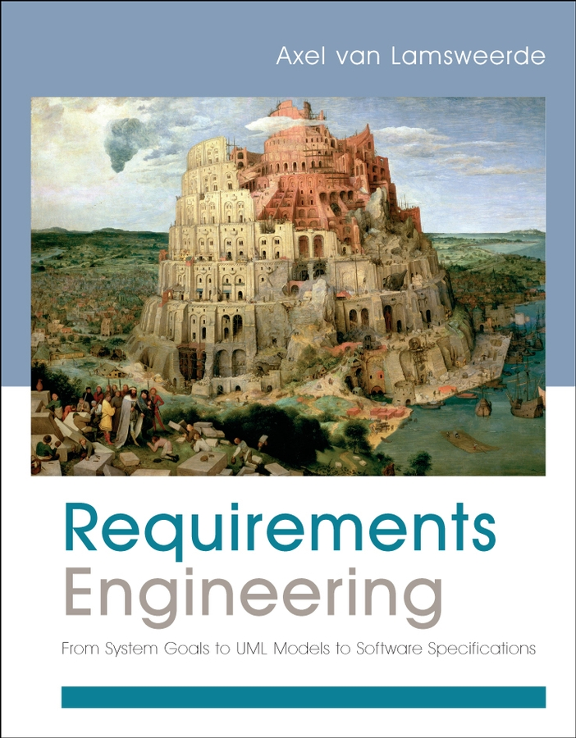
Requirements Engineering From System Goals to UML Models to Software Specifications
Axel Van Lamsweerde

Slide 2

Fundamentals of RE
Chapter 5
Requirements Quality Assurance

Slide 3
Chap.5: RE quality assurance
alternative options
Chap. 2:
Chap. 3:
Chap. 3:
Elicitation
techniques
Evaluation
techniques
Evaluation
techniques
consolidated
start
agreed
requirements
requirements
Chap. 4:
Chap. 5:
Quality assurance
Specification &
documentation
techniques
documented requirements

Slide 4
Requirements quality assurance: outline
Requirements inspections and reviews
The requirements inspection process
Inspection guidelines
Requirements inspection checklists
Queries on a requirements database
Requirements validation by specification animation
Resulting product: Consolidated Requirements Document

Slide 5
Requirements inspections and reviews
@
Widely applicable technique for req. QA is asking selected people to inspect the RD for defects and meet for reviews.
known to be quite effective for source code
more studies reveal its effectiveness when applied to RD
Requirements inspections and reviews process

Slide 6
The requirements inspection process
?
Inspection planning: determines …
The members of the inspection team
The size of the inspection team.
The timing of the inspection process.
The schedule, participants, and scope of each review meeting.
The format of inspection reports.

Slide 7
The requirements inspection process: Individual reviewing
?
Individual reviewing: inspectors reads the RD for defects.
This phase can be operated in several modes:
Free mode: The inspectors reads RD without directives on what part of the RD to consider and what type of defect to look for.
Checklist based: The inspectors is given a list of questions to guide the defect search process.
Process based: The inspectors is given a specific process to follow for defect search.

Slide 8
The requirements inspection process: Individual reviewing
?
Process based: The inspectors is given a specific process to follow for defect search.
RD distributed among inspectors (different roles, different perfectives)
Each inspector is assigned specific targets, checklists and procedures or techniques for checking a specific class of defects

Slide 9
The requirements inspection process: Defect evaluation at review meetings
?
Defect evaluation at review meetings
The defects found by each inspector are collected and discussed by the meeting participants.
Keep only defects on which all agree.
The team documents the conclusions in an inspection report.

Slide 10
The requirements inspection process: RD consolidation
?
RD consolidation: The requirements document is revised to address all concerns expressed in the inspection report.

Slide 11
Requirement inspection guidelines
?
Inspection process uses WHAT-WHO-WHEN-WHERE guidelines to make it more effective in finding defects.
WHAT? The inspection report should …
Be accurate and informative in specific points.
Contain substantiated facts (not opinions).
Be constructive and not offensive to the authors of the RD
WHO? The inspectors should be independent from the authors of the RD and not have a conflict of interest with them;…
Cover all stakeholder’s viewpoints, different backgrounds
WHEN? Should not be applied too soon or too late. Shorter, repeated meetings are more productive than longer, fewer ones.
WHERE? Inspection should consider places where critical aspects of the system are presented (safety or security - related ones)

Slide 12
Requirements inspection checklists
@
Checklist-based and process-based modes rely on lists of specific issues to address while searching for defects.
The checklists may be:
Defect-based checklists: are lists of questions structured according to the various types of defects (cf. Table 1.1).
Quality-specific checklists: specialize defect-based checklists to specific categories of non-functional requirements.
Domain-specific checklists: specialize generic and quality-specific checklists to the specific concepts and standard operations found in domain.
Language-based checklists: specialize the defect-based checklist to the specific constructs of the structured semi-formal or formal specification language used in the RD.

Slide 13
Defect checklists
@
Omission
Is this concept precisely defined somewhere?
Is this acronym defined?
Are there definitions summarized in the glossary of terms?
Contradiction
Is this statement consistent with the system objectives and constraints?
Is this statement consistent with other related statements?
Inadequacy
Does this RD item formulate what stakeholders really expect?

Slide 14
Defect checklists
@
Ambiguity
Can this statement be interpreted differently in different relevant contexts?
Are there other statements using this term with different meaning?
Immeasurability
Is there a fit criterion associated with this quality requirement?
Is this fit criterion stated in terms of measurable quantities and measurement protocol?
Noise
Is this statement relevant to system objectives and constraints

Slide 15
Defect checklists
@
Over specification
Does this statement entail a premature design choice?
Would there be alternative sensible choices?
Unfeasibility
Is this RD item implementable in view of infrastructure, budget or timing constraints?
Poor structuring
Is the structuring rule for organizing these RD sections apparent?
Does this RD item cover unrelated requirements?
Does this RD item mix requirements and assumptions together?

Slide 16
Quality-specific checklists
@
Is there any unspecified response in this operation to out-of-range values of an input variable?
Is there any unspecified response in this operation to not receiving an expected input value, or receiving it to early or too late?
Does the logical OR of the input conditions on this operation form a tautology?
Is there any recovery operation in case of input saturation?
Are all inputs from sensors used by the software controller?
Is there a check for data consistency perform before this decision is made based on those data?

Slide 17
Language –based checklists
@
Statement template
Is there a value for every field in this template instantiation?
Is this statement identifier used consistently throughout the RD?
Does the statement type correctly indicate a requirement, assumption, domain property or definition?
Is this fit criterion defined in terms of measurable quantities and measurement protocols?
Is this rationale consistent with the system objectives
Is this priority consistent with the priority of other requirements to which this requirement contributes?
Decision table discussed in Chapter 4

Slide 18
Language –based checklists
@
Diagrammatic languages
Does this input data flowing in this DFD operation appear as input data flowing in some upstream sub-operation in DFD refining operation?
Are the input and output of this DFD operation declared in an ER diagram?
Does this relationship in this ERD have an adequate multiplicity?
For the normal scenario described by this ET, is there any possible exception scenario associated with it and not specified in the set of corresponding abnormal scenarios?

Slide 19
Queries on a requirements database
@
Work on parts of the RD that are specified in terms of the diagrammatic notations.
The specification is maintained in a requirements database. The schema of this database closely reflects the structure of the diagram language used for specification.
Queries on the requirements database allow for structural consistency and completeness checks.
The schema of requirements database and language-specific database engine can be derived by meta-tool taking a meta-specification of the diagram language.
The generated database engine includes a diagram-specific query language and processor for querying.

Slide 20
Requirements validation by specification animation
@
The main purpose of RE validation is to check the adequacy of requirements and assumptions.
We want to check where the specified system-to-be meets the actual expectations of stakeholders. There’re two way:
Defining a representative sample of validation scenarios.
Animating parts of the specified system (integrating previous one).
How RE animation works on a specification:
Extracting an executable model from the specification
Simulating the system’s behavior using this model
Visualizing the simulation (animation)
Tools: http://www.objectiver.com/

Slide 21
Requirements quality assurance: summary
Requirements inspections and reviews
The requirements inspection process
Inspection guidelines
Requirements inspection checklists
Queries on a requirements database
Requirements validation by specification animation

