Slide 1

Building System Models for RE
Chapter 9
Modeling What Could Go Wrong:
Risk Analysis on Goal Models

Slide 2
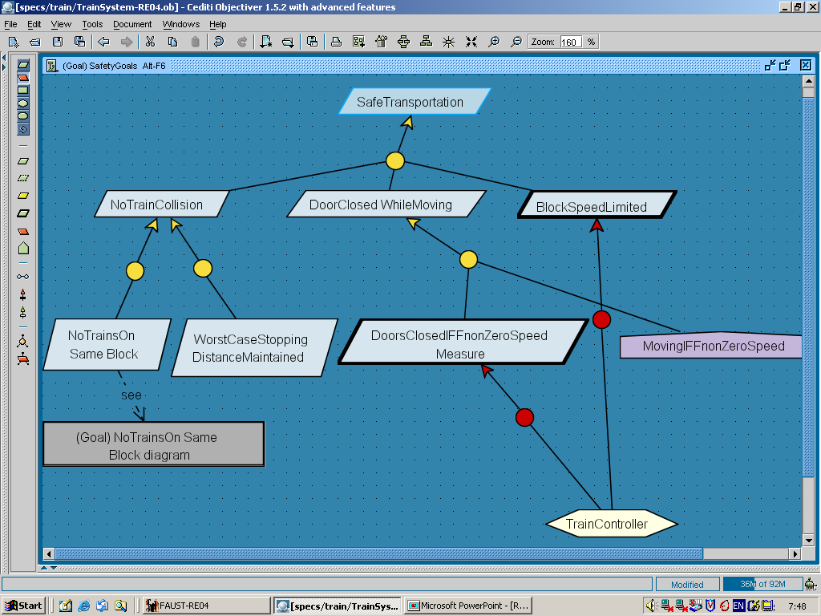
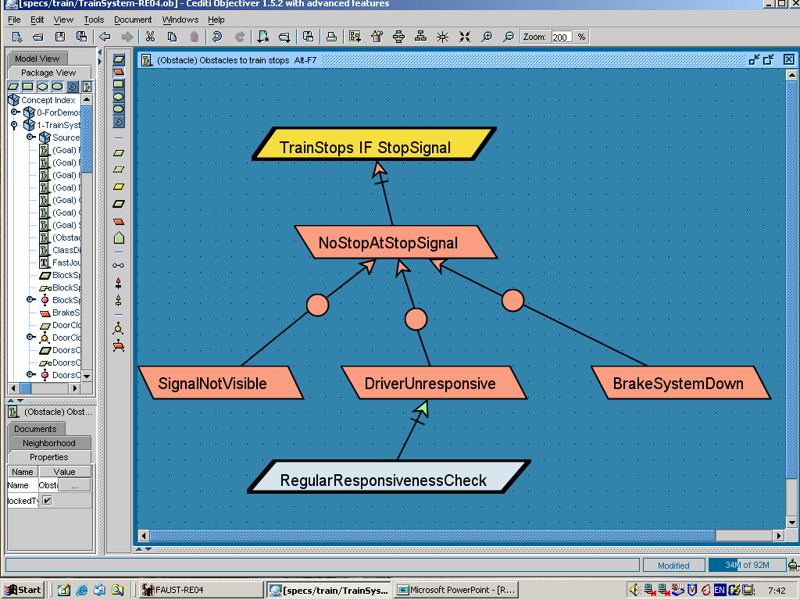
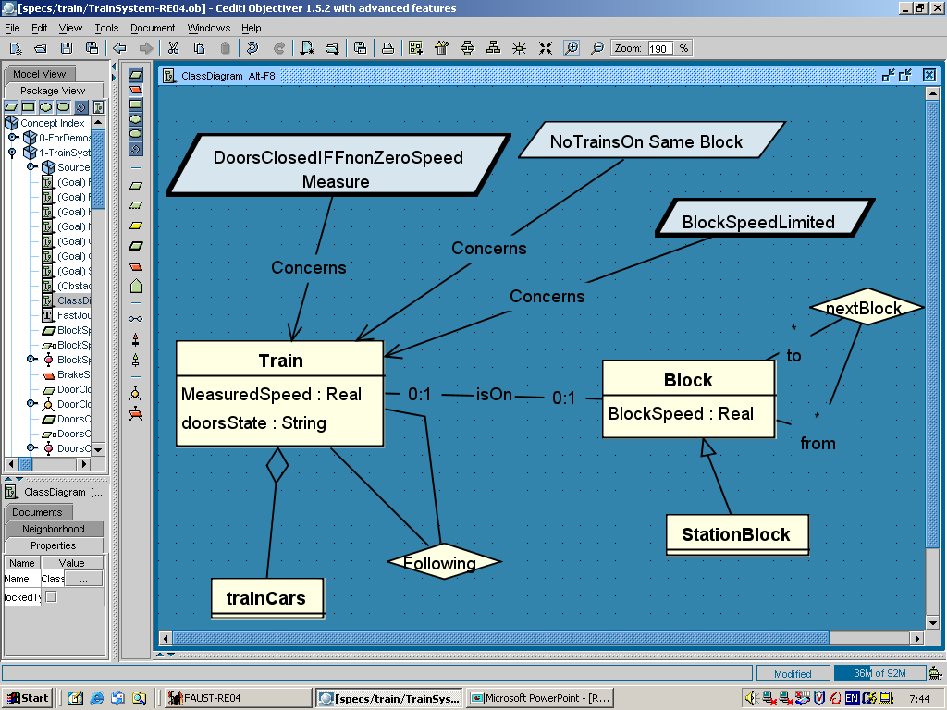
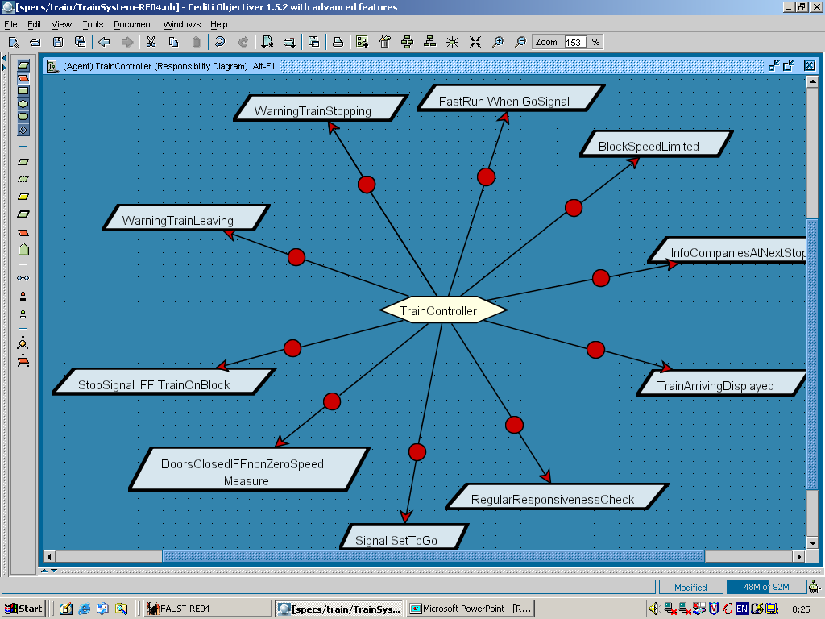
Building models for RE
Chap.8: Goals
Chap.9: Risks
why ?
how ?
Chap.10: Conceptual objects
Chap.11: Agents
on what?
who ?

Slide 3
Risk analysis as seen in Chapter 3
Risk = uncertain factor whose occurrence may result in loss of
satisfaction of corresponding objective
has likelihood & consequences (each having likelihood, severity)
Poor risk management is a major cause of software failure
Early risk analysis at RE time:
checklists,
component inspection,
risk trees
qualitative,
quantitative
explore countermeasures
(tactics),
select best as new reqs

Slide 4
Risk analysis can be anchored on goal models

Slide 5
Risk analysis on goal models: outline
Goal obstruction by obstacles
What are obstacles?
Completeness of a set of obstacles
Obstacle categories
Modeling obstacles
Obstacle diagrams
Obstacle refinement
Bottom-up propagation of obstructions in goal AND-refinements
Annotating obstacle diagrams
Obstacle analysis for a more robust goal model
Identifying obstacles
Evaluating obstacles
Resolving obstacles in a modified goal model

Slide 6
What are obstacles ?
Motivation: goals in refinement graph are often too ideal,
likely to be violated under abnormal conditions
(unintentional or intentional agent behaviors)
Obstacle = condition on system for violation of
corresponding assertion (generally a goal)
{O, Dom } |= not G obstruction
{O, Dom } |≠ false domain consistency
O can be satisfied by some system behavior feasibility
e.g. G: TrainStoppedAtBlockSignal If StopSignal
Dom: If TrainStopsAtStopSignal then DriverResponsive
O: DriverUnresponsive
For behavioral goal: existential property capturing
unadmissible behavior (negative scenario)

Slide 7
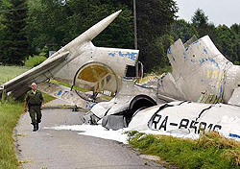
Completeness of a set of obstacles
Ideally, a set of obstacles to G should be complete
{not O₁,..., not O_{n}, Dom } |= G domain completeness
e.g.
If not DriverUnresponsive and not BrakeSystemDown and StopSignal
then TrainStoppedAtBlockSignal
Completeness is highly desirable for mission-critical goals ...
... but bounded by what we know about the domain !
Obstacle analysis may help elicit relevant domain properties

Slide 8
Obstacle categories for heuristic identification
Correspond to goal categories & their refinement ...
Hazard obstacles obstruct Safety goals
Threat obstacles obstruct Security goals
Disclosure, Corruption, DenialOfService, ...
Inaccuracy obstacles obstruct Accuracy goals
Misinformation obstacles obstruct Information goals
NonInformation, WrongInformation, TooLateInformation, ...
Dissatisfaction obstacles obstruct Satisfaction goals
NonSatisfaction, PartialSatisfaction, TooLateSatisfaction, ...
Unusability obstacles obstruct Usability goals
...

Slide 9
Risk analysis on goal models: outline
Goal obstruction by obstacles
What are obstacles?
Completeness of a set of obstacles
Obstacle categories
Modeling obstacles
Obstacle diagrams
Obstacle refinement
Bottom-up propagation of obstructions in goal AND-refinements
Annotating obstacle diagrams
Obstacle analysis for a more robust goal model
Identifying obstacles
Evaluating obstacles
Resolving obstacles in a modified goal model

Slide 10
Obstacle diagrams as AND/OR refinement trees
Anchored on leafgoals in goal model (unlike risk trees)
root = not G
obstacle AND-refinement, OR-refinement: same semantics as goals
leaf obstacles: feasibility, likelihood, resolution easier to determine

Slide 11
Obstacle diagrams as AND/OR refinement trees (2)

Slide 12
Obstacle refinement
AND-refinement of obstacle O should be ...
complete: {subO₁,..., subO_{n}, Dom } |= O
consistent: {subO₁,..., subO_{n}, Dom } |≠ false
minimal: {subO₁,..., subO_{j-1}, subO_{j+1} , ..., subO_{n}, Dom } |≠O
OR-refinement of obstacle O should be ...
entailments: {subO_{i}, Dom } |= O
domain-consistent: {subO_{i}, Dom } |≠ false
domain-complete: {not subO₁,..., not subO_{n}, Dom } |= not O
disjoint: {subO_{i}, subO_{j}, Dom } |= false
If subO_{i} OR-refines O and O obstructs G
then subO_{i} obstructs G

Slide 13
Obstructions propagate bottom-up in goal AND-refinement trees
Cf. De Morgan’s law: not (G1 and G2) equivalent to not G1 or not G2
=> Severity of consequences of an obstacle can be assessed
in terms of higher-level goals obstructed

Slide 14
Annotating obstacle diagrams
DriverUnresponsive
Obstacle DriverUnresponsive
Def Situation of a train driver failing to react to a command
and take appropriate action according to that command
[ FormalSpec ... in temporal logic for analysis, not in this chapter ... ]
[ Category Hazard ]
[ Likelihood likely ]
[ Criticality catastrophic]
annotation
precise definition
features

Slide 15
Risk analysis on goal models: outline
Goal obstruction by obstacles
What are obstacles?
Completeness of a set of obstacles
Obstacle categories
Modeling obstacles
Obstacle diagrams
Obstacle refinement
Bottom-up propagation of obstructions in goal AND-refinements
Annotating obstacle diagrams
Obstacle analysis for a more robust goal model
Identifying obstacles
Evaluating obstacles
Resolving obstacles in a modified goal model

Slide 16
Obstacle analysis for increased system robustness
Anticipate obstacles ...
⇒ more realistic goals,
new goals as countermeasures to abnormal conditions
⇒ more complete, realistic goal model
Obstacle analysis:
For selected goals in the goal model ...
identify as many obstacles to it as possible;
assess their likelihood & severity;
resolve them according to likelihood & severity
=> new goals as countermeasures in the goal model

Slide 17
Obstacle analysis and goal model elaboration are intertwined
Goal-obstacle analysis loop terminates when remaining obstacles can be tolerated
unlikely or acceptable consequences
Which goals to consider in the goal model?
leafgoals (requirements or expectations): easier to refine what is wanted than what is not wanted (+ up-propagation in goal model)
based on annotated Priority & Category (Hazard, Security, ...)

Slide 18
Identifying obstacles
For obstacle to selected assertion G
(goal, hypothesis, suspect dom prop) ...
negate G; {=> root obstacle}
find AND/OR refinements of not G in view of valid domain properties ... {according to desired extensiveness}
... until reaching obstruction preconditions whose feasibility, likelihood, severity, resolvability is easy to assess
= goal-anchored construction of risk-tree

Slide 19
Identifying obstacles: tautology-based refinement
Goal negation as root => use tautologies to drive refinements
e.g.
not (A and B) amounts to not A or not B
not (A or B) amounts to not A and not B
not (if A then B) amounts to A and not B
not (A iff B) amounts to (A and not B) or (not A and B)
=> complete OR-refinements when or-connective gets in

Slide 20
Identifying obstacles by tautology-based refinement
MotorReversed Iff MovingOnRunway
MovingOnRunway
Iff WheelsTurning
MotorReversed
Iff WheelsTurning

Slide 21
Identifying obstacles by tautology-based refinement
MotorReversed Iff MovingOnRunway
MovingOnRunway
Iff WheelsTurning
MotorReversed
Iff WheelsTurning
obstruction
NOT
MovingOnRunway
Iff WheelsTurning
NOT
MotorReversed
Iff WheelsTurning

Slide 22
Identifying obstacles by tautology-based refinement
MotorReversed Iff MovingOnRunway
MovingOnRunway
Iff WheelsTurning
MotorReversed
Iff WheelsTurning
obstruction
NOT
MovingOnRunway
Iff WheelsTurning
NOT
MotorReversed
Iff WheelsTurning
OR-refinement
(complete)
MovingOnRunway
AndNot
WheelsTurning
WheelsTurning
AndNot MovingOnRunway
MotorReversed
AndNot
WheelsTurning
WheelsTurning
AndNot
MotorReversed

Slide 23
Identifying obstacles by tautology-based refinement
MotorReversed Iff MovingOnRunway
MovingOnRunway
Iff WheelsTurning
MotorReversed
Iff WheelsTurning
obstruction
NOT
MovingOnRunway
IffWheelsTurning
NOT
MotorReversed
IffWheelsTurning
OR-refinement
(complete)
MovingOnRunway
AndNot
WheelsTurning
WheelsTurning
AndNot MovingOnRunway
MotorReversed
AndNot
WheelsTurning
WheelsTurning
AndNot
MotorReversed
...
WheelsNotOut
WheelsBroken
Aquaplaning
...
...
...

Slide 24
Obstacle identification: another example
BrakeReleased « DriverWantsToStart
BrakeReleased
« MotorRaising
AccelerPedalPressed
« DriverWantsToStart
MotorRaising «
AccelerPedalPressed

Slide 25
Obstacle identification: another example
BrakeReleased « DriverWantsToStart
BrakeReleased
« MotorRaising
AccelerPedalPressed
« DriverWantsToStart
MotorRaising «
AccelerPedalPressed
...
AccelerPedalPressed
And Not DriverWantsToStart
...
MotorRaising And Not
AccelerPedalPressed

Slide 26
Obstacle identification: another example
BrakeReleased « DriverWantsToStart
BrakeReleased
« MotorRaising
AccelerPedalPressed
« DriverWantsToStart
MotorRaising «
AccelerPedalPressed
...
AccelerPedalPressed
And Not DriverWantsToStart
...
MotorRaising And Not
AccelerPedalPressed
...
...
...
cf. driver killed by his
luxurious car on a hot summerday
AirConditioningRaising

Slide 27
Identifying obstacles from necessary conditions for obstructed target
always TrainStoppedIfStopSignal
sooner-or-later not TrainStoppedIfStopSignal
sooner-or-later not DriverResponsive
If TrainStoppedIfStopSignal
then DriverResponsive

Slide 28
Identifying obstacles from necessary conditions for obstructed target (2)
Can also be used for eliciting relevant domain properties
“what are necessary conditions for TargetCondition?”

Slide 29
Obstacle models as goal-anchored fault trees
WorstCaseStoppingDistanceMaintained
ReceivedCommand
ExecutedByTrain
SafeAcceleration
Computed
AccelerationSent
InTimeToTrain
SentCommand
ReceivedByTrain

Slide 30
Obstacle models as goal-anchored fault trees
WorstCaseStoppingDistanceMaintained
ReceivedCommand
ExecutedByTrain
SafeAcceleration
Computed
AccelerationSent
InTimeToTrain
SentCommand
ReceivedByTrain
...
Acceleration
NotSafe
AccelerationCommand
Not
SentInTimeToTrain
AccelerationCommand
Not
ReceivedInTimeByTrain
...
NotSent
SentLate
SentToWrongTrain
NotReceived
Corrupted
ReceivedLate

Slide 31
Evaluating obstacles
Check domain-consistency & feasibility conditions
satisfying scenario ?
Assess Likelihood and Criticality
cf. Chap. 3
with domain experts
rough estimates can be obtained from propagation rules:
Likelihood (O) = min_{i} (Likelihood (sO_{i}) if O is AND-refined to sO_{i}
Likelihood (O) = max_{i} (Likelihood (sO_{i}) if O is OR-refined to sO_{i}
severity of consequences can be estimated from number & Priority of higher-level goals obstructed by up-propagation in goal trees

Slide 32
Resolving obstacles
Resolution through countermeasures
new or modified goals in goal model
often to be refined
For every identified obstacle ...
explore alternative resolutions
select “best” resolution based on ...
likelihood/severity of obstacle
non-functional/quality goals in goal model

Slide 33
Exploring alternative countermeasures
By use of model transformation operators
encode resolution tactics
Goal substitution: consider alternative refinement of parent goal to avoid obstruction of child goal
G
alternative less exposed to risk
e.g. MotorReversed Iff WheelsTurning
® MotorReversed Iff PlaneWeightSensed

Slide 34
Exploring alternative countermeasures (2)
Agent substitution: consider alternative responsibilities for obstructed goal so as to make obstacle unfeasible
more reliable agent
e.g. Maintain [SafeAccelerationComputed]
obstructed by ComputedAccelerationNotSafe
OnBoardTrainController ® VitalStationComputer

Slide 35
Exploring alternative countermeasures (3)
Goal weakening: weaken the obstructed goal ’s formulation so that it no longer gets obstructed
for if-then goal specs: add conjunct in if-part
or disjunct in then-part
e.g. Maintain [TrafficControllerOnDutyOnSector]
obstructed by NoSectorControllerOnDuty
® goal weakening:
TrafficControllerOnDutyOnSector or WarningToNextSector

Slide 36
Exploring alternative countermeasures (4)
Obstacle prevention: introduce new goal Avoid [obstacle]
e.g. AccelerationCommandCorrupted
→ Avoid [AccelerationCommandCorrupted]
to be further refined
= standard resolution tactics for security threats
Goal restoration: enforce target condition as obstacle occurs
=> new goal: if O then sooner-or-later TargetCondition
e.g. ResourceNotReturnedInTime → ReminderSent
WheelsNotOut → WheelsAlarmGenerated

Slide 37
Exploring alternative countermeasures (5)
Obstacle reduction: reduce obstacle likelihood by ad-hoc countermeasure

Slide 38
Exploring alternative countermeasures (6)
Obstacle mitigation: introduce new goal to mitigate consequences
of obstacle
Weak mitigation: new goal ensures weaker version of goal when obstructed
e.g. Achieve [AttendanceIfInformedAndMeetingConvenient]
→ Achieve [ImpedimentNotified]
Strong mitigation: new goal ensures parent of goal when obstructed
e.g. OutdatedSpeed/PositionEstimates
→ Avoid [TrainCollisionWhenOutDatedTrainInfo]
Resolution goals must then be further refined in the goal model

Slide 39
Selecting best resolution
Evaluation criteria for comparing alternative resolutions ...
number of obstacles resolved by the alternative
their likelihood & criticality
the resolution’s contribution to soft goals
its cost
May be based on estimates of ...
risk-reduction leverage (cf. Chap.3)
qualitative/quantitative contribution to soft goals (cf. Chap.16)
If obstacle not eliminated, multiple alternatives may be taken
e.g. FineCharged + ReminderSent (for book copies not returned in time)
Selected alternative => new/weakened goal in goal model
resolution link to obstacle for traceability
weakening may need to be propagated in goal model
to be refined & checked for conflicts & new obstacles

Slide 40
Risk analysis on goal models: Summary
Goal obstruction by obstacles
What are obstacles?
Completeness of a set of obstacles
Obstacle categories
Modeling obstacles
Obstacle diagrams
Obstacle refinement
Bottom-up propagation of obstructions in goal AND-refinements
Annotating obstacle diagrams
Obstacle analysis for a more robust goal model
Identifying obstacles
Evaluating obstacles
Resolving obstacles in a modified goal model

