Slide 1

Building System Models for RE
Chapter 10
Modeling Conceptual Objects with Class Diagrams

Slide 2
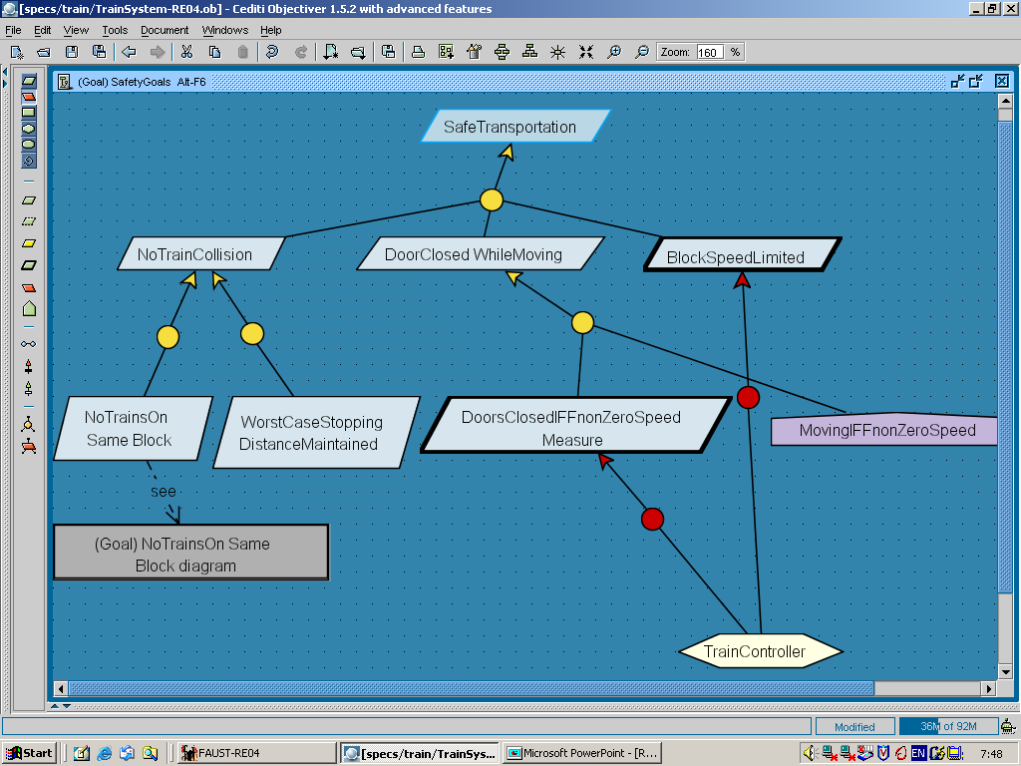
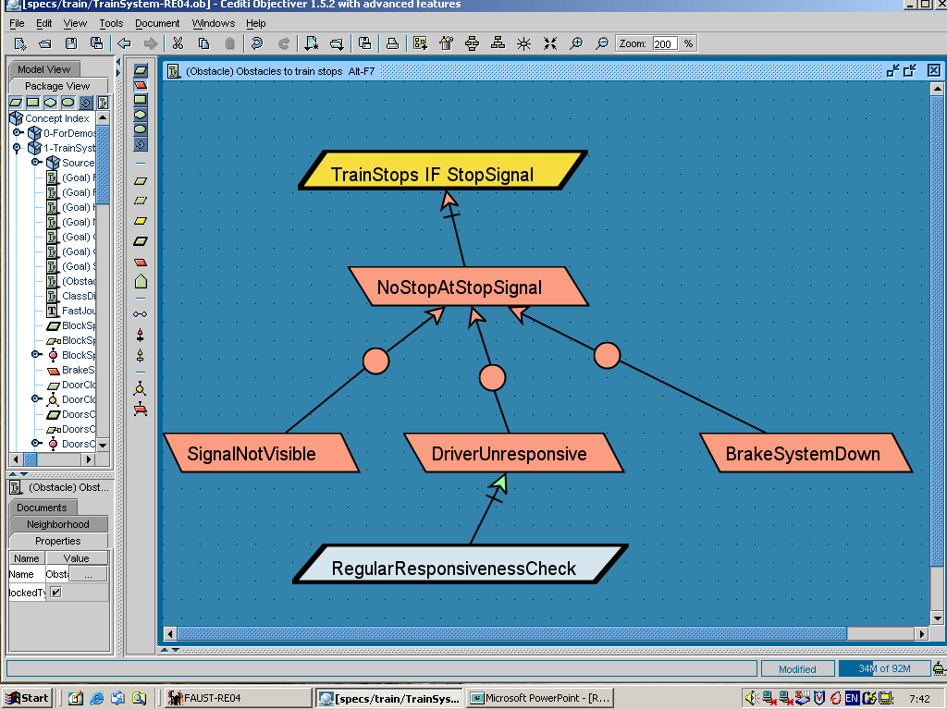
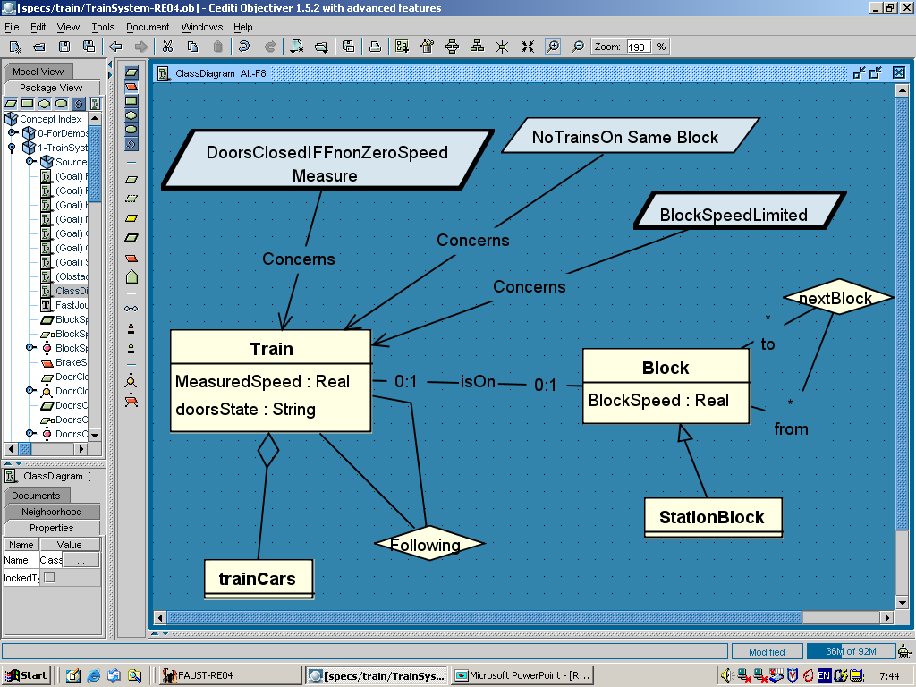
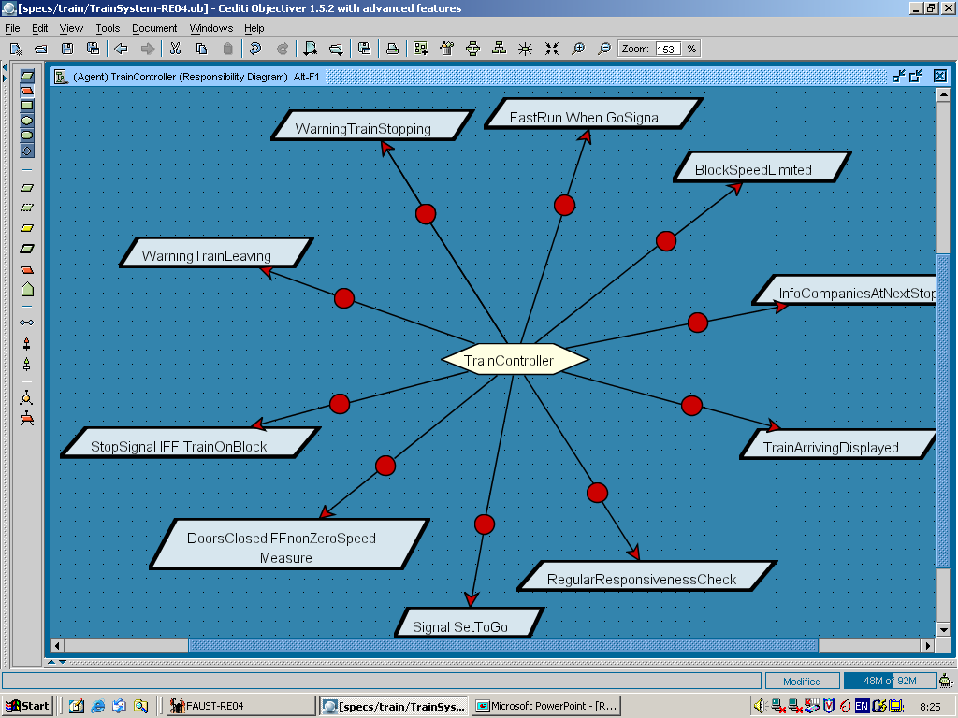
Building models for RE
Chap.8: Goals
Chap.9: Risks
why ?
how ?
Chap.10: Conceptual objects
Chap.11: Agents
on what?
who ?

Slide 3
The object model
Structural view of the system being modeled (as-is or to-be)
Roughly, shows how relevant system concepts are structured and interrelated
Represented by UML class diagram ...
“objects”, classes not in the OO design sense: RE is concerned with the problem world only !
classes with no operations: data encapsulation is a design concern; no design decisions here !
Multiple uses ...
precise definition of system concepts involved in other views, their structure & descriptive properties
state variables manipulated in other views
common vocabulary
basis for generating a glossary of terms

Slide 4
Modeling conceptual objects: outline
What is a conceptual object?
Entities
Associations & multiplicities
Attributes
Specialization
Aggregation
More on class diagrams
derived attributes, OR-associations, associations of associations
Building object models: heuristic rules
BookCopy
Loan
BookCopy
Patron
Patron
Name
StudentPatron
Patron
StaffPatron
Library
BookCopy

Slide 5
What is a conceptual object?
Set of instances of a system-specific concept ...
distinctly identifiable
immutable, built-in identity
e.g. 2 string instances “Justine Henin” are the same,
but 2 Patron instances named Justine Henin are different
can be enumerated in any system state
in any state we can list all instances of the Patron concept currently involved in the system
share similar features
common name, definition, type, domain properties,
common attributes, associations: see details later
e.g. Email attrib of Patron; Loan assoc linking Patron and BookCopy
may differ in their individual states and state transitions

Slide 6
What is a state of an instance of conceptual object ?
Tuple of functional pairs x_{i} |→ v_{i}
x_{i} : object attribute, association
v_{i} : corresponding value for that instance
E.g. instance tr of Train object might be in state:
(tr.Speed |→ 0, tr.Location |→ 9.25, tr.DoorsState |→ Open,
On |→ (tr, block13), At |→ (tr, platform1))
different from state of Train instance tr’.

Slide 7
Object instantiation: classes & current instances
Every conceptual object has a built-in semantic relation telling which instances are currently members of the object:
InstanceOf (o, Ob) iff o is currently an instance of Ob
kept implicit in the object model, used for Def specification
“current” state = some arbitrarily chosen system state
e.g. InstanceOf (bc, BookCopy) says bc is currently member of set BookCopy of book copies manimulated in the library system
might not be the case 3 weeks earlier or 1 year later ...
A set of object instances may evolve over time
An instance may migrate from one object to another
e.g. StudentPatron instance → StaffPatron instance
An instance may be member of multiple objects
Notes:
arbitrarily : Tùy tiện (adv): Chuyên chế

Slide 8
Object instantiation: classes & current instances (2)
Every concept in object model must be defined by Def annotation specifying the necessary & sufficient condition for an individual to satisfy InstanceOf (o, Ob)
i.e. specific conditions for individual to appear & disappear as instance of this object
e.g. “ A patron is any person who has registered to the
corresponding library for the corresponding period of time
and has not been excluded since then“
When an individual becomes instance of an object, the object’s attributes & associations get instantiated as state variables to characterize it
e.g. InstanceOf (tr, Train) → tr.Speed, tr.DoorsState, On (tr, ...)
State variables of the system = set of state variables of all conceptual objects declared in the object model

Slide 9
Types of conceptual object
Entity: autonomous, passive object
instances may exist in system independently of instances of other objects
instances cannot control behavior of other objects
e.g. Book, BookCopy ; Train, Platform, ...
represented as UML class
Association: object dependent on objects it links
instances are conceptual links among object instances
e.g. Loan linking Patron & BookCopy
Copy linking BookCopy & Book
At linking Train & Platform
On linking Train & Block
represented as UML association

Slide 10
Types of conceptual object (2)
Event: instantaneous object
instances exist in single system state
InstanceOf (ev, Ev) denoted by Occurs (Ev)
e.g. BookRequest ; StartTrain
represented as UML class if attributes, associations needed
Agent: active, autonomous object
instances have individual behavior =
sequence of state transitions for state variables they control
e.g. Patron, Staff ; TrainController, TrainDriver
represented as UML class if attributes, associations needed

Slide 11
Object features as model annotations

Slide 12
Entities
As seen before: autonomous, passive object
instances may exist in system independently of instances of other objects
distinctly identifiable, can be enumerated in any system state, share similar features, may differ in individual states & transitions
instances cannot control behavior of other objects
characterized by Def, domain invariants, attributes, initialization
In the Def annotation, the conditions for an individual to appear & disappear as instance of this entity must not necessarily refer to other objects in the model
Library
Train
BookCopy
Block

Slide 13
Associations
Association = conceptual object linking other objects,
each playing specific role
dependent on objects it links
linked objects may be entities, associations, events, agents
roles
isOn
holdsTrain
Train
Block
On
Association instance = tuple of linked object instances,
each playing corresponding role
may currently exist only if all instances are currently linked and currently instances of corresponding objects
Predicate notation
Assoc (o₁, ..., o_{n}) for InstanceOf ([o₁, ..., o_{n}], Assoc)

Slide 14
Association instances
Association instance = tuple of linked object instances,
each playing corresponding role
isOn
holdsTrain
Train
Block
On
InstanceOf
On (tr2,bl1)
tr1
tr2
bl1
bl2
bl3
On (tr1,bl3)

Slide 15
Associations & their instances
Like for any object, association instances ...
are distinctly identifiable
built-in immutable identity =
tuple of identities of linked object instances
can be enumerated in any system state
are characterized by common features
name, definition, attributes, domain invariants, initializations
evolve individually from state to state ...
instance appears as Ass (o₁, ..., o_{n}) gets true (link creation)
instance disappears as Ass (o₁, ..., o_{n}) gets false (link deletion)
state change as values of attached attrib, assoc are changing

Slide 16
Associations (2)
Arity of association = number of objects linked by it
Binary associations: arity = 2
N-ary associations: arity > 2
needed when links involving more than 2 objects must be distinguished
e.g. Registration linking ...
Patron (role MemberOf)
Library (role hasMember)
Period (role ValidityPeriod)
if binary, no distinction possible among registrations
of same patron & library for different periods
Reflexive association = same object appears under different roles
e.g. Following linking Train (role Follows), Train (role FollowedBy)

Slide 17
Multiplicities of n-ary association
From fixed source (n-1)-tuple of currently linked instances:
min/max number of linked target instances
attached to role of target instance
For binary associations, express standard constraints ...
min = 0: optional link (possibly no link in some states)
min = 1: mandatory link (at least one link to target in any state)
max = 1: uniqueness (at most one link to target in any state)
max = *: arbitrary number N of target instances linked to
source instance, in any state (N > 0)
Notation: “k” for “k..k”, “*” for “0..*”
Borrows
BorrowedBy
BookCopy
Patron
O..Max
O..1
Loan

Slide 18
Entities, associations in UML
Command
association
*
Driving
a block may hold
0 or 1 train
1
In
0..1
On
1..1
Block
Car
Train
isOn
holdsTrain
*
At
Platform
0..1
entity
a train may be at
0 or 1 platform at most

Slide 19
Entities, agents, associations in UML (2)
for a given libary and registration period,
there may be 0 up to an unbounded number
of registered patrons
agent
0..1
Loan
0..Max
BookCopy
Patron
Borrows
BorrowedBy
*
*
Copy
Period
0..1
1..*
Library
1
Book
Registration
n-ary association

Slide 20
Multiplicities, domain properties and goals
Multiplicities may encode some ...
domain properties (descriptive)
"A train may be at one platform at most at a time"
goals (prescriptive)
"A block may not accommodate more than one train at any time”
"A patron may not borrow more than Max book copies at a time”
to be found in the goal model as well !
=> source for goal elicitation (parent goals ?, subgoals ?)
BUT ...
multiplicities mix prescriptive & descriptive assertions
most assertions are not expressible by multiplicities
"A borrowed book must be returned within 2 weeks”
“A copy may not be both borrowed and available”
⇒ need for other domain invariants, goals/requirements

Slide 21
Attributes
Intrinsic feature shared by any instance of an object
entity, association, event, agent (like associations)
An attribute Att of object Ob is a function:
Att: Ob → SORT
Sort: set of possible attribute values (function range)
NOT a conceptual object we want to model
may be declared by ...
predefined, domain-independent name
CopyAvailable: Boolean PatronName: String
domain-specific name
BlockSpeedLimit: Speed Keywords: Topics
enumeration
GoSignal: {on, off}

Slide 22
Attributes (2)
Elementary attribute: sort is a set of atomic values
e.g. DoorsState: {open, closed}
Structured attribute: sort defined with type constructor
Tuple, SetOf, SequenceOf, Union
e.g. Keywords: SetOf [Topic] , dateRange: SeqOf [Date]
Precise, domain-specific semantics of attribute must be defined in Has annotations
Attribute multiplicity: min/max number of values the attribute may take
[0..x]: optional attribute
[x..*]: attribute value = set of values
[1..1]: mandatory attribute, single value: by default, omitted
e.g. PhoneNr [0..*]: String optional, possibly multiple values

Slide 23
Entities, associations, attributes in UML
Command
*
CommandedSpeed: Speed
CommandedAccel : Acceleration
Driving
attribute
1
In
0..1
On
0..1
Block
Car
Train
isOn
holdsTrain
CurrentSpeed: Speed
CurrentLoc: Location
DoorsState: {open,...}
SpeedLimit: Speed
*
At
Platform
0..1
...

Slide 24
Entities, agents, associations, attributes in UML
attribute of association
Loan
DateBorrowed: Date
TimeLimit: NumberWeeks
DueReturnDate: Date
0..1
0..Max
BookCopy
CopyID
Patron
Phone [*] : String
Borrows
BorrowedBy
*
Copy
Period
Library
1
Book
Keywords [1..*] : Topics
Registration
DateRegistered: Date
Deposit: Money
attribute of association
multiplicity

Slide 25
Modeling conceptual objects
What is a conceptual object?
Entities
Associations & multiplicities
Attributes
Specialization
Aggregation
More on class diagrams
Building object models: heuristic rules
BookCopy
Loan
BookCopy
Patron
Patron
Name
StudentPatron
Patron
StaffPatron
Library
BookCopy

Slide 26
Built-in associations for structuring object models
Object specialization/generalization, decomposition/aggregation
applicable to entities, agents, events, associations
Specialization = subclassing: object SubOb is a specialization of object SuperOb iff for any individual o:
InstanceOf (o, SubOb) ⇒ InstanceOf (o, SuperOb)
SubOb specializes SuperOb, SuperOb generalizes SubOb
amounts to set inclusion on set of current instances
Feature inheritance as a consequence ...
by default, SubOb inherits from SuperOb all its attributes, associations, domain properties
while have its own distinguishing features
may be inhibited by compatible redefinition of feature with same name within specialized SubOb (“override”)

Slide 27
Object specialization with inheritance
Command
*
CommandedSpeed: Speed
CommandedAccel : Acceleration
Driving
1
In
0..1
On
0..1
Block
Car
Train
isOn
holdsTrain
CurrentSpeed: Speed
CurrentLoc: Location
DoorsState: {open,...}
SpeedLimit: Speed
*
At
Platform
specialisation
inherited features
0..1
...
Semi-rapid
Rapid

Slide 28
Inhibiting inheritance
...
TrafficSignal
Color: {green, orange, red}
Location
inherited
WarningSignal
compatible redefinition
(subsort)
Color: {orange}
The more specific feature always overrides the more general one

Slide 29
Multiple inheritance
Same object may be specialization of multiple super-objects
by default, inheritance of all features from all super-objects
Can result in inheritance conflicts
different features with same name inherited from different super-objects
=> conflicting features first renamed to avoid this
Student
Patron
renamed
StudentAddress
to avoid conflict
Address
StudentID
Address
Email
StudentPatron
...

Slide 30
Multiple specializations
Same object may have multiple specializations
Different subsets of object instances associated with different criteria
Same object instance may be member of different subsets (one per criterion)
Discriminator = attribute of super-object whose values define different specializations (differentiation criterion)

Slide 31
Object generalization
generalization is
not necessarily apparent
in problem world

Slide 32
Benefits of generalization-based structuring
Common features in multiple objects are factored out into single generalized object
=> simpler model, no duplication
Generalized objects & their structure are reusable in different contexts & systems (by specialization)
e.g. BorrowableItem --> CDCopy , VideoCopy
Increased modifiability of large models
modifications of more general features are localized in more general objects, down-propagated to specialized objects
StudentPatron
NonPriviledgedPatron
Patron

Slide 33
Object aggregation
Aggregation = composite object whose components are objects
(“parts”)
InstanceOf (ob, AggrOb) ⇒ ob = Tuple (o₁, ..., o_{n})
with InstanceOf (o_{i} , PartOb_{i} )
applicable to entities, agents, events, associations
multiplicities may be attached to part-to-aggregation links
transitive, antisymmetrical links
Composition: aggregation & parts appear/disappear together
ob = Tuple (o₁, ..., o_{n}) and not InstanceOf (ob, AggrOb)
⇒ not InstanceOf (o_{i} , PartOb_{i} )
part object may then be part of one aggregation object only

Slide 34
Object aggregation: examples

Slide 35
More on UML class diagrams
Derived attribute, association = defined in terms of other attrib/assoc already in the model
controlled form of redundancy
Loan
derived attribute
DateBorrowed: Date
TimeLimit: NumberWeeks
/ DueReturnDate: Date
derived association
1..2
Car
In
Train
On
Block
Door
At
Platform
/ DoorsOf

Slide 36
More on UML class diagrams (2)
OR association = same role played by alternative objects
set of object instances in this role =
union of alternative sets of object instances

Slide 37
More on UML class diagrams (3)
Ordered association: multiple target instances from source instance (or tuple of instances) are ordered
Library
1
1
1..*
0..1
Directory
Shelve
AntiTheft
0..1
(ordered)
Content
*
BookCopy
CopyID

Slide 38
More on UML class diagrams (4)
Association of associations: one of the linked objects is an association

Slide 39
Modeling conceptual objects
What is a conceptual object?
Entities
Associations & multiplicities
Attributes
Specialization
Aggregation
More on class diagrams
Building object models: heuristic rules
BookCopy
Loan
BookCopy
Patron
Patron
Name
StudentPatron
Patron
StaffPatron
Library
BookCopy

Slide 40
Building object models: heuristic rules
Deriving pertinent & complete object models from goal models
deriving objects, associations, attributes
introducing software-environment tracking associations
identifying associations from domain invariants on multiple objects
Object or attribute ?
Entity, association, agent, or event ?
Attribute of a linked object or of a linking association ?
Aggregation or association ?
Specializing, generalizing concepts
Bad smells

Slide 41
Deriving objects, associations, attributes from the goal model
F Review all specs of goals & domain properties in goal model ...
take all referenced concepts meeting criteria for object, and only those
instances distinctly identifiable, enumerable in any state, sharing similar features, differing in individual states
consider the others as candidate qualifying attributes
values are NOT concept instances to be characterized by common attributes, associations
identify associations + participating objects from linking expressions in these specs
<sourceObj> <linkingVerb> <targetObj(s)>
<linkingNoun> of <targetObj> by <sourceObj>

Slide 42
Deriving objects, associations, attributes from goal specs: example
Goal Maintain [BlockSpeedLimited]
Def The speed of a train on a block may never
exceed the limit associated with that block
⇓
Train
On
Block
Speed: SpeedUnit
...
SpeedLimit: SpeedUnit
...
Rephrasing sometimes needed to highlight linking expressions
Yet another reason for goal specs to be precise !

Slide 43
Deriving objects, associations, attributes from goal specs: example (2)
Goal Maintain [WorstCaseStoppingDistance]
Def The distance between two trains following each other
shall be sufficient to prevent the back train from hitting
the front train in case the latter stops suddenly
⇓
Following
back
Train
On
Block
SpeedLimit: SpeedUnit
...
front
Speed: SpeedUnit
WCS-Dist: Distance

Slide 44
Introducing software-environment tracking associations
F For goal assignment to software-to-be, we must introduce shared “images” of environment objects referenced by the goal
the shared object tracking its environment counterpart must accurately reflect it (=> new accuracy goal)
e.g. TrainInfo (Speed, Position) tracking Train (Speed, Position)
LoanInfo tracking Loan, PatronInfo tracking Patron
cf. goal refinement pattern seen before:
GoalOnUnMonitorableCondition
GoalOnUnControllableCondition
GoalOnMonitorable
Condition
MonitorableCondition Iff
UnMonitorableCondition
GoalOnControllable
Condition
ControllableCondition Iff
UnControllableCondition

Slide 45
Introducing software-environment tracking associations: a general pattern
Goal on environment Object
Object
trackedBy
tracks
Obj-Info
Object Accurately
1
Tracking
1
Goal on
Obj-Info
…
Att:
Range
Att:
Range
Tracked
By
Obj-Info
Refers to
Software-to-be

Slide 46
Identifying associations from domain invariants on multiple objects
Domain properties in goal refinements are to be defined in annotations of the object model (as seen before)
invariants on single objects they constrain
Invariant seeming to constrain multiple objects ...
? => ? constrains missing association among these ?
e.g. “A platform cannot accommodate more than one train at a time”
... constrains platforms ? ... or trains ?
=> to be attached to missing association At linking
Train and Platform

Slide 47
Derivation links between goal model & object model are bidirectional
From goals to objects ...
as just seen
From objects to goals ...
Domain concepts that should “obviously” appear in object model ...
WHY? => missing goals in goal model
Systematic association decoration with multiplicities ...
prescriptive? => missing goals in goal model
WHY? => parent goals
HOW? => subgoals

Slide 48
Object or attribute ?
F For X: conceptual item in goal specs, make X an attribute if...
X is a function: yielding one single value (possibly structured) when applied to conceptual instance
instances of X need not be distinguished
you don’t want to attach attributes/associations to X, specialize it, or aggregate/decompose it
its range is not a concept you want to specialize or attach attributes/associations
Author
Writing
Book
Book
Authors: String
vs.
Birthdate
MainAuthor
Co-Author

Slide 49
Entity, association, agent, or event ?
F For X: conceptual object in goal specs ...
instances of X are defined in one single state
⇒ event e.g. StartTrain
instances of X are active: control behaviors of other object instances
⇒ agent e.g. DoorsActuator
instances of X are passive, autonomous
⇒ entity e.g. Train
instances of X are passive, dependent on other, linked object instances
⇒ association e.g. Following (Train, Train)
F N-ary if each of the N parties ...
- need be considered as objects
- yields tuples to be distinguished

Slide 50
Attribute of a linked object or of a linking association ?
Ob1
X ?
0..
0..
Ob1
X ?
Assoc
X ?
F Attach attribute to association if it explicitly or implicitly characterizes all participating objects
esp. if possibly no instance currently in some role,
to avoid losing info
e.g. who did borrow this book copy?
Borrower
0..1
0..Max
BookCopy
DateBorrowed
Loan
DateBorrowed

Slide 51
Aggregation or association ?
F For X a structural link between "composite" & "component" objects, make it an association if any of these holds ...
X has a domain-specific InstanceOf semantics
component & composite objects seem independent
component not subordinate to composite as in composition
attributes or associations need be attached to the link type
in case of doubt
e.g. In (Car, Train)

Slide 52
Specializing, generalizing concepts
F Identify specializations from classification expressions & discriminant factors in goal/domprop specs
taxonomical keywords “types of”, “kinds of”, “category”, “class”, ...
meet object criteria ?
relevant commonalities to factor out, specifics to discriminate ?
multiple classifications under discriminating attributes ?
F Identify generalizations from objects characterized by similar attributes, associations, domain invariants
bottom-up search for common abstractions, not necessarily visible
if worth doing so, without cluttering the model
StationBlock
Block
Corridor

Slide 53
Building object models: bad smells
N
F Avoid “pointers” to other objects as attributes
use binary associations insead
BAD
Borrower
Loan: BookCopy
BookCopy
GOOD
Loan
BookCopy
Borrower

Slide 54
Building object models: bad smells (2)
N
F Avoid non-structural links pertaining to other views
monitoring/control links from agent model (context diagram)
setsAcceleration
BAD
TrainController
Train
getsPosition
BAD
TrackingSystem
Train
BAD
GOOD
setsDateRange
Initiator
Initiating
Meeting
Initiator
Meeting
DateRange
Date
Scheduler
setsDate
Scheduler
Scheduling

Slide 55
Building object models: bad smells (3)
N
F Avoid non-structural links pertaining to other views
dynamic links from behavior model (state diagram)
BAD
Generates
BorrowerRequest
Loan
BAD
Activates
GoSignal
Train

Slide 56
Building object models: bad smells (4)
N
F Avoid obscure names for objects & attributes
suggestive shortcut of their annotated definition
don’t forget precise definition!
don’t confuse terms ! e.g. Book vs. BookCopy
from problem world, NOT implementation-oriented
Bad JPEG_File , Book_File
Good Picture , Directory
specific, NOT vague
Bad Person , Form
Good Patron , RegistrationForm
commonly used, NOT invented
Bad PersonalIdentificationCard, ConferenceBook
Good StudentCard, Proceedings

Slide 57
Modeling conceptual objects Summary
What is a conceptual object?
Entities
Associations & multiplicities
Attributes
Specialization
Aggregation
More on class diagrams
Building object models: heuristic rules
BookCopy
Loan
BookCopy
Patron
Patron
Name
StudentPatron
Patron
StaffPatron
Library
BookCopy

