Slide 1
Software Requirements
Chapter 13
Ha Noi, Jun-2012

Slide 2
In scenarios diagram, an interaction is a/an _________.
Active object
Passive object
Instantaneous object
Association

Slide 3
_____, the sequence of interactions illustrates a possible way of satisfying an obstacle to a goal.
In positive scenario
In negative scenario

Slide 4
_____ the sequence of interactions illustrates a possible way of satisfying an behavioral goal.
In positive scenario
In negative scenario

Slide 5
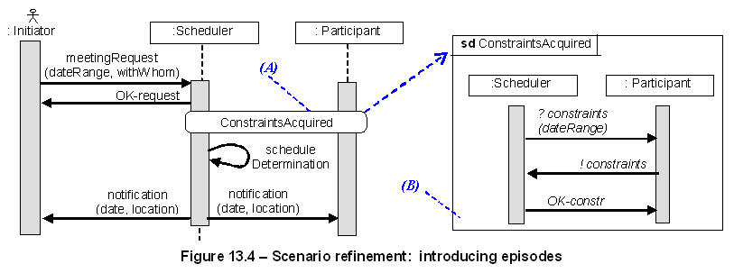
Which part of Figure 13.4 is called "episode"?
(A)
(B)

Slide 6
In scenario, Source agent ___the interaction; target agent ___it.
Controls/monitors
Monitors/controls
Which of the following is a way for scenario refinement when elaborating complex scenarios stepwise?
Agent decomposition
Interaction decomposition
Build interaction sequently

Slide 7
Which of the following is a correct statement described a lifetime in scenarios diagram?
An agent timeline defines a total order on incoming/outgoing events
An agent timeline defines a order on incoming/outgoing events
An entire sequence diagram defines a partial order for all events

Slide 8
Which of the following is a correct statement described about scenarios diagrams?
In scenarios diagrams, the source agent controls the interaction, whereas the target agent monitors it.
In scenarios diagrams, the source agent monitors the interaction, whereas the target agent controls it.
In scenarios diagrams, an interaction is an entity object

Slide 9
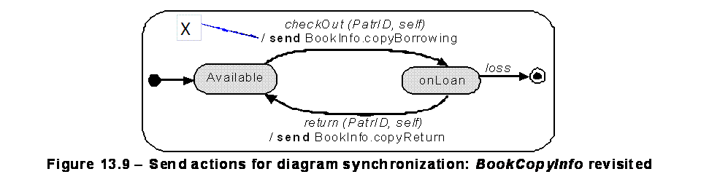
In the Figure 13.9, X is called an (a)________
Notification event
Event
Entry action

Slide 10
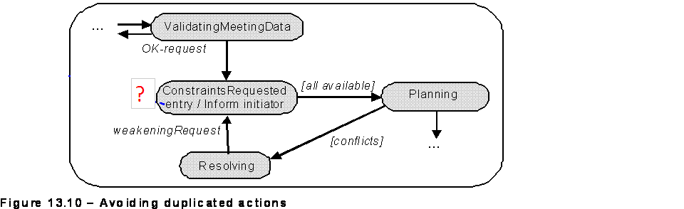
Which of the following are correct statements described the "entry / inform initiator" in Figure 13.10?
It is used to avoid the duplication the action "Inform initiator" on all incoming transitions to the state "ConstraintsRequested“
It is an entry action

Slide 11
Which of the following is NOT a correct statements described the parallel decomposition in state machine diagram?
An SM state may not be decomposed into sub-states
An SM state may be decomposed into concurrent sub-states
The finer-grained sub-states are call nested states, whereas the super-state is called a composite state.
Composite state can be structured as a parallel composition of nested diagrams.

Slide 12
Which of the following is NOT a semantic rule used to define sequential state decomposition?
The instance modeled by the diagram is in the super-state if and only if it is in one (and only one) of the sequential sub-states
The instance modeled by the diagram is in the super-state if and only if it is in each of the concurrent sub-states
An incoming transition to the super-state is by default inherited by every sequential sub-states as an incoming transition to it.

Slide 13
In the Figure 13.12, X is a________ and Y is a ______
guard/sequential sub-state
guard as synchronizing condition/sequential sub-state
guard reference/sequential sub-state

Slide 14
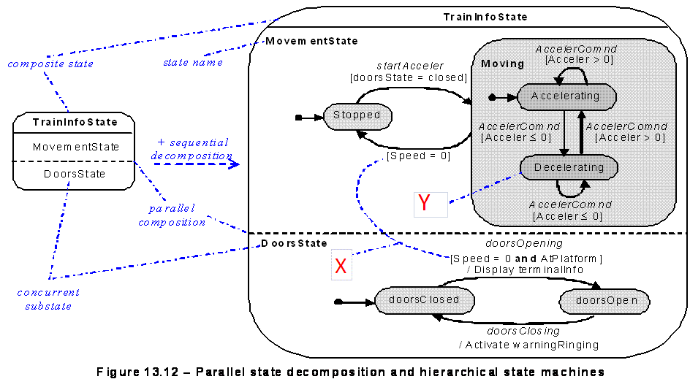

Slide 15
Which of the following is a correct statement about state transition in an SM diagram?
A transition labelled by an event and a guard fires if an event instance occurs and the modelled instance is in the source state, and only if the guard is true.
A transition labelled by an event and a guard fires if an event instance occurs and the modelled instance is in the target state, and only if the guard is true.

Slide 16
In an SM diagram, a guarded transition can have no event label. The guard the amounts to a________
trigger condition
sufficient condition
necessary condition
guard condition

Slide 17
Which of the following is NOT a strength of goal model?
Declarative, satisfaction arguments
Narrative, concrete examples
Expressive (functional, non-functional; alternative options)
Entire classes of behaviors

Slide 18
Which of the following is NOT a strength of state machines model?
Expressive (functional, non-functional; alternative options)
Visual abstraction of explicit behaviors of any agent instance in a class
Entire classes of explicit behaviors
Verifiable, executable, code generation

