Slide 1
Agile Development Lifecycle

Slide 2
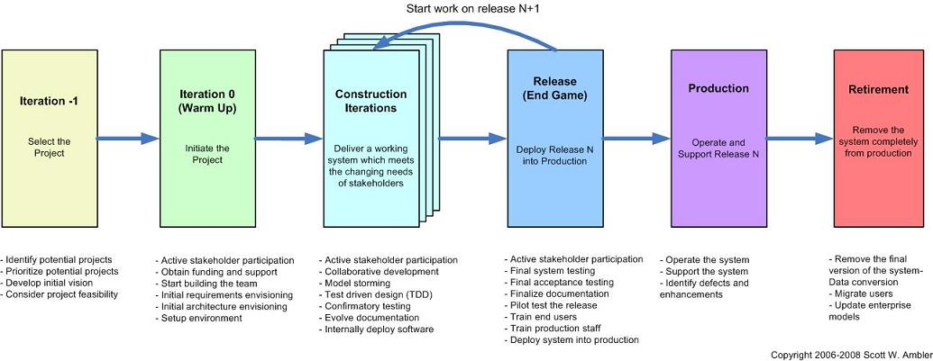
The Agile SDLC (high-level)

Slide 3
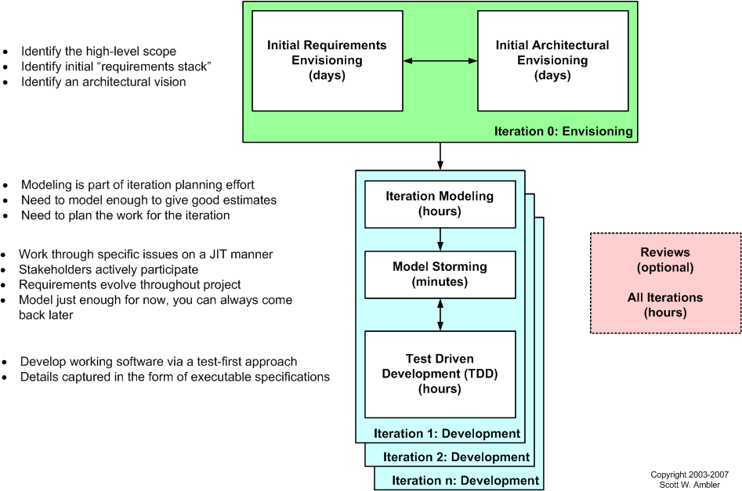
The Agile Model Driven Development (AMDD) life cycle

