Slide 1
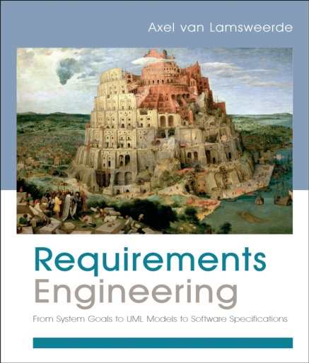
Building System Models for RE
Chapter 11
Modeling System Agents and Responsibilities

Slide 2
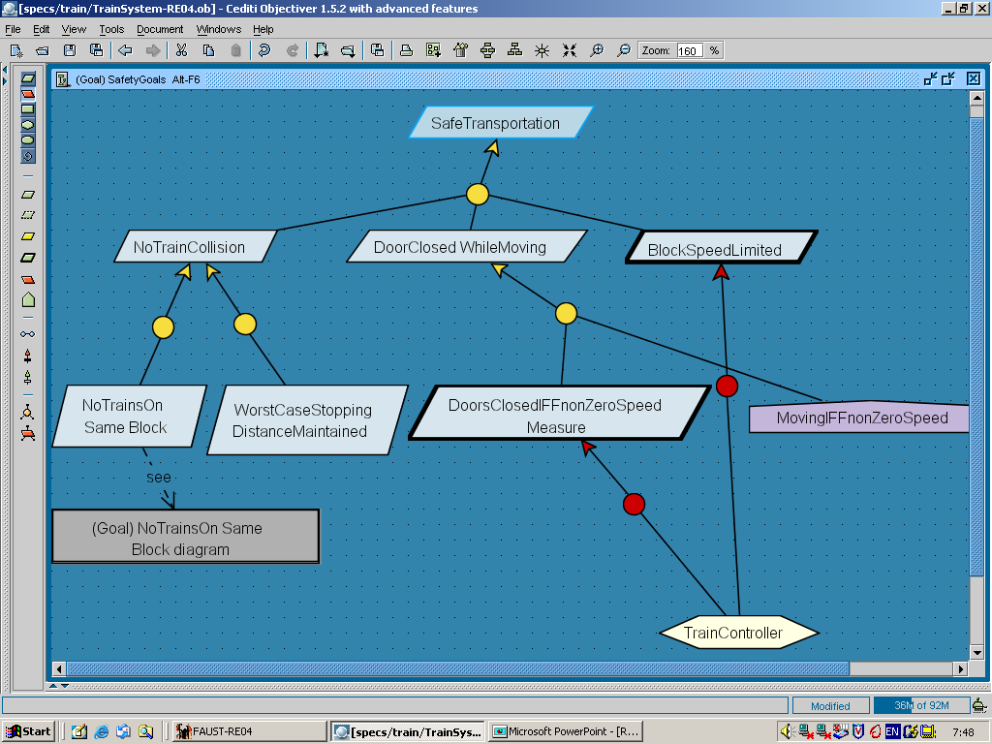
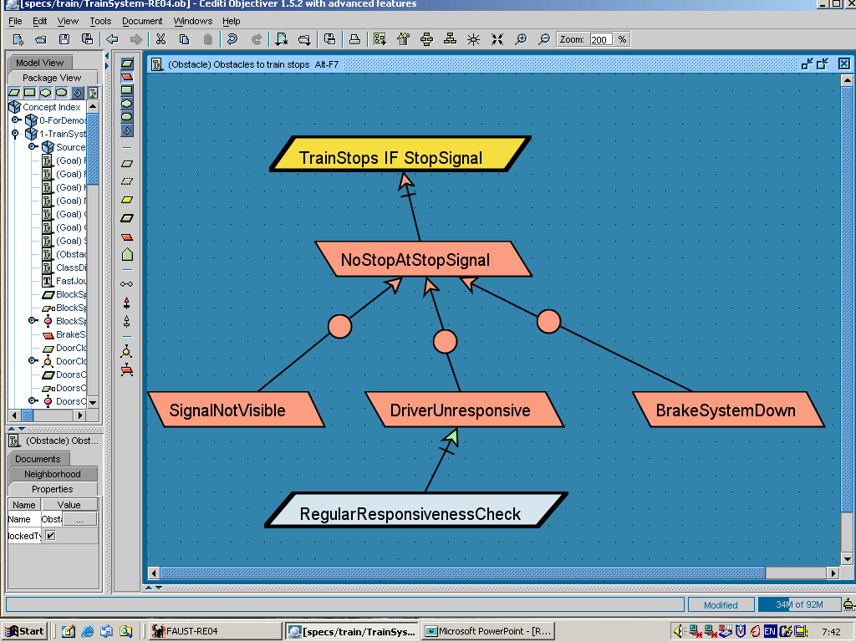
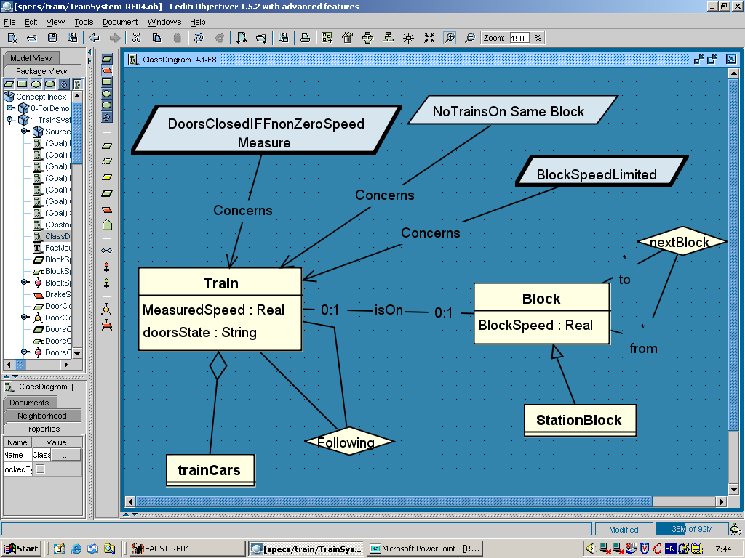
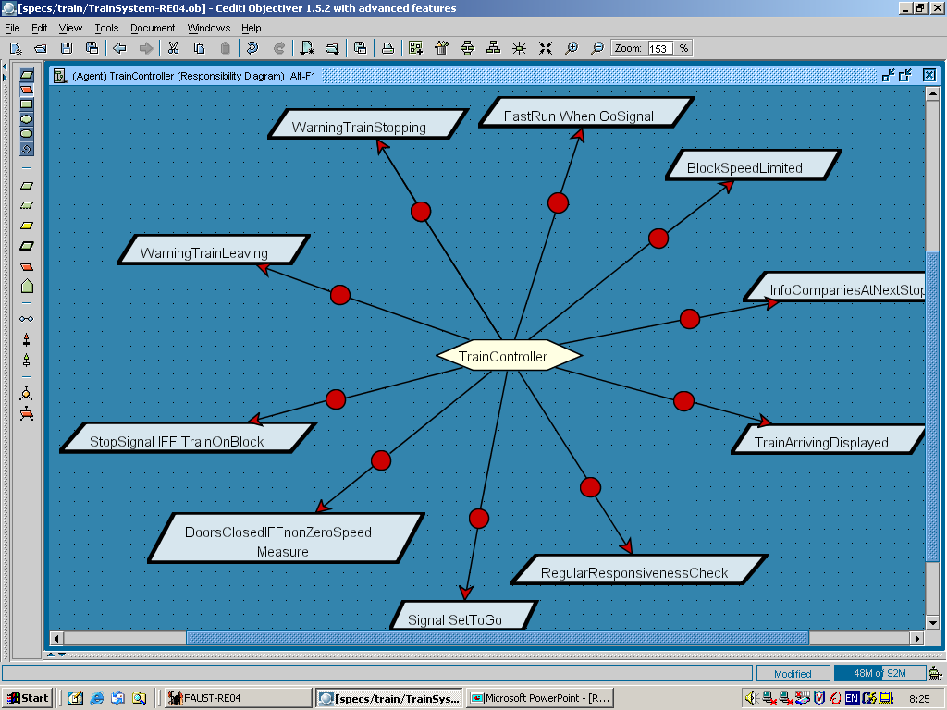
Building models for RE
Chap.8: Goals
Chap.9: Risks
why ?
how ?
Chap.10: Conceptual objects
Chap.11: Agents
on what?
who ?

Slide 3
The agent model
Responsibility view of the system being modeled
who is doing what, and why
Different perspectives, different diagrams
agent capabilities, responsibilities, interfaces
dependencies among agents
Multiple uses ...
showing distribution of responsibilities within system
load analysis
Define system scope & configuration, boundary software/environment
Formulate heuristics for responsibility assignment
vulnerability analysis among agents
As an input to architectural design

Slide 4
Modeling system agents: outline
What we know about agents so far
Characterizing system agents
capabilities
responsibilities
operation performers
wishes & beliefs
dependencies
Representing agent models
agent diagram, context diagram, dependency diagram
Refinement of abstract agents
Building agent models: heuristics & derivation rules

Slide 5
What we know about agents so far
Active objects: control behaviors in system as-is or to-be
“processors” of operations
Responsible for goal satisfaction
role rather than individual
assigned to leaf goals (requirements, expectations)
must restrict system behaviors accordingly
May run concurrently with others
Different categories
software-to-be
environment: people, devices, legacy/foreign software

Slide 6
Characterizing system agents
Def: condition for individual to be currently instance of this agent
Attributes/associations, DomInvar/Init: in object model
Category: software or environment agent
Capabilities: what the agent can monitor and control
monitoring/control links to object model, cf next slides
Responsibility: links to goal model
Performance: links to operation model
Dependency links to other agents for goal satisfaction
Wishes (for responsibility assignment heuristics)
Knowledge and beliefs (for obstacle analysis, security analysis)

Slide 7
Agent capabilities
Ability to monitor or control items declared in object model
attributes/associations get instantiated as state variables monitorable/controllable by agent instances (cf. 4-var model)
which agent instance monitors/controls attrib/assoc of which object instance: specified in instance declaration annotating link
An agent monitors (resp. controls) an object attribute if its instances can get (resp. set) values of this attribute
it monitors (resp. controls) an association if its instances can get (resp. create or delete) association instances
it monitors (resp. controls) an object if it monitors (resp. controls) all object’s attributes & associations

Slide 8
Agent capabilities (2)
Capabilities define agent interfaces
an agent monitors a state variable controlled by another
Higher-level capabilities sometimes convenient
an agent monitors (resp. controls) a condition if its instances can evaluate it (resp. make it true/false)
A variable may be controlled by at most one agent
to avoid interferences among concurrent agents

Slide 9
Agent responsibilities
An agent is responsible for a goal if its instances are the only ones required to restrict behaviors to satisfy the goal
through setting of their controlled variables
which agent instance is responsible for the goal on which object instance: specified in instance declaration annotating link
Maintain [DoorStateClosedWhileNonZeroMeasuredSpeed]
measuredSpeed ¹ 0 ® doorState = ‘closed’
TrainControler
The train controller on board of a train
is responsible for the goal on this train
responsibility
responsibility instance declaration

Slide 10
Agent capabilities & goal realizability
Responsibility assignment is subject to agent capabilities
the goal must be realizable by the agent in view of what the agent can monitor and control
roughly: we can define a set of sequences of state transitions on the agent’s monitored/controlled variables that coincides with the set of behaviors prescribed by the goal
monitored
controlled

Slide 11
Causes of goal unrealizability by agents
Lack of monitorability of state variables to be evaluated in assigned goals
Lack of controllability of state variables to be constrained in assigned goals
State variables to be evaluated in future states
Goal unsatisfiability under certain conditions
Unbounded achievement of assigned Achieve goals
target can be indefinitely postponed

Slide 12
Agent capabilities & goal realizability: examples
agent capabilities
monitored variable
measuredSpeed
controlled variable
doorState
TrainController
Ex 1: Realizable by TrainController
measuredSpeed ¹ 0 Þ doorState = ‘closed’
TrainControler
Ex 2: Not realizable by TrainController
Moving Þ DoorsClosed
TrainControler

Slide 13
Agents as operation performers
An agent performs an operation if the applications of this operation are activated by instances of this agent
means for getting/setting the agent’s monitored/controlled variables
under restricted conditions so as to satisfy assigned goals: permissions, obligations specified in operation model (cf. Chap.12)
which agent instance activates which operation application: specified in instance declaration annotating Performance link

Slide 14
Agent wishes
A human agent wishes a goal if its instances would like the goal to be satisfied
e.g. Wish link between ... Patron and LongLoanPeriods
Participant and MinimumInteraction
Optional agent feature used for ...
Goal elicitation: goals wished by this human agent ?
Responsibility assignment:
Avoid assignments of goals conflicting with wished goals
e.g. no assignment of ReturnEncoded to Patron
Favor assignments of security goals to trustworthy agents: wishing them

Slide 15
Agent belief and knowledge
Agents may be equipped with a local memory maintaining facts about their environment
domain properties should state how facts get in and out
An agent believes a fact F if F is in its local memory
An agent knows a fact F if it believes F and F actually holds
Optional agent feature used for ...
obstacle analysis: wrong belief obstacles are common
ag believes F and F does not hold
e.g. Belief_{Participant} (m.Date = d) and m.Date ≠ d for some meeting m
security analysis: goals on what agents may not know
no knowledge of sensitive facts

Slide 16
Agent dependencies
An agent ag1 depends on another agent ag2 for a goal G under responsibility of ag2 if ag2’s failure to get G satisfied can result in ag1’s failure to get one of its assigned goals satisfied
dependee ag2 is not responsible for ag1’s goals & their failure
goal failure propagates ...
up in refinement trees
backwards through dependency chains
Optional agent feature used for ...
vulnerability analysis along dependency chains
=> agent model restructuring, countermeasures
capturing strategic dependencies among organizational agents

Slide 17
Dependencies may propagate along chains
If ag1 depends on ag2 for G2,
ag2 depends on ag3 for G3,
G2 is among ag2’s failing goals when G3 fails;
then ag1 depends on ag3 for G3
Critical dependency chains should be detected and broken
alternative goal refinements or assignments with fewer,
less critical dependencies
dependency mitigation goals

Slide 18
A common dependency pattern: milestone-based dependency
G1
G2
ag1
ag2
If ag2 can fail to establish TargetCondition
when ag1 fails to establish MilestoneCondition
then ag2 depends on ag1 for G1

Slide 19
Modeling system agents: outline
What we know about agents so far
Characterizing system agents
capabilities
responsibilities
operation performers
wishes & beliefs
dependencies
Representing agent models
agent diagram, context diagram, dependency diagram
Refinement of abstract agents
Building agent models: heuristics and derivation rules

Slide 20
An agent diagram shows agents with their capabilities, responsibilities & operations
environment agent
CurrentSpeed
CurrentLoc
AccurateEstimate
OfSpeed&Position
Tracking
System
Train
MeasuredSpeed
MeasuredLoc
InstanceResponsibility A train controller at a station
is responsible for computing safe accelarations of all
trains between this station and the next one
Monitoring
Speed&Accel
Controller
MeasuredSpeed
MeasuredLoc
SafeCommand
Message
Control
CommandedSpeed
CommandedAccel
CommandSent
InTime
Command
Responsibility
Send
Command
Performance

Slide 21
Alternative agent assignments define alternative software-environment boundaries
OR-assignment
Train
Controller
DoorsStateClosedWhile
NonZeroMeasuredSpeed
Train
Driver
Passenger
OR-assignment => alternative options => alternative system proposals
more or less automation
Captured in goal model; selected assignment shown in agent model

Slide 22
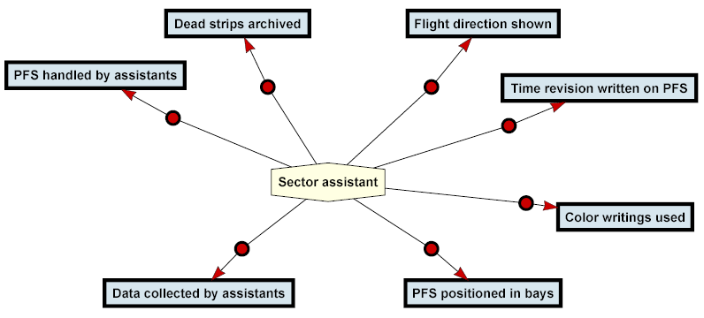
Load analysis from query on agent model for air traffic control
responsibility

Slide 23
A context diagram shows agents and their interfaces
Partial view: focus on capabilities & interfaces
interface = monitored/controlled state variables
(attrib/assoc from object model)
link (ag1, ag2) with label var generated from agent diagram iff
var is controlled by ag1, monitored by ag2
var is monitored by ag1, controlled by ag2
Cf. context diagrams & problem diagrams in Chap.4
variables monitored by ag1
& controlled by ag2
ag1
ag2
variables controlled by ag1
& monitored by ag2

Slide 24
Context diagram: example
Train.CurrentSpeed,
Train.CurrentLoc
Train
Actuator
Train.ActuatedAcceleration
Tracking
System
OnBoard
Controller
Train.MeasuredSpeed,
Train.MeasuredLoc
Speed&Accel
Controller
Command.
CommandedAcceleration

Slide 25
A dependency diagram shows agents and their dependencies
Dependencies among agent pairs for goals to be satisfied
including dependency chains
Complementary view to agent/context diagrams
for vulnerability analysis: goal failure propagation
for modeling organizational components of the system
Cf. i* diagrams [Yu’97]

Slide 26
Modeling system agents: outline
What we know about agents so far
Characterizing system agents
capabilities
responsibilities
operation performers
wishes & beliefs
dependencies
Representing agent models
agent diagram, context diagram, dependency diagram
Refinement of abstract agents
Building agent models: heuristics and derivation rules

Slide 27
Agent refinement
Agents may be defined as aggregations of finer-grained agents
like any object in object model, cf. Chap. 10
Supports incremental refinement of responsibilities
coarse-grained goal assigned to coarse-grained agent, then subgoals assigned to finer-grained agents
Coarse-grained agent may be...
environment agent e.g. organizational department -> units -> operators
hybrid: environment agent + software-to-be
for software-to-be agents: deferred to architectural design

Slide 28
Goal-agent co-refinement: example

Slide 29
A goal-agent co-refinement pattern in process control
Cf. 4-variable model (Chap.1),
problem frame for control systems (Chap.4)

Slide 30
Modeling system agents: outline
What we know about agents so far
Characterizing system agents
capabilities
responsibilities
operation performers
wishes & beliefs
dependencies
Representing agent models
agent diagram, context diagram, dependency diagram
Refinement of abstract agents
Building agent models: heuristics and derivation rules

Slide 31
Heuristics for building agent diagrams
For agent identification ...
Goal target: active objects Concerned by this goal ?
their monitoring & control capabilities in object model ?
e.g. Achieve [ResourceRequestSatisfied] => ResourceUser
Goal enforcer: possible enforcers of this goal ? their capabilities ?
e.g. Avoid [CopiesStolen] => Staff or AntiTheftDevice
Goal wisher: human system agents Wishing this goal ? their capabilities ?
e.g. Maintain [AccurateBookClassification] => ResearchStaff
Variable monitor/controller: possible source (resp. target) of this Monitoring (resp. Control) link in this context diagram ? why ?
e.g. Scheduler Controls Meeting.RequiredEquipment
=> LocalOrganizer as monitoring agent
N Don’t confuse product-level agents & process-level stakeholders

Slide 32
Heuristics for building agent diagrams (2)
For goal responsibility assignment ...
Assignment based on goal-capability matching: Consider agents whose monitoring/control capabilities match quantities to be evaluated/constrained in the goal spec
Software counter-part of a human assignment: Consider software assignment as alternative to human assignment, together with pros/cons as soft goals
e.g. AccurateBookClassification => Staff vs. AutoClassifier ?
Assignment refinement: Identify finer-grained assignments by goal-agent co-refinement
Notes:
Assignment based on goal-capability matching
Software counterpart of a human assignment
Assignment refinement
Assignment selection based on soft goals
Assignment to wisher

Slide 33
Heuristics for building agent diagrams (3)
For goal responsibility assignment ...
Assignment selection based on soft goals: Select assignments that best contribute to high-priority soft goals
Assignment to wisher: Favor human assignments to agents wishing the goal or a parent goal
e.g. AccurateBookClassification to ResearchStaff
rather than AdministrativeStaff
N Avoid assignments resulting in critical agent dependencies
e.g. BiblioSearchEngine depending on AdministrativeStaff
for AccurateBookClassification

Slide 34
Deriving context diagrams from goals
Behavioral goal specs are of form:
G: CurrentCondition [monitoredVariables]
⇒ [sooner-or-later/always] TargetCondition [controlledVariables]
Cf. goal-capability matching for goal realizability
tr.measuredSpeed ≠ 0 ⇒ tr.DoorsState = ‘closed’
DoorsClosedWhile
NonZeroSpeed
OnBoard
Controller
Tracking
System
Train
Actuator
OnBoard
Controller
Train.measuredSpeed
Train.DoorsState

Slide 35
Deriving context diagrams from goals, more generally
Agent interfaces are derived from goal specs
Context diagram is derived piecewise by iteration on leaf goals
agent with outgoing arrow labelled var is connected to all agents with incoming arrow labelled var

Slide 36
Deriving context diagrams from goals: another example

Slide 37
Modeling system agents: summary
What we know about agents so far
Characterizing system agents
capabilities
responsibilities
operation performers
wishes & beliefs
dependencies
Representing agent models
agent diagram, context diagram, dependency diagram
Refinement of abstract agents
Building agent models: heuristics & derivation rules

