Slide 1
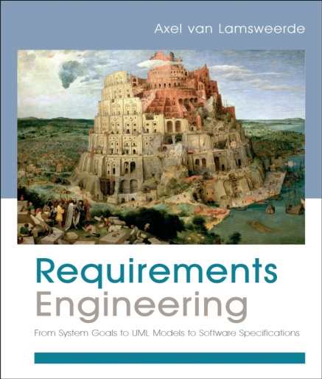
Building System Models for RE
Chapter 13
Modeling System Behaviours

Slide 2
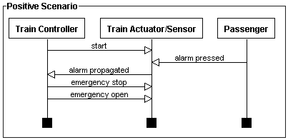
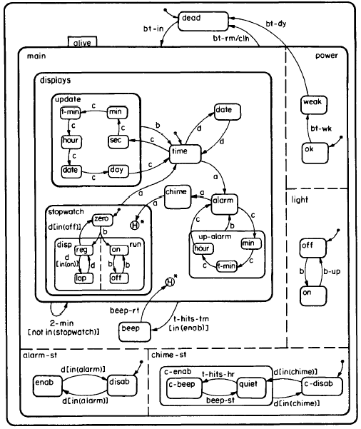
Building models for RE
Behaviors -
Scenarios (Chap.13)
Behaviors -
State machines (Chap.13)

Slide 3
The behaviour model
Behaviour view of the system being modeled
Modelling the dynamic of an agent, consider:
Specific behaviours of specific agent instances
All possible behaviours of any agent instance.
Specific instance behaviours are captured through scenarios.
General class behaviours are captured through state machines.

Slide 4
Modeling system behaviours: outline
Modeling instance behaviours
Scenarios as UML sequence diagrams
Scenario refinement
Modeling class behaviours
State machines as UML state diagrams
State machine refinement
Building behaviour models

Slide 5
Modeling instance behaviours
What is scenario?
Is a temporal sequence of interaction events among agent instances
Positive scenario: the sequence of interactions illustrates a possible way of satisfying an behavioral goal.
Negative scenario: the sequence of interactions illustrates a possible way of satisfying an obstacle to a goal.
Interaction:
Is an instantaneous object
Corresponding to the source agent instance applying an operation whose effect is monitored by the target agent instance.
Source agent controls the interaction; target agent monitors it.

Slide 6
Scenario as UML sequence diagrams
Sequence diagrams are a UML variant of the event trace diag.
Basic UML syntax for sequence diagrams is similar to the one used in event trace diagrams.

Slide 7
Scenario as UML sequence diagrams (2)

Slide 8
Scenario refinement: Episodes and agent decomposition
When elaborating complex scenarios stepwise, expressing a coarse-grained scenario first then refine it with further details
coarse-grained scenario -> finer-grained scenario:
Introducing episodes
Decomposing an agent instance into finer-grained agents.

Slide 9
Scenario refinement: Episodes

Slide 10
Scenario refinement: agent decomposition

Slide 11
Modeling system behaviours: outline
Modeling instance behaviours
Scenarios as UML sequence diagrams
Scenario refinement
Modeling class behaviours
State machines as UML state diagrams
State machine refinement
Building behaviour models

Slide 12
Modeling class behaviours
State machines complement the fragmentary information provided by scenarios in multiple ways:
They make state information explicit
They capture the behaviour of any agent instance, not just a specific one.
They are aimed at capturing all admissible sequences of state transitions, not just a specific one.
Snapshot state <-> SM state
State transitions captured by a state machine refer to SM states.
The events causing state transitions can be of different types:
External events: the agent associated with the State Machine does not controls.
Internal events: events controlled by the agent associated with the State Machine

Slide 13
State machines as UML state diagrams
A state machine is represented in UML by a variant of a statechart called a state diagram.
Some features …
State transition is caused by an event
Transition may be labeled by the name of the causing event
In contrast to events, a state has a duration.
Initial and final states

Slide 14
State machines as UML state diagrams (2)
Guarded transitions
A guard captures a necessary condition for transition firing
Actions
An action is an auxiliary associated with a state transition.
Event notifications
An important class of action where an event is notified by a ‘producing’ diagram to a ‘consuming’ diagram where this event causes transitions.
This allows for synchronization among multiple diagrams.
Entry/exit actions

Slide 15
State machines as UML state diagrams (3)

Slide 16
State machines as UML state diagrams (4)

Slide 17
State machine refinement: sequential and concurrent sub-states
… when we elaborate a complex state machine model stepwise:
specify first a coarse-grained state diagram
refine this diagram with more states that are finer-grained
Sub-state -> nested state / super-state -> composite state
Sequential decomposition
An SM state may be decomposed into sub-states
Structuring mechanism is recursive
Sub-state may in turn be sequentially decomposed
Parallel decomposition
An SM state may be decomposed into concurrent sub-states
Composite state can be structured as a parallel composition of nested diagrams.

Slide 18
State machine refinement: sequential decomposition
Semantic rules define sequential state decomposition more precisely: [textbook, p459)

Slide 19
State machine refinement: parallel decomposition
Semantic rules define parallel state decomposition more precisely: [textbook, p461)

Slide 20
Modeling system behaviours: outline
Modeling instance behaviours
Scenarios as UML sequence diagrams
Scenario refinement
Modeling class behaviours
State machines as UML state diagrams
State machine refinement
Building behaviour models

Slide 21
Building behaviour models
Goals, scenarios and state machines have complementary strengths and limitations:
Goals are declarative, capture functional, non-functional and alternative options aspects.
Scenarios support an informal, narrative and concrete style of expression.
State machines provide visual abstractions of explicit behaviours of any agent instance in a class.
Expecting goals, scenarios and state machines to form a win-win partnership for building complex models.
Table 13.1 summarizes the respective pros/cons of goals, scenarios and state machines. (textbook.p464).

Slide 22
Building behaviour models
Elaborating relevant scenarios for good coverage
Ensure goal coverage by positive scenarios
Ensure obstacle coverage by negative scenarios
Identify normal scenarios and their associated abnormal scenarios
Identify auxiliary episodes
Identify responses to stimuli events
Check scenarios for clean-up
Decorating scenarios with state conditions
From scenarios to state machines
From scenarios to goals
From operationalized goals to state machines.

Slide 23
Modeling system behaviors: Summary
Modeling instance behaviours
Scenarios as UML sequence diagrams
Scenario refinement
Modeling class behaviours
State machines as UML state diagrams
State machine refinement
Building behaviour models

