Slide 1
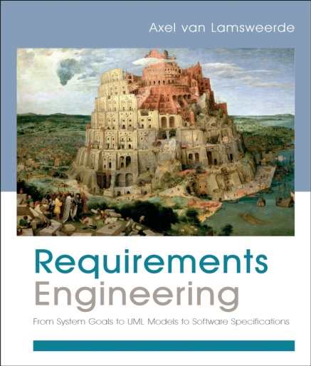
Building System Models for RE
Chapter 14
Integrating multiple system views

Slide 2
Integrating Multiple System Views: outline
A meta-model for view integration
Overall structure of the meta-model
The goal meta-model
The object meta-model
The agent meta-model
The operation meta-model
The behaviour meta-model
Inter-view consistency rules
Grouping related view fragments into packages

Slide 3
A meta-model for view integration
What is meta-model?
Is a model that defines and interrelates conceptual abstractions in terms of which other models are defined.
Is a conceptual model for the meta level.
Consisting of meta-level concepts, relationships, attributes and constraints.
Three different levels of modeling:
The meta level: refers to domain-independent abstractions.
The domain level: refers to concepts specific to the modeled system (library, loan, block, signal, …).
The instance level: refers to specific instances of domain-level concepts in the running system.

Slide 4
A meta-model for view integration: example

Slide 5
Role of a meta-model
Define the structure of modeling languages and a meta-language for describing it
Provide a framework within which intra- and inter-view consistency rules can be defined
Yield the logical schema of model database
Allows modeling methods to be defined
Summarizes the features of modeling language or method and allows variants of a language or method to be compared
Provide a solid basis for tool support and integration

Slide 6
Overall structure of the meta-model
A system model is made up of five views.
The root meta-concept SystemModel aggregates of five meta-concepts corresponding to those views.
Every meta-concept in meta-model is characterized by meta-attributes and meta-relationships.
Two meta-attributes are mandatory for any meta-concept whaterver view it refers to: Name and Def

Slide 7
The goal meta-model

Slide 8
The object meta-model

Slide 9
The agent meta-model

Slide 10
The operation meta-model

Slide 11
The behaviour meta-model

Slide 12
Inter-view consistency rules
Two views of a system model are said to be structurally consistent if they satisfy a set of rules constraining their respective elements for compatibility and complementarity.
Many structural consistency rules have the following pattern:
For every item it1 satisfying some property P1(it1) in view V1, there exists a corresponding item it2 in view V2 that satisfies some property P2(it1, it2) linking it1 and it2.

Slide 13
Some structural consistency rules
Structural consistency of the goal and object models
Every conceptual item referred to in a goal specification in the goal model must appear as an attribute or object in the object model.
Every goal in the goal model must concern at least one object in the object model.
For every object in the object model, there must be at least one goal in the goal model concerning with it.
Structural consistency of the goal and behaviour models
Every scenario in the behaviour model must be covered by at least one goal in the goal model.
The other structural consistency rules: ref. textbook(494).

Slide 14
Grouping related view fragments into packages
A package is a container in which model parts are defined and grouped together.

Slide 15
Integrating Multiple System Views: Summary
A meta-model for view integration
Overall structure of the meta-model
The goal meta-model
The object meta-model
The agent meta-model
The operation meta-model
The behaviour meta-model
Inter-view consistency rules
Grouping related view fragments into packages

