Slide 1
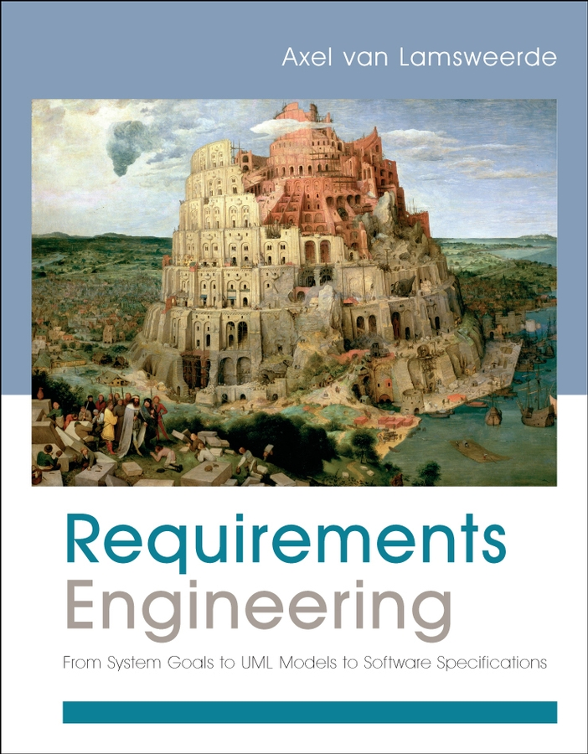
Requirements Engineering From System Goals to UML Models to Software Specifications
Axel Van Lamsweerde

Slide 2

Fundamentals of RE
Chapter 1 Setting the Scene

Slide 3
Learning Objectives
Understand scope and basic concept of RE
Explain what requirements there are with respect to other key RE notions such as domain properties and environment assumptions
Specific roles of functional and non-functional requirements in RE
Requirement engineering process
Quality criteria according to which requirement documents is elaborated and evaluated
Why a careful elaboration of requirements and assumptions in early stages of software lifecycle is important?
What are obstacles to do good RE?

Slide 4
Setting the scene: outline
What is Requirements Engineering (RE) ?
The problem world & the machine solution
The scope of RE: the WHY, WHAT and WHO dimensions
Types of statements involved: descriptive vs. prescriptive
Categories of requirements: functional vs. non-functional
The requirements lifecycle: actors, processes, products
Target qualities and defects to avoid
Types of software projects
Requirements in the software lifecycle
Relationship to other disciplines

Slide 5
Setting the scene: outline (2)
Why engineer requirements?
The requirements problem: facts, data, citations
Role and stakes of Requirements Engineering
Obstacles to good RE practice
Agile development and RE
To fully apprehend the material in this chapter and the next ones, you should carefuly read the 3 case study descriptions in Section 1.1.2 of the book

Slide 6

The problem world and the machine solution
To make sure a software solution “correctly” solves some real-world problem, we must first fully understand and define ...
what problem needs to be solved in the real world
the context in which the problem arises
Example: car control
Problem: manual handbrake release can be inconvenient in certain situations
Context: car driving, braking, driver ’s intent, safety rules, ...
Notes:
Problems world: discover, understand, formulate, analyze and agree on what problem should be solved
Why they should be solved, who are involved responsibility of solving problems.

Slide 7
The problem world and the machine solution (2)
World: problematic part of the real-world, made of
human components: organization units, staff, operators, ...
physical components: devices, legacy software, mother Nature, ...
Machine: what needs to be installed to solve the problem
software to be developed and/or purchased
hardware/software implementation platform, associated input/output devices (e.g. sensors & actuators)
Requirements engineering (RE) is concerned with ...
the desired machine’s effect on the problem world
the assumptions and relevant properties about this world

Slide 8

The problem world and the machine solution (3)
The world and the machine have their own phenomena while sharing others
RE is solely concerned with world phenomena, including shared ones [Jackson95]
unlike software design, concerned with machine phenomena
World
phenomena
Shared
phenomena
Machine
phenomena
MotorRaising
DriverWantsToStart
motor.Regime = ‘up’
stateDatabase
updated
errorCode = 013
HandbrakeReleased
World
Machine
handBrakeCtrl = ‘off’

Slide 9

The problem world involves two system versions
System: set of interacting components structuring the problem world
System-as-is: system as it exists before the machine is built into it
System-to-be: system as it should be when the machine will operate into it
Concepts, phenomena, rules about car handbraking
Car
Driver
Brake
System-as-is
Concepts, phenomena, rules about automated handbraking
System-to-be
Machine
Notes:
System is a set of components interacting with each other to satisfy some global objectives

Slide 10
RE: a preliminary definition
Coordinated set of activities ...
for exploring, evaluating, documenting, consolidating, revising and adapting the objectives, capabilities, qualities, constraints & assumptions on a software-intensive system
based on problems raised by the system-as-is and opportunities provided by new technologies

Slide 11
What others said ...
Ross'77
Requirements definition must say ...
why a new system is needed, based on current or foreseen conditions,
what system features will satisfy this context,
how the system is to be constructed
RE is concerned with the real-world goals for, functions of, constraints on software systems; and with their
link to precise specifications of software behavior,
evolution over time and families
Zave'97

Slide 12
System requirements vs. software requirements
Software-to-be: software to be developed - part of the machine, component of the system-to-be
Environment: all other components of the system-to-be, including people, devices, pre-existing software, etc.
System requirements: what the system-to-be should meet; formulated in terms of phenomena in the environment
“The handbrake shall be released when the driver wants to start.”
Software requirements: what the software-to-be should meet on its own; formulated in terms of phenomena shared by the software and the environment
“The software output variable handBrakeCtrl shall have the value off when the software input variable motorRegime gets the value up.”

Slide 13
The scope of RE: the WHY, WHAT, WHO dimensions
System-as-is
System-to-be
WHY
a new system?
problems,
opportunities,
system knowledge
Objectives
satisfy
requirements,
constraints,
assumptions
WHAT
services?
assignment
WHO
will be responsible
for what ?

Slide 14
The WHY dimension
?
Identify, analyze, refine the system-to-be’s objectives
to address analyzed deficiencies of the system-as-is
in alignment with business objectives
taking advantage of technology opportunities
Example: airport train control
“Serve more passengers”
“Reduce transfer time among terminals”
Difficulties
Acquire domain knowledge
Evaluate alternative options (e.g. alternative ways of satisfying the same objective)
Match problems-opportunities, and evaluate these: implications, associated risks
Handle conflicting objectives

Slide 15
The WHAT dimension
?
Identify & define the system-to-be’s functional services (software services, associated manual procedures)
to satisfy the identified objectives
according to quality constraints: security, performance, ...
based on realistic assumptions about the environment
Example: airport train control
“Computation of safe train accelerations”
“Display of useful information for passengers inside trains”
Difficulties
Identify the right set of features
Specify these precisely for understanding by all parties
Ensure backward traceability to system objectives

Slide 16
The WHO dimension
?
Assign responsibilities for the objectives, services, constraints among system-to-be components
based on their capabilities and on the system’s objectives
yielding the software-environment boundary
Example: airport train control
“Safe train acceleration” ... under direct responsibility of software-to-be (driverless option) or of driver following software indications ?
“Accurate estimation of train speed/position” ... under responsibility of tracking system or of preceding train ?
Difficulties
Evaluate alternative options to decide on the right degree of automation

Slide 17
Setting the scene: outline
What is Requirements Engineering?
The problem world & the machine solution
The scope of RE: the WHY, WHAT and WHO dimensions
Types of statements involved: descriptive vs. prescriptive
Categories of requirements: functional vs. non-functional
The requirements lifecycle: actors, processes, products
Target qualities and defects to avoid
Types of software projects
Requirements in the software lifecycle
Relationship to other disciplines

Slide 18
Statements may differ in mood
Descriptive statements state system properties holding regardless of how the system should behave (indicative mood)
natural law, physical constraint, etc
e.g. “If train doors are closed, they are not open”
“If the train’s acceleration is positive, its speed is non-null”
Prescriptive statements state desirable properties holding or not depending on how the system behaves (optative mood)
e.g. “Doors shall always remain closed when the train is moving”
Important distinction for RE:
prescriptive statements can be negotiated, weakened, replaced by alternatives
descriptive statements cannot
Notes:
- Indicative: directive mood- Lối biểu thị/trình bày
- Optative: willing mood
- Descriptive : system properties that hold regardless of …
- Prescriptive: state desirable properties that system hold or not depending on how the system behaves

Slide 19
Statements may differ in scope
A RE statement may refer to phenomena ...
owned by the environment
or shared between the environment & the software-to-be: one controls phenomena monitored by the other, and resp.
TrainMoving ® DoorsClosed
measuredSpeed ¹ 0 ® doorsState = 'closed'
TrainMoving
DoorsClosed
measuredSpeed ¹ 0
trainPosition-DB
updated
errorCode = 05
TrainAtPlatform
Environment
Software
doorsState = 'closed'

Slide 20
Types of statements: system requirements, software requirements
System requirement: prescriptive statement refering to environment phenomena (not necessarily shared)
to be enforced by the software-to-be possibly together with other system components
formulated in a vocabulary understandable by all parties
TrainMoving → DoorsClosed
Software requirement: prescriptive statement refering to shared phenomena
to be enforced by the software-to-be solely
formulated in the vocabulary of software developers
measuredSpeed ≠ 0 → doorsState = 'closed’
(A software req is a system req; the converse is not true)

Slide 21
Types of statements: domain properties, assumptions, definitions
Domain property: descriptive statement about problem world phenomena (holds regardless of any software-to-be)
trainAcceleration > 0 → trainSpeed ≠ 0
Assumption: statement to be satisfied by the environment of the software-to-be
formulated in terms of environment phenomena
generally prescriptive (e.g. on sensors or actuators)
measuredSpeed ≠ 0 iff trainSpeed ≠ 0
Definition: statement providing a precise meaning to system concepts or auxiliary terms
no truth value
“measuredSpeed is the speed estimated by the train’s speedometer”

Slide 22
Relating software reqs to system reqs: the 4-variable model [Parnas95]
Input Devices (e.g. sensors)
trainSpeed
measuredSpeed
M: monitored variables
I: input data
Environment
SoftwareToBe
DoorsClosed
doorsState
C: controlled variables
O: output results
Output Devices (e.g. actuators)
SysReq Í M ´ C relation on environment monitored/controlled variables
SofReq Í I ´ O relation on software input/output variables
SofReq = Map (SysReq, Dom, Asm)
translates SysReq using domain properties and assumptions

Slide 23
Mapping system reqs to software reqs involves satisfaction arguments
SOFREQ, ASM, DOM |= SysReq
“If the software requirements in SOFREQ, the assumptions in ASM and the domain properties in DOM are all satisfied and consistent, then the system requirements SysReq are satisfied”
SofReq: measuredSpeed ≠ 0 → doorsState = 'closed’
ASM: measuredSpeed ≠ 0 iff trainSpeed ≠ 0
doorsState = 'closed’ iff DoorsClosed
Dom: TrainMoving iff trainSpeed ≠ 0
---------------------------------------------------------------------------
SysReq: TrainMoving → DoorsClosed
Further to requirements, we need to elicit, evaluate, document, consolidate relevant assumptions & domain properties

Slide 24
Categories of requirements
Functional requirements: prescribe what services the software-to-be should provide
capture intended software effects on environment, applicability conditions
units of functionality resulting from software operations
“The software shall control the acceleration of all trains”
Non-functional requirements: constrain how such services should be provided
Quality requirements: safety, security, accuracy, time/space performance, usability, ...
Others: compliance, architectural, development reqs
To be made precise in system-specific terms
“Acceleration commands shall be issued every 3 seconds to every train”

Slide 25
A taxonomy of non-functional requirements
Non-Functional Requirement
Quality of Service
Compliance
Architectural Constraint
Development Constraint
Accuracy
Safety
Security
Reliability
Performance
Interface
Installation
Distribution
Cost
Maintainability
Cost
Deadline
Variability
Confidentiality
Integrity
Availability
Time
Space
User
Device
Software
interaction
interaction
interoperability
Subclass link
Usability
Convenience
See definitions and examples in the book
No clear-cut boundaries, possible overlaps
Functional/non-functional: e.g. functional reqs for firewall management are security-related
Non-functional overlaps: e.g. “high frequency of train commands” is related to performance and safety
Notes:
-Safety: are quality reqs that rule out software effects that might result in accidents, degradations or losses in the environment.
Security: ……………… that prescribe the protection of system assets against undesirable env behavioral
Reliability: constraints the software to operate as expected over long periods of time.
Accuracy: that constraint the state of the information processed by software reflect the state of physical information in the env accurately.

Slide 26
Requirements taxonomies are helpful ...
More specific definition of what requirements are in specific classes
More semantic characterization of requirements ...
prescribing desired behaviors e.g. many functional reqs
ruling out inadmissible behaviors e.g. many safety, security, accuracy reqs
indicating preferred behaviors e.g. soft, “ility” reqs
Elicitation/analysis can be guided by taxonomy browsing
Is there any confidentiality req on information X ?
Is there any accuracy req on information Y ?
Is there any conflict between confidentiality and accountability reqs in my system?
Notes:
Req Taxonomy: Categorize requirements
More semantic characterization of requirements in term of prescribed behaviors
There are requirements that prescribe desired behaviors….

Slide 27
Setting the scene: outline
What is Requirements Engineering?
The problem world & the machine solution
The scope of RE: the WHY, WHAT and WHO dimensions
Types of statements involved: descriptive vs. prescriptive
Categories of requirements: functional vs. non-functional
The requirements lifecycle: actors, processes, products
Target qualities and defects to avoid
Types of software projects
Requirements in the software lifecycle
Relationship to other disciplines

Slide 28
The RE process (1)
alternative proposals
domain understanding
& elicitation
start
Notes:
Stakeholders – a group or individual affected by system-to-be

Slide 29
Domain understanding
Studying the system-as-is
Business organization: structure, dependencies, strategic objectives, policies, workflows, operational procedures, ...
Application domain: concepts, objectives, tasks, constraints, regulations, ...
Strengths & weaknesses of the system-as-is
Identifying the system stakeholders:
Groups or individuals affected by the system-to-be, who may influence its elaboration and its acceptance
Decision makers, managers, domain experts, users, clients, subcontractors, analysts, developers, ...
Products: Initial sections for preliminary draft proposal
Glossary of terms

Slide 30
Requirements elicitation
Exploring the problem world ...
Further analysis of problems with system-as-is: symptoms, causes, consequences
Analysis of technology opportunities, new market conditions
Identification of ...
improvement objectives
organizational/technical constraints on system-to-be
alternative options for satisfying objectives, for assigning responsibilities
scenarios of hypothetical software-environment interaction
requirements on software, assumptions on environment
Product: Additional sections for preliminary draft proposal

Slide 31
The RE process (2)
alternative proposals
domain understanding
evaluation
& elicitation
& agreement
start
agreed
requirements

Slide 32
Evaluation & agreement
Negotiation-based decision making ...
Identification & resolution of conflicting concerns
Identification & resolution of risks with proposed system
Comparison of alternative options against objectives & risks, and selection of preferred ones
Requirements prioritization: to resolve conflicts, address cost/schedule constraints, support incremental development
Product: Final sections of draft proposal documenting the selected/agreed objectives, requirements, asssumptions (incl. rationale for selected options)

Slide 33
The RE process (3)
alternative proposals
domain understanding
evaluation
& elicitation
& agreement
start
agreed
requirements
specification
& documentation
documented requirements

Slide 34
Specification & documentation
Precise definition of all features of the agreed system
Objectives, concepts, relevant domain properties, system/software requirements, assumptions, responsibilities
Satisfaction arguments, rationale for options taken
System variants & evolutions
Estimated costs
Organization of these in a coherent structure
Documentation in a form understandable by all parties
Resulting product: Requirements Document (RD)

Slide 35
The RE process (4)
alternative proposals
domain understanding
evaluation
& elicitation
& agreement
consolidated
start
agreed
requirements
requirements
validation
specification
& verification
& documentation
documented requirements

Slide 36
Requirements consolidation
Quality assurance activity on RD ...
Validation: adequacy of RD items wrt real needs ?
Verification: omissions, inconsistencies ?
Checks for other target qualities (discussed next)
Fixing of errors & flaws
Products: Consolidated RD
Acceptance test data, prototype
Development plan
Project contract

Slide 37
RE: an iterative process
RE phases are ordered by data dependencies
No strict sequencing: intertwining, overlap, backtracking
Iterated cycles due to error corrections & evolving needs
during RE, during software development, after deployment
alternative proposals
domain understanding
evaluation
& elicitation
& agreement
consolidated
start
agreed
requirements
requirements
validation
specification
& verification
& documentation
documented requirements

Slide 38
Setting the scene: outline
What is Requirements Engineering?
The problem world & the machine solution
The scope of RE: the WHY, WHAT and WHO dimensions
Types of statements involved: descriptive vs. prescriptive
Categories of requirements: functional vs. non-functional
The requirements lifecycle: actors, processes, products
Target qualities and defects to avoid
Types of software projects
Requirements in the software lifecycle
Relationship to other disciplines

Slide 39
Target qualities for RE process
Completeness of objectives, requirements, assumptions
Consistency of RD items
Adequacy of requirements, assumptions, domain props
Unambiguity of RD items
Measurability of requirements, assumptions
Pertinence of requirements, assumptions
Feasibility of requirements
Comprehensibility of RD items
Good structuring of the RD
Modifiability of RD items
Traceability of RD items
Notes:
Adequacy: the reqs must address the actual needs for a new system- explicitly expressed by stakeholders. Soft reqs must be adequate translation of sys reqs
Pertinence: reqs and assumptions must all contribute to the satisfaction of one or several objectives underpinning the system-to-be

Slide 40
Types of RE errors & flaws: a wide palette
Omission (critical error!)
Contradiction (critical error!)
Inadequacy (critical error!)
Ambiguity (critical error!)
Unmeasurability
Noise, overspecification
Unfeasibility (wishful thinking)
Unintelligibility
Poor structuring, forward reference, remorse
Opacity
Notes:
- Opacity: not clear meaning
- Noise, over..: Overstate
Unintelligibility : Difficult to understand
Remorse: Explain/define the meaning an acronyms after they have been used many times
Flaws: lack of requirement document

Slide 41
Errors in a requirements document (RD)
Omission: problem world feature not stated by any RD item
e.g. no req about state of train doors in case of emergency stop
Contradiction: RD items stating a problem world feature in an incompatible way
“Doors must always be kept closed between platforms”
and “Doors must be opened in case of emergency stop”
Inadequacy: RD item not adequately stating a problem world feature
“Panels inside trains shall display all flights served at next stop”
Ambiguity: RD item allowing a problem world feature to be interpreted in different ways
“Doors shall be open as soon as the train is stopped at platform”
Unmeasurability: RD item stating a problem world feature in a way precluding option comparison or solution testing
“Panels inside trains shall be user-friendly”

Slide 42
Flaws in a requirements document (RD)
Noise: RD item yielding no information on any problem world feature (Variant: uncontrolled redundancy)
“Non-smoking signs shall be posted on train windows”
Overspecification: RD item stating a feature not in the problem world, but in the machine solution
“The setAlarm method shall be invoked on receipt of an Alarm message”
Unfeasibility: RD item not implementable within budget/schedule
“In-train panels shall display all delayed flights at next stop”
Unintelligibility: RD item incomprehensible to those needing to use it
A requirement statement containing 5 acronyms
Poor structuring: RD item not organized according to any sensible & visible structuring rule
Intertwining of acceleration control and train tracking issues
Notes:
Yield: produce, bring again,

Slide 43
Flaws in a requirements document (2)
Forward reference: RD item making use of problem world features not defined yet
Multiple uses of the concept of worst-case stopping distance before its definition appears several pages after in the RD
Remorse: RD item stating a problem world feature lately or incidentally
After multiple uses of the undefined concept of worst-case stopping distance, the last one directly followed by an incidental definition between parentheses
Poor modifiability: RD items whose changes must be propagated throughout the RD
Use of fixed numerical values for quantities subject to change
Opacity: RD item whose rationale, authoring or dependencies are invisible
“The commanded train speed must always be at least 7 mph above physical speed” without any explanation of rationale for this

Slide 44
The RE process may vary according to project type
Greenfield vs. brownfield projects
Customer-driven vs. market-driven projects
In-house vs. outsourced projects
Single-product vs. product-line projects
Variation factors ...
Respective weights of elicitation, evaluation, documentation, consolidation, evolution
Intertwining RE/design
Respective weights of functional vs. non-functional reqs
Types of stakeholder & developer involved
Specific uses of the RD
Use of specific techniques
Notes:
Consolidation is likely to be prominent in green-field, customer-driven, mission-critical projects
Documents has been observed to be more prominent in customer-driven projects
Prioritization ...

Slide 45
Requirements in the software lifecycle
The RD impacts on many software artefacts
RE, system design & software architecture design are inevitably intertwined

Slide 46
RE has multiple connections with other disciplines
Primarily with Software Engineering (SE)
Other connections:
Domain understanding & requirements elicitation: system engineering, control theory, management science, organization theory, behavioral psychology, anthropology, AI knowledge acquisition
Requirements evaluation & agreement: multicriteria analysis, risk management, conflict management, negotiation theory
Requirements specification, documentation & consolidation: software specification, formal methods in SE
Requirements evolution: change management, configuration management in SE
System modeling: conceptual models in DB & MIS; task models in HCI; knowledge representation in AI

Slide 47
Setting the scene: outline (2)
Why engineer requirements?
The requirements problem: facts, data, citations
Role and stakes of Requirements Engineering
Obstacles to good RE practice
Agile development and RE

Slide 48
The requirements problem: facts, data, citations
Poor requirements are ubiquitous ...
“Requirements need to be engineered and have
continuing review and revision”
Prohibitive cost of late correction ...
“Up to 200 x cost of early correction”
RE is hard & critical ...
“Hardest, most important function of SE is the iterative extraction & refinement of requirements”
Bell&Thayer ’76
Boehm ’81
Brooks ’87

Slide 49
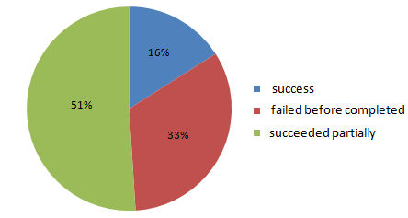
The requirements problem: Standish report, 1995
Survey of 350 US companies, 8000 projects
(partial success = partial functionalities, excessive costs, big delays)
Major source of failure:
poor requirements engineering ≅ 50% responses

Slide 50
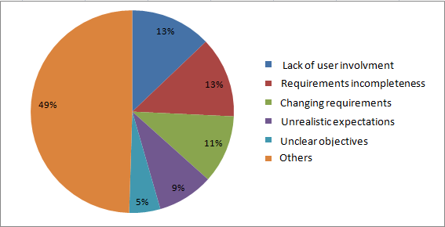
The requirements problem: Standish report, 1995 (2)
Major source of failure:
poor requirements engineering ≅ 50% responses:
www.standishgroup.com/chaos.html

Slide 51
The requirements problem: European survey, 1996
Coverage: 3800 EUR organizations, 17 countries
Main software problems perceived to be in...
requirements specification
> 50% responses
requirements evolution management
50% responses
[European Software Institute, 1996]

Slide 52
The requirements problem is perceived to persist in spite of progress in software technology
Failure %
100
other causes
50
requirements-related
0
1994
2000
2003
[J. Maresco, IBM developersWork, 2007]

Slide 53
Requirements-related errors are ...
the most numerous
± 40% of software errors
the most persistent
found very late, often after software delivery
the most expensive
cost ... 5x more if fixed during design
10x more if fixed during implementation
20x more if fixed during integration testing
200x more if fixed after delivery
account for 66% of software error costs
[Boehm, Jones, Lutz, Hooks & Farry, ...]

Slide 54
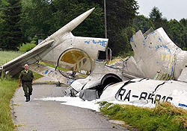
Requirements-related errors can be dangerous
US Aegis/Vincennes (1988): shooting of IranAir airbus
Missing timing between 2 threat events in requirements on alarm software
Patriot anti-missile system (1st Gulf war)
Hidden assumption on maximum usage time
London Ambulance System (1993): fatal delays
Wrong assumptions on crew behavior, ambulance localization system, radio communication, ...
Boeing 757 crash, Cali (1995)
Autopilot ’s wrong timing/localization assumption on flap extension point
Cf. ACM RISKS Digest Forum website

Slide 55
Example: inadequate domain property in A320 braking logic
SofReq: reverse = ‘on’ iff WheelPulses = ‘on’
ASM: reverse = ‘on’ iff ReverseThrustEnabled
WheelPulses = ‘on’ iff WheelsTurning
Dom: MovingOnRunway iff WheelsTurning
---------------------------------------------------------------------------
SysReq: ReverseThrustEnabled iff MovingOnRunway
Warsaw crash: plane moving on waterlogged runway with no wheels turning (aquaplaning)

Slide 56
Role and stakes of RE
Technical impact
on many software-related artefacts (as seen before)
Managerial impact
basis for communication among parties and for project management
Legal impact
contractual commitment client-provider-subcontractors
Impact on certification
Mastered RE process required by many quality standards & certification authorities

Slide 57
Role and stakes of RE (2)
Impact on economy, security, and safety
Cost and consequences of errors in requirements on the software-to-be, assumptions about its environment
Social impact
from user satisfaction
to degradation of working conditions
to system rejection

Slide 58
Obstacles to good RE practice
RE efforts often spent without guarantee of project contract being concluded
Pressure on tight schedules, short-term costs, catching up on technology
Too little research work available on RE economics
Lack of quantitative data on RE benefits & cost savings
Progress in RE process is harder to measure than in design, implementation
RDs are sometimes felt ...
big, complex, to be quickly outdated
too far away from the executable product customers are paying for

Slide 59
Agile development and RE
More agile development may overcome some obstacles
early & continuous provision of functionality of value to customer
by reducing the req-to-code distance
Short RE cycles in spiral RE process, each directly followed by short implementation cycle
Useful functional increment is elicited directly from the user
Evaluation/spec/consolidation phases often shortcut (e.g. spec = test case on the implementation)
Increment is implemented/tested by small team at same location, close to the user for instant feedback, using strict rules

Slide 60
Strong assumptions for agility to be successful
All stakeholder roles are reducible to one single role
Project sufficiently small to be assignable to single, small, single-location team (programmers/testers/maintainers)
“User” can interact promptly & effectively
Functionality can be provided quickly, consistently, incrementally from essential to less important (no prioritization required)
Non-functional aspects, environment assumptions, objectives, alternative options, risks may receive little attention
Little documentation required for work coordination & product maintenance; requirements precision not required; verification before coding is less important than early release
Requirements changes are not likely to require major code refactoring
More/less agility is achievable by less/more weight in elicitation, evaluation, documentation, consolidation phases of RE cycles

Slide 61
Setting the scene: summary
What is Requirements Engineering?
RE is concerned with the problem world only
Scope: WHY, WHAT, WHO issues
Statement types: descriptive vs. prescriptive; requirements, assumptions, domain properties, defs; satisfaction arguments
Categories of requirements: functional, non-functional
RE is a spiral process; elicit-evaluate-specify-consolidate cycles driven by corrections & evolving needs
Multiple target qualities, defects to avoid --some are critical !
Weight on each RE phase may depend on project type
Requirements impact on many software artefacts
Why engineer requirements?
Requirements-related errors are the most numerous, persistent, expensive, dangerous
Technical, managerial, legal, economical, social impact of RE
Obstacles to good RE practice; agility in spiral RE

