Slide 1
Mobile Programming
Lecture 1
Getting Started
Notes:
Testing notes

Slide 2
Today's Agenda
About the Eclipse IDE
Hello, World! Project
Android Project Structure
Intro to Activities, Layouts, and Widgets
Editing Files in Eclipse
SDK Tools
Notes:
Notes page 2

Slide 3
About the Eclipse IDE
Eclipse is an IDE as Visual Studio is an IDE
It's a great tool, but you will have a few problems with it
Notes:
Hardy ahr har!

Slide 4
About Android SDK
Android SDK provides you the API libraries and developer tools necessary to build, test, and debug apps for Android.
Follow this link to setup your development environment:
http://developer.android.com/sdk/index.html

Slide 5
Hello, World! Project - navigation
From the Eclipse main menu,
File > New > Project
Android > Android Project > Next

Slide 6
Hello, World! Project - project details
Project Name: Your app's display name, e.g. "Hello World". click Next
Build Target: Check your phones Settings > About phone > Android version to determine your version
Package Name: must be a Java namespace with at least two components
e.g. edu.fu.cs.hello
Always check Create Activity: enter the name of your initial class
Minimum SDK: What's the earliest version of
Android you want to support?

Slide 7
Hello, World! Project - target devices
Allow your apps to run on your physical Android device
Settings > Applications > Development > USB debugging
Alternatively, run apps in an Android Virtual Device
Window > AVD Manager > New
Name: e.g. "My ICS Device"
Target: Which version of Android you want to emulate
Size: be generous if you can. 512MB - 1GB?
Click on Create AVD

Slide 8

Hello, World! Project - execution
To run your project
Ctrl + F11 or
If necessary
Click Yes to launch a new virtual device
Choose to run as Android Application

Slide 9
Project Structure
bin/ stores the compiled app
assets/ holds other static files you wish packaged with the application for deployment onto the device
res/ contains “resources”, such as drawable files, layouts, constant string values.
src/ contains your source code.
AndroidManifest.xml file describes the application
What components are in the application, such as activities, services, etc.
R.java - do not modify this!
generated whenever the project compiles
more on this later
Notes:
Manifest - what does MM say about the <intent> element?

Slide 10

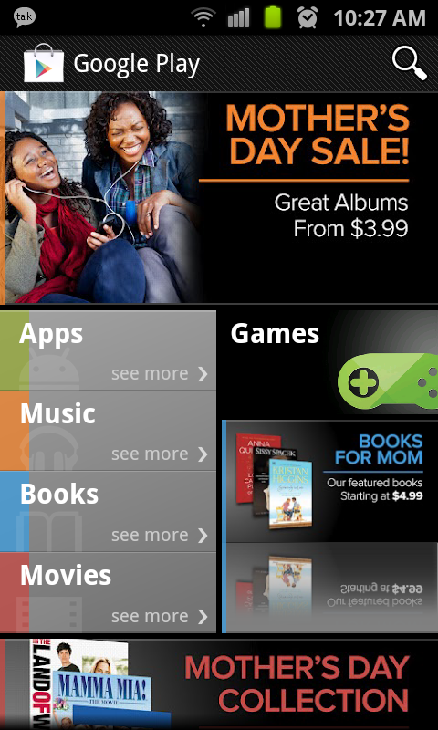
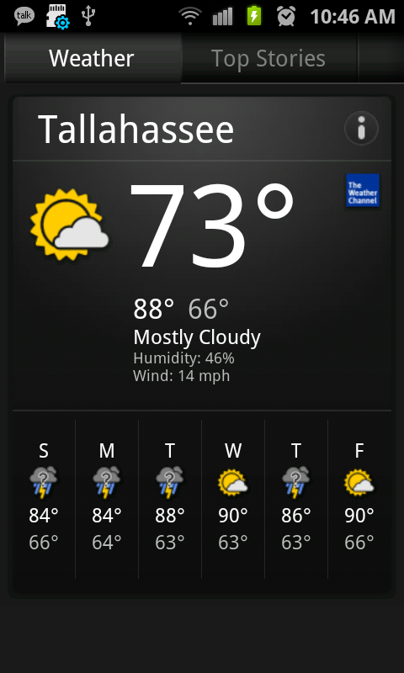
Activities - Examples
3 different apps, 3 different activities

Slide 11
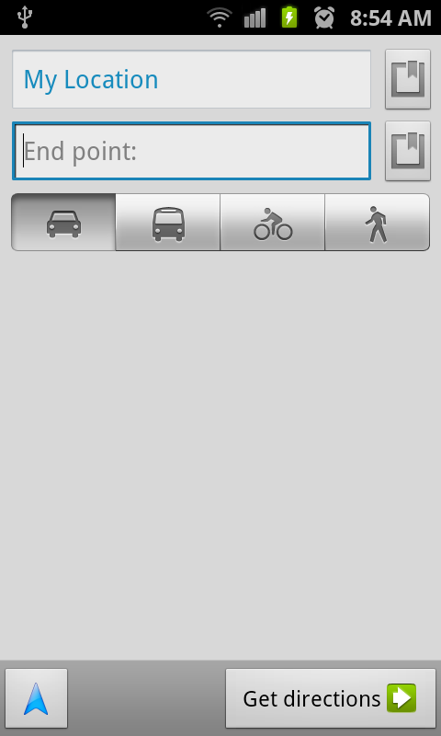
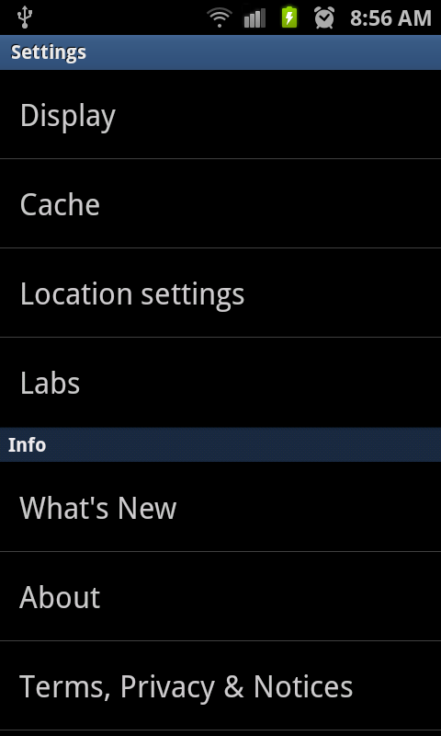
Activities - Examples
1 app (Google Maps), 3 different actitivies

Slide 12
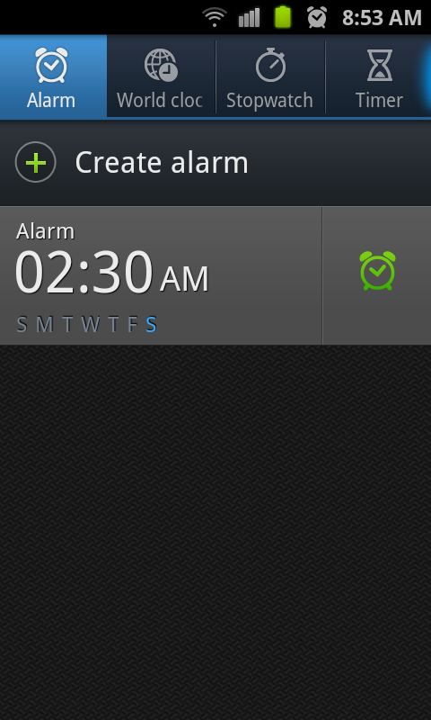
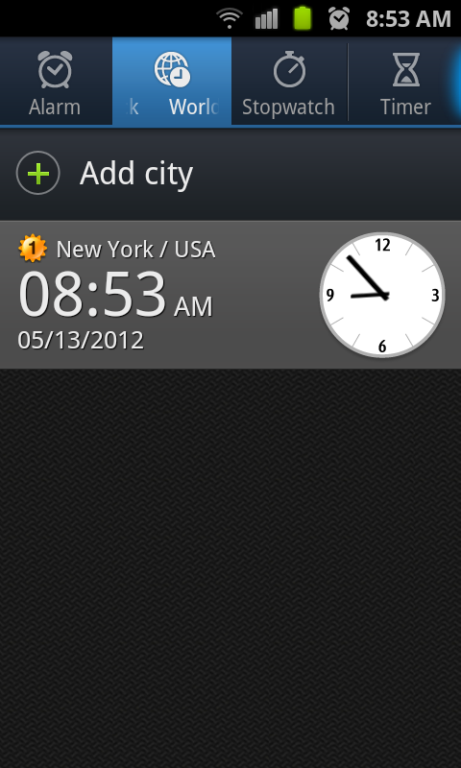
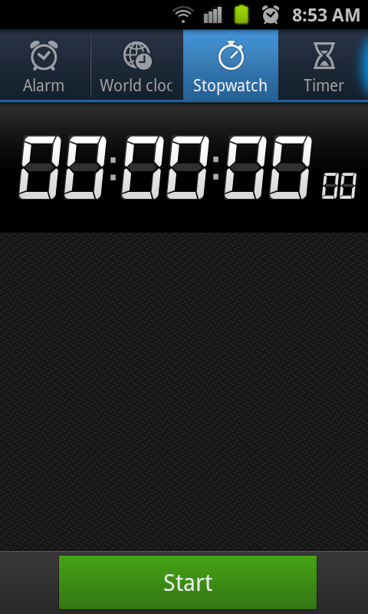
Activities - Examples
1 app (Clock), 3 different actitivies

Slide 13
Activities
An Activity is a single, focused thing that the user can do
To create an Activity, you must create a subclass of Activity (or an existing subclass of it)
Main point of entry
int main() is the main point of entry in C++
public static void main(string args[]) is for Java
public void onCreate(Bundle savedInstance) for Android!

Slide 14
Layouts
Defines the layout structure and holds all elements in an Activity

Slide 15
Layouts
LinearLayout
We'll only talk about this one today
RelativeLayout
TableLayout
TabLayout

Slide 16
Layouts - LinearLayout
1

Slide 17
Layouts - LinearLayout
button, textbox, checkbox, etc.
1

Slide 18
Layouts - LinearLayout
1
2

Slide 19
Layouts - LinearLayout
1
2
3

Slide 20
Layouts - LinearLayout
1
2
3
4

Slide 21
Layouts - LinearLayout
1
2
3
4
5

Slide 22
Widgets
Widgets are UI elements that appear in an Activity (inside of Layouts!)
Buttons
TextViews (labels)
CheckBoxes
Many more!

Slide 23
Editing Files in Eclipse
XML Files
Plain XML editor
edit XML files directly
Form based editor
allows you to modify XML files indirectly using forms
Content Assist
similar to Intellisense, autocomplete
When in doubt, press Ctrl + Spacebar
Quick fixes
e.g. import a package without typing anything
WYSIWYG editor
Allows you to drag and drop Widgets into your Layouts
"What You See Is What You Get"

Slide 24
SDK Tools
Development and debugging tools for Android
SDK Manager
Allows you to install tools necessary to develop for specific Android platforms
In Eclipse
Window > SDK manager

Slide 25
Next Class
Required readings:
page 1 – page 124
Focus on chapter “The ANDROID USER INTERFACE”
and chapter “BASIC WIDGETS”

Slide 26
Textbook
The Busy Coder’s Guide to Android Development (by Mark Murphy)
To use your coupon code, create an account on the Warescription site
(http://wares.commonsware.com). Then, on your Warescription page,
click the Subscribe tab, paste in the coupon code and your name on the right, and submit the form. Your book should be ready in 20-30 seconds if nobody else's books are being generated right then.
I will email everyone a unique coupon code later so that you can get a pdf version of the textbook for free!

