Slide 1
Mobile Programming
Lecture 15
Web APIs and Mashups

Slide 2
Agenda
Web APIs
Creating your own Web API
Mashups
programmableweb.com

Slide 3
Web APIs - What are they?
Data, data, data, there's data somewhere and I want to use it

Slide 4
Web APIs - What are they?
Data, data, data, there's data somewhere and I want to use it
Google data, Facebook data, Twitter data, ESPN data, music data, movie data, my own data

Slide 5
Web APIs - What are they?
Data, data, data, there's data somewhere and I want to use it
Google data, Facebook data, Twitter data, ESPN data, music data, movie data, my own data
I don't want to see the data graphically, I just want to use it for my app!

Slide 6
Social APIs
Where's the first place you should go if you're feeling an earthquake?

Slide 7
Social APIs
Where's the first place you should go if you're feeling an earthquake?
Electronically speaking: twitter.com

Slide 8
Social APIs
Where's the first place you should go if you're feeling an earthquake?
Electronically speaking: twitter.com
Japan earthquake: how Twitter and Facebook helped

Slide 9
Social APIs - Twitter
Twitter has a wealth of information, which in some cases may be of higher quality than information on found on Facebook
Let's take a look at the Twitter API Documentation and try several queries!
You can also test out the developer console here

Slide 10
Twitter - GET Search Examples
GET Search request allows you to perform a generic query
How are people feeling about the weather in Manhattan?
http://search.twitter.com/search.json?q=degrees&geocode=40.7834345,-73.9662495,11mi
See TwitterWeatherExample.tar
What are people eating in Paris right now?
http://search.twitter.com/search.json?q=delicious&geocode=48.856614,2.3522219,21mi&result_type=recent

Slide 11
Mobile Back-end Services
Mobile application back-end services can store your data in the cloud, allowing you to share data across mobile devices, among other things
Some allow you to integrate chat, messaging, ratings, etc in your mobile application

Slide 12
MongoDB - What is it?
A NoSQL database is one that does not use SQL as a query language
MongoDB is an open-source NoSQL database system
MongoLab provides MongoDB hosting on the cloud
free for small databases (enough for your projects)

Slide 13
MongoDB
MongoDB is used by
FourSquare
Craigslist

Slide 14
MongoDB - Why use it?
Use it for databases where your main goal is to share data across machines or devices
It supports 1:M relationships
You can host the database yourself (if you don't want to use mongolab.com)
It returns data from the database as JSON!

Slide 15
MongoDB - Why stay away from it?
If your database will have complex joins, or the structure of your data is complex
If you need more than 240MB for your project

Slide 16
MongoDB
See MongoDbExample.tar

Slide 17
mobDB - What is it?
A "ready to use back-end server for your mobile app"
It's similar to mongoDB in that it can be used as a database for your mobile app

Slide 18
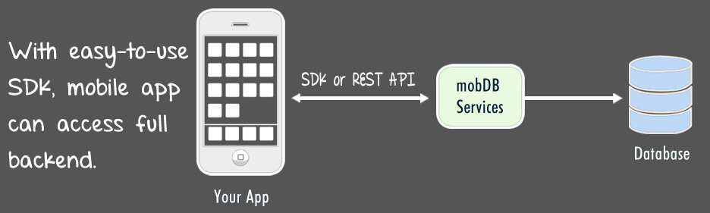
mobDB - What is it?

Slide 19
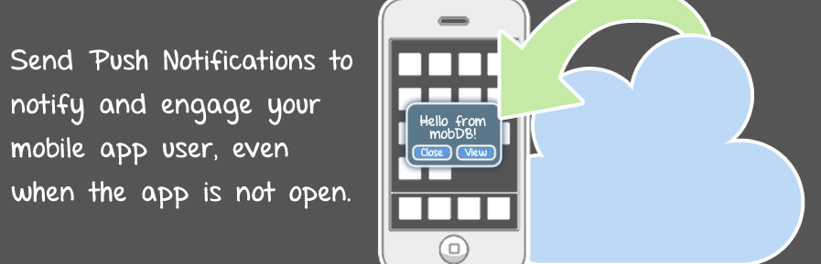
mobDB - What is it?

Slide 20
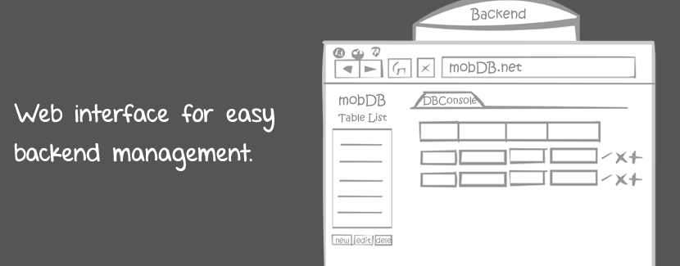
mobDB - What is it?

Slide 21
mobDB - Why use it?
mobDB uses Google Cloud Messaging for Android (GCM)
So, in addition to using mobDB as a database server, you can use it as a server for GCM

Slide 22
mobDB - Why use it?
Easy to view and manage your data
Relatively simple SDK, easy to use once you understand it
Returns data as JSON or as a HashMap (key-value pairs)

Slide 23
mobDB - Why stay away from it?
No explicit 1:M relationships
Can't do JOIN explicitly
Can't lose data integrity

Slide 24
mobDB - Why stay away from it?
See MobDbCodeExample.tar
See MobDbExample.tar
Download the SDK

Slide 25
MongoDB and MobDB
Pros
Easy to share data across devices
Many platforms/languages support JSON
No need to write server-side code for modifying the database
Cons
Less control over the data being returned to you
Disadvantages of using someone else's API
May not have primary-key / foreign-key concept
No complex relational queries (e.g. JOIN)
More ...

Slide 26
Creating your own Web API
If you already have a SQL database server setup, you can create an API for your data
Similar to the concept of ContentProviders, you can either create an API for yourself, or to allow external developers to use your data
Some companies create APIs and use them internally for development

Slide 27
Creating your own Web API
Let's say you have a server, which hosts a very valuable database
That is, the community sees your data as a money-maker
Server
VeryValuableTable

Slide 28
Creating your own Web API
e.g. VeryValuableDatabase
VeryValuableTable
id | fname | lname | email | password
1 | Martin | Brown | mbrown@cs.fsu.edu | *(&^==*&^%
2 | Abe | Lincoln | linc@zelda.com | @^&$((4
Server
VeryValuableTable

Slide 29
Creating your own Web API
Create a file on your server, e.g. api.php
Construct a query from the arguments to api.php, e.g.
HTTP GET www.mysite.com/api.php?id=1
SELECT fname, lname from VeryValuableTable
WHERE id = 1
return the data in JSON format
Example custom api
return all users
return user with id = 3

Slide 30
Creating your own Web API
That's the basic idea
Your API may also allow HTTP POST/PUT/DELETE
There's a lot more to consider when creating a Web API
security
developer registration / API keys
Web API Architecture
documentation for your API users
service for your API users
etc ...

Slide 31
Creating your own Web API
Creating a REST API with PHP
REST APIs
RESTful

Slide 32
Web API Consumer versus Provider
Using an existing Web API
No need for a server
Don't have to write server-side code
Quicker way to communicate over the Internet
Platform independent because of XML/JSON
Creating your own Web API
Full control over the data (you write the SQL queries)
You can use your existing relational database for other purposes
Data integrity
This may be the way to go if you already have a sophisticated relational DB up and running
May be a money-maker

Slide 33
Web API Consumer versus Provider
Using an existing Web API
API may have bugs, which you cannot fix
API may be discontinued
face.com
x-stream.ly
Imagine if you were using the MySpace API in 2004!
Terms of service may change
Google Translate used to be free!
Creating your own Web API
Need for maintenance / bug fixes
Time consuming
Have to really consider the cost

Slide 34
Communicating via the Internet
MobDB / MongoDB /
Custom Server
Client A
Send JSON
Read JSON
Client B
Read JSON
Send JSON

Slide 35
API Management Services
"When launching and managing your API, many companies choose to do all the work themselves, unaware that are service providers available to help you plan, deploy, launch and manage your API infrastructure and ecosystem"
Source

Slide 36
Mashups
A web mashup is a web page or application that combines data from two or more external online sources

Slide 37

Mashups
A mashup is an application that combines multiple APIs to create a new service

Slide 38
Mashups
A mashup is an application that combines multiple APIs to create a new service
+

Slide 39

Mashups
A mashup is an application that combines multiple APIs to create a new service
+

Slide 40
Mashups
A mashup is an application that combines multiple APIs to create a new service
+
=

Slide 41
Mashups
A mashup is an application that combines multiple APIs to create a new service
+
=
?

Slide 42

Mashups
A mashup is an application that combines multiple APIs to create a new service
+
=

Slide 43
Mashups
geoGreeting is pretty cool

Slide 44
Mashups
Mashups weren't doing too well back in 2007
Don't seem to be doing too well today either

Slide 45
programmableWeb.com
API Directory
Mashup Directory

Slide 46
Some other Interesting Web APIs
Movie Information
The Movie Database
The IMDB Api
Music Information
last.fm
Sports
ESPN

Slide 47
Gamification
Google Tech Talk on Gamification by Sebastian Detering
Why I Quit Playing FourSquare by Arsenio Santos

