Slide 1
Mobile Programming
Lecture 16
The Facebook API

Slide 2
Agenda
The Setup
Hello, Facebook User
Facebook Permissions
Access Token
Logging Out
Graph API

Slide 3
Facebook - The Setup
Before you can use the Facebook API for Android, you need to create and register an app with Facebook
You also need to have Facebook for Android installed on your device
Note your App ID

Slide 4
Facebook - The Setup
Now you need to download the Facebook SDK for Android
Do this using git:
git clone https://github.com/facebook/facebook-android-sdk.git

Slide 5
Facebook - The Setup
Import the Facebook SDK into your Eclipse workspace and add it as a library project for your main project.
Please follow the instructions on this link:
http://developers.facebook.com/docs/getting-started/facebook-sdk-for-android/3.0/
You need to generate a hashkey: HashKey + packageName → App ID.
keytool -exportcert -alias androiddebugkey -keystore ~/.android/debug.keystore | openssl sha1 -binary | openssl base64

Slide 6
Facebook - The Setup
Now go ahead and create your own project
Right click on your project > Properties
Select Android
In the Library pane, select Add ...
Navigate to the facebook project and select it
Click OK
Add Internet Permissions to your project

Slide 7
Facebook - The Setup
You must add the activity into your app
Com.facebook.LoginActivity.
<meta-data
Android:name=“com.facebook.sdk.ApplicationId”
Android:value=“@string/facebookAppId”/>

Slide 8
Hello, Facebook User
import com.facebook.*;
import com.facebook.model.*;
@Override public void onCreate(Bundle savedInstanceState) { super.onCreate(savedInstanceState); setContentView(R.layout.main);
Session.openActiveSession(this, true, new Session.StatusCallback(){
@Override
public void call(Session session, SessionState state, Exception exception){
if(session.isOpened()){ //do something}
}
} }

Slide 9
Hello, Facebook User
You must override onActivityResult method
@Override public void onActivityResult(int requestCode, int resultCode, Intent data) { super.onActivityResult(requestCode, resultCode, data); Session.getActiveSession().onActivityResult(this, requestCode, resultCode, data);
}

Slide 10
Hello, Facebook User
Request.executeMeRequestAsync(session, new Request.GraphUserCallback()
{
@Override
public void onCompleted(GraphUser user, Response response)
{
if( user != null)
{
tv_user = (TextView) findViewById(R.id.user);
user_tv.setText( user.getName() );
}
}
}

Slide 11
Hello, Facebook User
Now we can try to get the user's basic information
We can get things like the user's name, birthday, email address, etc
Facebook provides some general basic information without having to ask the user for permission

Slide 12
Accessing Friends’ Data
Accessing the user's data is done using the Facebook Graph API, which should have been installed along with the Facebook API
This is similar to how we were able to get the user's basic information such as their first and last name

Slide 13
Accessing Data
Request.executeMyFriendsRequestAsync(session, new Request.GraphUserListCallback(){
@Override void onCompleted(List<GraphUser> users, Response response){
TextView friendNum_tv = (TextView) findViewById(R.id.user);
friendNum_tv.setText(“You have ” + users.size() + “ friends on facebook”);
}
}
});

Slide 14
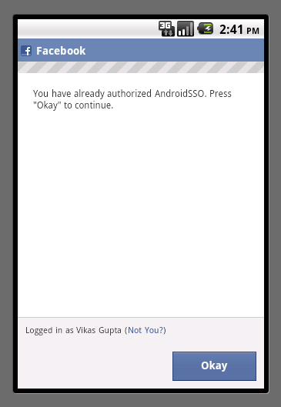
Access Token
At some point, the user may want to log out of your app, or you may want to log the user out of your app
If the user tries to login to your app after being logged out, they don't need to grant permissions again.
They will be logged in automatically because the token is still valid.

Slide 15
Access Token
We need to use the Facebook access token to check whether the user is already logged in
You can save the token in a sharedPreference right before you exit your app.
When you launch your app again later, you can check if the token is still valid.
If the saved token is valid, you will be logged in automatically.
Otherwise, you need log in again.

Slide 16
Access Token
There are many facebook related methods, you can learn those methods following the link:
http://developers.facebook.com/docs/reference/android/3.0/

Slide 17
References
Facebook Developers

