Slide 1
Data Persistence in Android

Slide 2
Content
Overview
Preferences
Using files
Using databases
Network connection

Slide 3
Storage Options
Android provides several storage options for
Private data
Public data
Depends on space requires
.

Slide 4
Data Storage options
Shared Preferences
Store private primitive data in key-value pairs.
Files
Store private data on the device memory.
Store public data on the shared external storage.
SQLite Databases
Store structured data in a private database.
Network Connection
Store data on the web with your own network server.

Slide 5
Shared Preferences object
It provides general framework for saving and retrieving
To get Shared Preferences, use
getSharedPreferences(String name) Use if you need multiple preference ﬁles (identiﬁed by name)
getPreferences()
Use if only one preferences ﬁle is needed
To write values, call edit() to get
SharedPreferences.Editor to be used when adding values to ﬁle

Slide 6
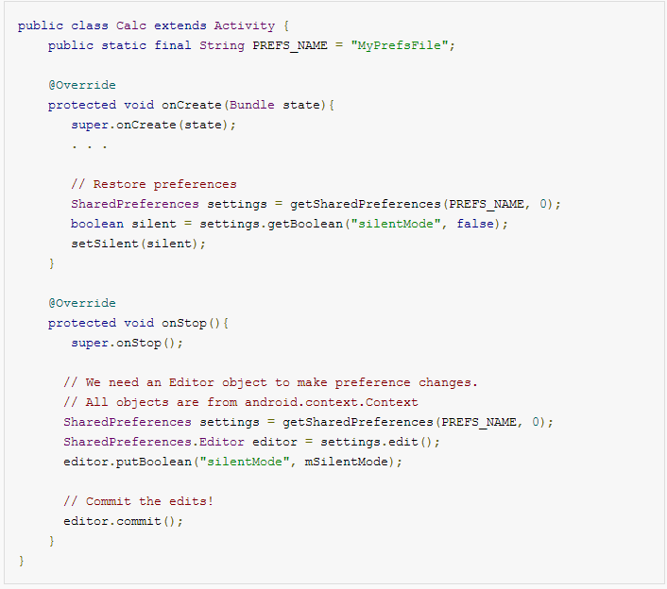
Shared Preferences

Slide 7
Files
Its possible to store ﬁles on the mobile device or on a removable storage
Current application folder only. Exception throws otherwise
Modes: MODE_PRIVATE, MODE_WORLD_READABLE, MODE_WORLD_WRITABLE .
Reading
– openFileInput()
Writing
– openFileOutput()
Standard Java streams after that

Slide 8
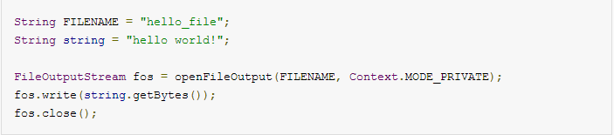
Files

Slide 9
SQLite Database
Android Provides full support for SQLite
To create a new SQLite database
create a subclass of SQLiteOpenHelper
override the onCreate() method,
execute a SQLite command to create tables in the database.

Slide 10
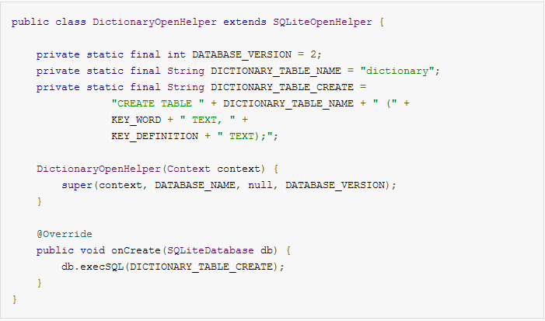
SQLiteOpenHelper

Slide 11
Sqlite Database
Database communication
call getWritableDatabase()
getReadableDatabase()
It returns a SQLiteDatabase object for SQLite operations.

Slide 12
SQLite Database query()
Use to execute SQLite queries,
Every SQLite query returns a Cursor
Cursor used to hold query result and read rows and columns.
Cursor points to all the rows found by the query.

Slide 13
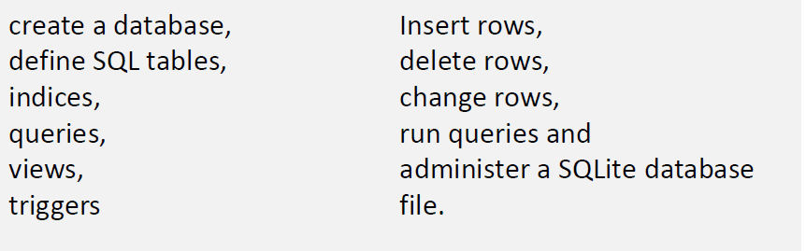
Querys

Slide 14

Create SQLite database
Open the database according to the flags OPEN_READWRITE,OPEN_READONLY CREATE_IF_NECESSARY .
Sets the locale of the database to the system's current locale.
Parameters
path to database file to open and/or create
Factory an optional factory class that is called to instantiate a cursor when
query is called, or null for default
Flags to control database access mode
Returns the newly opened database
Throws SQLite Exception if the database cannot be opened

Slide 15
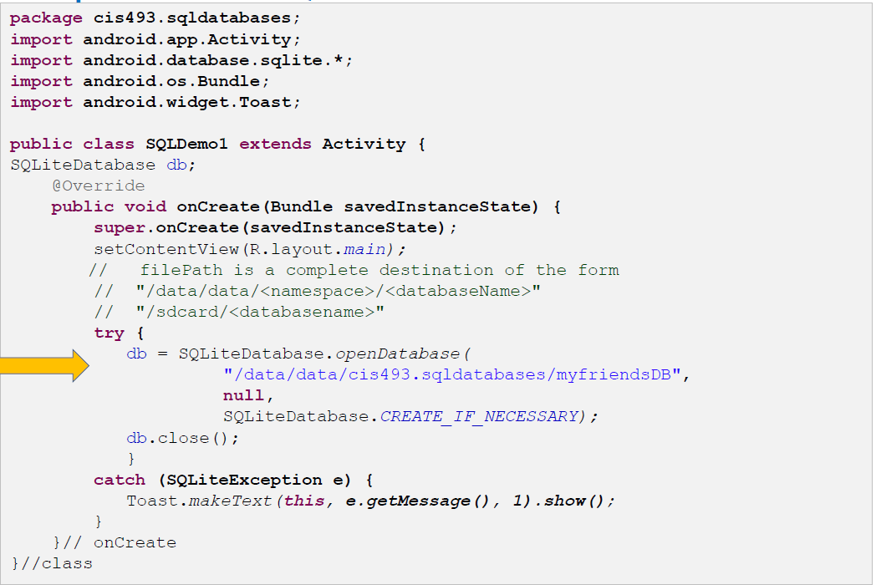
Create SQLite databse

Slide 16
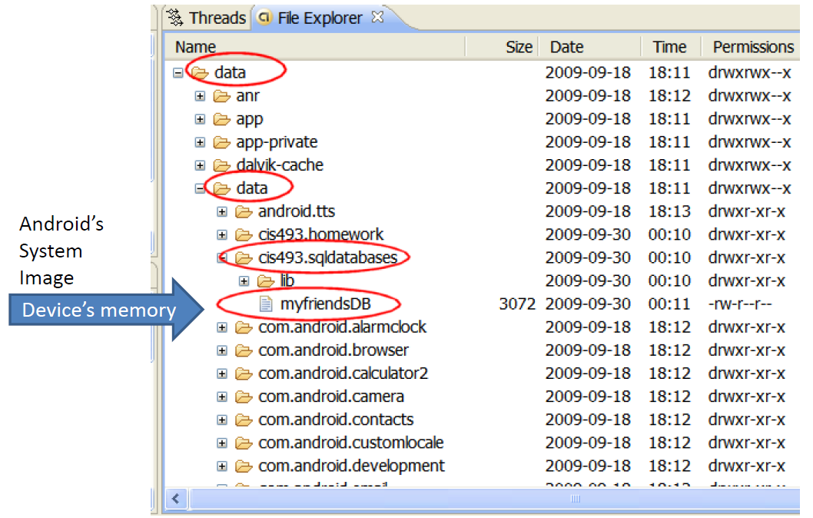
Create SQLite databse

Slide 17
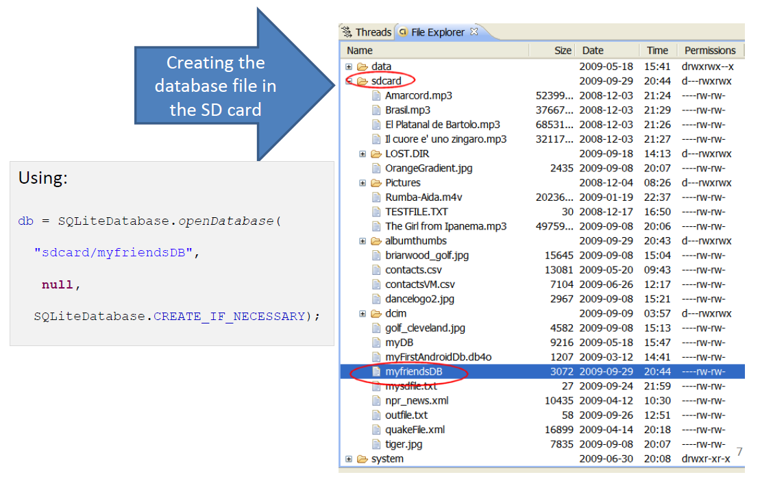
Create SQLite databse

Slide 18
warning
Beware of sharing issues.
can not access other people’s database resources
(instead use Content Providers or SD resident DBs).
An SD resident database requires the Manifest to include:

Slide 19
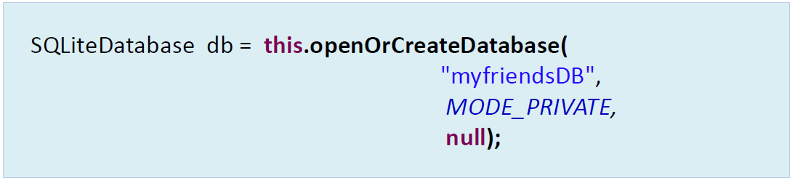
Method 2 SQLITE database
where Default storage location in the devices ram is: "/data/data/<CURRENT_namespace>/databases/".
“/data/data/cis493.sql1/databases/myfriendsDB”.
Namespace
Database

Slide 20
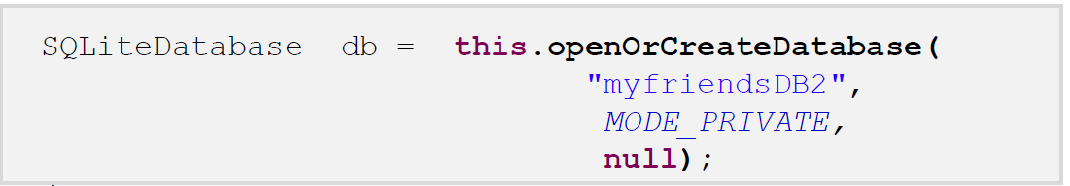
Open database
Where:
“myFriendsDB2”is the abbreviated file path.
The prefix is assigned by Android as: /data/data/<appnamespace>/databases/myFriendsDB2.
2. MODE could be: MODE_PRIVATE, MODE_WORLD_READABLE, and MODE_WORLD_WRITEABLE.
Meaningful for apps consisting of multiples activities.
3.Null refers to optional factory class parameter

Slide 21
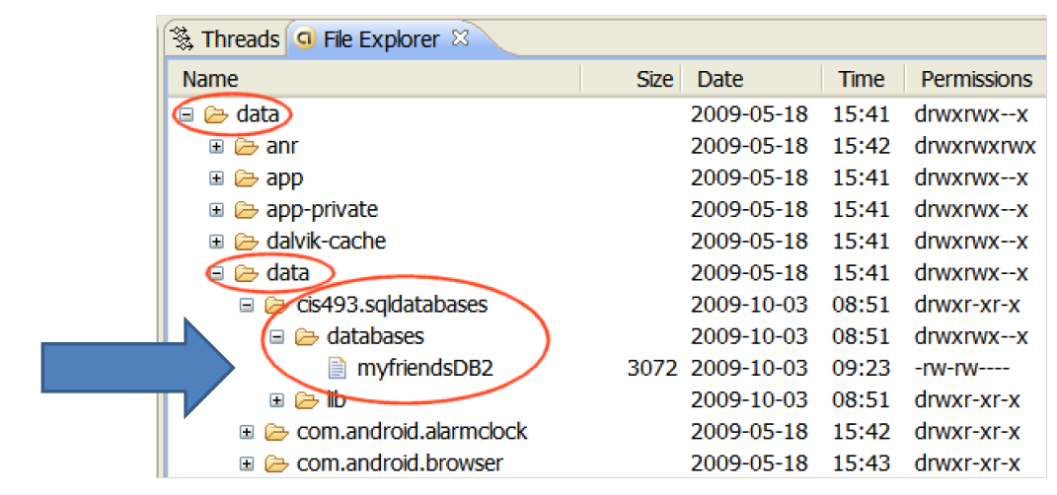

Slide 22
Inserting Data
Content Values are key/value pairs that are used
when inserting/updating databases
Each Content Value object corresponds to one row in a table
ContentValues newValues = new ContentValues();
newValues.put("author", “xyz");
newValues.put("joke", "This is a joke");
myDb.insert("jokeTable",null,newValues);

Slide 23
Updating Data
ContentValues updatedValues = new ContentValues();
updatedValues.put("joke", "This is a better joke");
myDb.update("jokeTable", updatedValues, "author=‘xyz'", //where clause
null); //whereArgs

Slide 24
Querying Data with query()
Cursor jokes = myDb.query("jokeTable",
null, //columns
null, //where clause
null, //args if ? in where clause
null, //groupBy
null, //having
null); //orderBy
if (jokes.moveToFirst()) {
do {
String author = jokes.getString(1);
String joke = jokes.getString(2);
((TextView)findViewById(R.id.hello)).setText(author +
": " + joke);
} while(jokes.moveToNext());
}

Slide 25
Other Cursor Functions
moveToPrevious
getCount
getColumnIndexOrThrow
getColumnName
getColumnNames
moveToPosition
getPosition

Slide 26
Deleting Data
myDb.delete("jokeTable“, "author='David Janzen'“, null);

