Slide 1
Octave
http://www.octave.org/
Daniel Sangorrin
@daromart
http://sangorrin.blogspot.com

Slide 2
Octave
The open-source version of Matlab®
  Good documentation.
  Easier than Python/Numpy, Lua/Torch or R.
Good for investigating and studying
  Bioinformatics, Math, Machine learning, DSP...

Slide 3
What's new
Octave 4.x
  Finally a good default GUI
  Matlab compatibility improved
Cloud app
  http://octave-online.net/

Slide 4
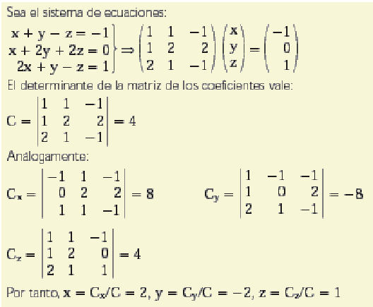
Ex: solving system of equations

Slide 5
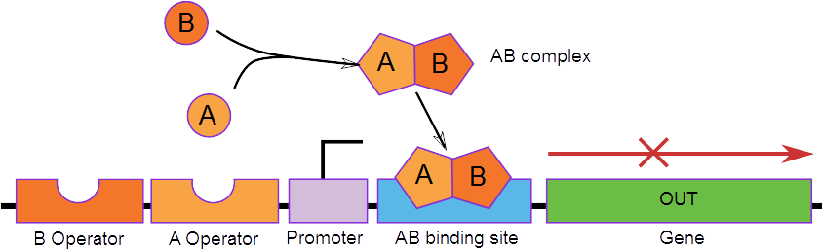
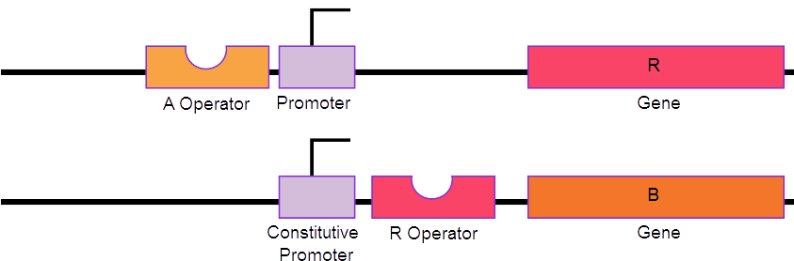
Synthetic biology: genetic circuit

Slide 6
Synthetic biology: math model

Slide 7
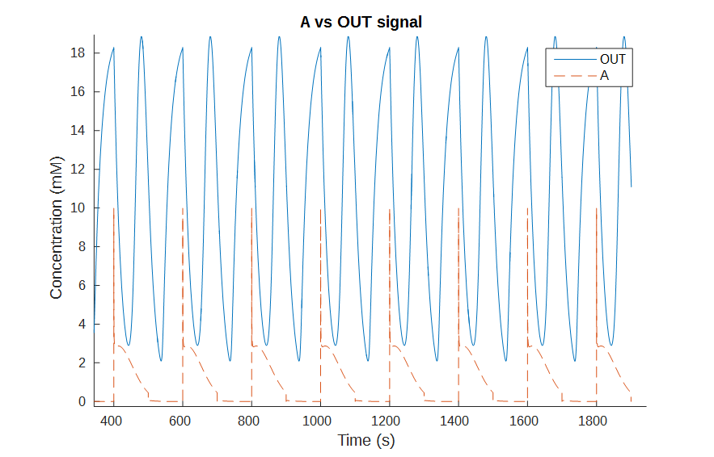
Synthetic biology: simulation

Slide 8
References
http://srl.informatik.uni-freiburg.de/teachingdir/ws13/slides/02-OctaveMatlabTutorial.pdf
http://www.hpc.lsu.edu/training/weekly-materials/2013-Spring/Octave-Spring2013.pdf
http://www.gnu.org/software/octave/doc/interpreter/
http://www.mathworks.com/help/matlab/

