Slide 1
A software that suggests drugs and formulations for a disease/pharmacological property based on the Ayurvedie classical books/Repositories.
PIP2001 Capstone Project
Review-0
Batch Number: PSCS-70
Under the Supervision of,
Dr. Sudha.P –Assistant Professor-SCSE
Presidency University
Roll Number | Student Name
20211COM0080 | Akash.K.A
20211COM0081 | Sanjana.B.K
20211COM0088 20211COM0092 | Chanchak.K Thejaswini.G.K
Name of the Program: Computer Engineering
Name of the HoD: Dr. GopalKrishna Shyam
Name of the Program Project Coordinator: Dr. Sudha.P
Name of the School Project Coordinators: Dr. Sampath A K / Dr. Abdul Khadar A / Mr. Md Ziaur Rahman

Slide 2
Content
Problem Statement
Analysis of Problem Statement
Timeline of the Project
References

Slide 3
Problem Statement Number:
Organization: Difficulty Level: Complex
Category (Hardware / Software / Both) : Software
Problem Description: Ayurveda has a large database of single herbs, minerals, and formulations that have been tailormade to suit each individual, his/her psychosomatic constitution, clinical condition, comorbidities, age, region, etc. These data are spread over more than 150 texts, amidst manuscripts in multiple languages and scripts. With the rise of transcriptional and translational facilities, several traditional medicinal texts are now available in their digitized forms. But for an Ayurvedic student or practitioner, exploring this multitude of literature for identifying their ""drug of choice' often becomes tedious and impractical. Here is the need of a custom software that can identify the apt formulation that has been designed to treat a constellation of symptoms and present it to the student/practitioner along with its reference and other desired properties. For example, the two formulations Punarnavadi Kashaya and Vyaghryadi Kashaya are mentioned in texts as follows: Both these are decoctions advised in Jvara (fever) and Kasa (cough). But in a patient with upper respiratory tract infections like common cold (Pinasa), Vyaghryadi would suit better than Punarnavadi. Whereas in a condition associated with inflammatory changes all over the body, I Punarnavadi would be the appropriate choice. The objective of the proposed software is to identify the single drugs and formulations that suit a set of symptoms. Certain ingredients (eg. jaggery) are unsuitable for certain categories of patients (e.g. diabetics). There are also medicine mediums that are unsuitable for specific discases (c.g. fermented/alcoholic preparations in diabetes). Such information is also expected to be conveyed to the learner or practitioner who uses the software. The same discase has been mentioned in different names (E.g. Jvara and Santapa for fever) and the same word has been used to denote different (Eg. Abhaya generally means Terminalia chebula but in the context o!Jatyadi ghrita, it means Vetiveria zizanioides. The multiple names of same diseases are expected to be included in the tags of each formulation. The sources for the formulations, and synonyms and similar words have been included in the data section. It is also desirable to include the Ayurvedic pharmacological properties of the single drugs, and the compound formulation (called Rasa, Guna, Virya, Vipaka, etc.)as and where available.

Slide 4
Analysis of Problem Statement
Technology Stack Components:
Frontend:
Technology Stack:
• Programming Language: Java
• UI Framework: XML (for layouts)
• Networking Library: Retrofit (for API calls)
• Local Database: Room Database (SQLite)
• IDE: Android Studio (Latest Version)
• State Management: LiveData & ViewModel (MVVM Architecture)

Slide 5
Analysis of Problem Statement
Technology Stack Components:
Frontend:
UI Components:
1. Login/Signup Screen
• Firebase Authentication (Email/Google Sign-In)
• EditText for Email/Password
• Button for Login/Signup
2. Home Screen
• Search bar (EditText + RecyclerView)
• Dropdown (Spinner) for filtering symptoms
3. Drug Recommendation Screen
• RecyclerView for listing recommendations
• CardView displaying Ayurvedic drug name, ingredients, and usage
4. Details Page
• Displays complete information (Rasa, Guna, Virya, Vipaka, usage)
• Scrollable TextView
5. Favorites & History
• ListView/RecyclerView for saved drugs
• Room Database for offline storage
6. Settings Page
• User preferences (e.g., dark mode)

Slide 6
Analysis of Problem Statement (contd...)
Backend:
Backend Frameworks:
•⁠ Technology Stack:
• Database: Firebase Firestore (Recommended) or MySQL
• API Development: Node.js (Express.js) or Firebase Functions
• Authentication: Firebase Authentication (Google/Email)
• Storage: Firebase Storage (for images/documents)

Slide 7
Analysis of Problem Statement (contd...)
Software requirements:
1.⁠ ⁠Operating System Requirements
• Windows 10/11, macOS, or Linux
2.⁠ ⁠Development Tools
• Android Studio (Latest Version)
• JDK (Java Development Kit) 11 or above
• Gradle (Built into Android Studio)
3.⁠ ⁠Programming Language
• Java
4.⁠ ⁠Database / Data Storage
• JSON (stored locally in assets folder) or XML

Slide 8
Analysis of Problem Statement (contd...)
Software requirements:
5.⁠ ⁠Android Device Requirements
• Minimum API Level: Android 5.0 (Lollipop) – API 21
• Recommended API Level: Android 8.0 (Oreo) and above
6.⁠ ⁠Libraries & Dependencies
• Gson for JSON parsing (com.google.code.gson:gson:2.8.9)
• RecyclerView for displaying results
• Material Components for UI (com.google.android.material:material:1.6.0)
7.⁠ ⁠Testing Tools
• Android Emulator
• JUnit for unit testing
• Espresso for UI testing

Slide 9
Analysis of Problem Statement (contd...)
Core Objectives
1.⁠ ⁠Knowledge Extraction & Structuring
Digitize and structure data from classical Ayurvedic texts like Charaka Samhita, Sushruta Samhita, and other repositories.
Categorize information based on diseases (Vyadhi), doshas, pharmacological properties (Rasa, Guna, Virya, Vipaka, Prabhava), and formulations (Yoga, Kalpana).
2.⁠ ⁠Intelligent Search & Recommendation Engine
Provide AI-powered search for disease names, symptoms, and pharmacological properties.
Suggest single herbs (Dravyas) and formulations (Yogas) based on classical references.
Offer personalized recommendations based on dosha type and patient-specific parameters.
3.⁠ ⁠Text-Based & Natural Language Processing (NLP) Support
Enable keyword-based and NLP-based search for users to enter symptoms or disease names in Sanskrit, Hindi, or English.
Extract insights from textual descriptions in classical books.

Slide 10
Analysis of Problem Statement (contd...)
Core Objectives
4.⁠ ⁠Standardization & Cross-Referencing
Map classical Ayurvedic terms to modern medical terminologies (ICD codes, botanical names, pharmacological actions).
Cross-reference with existing Ayurvedic pharmacopoeia and modern scientific research.
5.⁠ ⁠Customization for Practitioners & Researchers
Allow Ayurveda practitioners to filter recommendations based on Prakriti, Dosha, Srotas, and Bala.
Provide researchers with a comparative study of classical and modern pharmacological insights.
6.⁠ ⁠User-Friendly Interface & Accessibility
Develop a mobile and web application with an intuitive UI for practitioners, students, and researchers.
Support multi-language access (Sanskrit, Hindi, English).

Slide 11
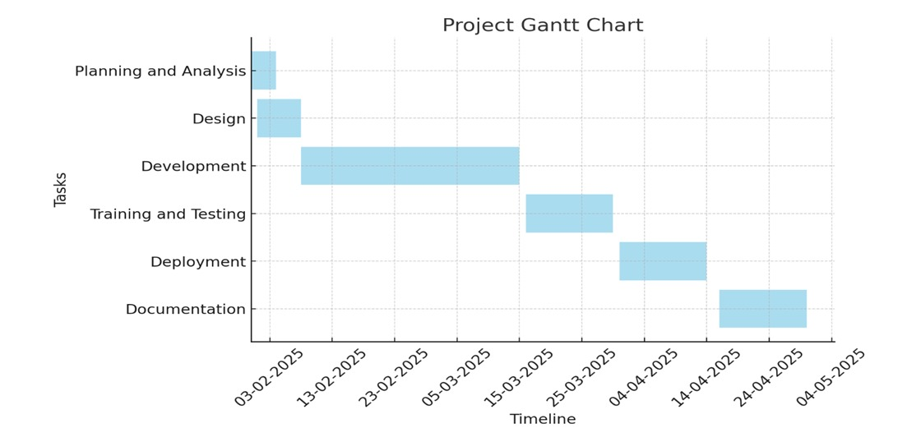
Timeline of the Project (Gantt Chart)

Slide 12
References (IEEE Paper format)
Add APA Citation for all references.
Use the below link for various APA styles :
https://www.indeed.com/career-advice/career-development/how-to-cite-a-research-paper
https://www.academia.edu/download/74085980/AGRIBAZAAR_A_VIRTUAL_TRADING_PLACE_FOR_F20211102-22413-uw5hba.pdf

Slide 13


