Slide 1
A Software that suggests drugs and formulation for a disease/pharmacological property based on the Ayurvedic classical books/Repositories.
PIP2001 Capstone Project
Review-1
Batch Number: COM5
Under the Supervision of,
Dr. Sudha P
Associate Professor
School of Computer Science and Engineering
Presidency University
Roll Number | Student Name
20211com0080 | Sanjana B K
20211com0081 | Akash K A
20211com0088 | Chanchal K
20211com0092 | Thejaswini G K
Name of the Program: Computer Engineering
Name of the HoD: Dr. Gopal Krishna Shyam
Name of the Program Project Coordinator: Dr. Sudha P
Name of the School Project Coordinators: Dr. Sampath A K / Dr. Abdul Khadar A / Mr. Md Ziaur Rahman

Slide 2
Introduction
Our software is an intelligent platform that suggests Ayurvedic drugs and formulations based on classical texts like Charaka Samhita, Sushruta Samhita, and Ashtanga Hridaya. By leveraging a structured database and advanced search algorithms, it provides precise recommendations for diseases and pharmacological properties, making Ayurvedic knowledge more accessible to practitioners and researchers.

Slide 3
Existing method Drawback
Lack of Real-Time Updates – New Ayurvedic discoveries and research cannot be integrated without dynamic updates, limiting the app's accuracy and relevance.
No Personalized Diagnosis – Ayurvedic treatment is highly individualized based on Prakriti (body constitution) and medical history. The app’s generic symptom-based recommendations may not be effective for all users.
No Cloud Integration – The app cannot sync with expert databases or leverage collaborative learning without cloud support, reducing its credibility and adaptability.
Potential for Misinterpretation – Users without Ayurvedic knowledge may misinterpret recommendations, leading to incorrect self-medication, which can be risky.
No Direct Practitioner Consultation – Users lack access to professional guidance, which is crucial for complex conditions requiring expert intervention.

Slide 4
Literature Review
Intelligent Ayurvedic Formulation Recommendation System.
A Tool for Suggesting Ayurvedic Remedies from Curated and Classified Clinical Trial Reports.
Exploring Ayurvedic Medicine Recommendation Using Machine Learning Techniques.
Web Application for Recommendation of Ayurvedic Drugs and Medicine using ML.

Slide 5
Proposed Method
1. Data Collection & StructuringThe app gathers data from Ayurvedic texts, research papers, and authentic sources. Data is stored in XML form within like Rasa, Guna, Virya, and Vipaka. It maps many names of one disease for accuracy. Age and contraindications specific to patients are also considered, with classical text references for validation.
2. Symptom-Based Search AlgorithmSymptoms are mapped with the best Ayurvedic medicines by synonym mapping using the search algorithm. It subsequently filters against symptoms, patient status, and contraindications (e.g., removal of alcohol-based medicines for diabetics). Final recommendations are ranked based on relevance and safety.
3. Android Application DevelopmentThe app's interface is built using XML and the backend using Java in Android Studio. Storage of data is carried out in the app using XML. Users can input symptoms or choose from a list to receive personalized formulation recommendations, as well as information and references. The app also warns users of contraindications against their health status.
4. User Experience & TestingThe app is simple and convenient to operate and use for students and practitioners. It is tested, validated, and used within real-world applications to yield accuracy. The algorithm and interface are fine-tuned on the basis of feedback from users, and it is a trustworthy tool for Ayurvedic drug recommendations.

Slide 6
Objectives
1.Develop a Comprehensive Ayurvedic Database:
•Collect and structure data from authentic Ayurvedic texts, research papers, and classical sources.
•Store information in XML format, categorizing it based on key Ayurvedic principles (Rasa, Guna, Virya, Vipaka).
2.Implement a Symptom-Based Search Algorithm
•Design an intelligent algorithm that maps user-inputted symptoms to Ayurvedic formulatio
•Filter medicines based on contraindications and patient-specific factors (e.g., age, diabetes, pregnancy).
•Rank recommendations based on relevance and safety.
3.Develop an Android Application
•Build a user-friendly app using XML for UI design and Java for backend development in Android Studio.
•Enable users to input symptoms or select from a predefined list for personalized recommendations.

Slide 7
Methodology/Modules
Data Collection & Preprocessing Relevant data is gathered from Ayurvedic texts and research papers. Information includes herbs, formulations, symptoms, synonyms, and contraindications. Data is structured in JSON/XML for easy storage and retrieval. Synonyms for diseases and symptoms are mapped for accurate search results.
2. Symptom-Based Search Algorithm DevelopmentA search algorithm is created to match symptoms with the best Ayurvedic formulations.
3. Android Application DevelopmentThe app is built using Android Studio, with Java/Kotlin for backend logic and XML for UI design. Users can enter symptoms manually or select from a list. The app suggests formulations with details, references, and alerts for contraindications.
4. User Interface & Experience EnhancementThe UI is designed to be simple and easy to use. Large buttons, readable fonts, and a clear layout ensure accessibility for students and practitioners. The app minimizes steps to access information quickly.
5. Testing & ValidationThe app undergoes:Unit Testing: Checks individual features.Expert Validation: Ayurvedic practitioners review recommendations.
6. Deployment & Future ImprovementsThe app is launched for real-world use. Future updates may expand the database, improve accuracy, add voice input, and enable cloud-based updates for better data management.

Slide 8
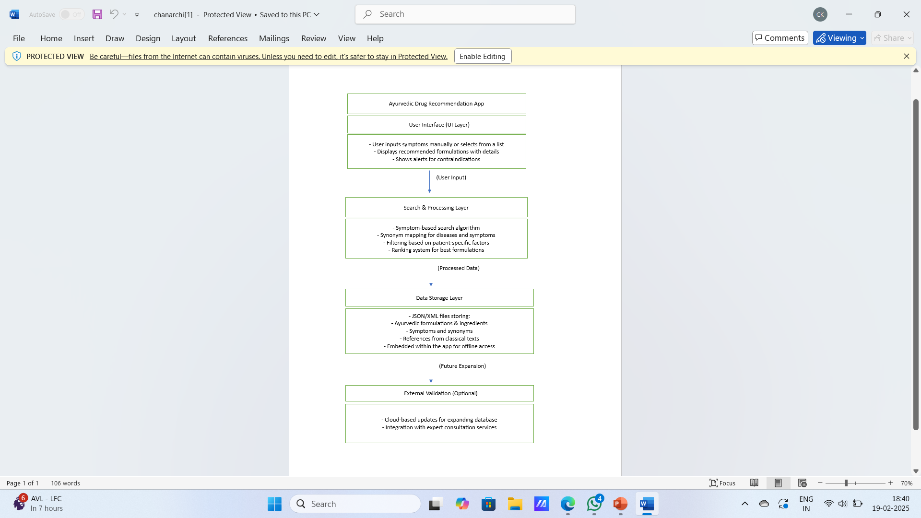
Architecture

Slide 9
Hardware/software components
HARDWARE :
-Development Hardware:
Laptop/Desktop (For Development & Testing)
Processor: Intel i5/i7 (or AMD equivalent) or higher
RAM: Minimum 8GB (Recommended 16GB for better performance)
Storage: Minimum 256GB SSD (Recommended 512GB SSD for faster performance)
Operating System: Windows 10/11, macOS, or LinuxGraphics Card: Integrated or dedicated (Optional, for better performance)Testing Hardware:Android Smartphone (For App Testing)
-Minimum Android Version:
Android 5.0 (Lollipop) – API Level 21Recommended Android Version: Android 8.0 (Oreo) and above
RAM: Minimum 3GB (Recommended 4GB or higher for smooth performance)
Storage: Minimum 32GB (Recommended 64GB or higher)
Android Emulator (For Virtual Testing)
-Runs on development machine (Laptop/Desktop) within Android StudioServer/Backend Requirements (If Hosted On-Premises Instead of Cloud):Server (For Hosting Database & API) (Optional, if not using Firebase Cloud)Processor: Intel Xeon / AMD EPYC or equivalentRAM: Minimum 16GB (Recommended 32GB or higher)Storage: Minimum 500GB SSD (Recommended 1TB SSD for better performance)Internet Connection: High-speed connection for API communication

Slide 10
Hardware/software components
SOFTWARE:
Development Tools & IDE
•Android Studio (Latest version) – Official IDE for Android development
•Java Development Kit (JDK) – Required for Java-based development
•Gradle – Build automation tool for managing dependencies
•XML – Used for UI design and data storage
•Git/GitHub (Optional) – For version control and collaboration
2. Database & Storage
•SQLite (For local storage within the app)
•Firebase Firestore (Optional) – If cloud-based storage is needed
•XML Files – For storing Ayurvedic formulations, synonyms, and properties
3. Backend & API (If Required)
•Node.js / Python (Flask or Django) – If a separate backend is used for processing

Slide 11
Hardware/software components
SOFTWARE:
4. Testing & Debugging Tools
•Android Emulator (Built-in Android Studio) – For virtual testing
•Physical Android Device (Android 5.0 and above) – For real-device testing
•Logcat & Debugger (Android Studio) – For identifying and fixing errors
5. Design & Documentation Tools
•Figma / Adobe XD – For UI/UX design (Optional)
•Microsoft Word / Google Docs – For documentation
•Draw.io / Lucidchart – For flowcharts and system diagrams

Slide 12
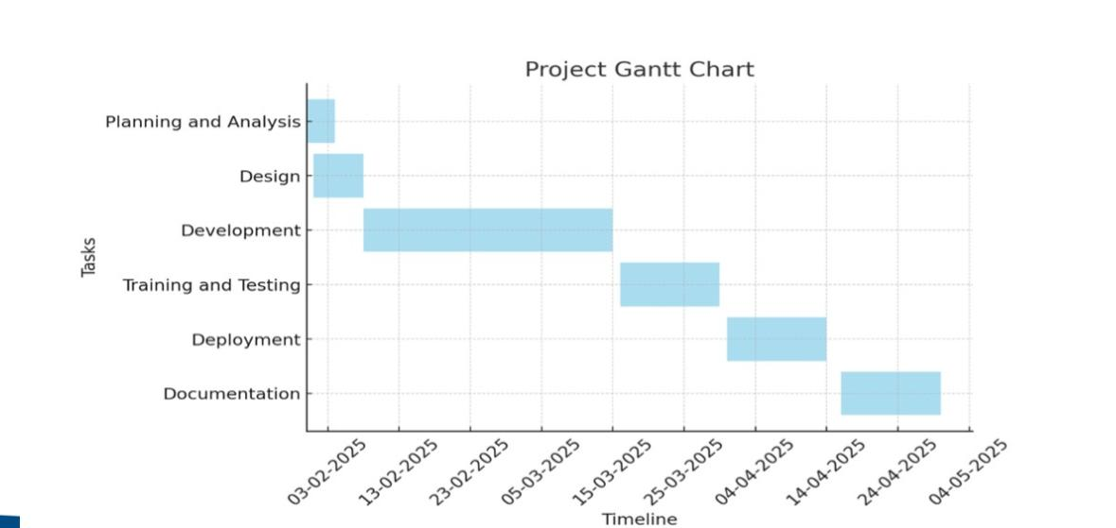
Timeline of Project

Slide 13
Expected Outcomes
– A software that suggests Ayurvedic drugs and formulations based on symptoms and disease conditions by referencing classical Ayurvedic texts.
-Personalized Recommendations – Provides tailored suggestions considering factors like patient-specific parameters (e.g., Prakriti, Dosha, and Bala) and contraindications.
-AI-Powered Search and NLP Support – Enables intelligent keyword and NLP-based searches in Sanskrit, Hindi, and English for disease names, symptoms, and pharmacological properties.
-Structured Ayurvedic Knowledge Base – Digitizes and categorizes Ayurvedic data from classical texts, making it easier for practitioners and students to access structured information.
-Standardization and Cross-Referencing – Maps Ayurvedic terms to modern medical terminologies (ICD codes, botanical names, pharmacological actions) and cross-references traditional formulations with scientific research.
-User-Friendly and Accessible Interface – A mobile and web application with an intuitive UI, supporting multi-language access to cater to students, researchers, and practitioners.
-Offline and Online Storage – Utilizes Firebase Firestore/MySQL for backend storage, along with Room Database for offline accessibility.
-Customization for Practitioners and Researchers – Allows filtering recommendations based on various Ayurvedic principles and enables comparative analysis of classical and modern insights.

Slide 14
Conclusion
In conclusion, our software serves as a valuable tool for Ayurvedic practitioners and researchers by offering precise drug and formulation recommendations based on classical texts. With its structured database and advanced search algorithms, it enhances accessibility to traditional Ayurvedic knowledge, ensuring accurate and efficient decision-making in clinical practice and research.

Slide 15
Github Link
The Github link provided should have public access permission.
Github Link

Slide 16

Project work mapping with SDG

Slide 17
Thank You

