Slide 1
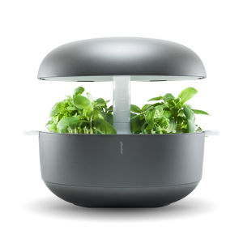
Smart
Garden
Group 1:
Report 1

Slide 2
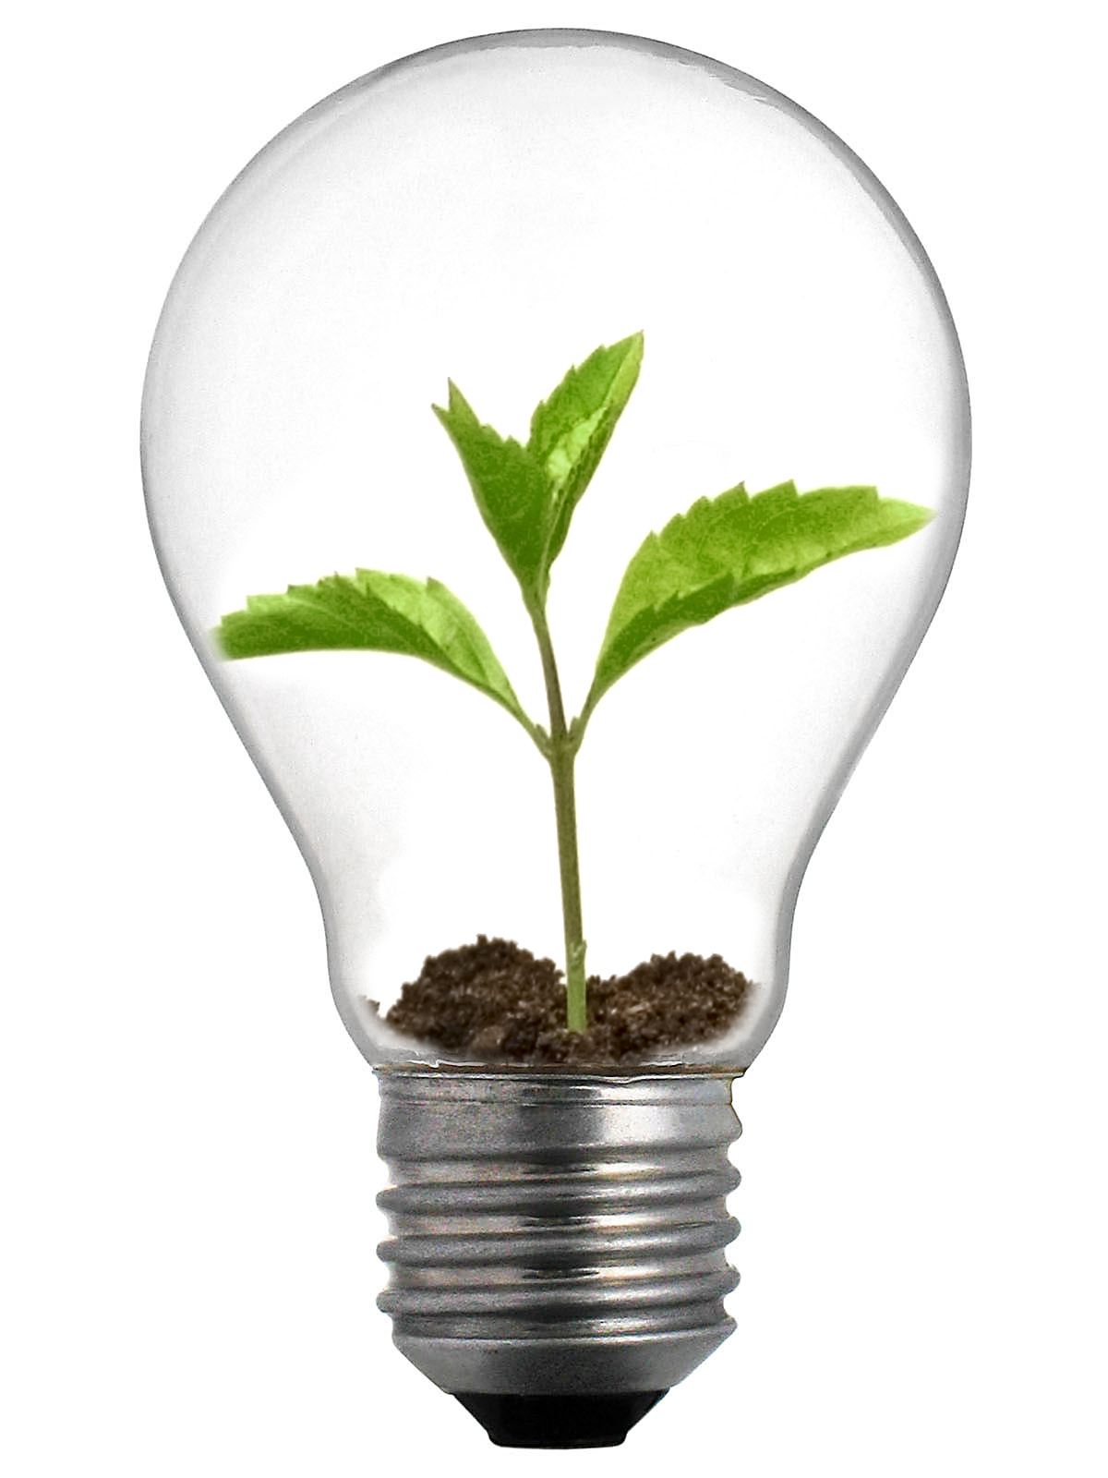
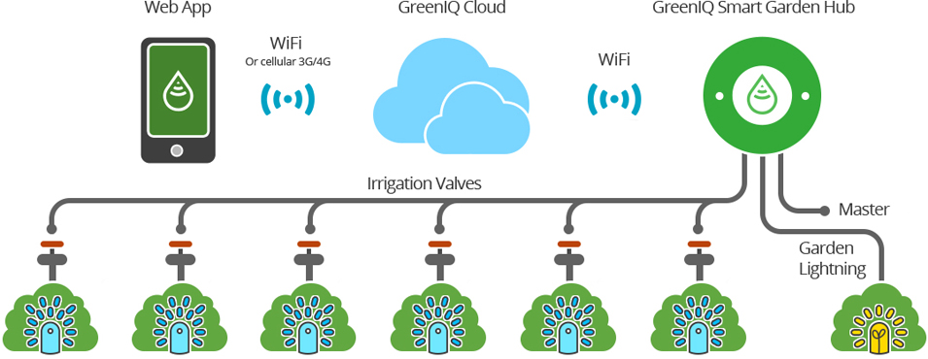
Introduction
Ideas????
Notes:
Nowadays, farming is absolutely vital for every society. However, land costs too much and farming make too little, its depend on spread of land. Besides that, people don’t have enough time to take care the plant and easy to forget the schedule about gardening. The actual situation is people don’t know when the most convenient time to watering or fertilize the plants, it is easy make the plants to die or waste the resource. This project can help farmer increase productivity even in a small land, reduce the water or fertilizer, helps plants to have a better life.

Slide 3
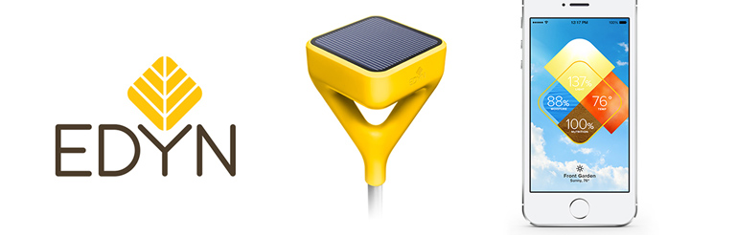
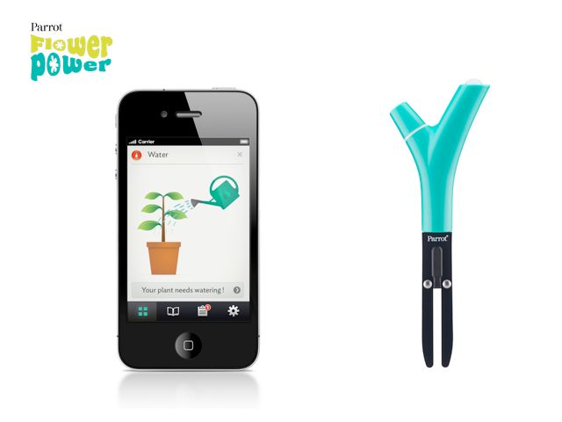

Current Situation
Edyn – Smart Garden System
Parrot Flower Power
Notes:
+ Edyn – Smart Garden System: They have 2 part which is Edyn Garden Sensor and Edyn Water Valve. Edyn Garden Sensor will track light, humidity, temperature, soil nutrition and moisture and cross-references collected data with plant, soil science, and weather databases to recommend which plants will thrive; monitors continuously and alerts users to changes that require immediate action. Edyn Water Valve automatically controls existing water system based on data collected by the Garden Sensor and adapts to changes in the weather forecast. Edyn app provides information on what plants that will grow best, the optimal time for planting, and even plant groupings with the same conditional needs. It can also be used to manually control the Edyn Water Valve. Advantage: Solar Powered, in addition to rechargeable lithium iron phosphate battery when not in full sun; Measures ambient temperature, humidity, light intensity and soil electrical conductivity. Many sensors are just in one device; Water and fertilizer resistant; Connects to the cloud.
+ Parrot Flower Power: collects a variety of plant-relevant data accurately and uses it in conjunction with its excellent database to make plant-specific recommendations. Advantage: Has a huge database about plant (7000 plants)

Slide 4
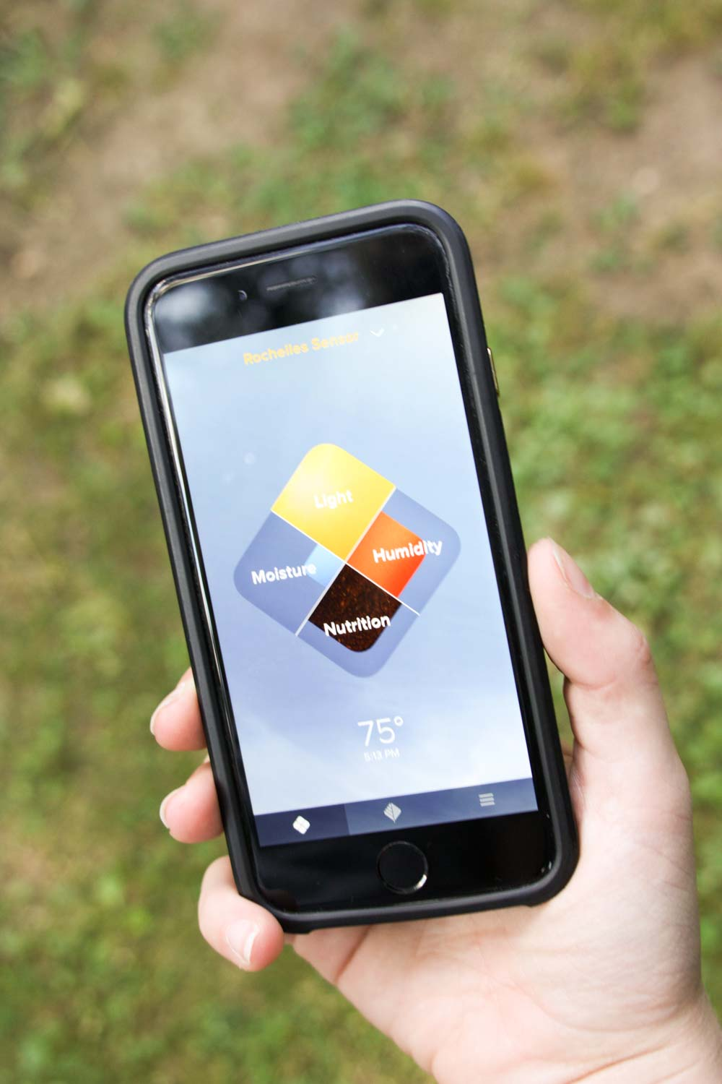
Problem Definition
Edyn – Smart Garden System
Wi-Fi network
a big problem if the garden has a large area
Notes:
Nowadays, farming is absolutely vital for every society. However, land costs too much and farming make too little, its depend on spread of land. Besides that, people don’t have enough time to take care the plant and easy to forget the schedule about gardening. The actual situation is people don’t know when the most convenient time to watering or fertilize the plants, it is easy make the plants to die or waste the resource. This project can help farmer increase productivity even in a small land, reduce the water or fertilizer, helps plants to have a better life.

Slide 5
Current Situation
Parrot Flower Power
device can only transmit data to a Bluetooth device
limiting ability to monitor your plant or get alerts on the go
Notes:
+ Edyn – Smart Garden System: They have 2 part which is Edyn Garden Sensor and Edyn Water Valve. Edyn Garden Sensor will track light, humidity, temperature, soil nutrition and moisture and cross-references collected data with plant, soil science, and weather databases to recommend which plants will thrive; monitors continuously and alerts users to changes that require immediate action. Edyn Water Valve automatically controls existing water system based on data collected by the Garden Sensor and adapts to changes in the weather forecast. Edyn app provides information on what plants that will grow best, the optimal time for planting, and even plant groupings with the same conditional needs. It can also be used to manually control the Edyn Water Valve. Advantage: Solar Powered, in addition to rechargeable lithium iron phosphate battery when not in full sun; Measures ambient temperature, humidity, light intensity and soil electrical conductivity. Many sensors are just in one device; Water and fertilizer resistant; Connects to the cloud.
+ Parrot Flower Power: collects a variety of plant-relevant data accurately and uses it in conjunction with its excellent database to make plant-specific recommendations. Advantage: Has a huge database about plant (7000 plants)

Slide 6
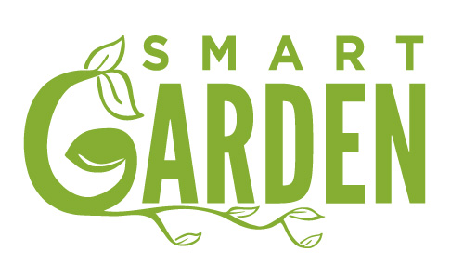
Proposed Solution
The proposed solution is “Design and implement the model of smart garden”.
- This model will combine from above model such as:
- Integrate sensors in a device like Edyn or Parrot.
- Reaction with the change indexes.
- Making plan, reminder, or suggestion based on sensors’ indexes.
This model will resolve problems such as:
- Limit transmit and control distance.
- System is difficult to use.
- Applicable with a small or large area.
- Not depend on what kind of trees.
We want this model will be an improvement over other systems in Vietnam:
- More reactive based on indexes and weather condition than just control volume of water valve or turn light on/off.
- Detail Planning for gardener, it is not just a timer.
This model will build to resolve problems which are easy to use, save time, transmit distance, planning and weather condition in gardening.
Notes:
+ Edyn – Smart Garden System: They have 2 part which is Edyn Garden Sensor and Edyn Water Valve. Edyn Garden Sensor will track light, humidity, temperature, soil nutrition and moisture and cross-references collected data with plant, soil science, and weather databases to recommend which plants will thrive; monitors continuously and alerts users to changes that require immediate action. Edyn Water Valve automatically controls existing water system based on data collected by the Garden Sensor and adapts to changes in the weather forecast. Edyn app provides information on what plants that will grow best, the optimal time for planting, and even plant groupings with the same conditional needs. It can also be used to manually control the Edyn Water Valve. Advantage: Solar Powered, in addition to rechargeable lithium iron phosphate battery when not in full sun; Measures ambient temperature, humidity, light intensity and soil electrical conductivity. Many sensors are just in one device; Water and fertilizer resistant; Connects to the cloud.
+ Parrot Flower Power: collects a variety of plant-relevant data accurately and uses it in conjunction with its excellent database to make plant-specific recommendations. Advantage: Has a huge database about plant (7000 plants)

Slide 7
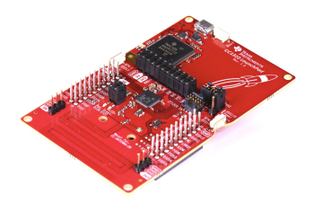
Feature functions
Smart Garden System
C3310 launchpad
Notes:
Nowadays, farming is absolutely vital for every society. However, land costs too much and farming make too little, its depend on spread of land. Besides that, people don’t have enough time to take care the plant and easy to forget the schedule about gardening. The actual situation is people don’t know when the most convenient time to watering or fertilize the plants, it is easy make the plants to die or waste the resource. This project can help farmer increase productivity even in a small land, reduce the water or fertilizer, helps plants to have a better life.

Slide 8
Advantages and disadvantages
Smart Garden System
Advantages:
-Spend less time for gardening but increase productivity of plants.
-Waste reduction of resources such as water, fertilize.
-Simply collect data and monitor the conditions of land and plants.
-Plant disease, forecasting, make a better criteria conditions for each plant.
Disadvantages:
-The lack of technology knowledge from Vietnam gardener
-Accuracy and durability of sensors or electric devices in a long time with hard weather.
Notes:
Nowadays, farming is absolutely vital for every society. However, land costs too much and farming make too little, its depend on spread of land. Besides that, people don’t have enough time to take care the plant and easy to forget the schedule about gardening. The actual situation is people don’t know when the most convenient time to watering or fertilize the plants, it is easy make the plants to die or waste the resource. This project can help farmer increase productivity even in a small land, reduce the water or fertilizer, helps plants to have a better life.

Slide 9
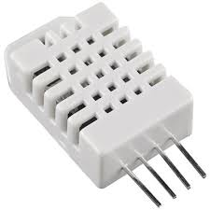
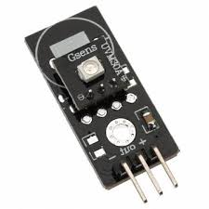
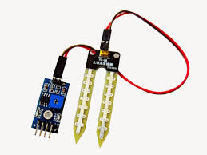
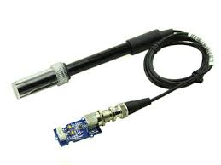
Functional Requirements
Sensors Management
- Setting range of allowed indexes
- Tracking report of indexes
- Setting period time for each sensors
Notes:
Nowadays, farming is absolutely vital for every society. However, land costs too much and farming make too little, its depend on spread of land. Besides that, people don’t have enough time to take care the plant and easy to forget the schedule about gardening. The actual situation is people don’t know when the most convenient time to watering or fertilize the plants, it is easy make the plants to die or waste the resource. This project can help farmer increase productivity even in a small land, reduce the water or fertilizer, helps plants to have a better life.

Slide 10
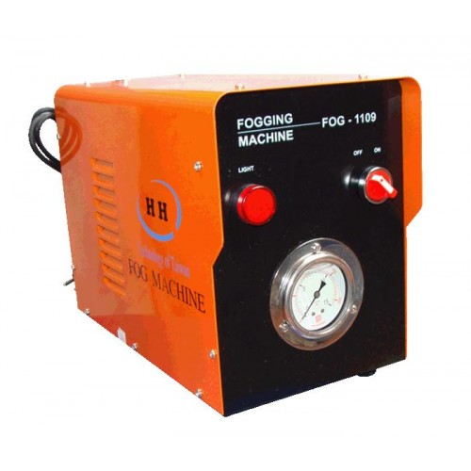
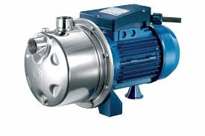
Functional Requirements
Actuators Management
Add new a device
Setting levels, volumes of resources
Notes:
Nowadays, farming is absolutely vital for every society. However, land costs too much and farming make too little, its depend on spread of land. Besides that, people don’t have enough time to take care the plant and easy to forget the schedule about gardening. The actual situation is people don’t know when the most convenient time to watering or fertilize the plants, it is easy make the plants to die or waste the resource. This project can help farmer increase productivity even in a small land, reduce the water or fertilizer, helps plants to have a better life.

