Slide 1
CC1310 Launchpad Tutorial 6LowPAN WSN
July 8t^{h} 2016

Slide 2
Agenda
CC13xx/C26xx Quick Guide
Contiki OS
6LowPAN
Setting up SW Environment
6LowPAN Edge Router
6LowPAN Node

Slide 3
CC13xx/C26xx Quick Guide

Slide 4
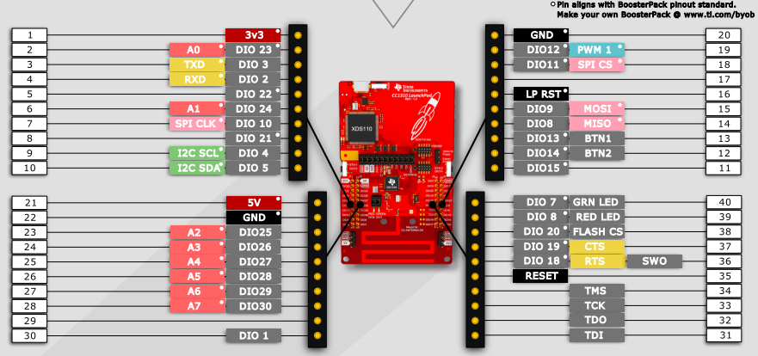
CC1310 Launchpad

Slide 5
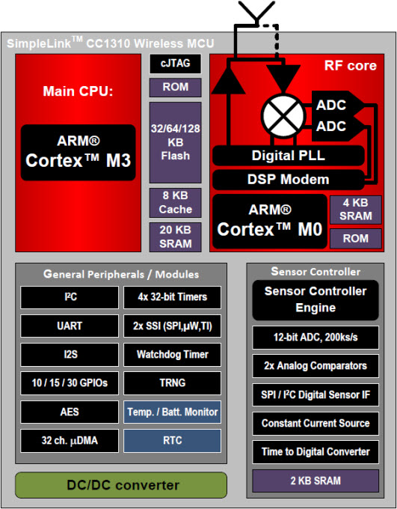
CC1310 inside

Slide 6
6LowPAN

Slide 7
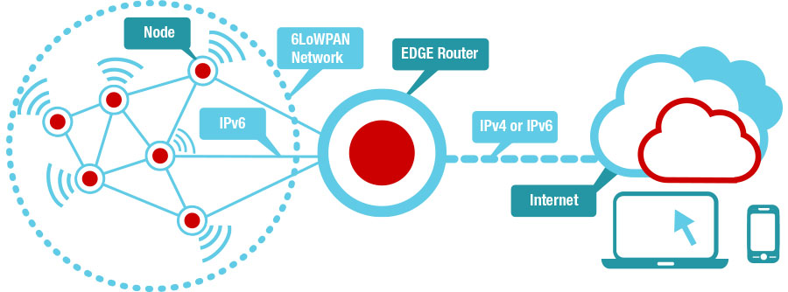
6LowPAN overview

Slide 8
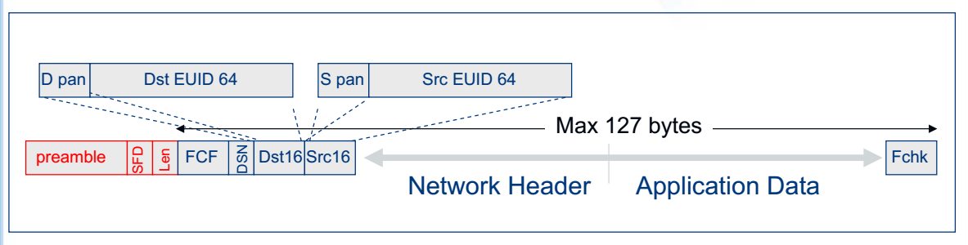
IEEE 802.15.4 Frame Format
Low Bandwidth (250 kpbs), low power (1 mW) radio
Simple MAC allows for general use
Small Packets to keep packet error rate low & permit media sharing
Moderately spread spectrum (QPSK) provides robustness

Slide 9
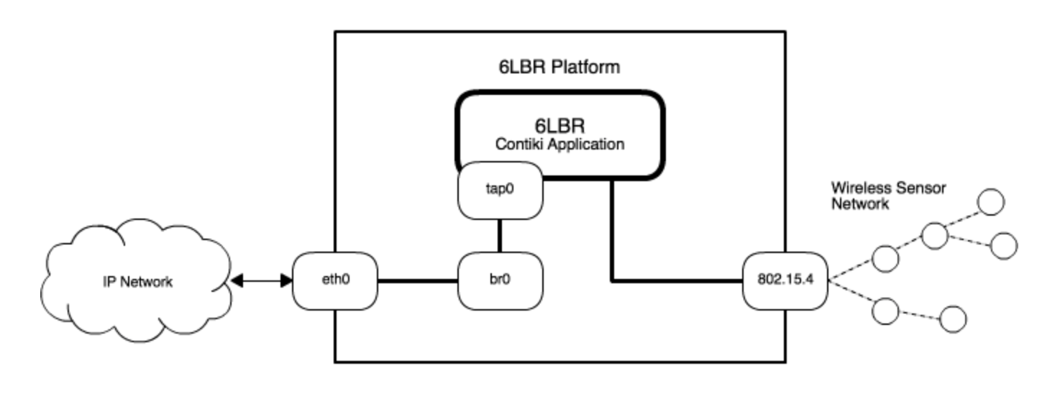
Sample routing mode

Slide 10
6LowPAN Edge Router
Hardware
CC1310 lauchpad as slip-radio modem
PC installed Ubuntu 14.04 as Edge Router
Source code
Lastest Contiki source code
Example: /examples/ipv6/slip-radio

Slide 11
6LowPAN Edge Router
Building steps
Get Contiki latest source code
git clone --recursive https://github.com/contiki-os/contiki
Open /example/ipv6/slip-radio/project-conf.h and change “rf channel”:
#define RF_CORE_CONF_CHANNEL 25
#undef UIP_CONF_ROUTER
#define UIP_CONF_ROUTER 0
Build slip-radio.bin
cd example/ipv6/slip-radio
mingw32-make clean
mingw32-make TARGET=srf06-cc26xx BOARD=srf06/cc13xx slip-radio.bin

Slide 12
Configure 6lbr
Refer to Setup 6lbr to run 6LowPAN with CC1310 on Ubuntu:
https://github.com/cetic/6lbr/wiki/Other-Linux-Software-Configuration
Change 6lbr config file: /etc/6lbr/6lbr.conf
RAW_ETH=0
BRIDGE=1
CREATE_BRIDGE=0
DEV_ETH=eth0
DEV_BRIDGE=br0
DEV_TAP=tap0
Start 6lbr service & access to web page (bbbb:100] )
sudo service 6lbr start

Slide 13
Building 6LowPAN demo node
Build cc26xx-web-demo.bin
cd /examples/cc26xx/cc26xx-web-demo
mingw32-make Make clean
mingw32-make TARGET=srf06-cc26xx BOARD=srf06/cc13xx cc26xx-web-demo.bin
Flash cc26xx-web-demo.bin to Launchpad using SmartRF Flash programmer 2.0

Slide 14
Q&A

