Slide 1
Smart Garden

Slide 2
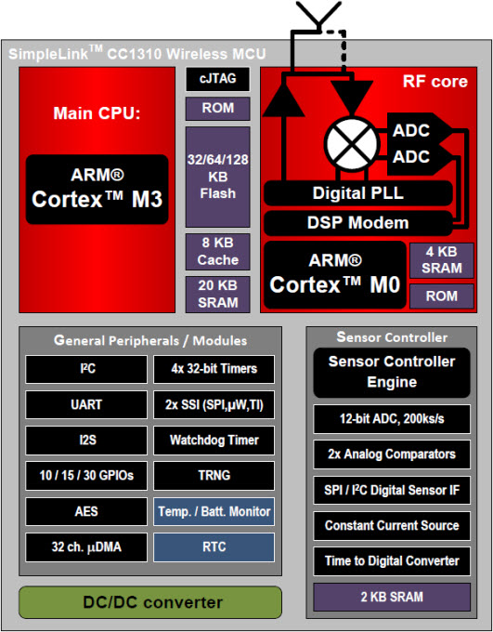
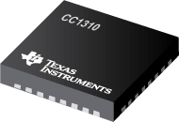
Hardware: MCU
CC1310

Slide 3
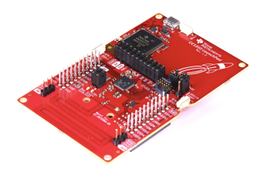
CC1310 Launchpad
Hardware: MCU
Feature:
MCU 32bit ARM Cortex-M3 processor 48MHz
Ultra low power
Sub 1Ghz RF devices
30 pins GPIO
Four General-Purpose Timer Modules
12-Bit ADC, 200 ksamples/s, 8-Channel Analog MUX
UART
2× SSI (SPI, MICROWIRE, TI)
I2C
SmartRF
Suitable for Systems Targeting Compliance With Worldwide Radio Frequency Regulations
ETSI EN 300 220, EN 303 131, EN 303 204 (Europe)
FCC CFR47 Part 15 (US)
ARIB STD-T108 (Japan)
Wireless M-Bus and IEEE 802.15.4g PHY
IAR Embedded Workbench® for ARM
Notes:
Microcontroller
Powerful ARM® Cortex®-M3
EEMBC CoreMark® Score: 142
EEMBC ULPBench™ Score: 158
Up to 48-MHz Clock Speed
128KB of In-System Programmable Flash
8KB of SRAM for Cache (or as General- Purpose RAM)
20KB of Ultralow Leakage SRAM
2-Pin cJTAG and JTAG Debugging
Supports Over-the-Air Upgrade (OTA)
Ultralow Power Sensor Controller
Can Run Autonomous From the Rest of the System
16-Bit Architecture
2KB of Ultralow Leakage SRAM for Code and Data
Efficient Code-Size Architecture, Placing TI-RTOS, Drivers and Bootloader in ROM
RoHS-Compliant Package
7-mm × 7-mm RGZ VQFN48 (30 GPIOs)
5-mm × 5-mm RHB VQFN48 (15 GPIOs)
4-mm × 4-mm RSM VQFN48 (10 GPIOs)
Peripherals
All Digital Peripheral Pins Can Be Routed to Any GPIO
Four General-Purpose Timer Modules (Eight 16-Bit or Four 32-Bit Timers, PWM Each)
12-Bit ADC, 200 ksamples/s, 8-Channel Analog MUX
Continuous Time Comparator
Ultralow Power Clocked Comparator
Programmable Current Source
UART
2× SSI (SPI, MICROWIRE, TI)
I2C
I2S
Real-Time Clock (RTC)
AES-128 Security Module
True Random Number Generator (TRNG)
Support for Eight Capacitive Sensing Buttons
Integrated Temperature Sensor
External System
On-Chip Internal DC-DC Converter
Very Few External Components
Seamless Integration With the SimpleLink CC1190 Range Extender
Low Power
Wide Supply Voltage Range: 1.8 to 3.8 V
Active-Mode RX: 5.5 mA
Active-Mode TX at +10 dBm: 12.9 mA
Active-Mode MCU 48 MHz Running Coremark: 2.5 mA (51 µA/MHz)
Active-Mode MCU: 48.5 CoreMark/mA
Active-Mode Sensor Controller at 24 MHz: 0.4 mA + 8.2 µA/MHz
Sensor Controller, One Wake Up Every Second Performing One 12-Bit ADC Sampling: 0.85 µA
Standby: 0.6 µA (RTC Running and RAM and CPU Retention)
Shutdown: 185 nA (Wakeup on External Events)
RF Section
Excellent Receiver Sensitivity –124 dBm Using Long-Range Mode, –110 dBm at 50 kbps
Excellent Selectivity: 52 dB
Excellent Blocking Performance: 90 dB
Programmable Output Power up to +14 dBm
Single-Ended or Differential RF Interface
Suitable for Systems Targeting Compliance With Worldwide Radio Frequency Regulations
ETSI EN 300 220, EN 303 131, EN 303 204 (Europe)
FCC CFR47 Part 15 (US)
ARIB STD-T108 (Japan)
Wireless M-Bus and IEEE 802.15.4g PHY
Tools and Development Environment
Full-Feature and Low-Cost Development Kits
Multiple Reference Designs for Different RF Configurations
Packet Sniffer PC Software
Sensor Controller Studio
SmartRF™ Studio
SmartRF Flash Programmer 2
IAR Embedded Workbench® for ARM
Code Composer Studio™

Slide 4
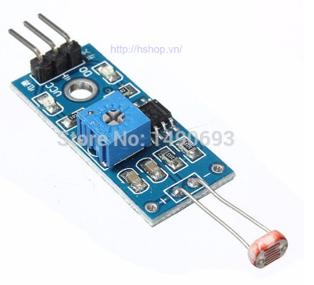
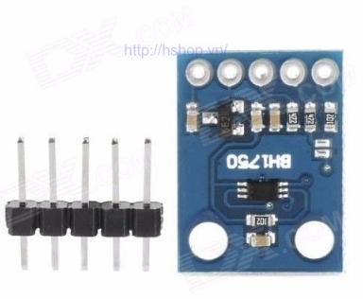
Light Sensor
Hardware: Sensor
LM393 | BH 1750
Using photoresistor Split−Supply Range: ±1.0 Vdc to ±18 Vdc Output 0-1023 value analog and digital Data protocols: Analog and digital http://hshop.vn/products/cam-bien-anh-sang-quang-tro-2 35.000 VND | Using photodiode Split−Supply Range:3.3 ­> 6v DC Output 16bit digital Data protocols: I2C http://hshop.vn/products/cam-bien-cuong-do-onh-song-lux-bh1750 60.000 VND
Notes:
Quang trở = quang diot

Slide 5
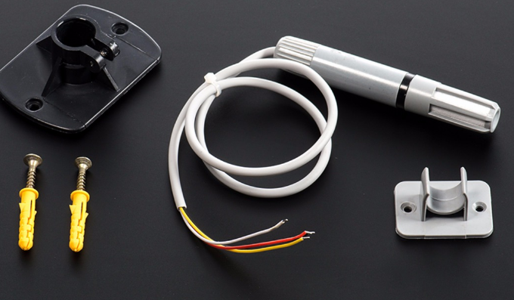
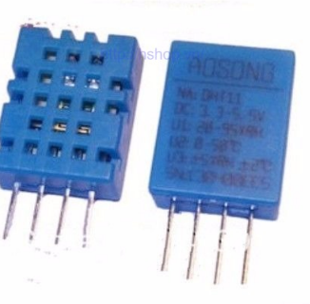
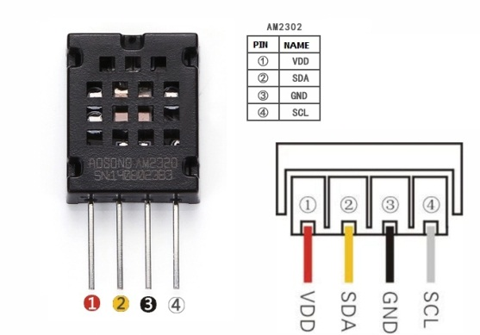
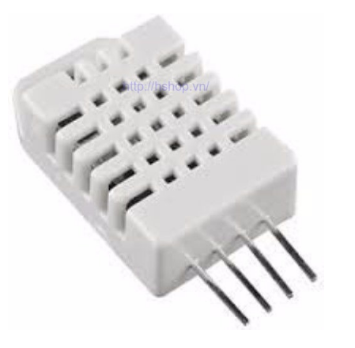
Temperature and Humility
Hardware: Sensor
Sensor | Specification
AM2315 | H: 0-100% ~ 2% T: -20 -80 ^{c} c ~ 0.1 ^{c} c Data protocols: I2C 450.000 VNĐ
DHT11 | H: 0-80% ~ 5% T: 0 - 50 ^{c} c ~ 2 ^{c} c Data protocols: 1x digital 30.000 VNĐ
AM2320 | H: 0-100% ~ 2% T: -40 -80 ^{c} c ~ 0.5 ^{c} c Data protocols: I2C 85.000 VNĐ
DHT22 | H: 0-100% ~ 2-5% T: -40 -80 ^{c} c ~ 0.5 ^{c} c Data protocols: 1x digital/ 0.5Hz 120.000 VNĐ

Slide 6
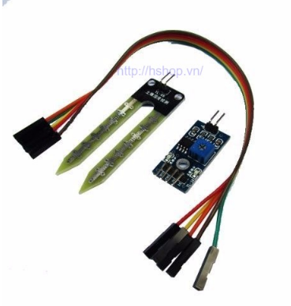
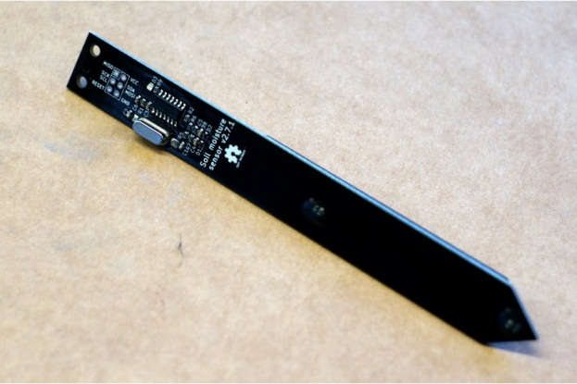
Soil Humility Sensor
Hardware: Sensor
I2C Soil moisture sensor | LM393
Operating temperature 0°C - 85°C Moisture reading drift with temperature - <10% over full temp range Data protocols: I2C $13.00 (290.212 ₫ VND) https://www.tindie.com/products/miceuz/i2c-soil-moisture-sensor/ | Output: 0-1023 Data protocols: : Analog or Digital http://hshop.vn/products/cam-bien-do-am-dat-2http://hshop.vn/products/cam-bien-do-am-dat-2 35.000 VNĐ

Slide 7
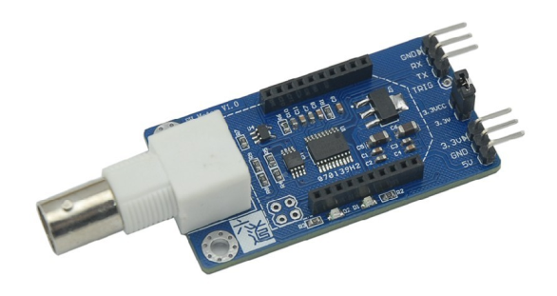

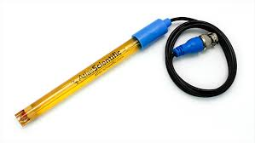
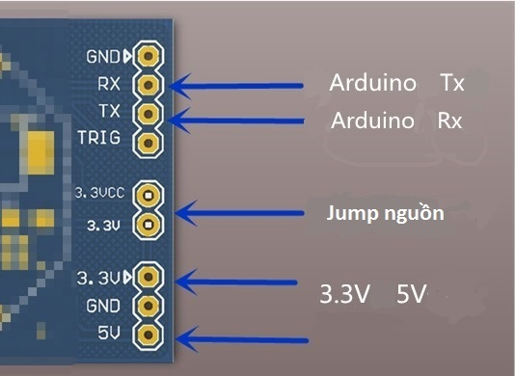
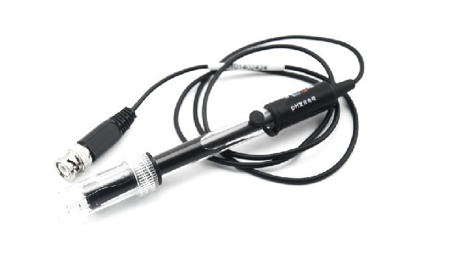
pH Sensor
Hardware: Sensor
pH KIT with UART | Atlas scientific pH KIT
Power: 3.3 -5 V Data protocols: UART Full range pH reading from .001 to 14.000 Accurate pH readings down to +/- 0.05 Price: 1,050,000 vnd | Power: 3.3 -5 V Data protocols: UART, I2C Full range pH reading from .001 to 14.000 Accurate pH readings down to +/- 0.02 Price: $149.15

Slide 8
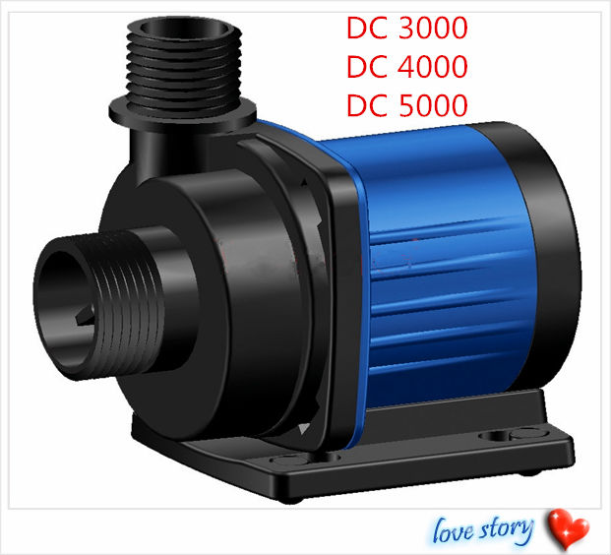
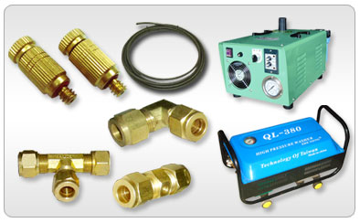
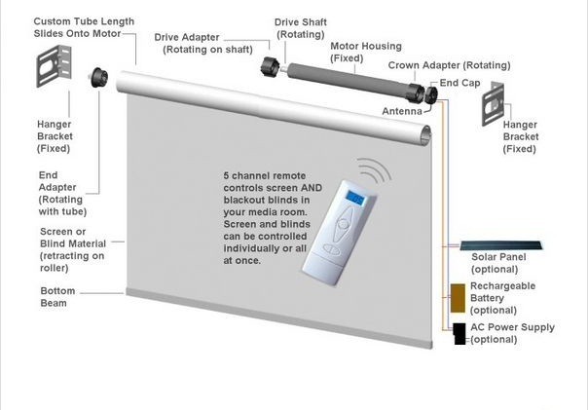
Hardware: Output

Slide 9
Sensor
Sub - Controller
Database
Component
RF
Sensor
Sub - Controller
Main Controller
Web Server
RF
Wi-Fi
Component
RF
Sensor
Mobile App
Sub - Controller
Component

Slide 10

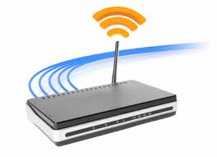

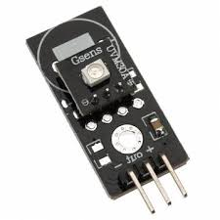

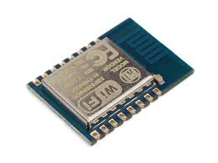

RF
Wi-Fi
RF
RF

Slide 11
I2C
I2C
I2C
I2C

Slide 12
Increment | Num Of Week | Main Task
Increment 0 | 1 | Choose hardware
Increment 1 | 2 | Research and buy sensors, MCU
Increment 2 | 3 | Implement and code hardware
Increment 3 | 3 | Make board and continue to implement, Test
Increment 4 | 1 | Test and create a modeling

Slide 13
TaskSheet
Name | Task Assign
Phan Thành Sang | Hardware + MCU Control and managing process Report and Document Support team member
Lê Văn Pháp | Document Web server Web API Database design
Huỳnh Hữu Nghị | Document Android Application Implement Component Connection interfaces
Phạm Hoàng Chinh | Diagram Database Design Document Report Meeting Report

