Slide 1
Smart Garden

Slide 2
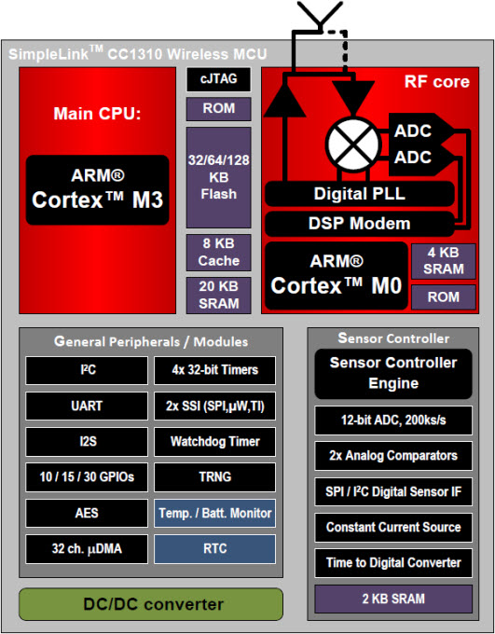
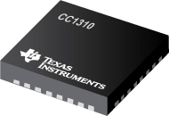
Hardware: MCU
CC1310

Slide 3
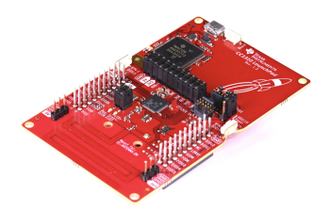
Hardware: MCU
CC1310 Launchpad

Slide 4
Hardware: Sensor
CC1310 Launchpad

Slide 5
Sensor
Sub - Controller
Database
Component
RF
Sensor
Sub - Controller
Main Controller
Web Server
RF
Wi-Fi
Component
RF
Sensor
Mobile App
Sub - Controller
Component

Slide 6
