Slide 1
[DS² 4기] Database Project
4조
(김상규, 손민우, 최희영)

Slide 2
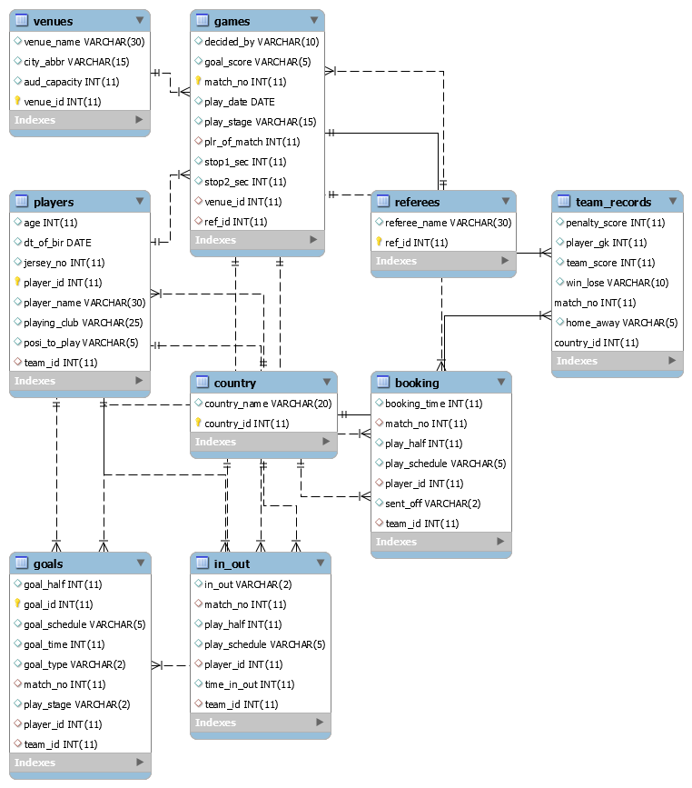
ERD

Slide 3
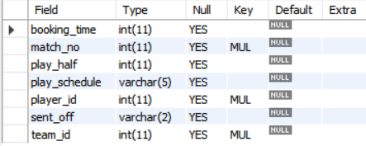

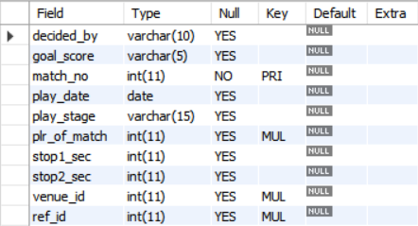
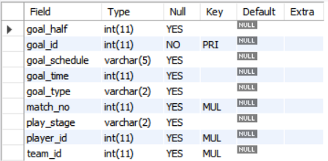
Table description - 1
booking
country
games
goals

Slide 4
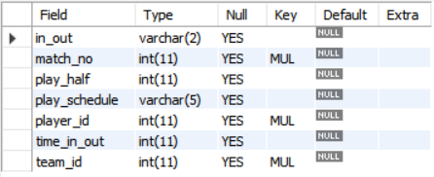
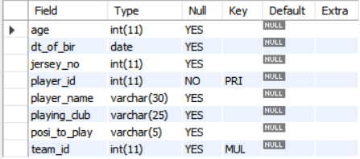

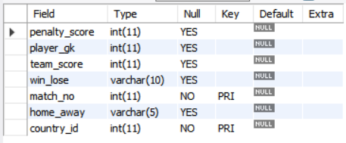
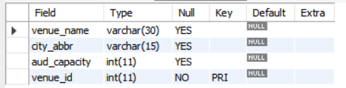
Table description - 2
in_out
players
referees
team_records
venues

Slide 5
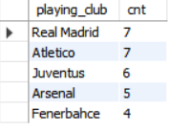
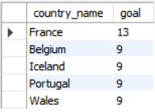
분석 SELECT 쿼리
# 축구클럽별 골을 넣은 선수의 수, 내림차순 상위 5개
SELECT
player_club.playing_club,
COUNT(player_club.player_name) AS cnt
FROM
(SELECT
player_name, playing_club
FROM
players
JOIN goals ON players.player_id = goals.player_id) AS player_club
GROUP BY player_club.playing_club
ORDER BY cnt DESC
LIMIT 5;
# 골을 가장 많이 넣은 나라 상위 5개
SELECT
b.country_name, COUNT(*) AS goal
FROM
goals AS a
JOIN
country AS b ON a.team_id = b.country_id
GROUP BY b.country_name
ORDER BY goal DESC
LIMIT 5;

Slide 6
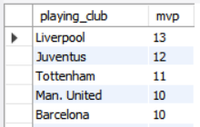
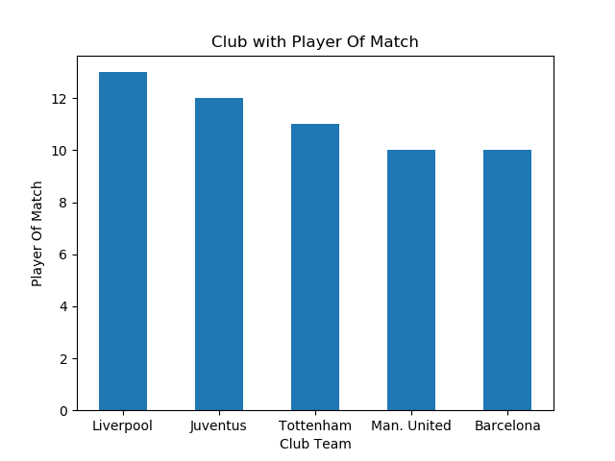
분석 쿼리 차트
# Player of match를 많이 배출한 축구클럽 상위 5개
SELECT
playing_club, COUNT(*) AS mvp
FROM
games AS g
RIGHT JOIN
players AS p ON g.plr_of_match = p.player_id
GROUP BY p.playing_club
ORDER BY mvp DESC
LIMIT 5;
<Player of match를 많이 배출한 축구클럽 상위 5개 Bar Chart>

