Slide 1
Aegle Health App and dashboard
BTech Project

Slide 2
Group members:
Sr No | Name | Gr No | Roll No
1 | Anuj Dube | 21810299 | 433042
2 | Sangram Shinde | 21810248 | 433003
3 | Aniruddha Ghadge | 21810708 | 433055
4 | Roshan Wazare | 21810420 | 433054

Slide 3
ABSTRACT
The prime objective of creating “Aegle Health App” is to create a fully-fledged application to facilitate both the doctor and the patient. This would be an app which can be used for Tele Consulting in the domain of healthcare by Aegle Clinic. It connects Doctor and Patient using app and patients can search for a Doctor and book his/her appointment or prescription using their Smartphone. There is dashboard for Doctors from which they can see previous history of a particular patient and can prescribe on basis of the history of patient. The main objective of this project is connecting doctor and patient very quickly and easily from any location without any involvement of any third party. Any doctor of Aegle Clinic and patient can easily use this application by registering themselves, and doctor can diagnose the patient and prescribe the required medicines. This system also notifies the Doctor and patient through the app about the doctor’s appointment and prescription within shortest possible time. The patients and the doctors will get access to various features such as consultation, monitoring health parameters, emergency backup, appointment booking, reminders of important dates, etc

Slide 4
Literature Survey
Many Medication Systems have been developed based on different platforms and concepts. The use of healthcare-related apps is growing but there are many issues related to their functionality. In this section, we reviewed some of the literatures and applications that are related to our work.
1) Practo - This application enables for consumers to find best doctors, book instant appointments, consultations and make better more informed health decisions.
2) Doctor at Work - This application manages patient records, appointments, patient visit notes, bill patients, track customer payments and balance due. This app can be useful for medical professionals and students that visit patients every now and then. It also helps the patients to get the appointments with doctors and sends the reminder through SMS or by email, creates itemized bills for patients to track the due amount, maintains the visit history of the patients, etc.
3) Diagnotes - This mobile application is web-based and provides healthcare practitioners the tools to enhance doctor interaction with their patients and other support staff. The user is expected to first create his account to enable him have access to all the functionalities the application. It routes phone calls and text, supports documentation of every encounter for continuity of patient care.

Slide 5
Review of existing System
All the existing applications discussed above are kind of more commercial, but this our proposed system cares more for patient- centered approach, and provides an optimal communication between doctors and patients. This app is helpful to patients to ask questions and state their concerns to doctors regarding their health condition. This app will facilitate the patients to interact with doctors without making any physical appointments.
There is no existing mobile application for Aegle Clinic. They mainly operate through their existing website which helps patients to interact with the doctors upto an extent. The system is also unable to remind and notify patient about their appointments as it is operated on a web console. They currently do not have a platform or a dashboard to store their health files while operating through their existing website.

Slide 6
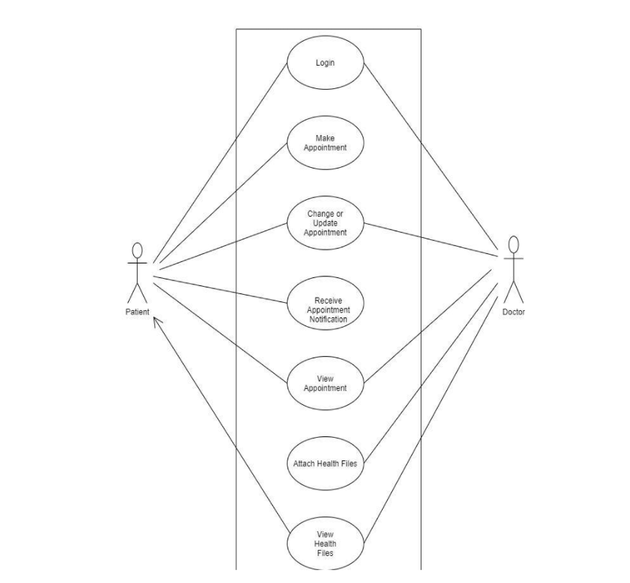
Use case diagram

Slide 7
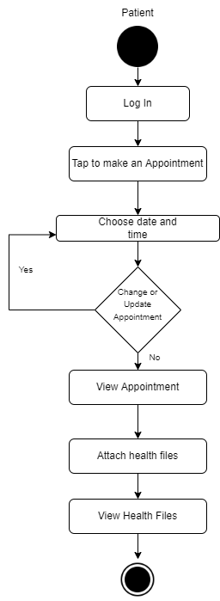
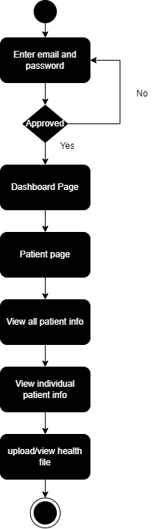
Android App Activity Diagram
Web App Activity Diagram

Slide 8
Android Application
Tasks:
Solve UI problems in the previous version of application so it resembles the actual UI UX design created.
Home Page, Edit Profile and Login Page changes.
Add a feature to upload reports for the patient side.
Generate Unique QR code for each profile with basic info about the user.
Technologies:
Android Studio
Kotlin
Firebase

Slide 9
Doctor’s Dashboard
Features:
Main page showing summary of all patients
Page of each individual patient showing static information like name,age,weight,height,contact info,address etc
Dynamic information like past appointments,different lab report etc
Doctors can upload each patients reports on their page.

Slide 10
Tools & Technology:
IDE: VS code
Browser: Chrome
Front-end: html,css,javascript,react
Back-end: firebase
Database for storing files : firebase firestore
Authentication: firebase auth
Hosting: firebase hosting/netlify

Slide 11
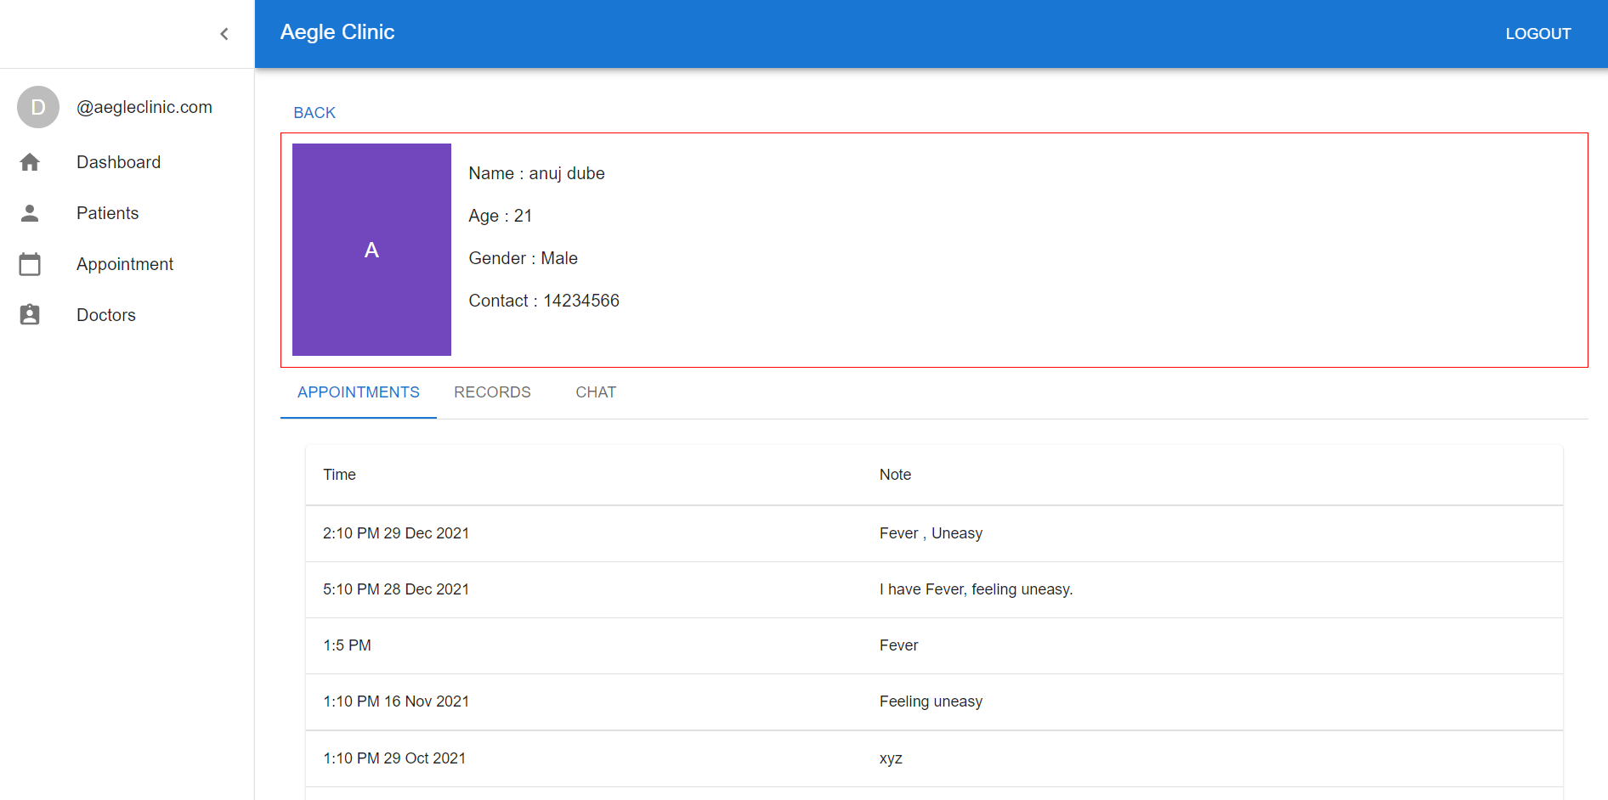
Implementation

Slide 12
working plan:
Week 1 | Deciding user-interface and features to implement and planning for dashboard, Identify the flaws in the previous version of app
Week 2 | Implementing front-end of dashboard
Week 3 | Implementing front-end of dashboard
Week 4 | Implementing front-end of dashboard
Week 5 | Deciding implementation of backend so backend of android app and dashboard is same but they are not introducing error in each other.
Week 6 | Implementing back-end and front end
Week 7 | Implementing back-end and front end
Week 8 | Adding more features as basic back-end and front-end is ready.
Week 9 | Adding more features
Week 10 | Doing changes in app and dashboard according to feedbacks
Week 11 | Doing changes in app and dashboard according to feedbacks
Week 12 | Hosting dashboard on web hosting like firebase hosting/netlify

Slide 13
Thank You

