Slide 1
Aegle Health App and dashboard
BTech Project

Slide 2
Group members:
Sr No | Name | Gr No | Roll No
1 | Anuj Dube | 21810299 | 433042
2 | Sangram Shinde | 21810248 | 433003
3 | Aniruddha Ghadge | 21810708 | 433055
4 | Roshan Wazare | 21810420 | 433054

Slide 3
ABSTRACT
The prime objective of creating “Aegle Health App” is to create a fully-fledged application to facilitate both the doctor and the patient. This would be an app which can be used for Tele Consulting in the domain of healthcare by Aegle Clinic. It connects Doctor and Patient using app and patients can search for a Doctor and book his/her appointment or prescription using their Smartphone. There is dashboard for Doctors from which they can see previous history of a particular patient and can prescribe on basis of the history of patient. The main objective of this project is connecting doctor and patient very quickly and easily from any location without any involvement of any third party. Any doctor of Aegle Clinic and patient can easily use this application by registering themselves, and doctor can diagnose the patient and prescribe the required medicines. This system also notifies the Doctor and patient through the app about the doctor’s appointment and prescription within shortest possible time. The patients and the doctors will get access to various features such as consultation, monitoring health parameters, emergency backup, appointment booking, reminders of important dates, etc

Slide 4
Android Application
Tasks:
Solve UI problems in the previous version of application so it resembles the actual UI UX design created.
Home Page, Edit Profile and Login Page changes.
Add a feature to upload reports for the patient side.
Generate Unique QR code for each profile with basic info about the user.
Technologies:
Android Studio
Kotlin
Firebase

Slide 5
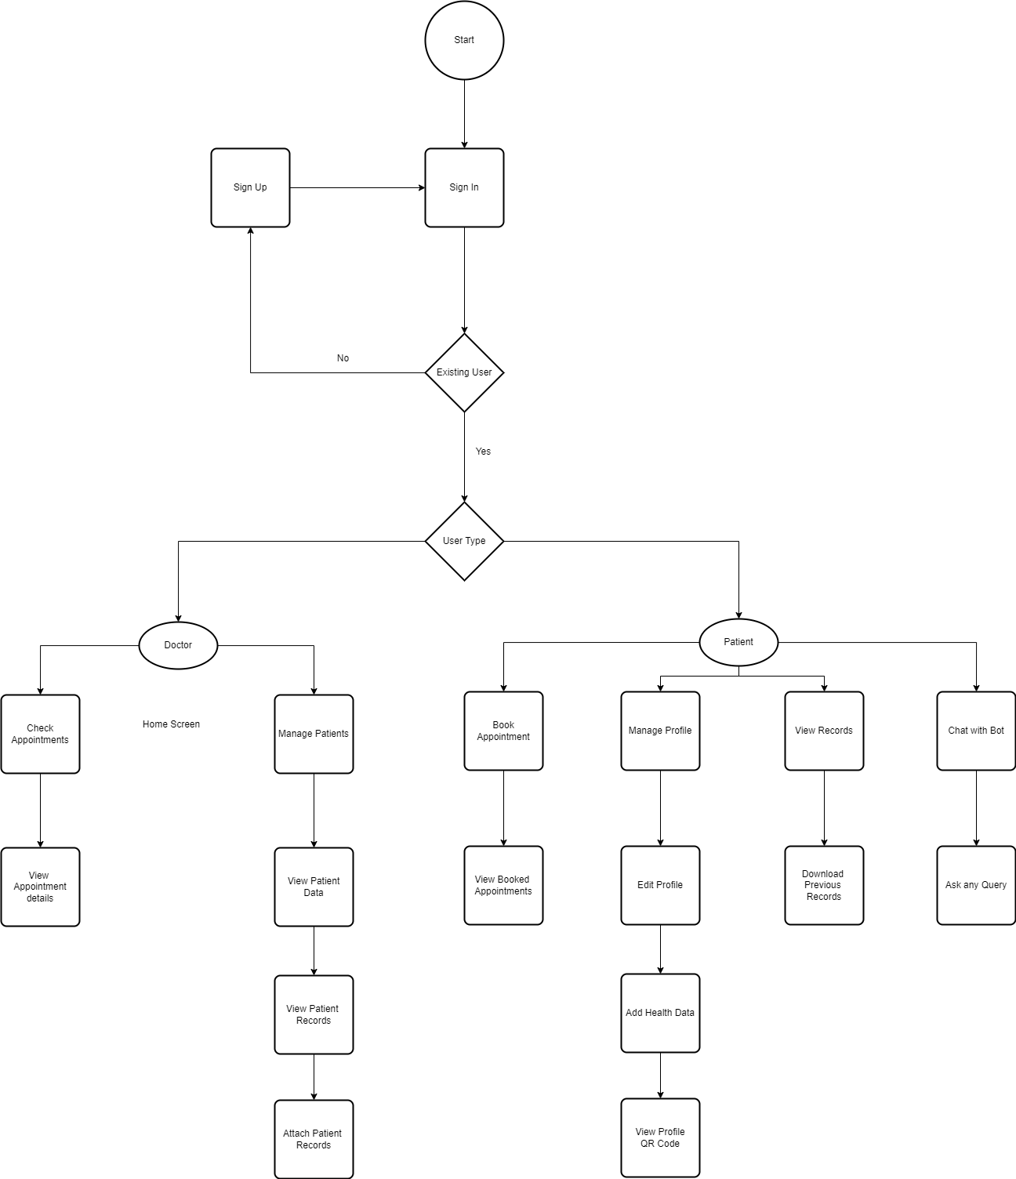
Flowchart of System

Slide 6
Doctor’s Dashboard
Features:
Main page showing summary of all patients
Page of each individual patient showing static information like name,age,weight,height,contact info,address etc
Dynamic information like past appointments,different lab report etc
Doctors can upload each patients reports on their page.

Slide 7
Tools & Technology:
IDE: VS code
Front-end: html,css,javascript,react,material UI
Back-end: firebase
Database for storing files : firebase firestore
Authentication: firebase auth
Hosting: firebase hosting/netlify

Slide 8
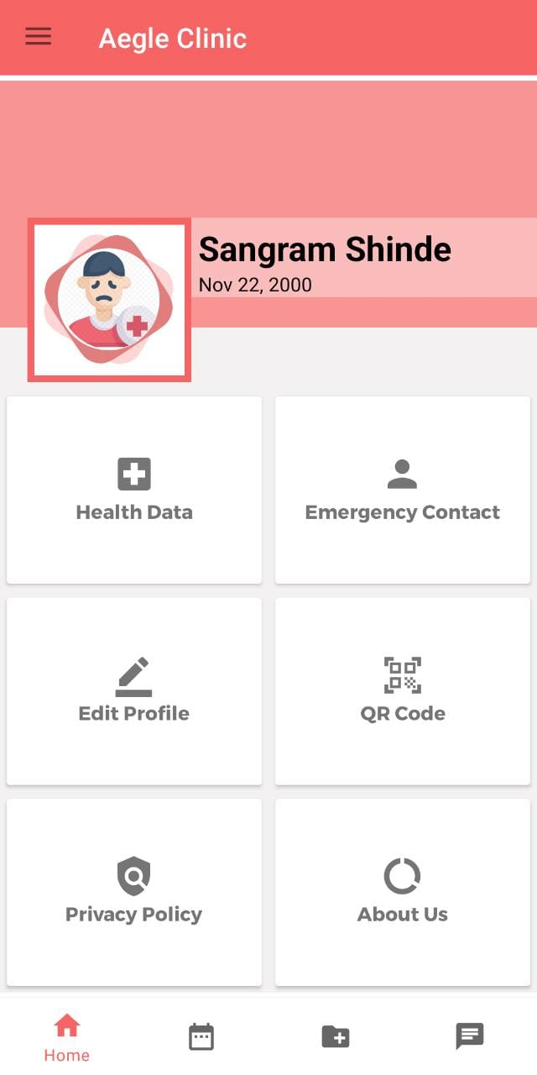
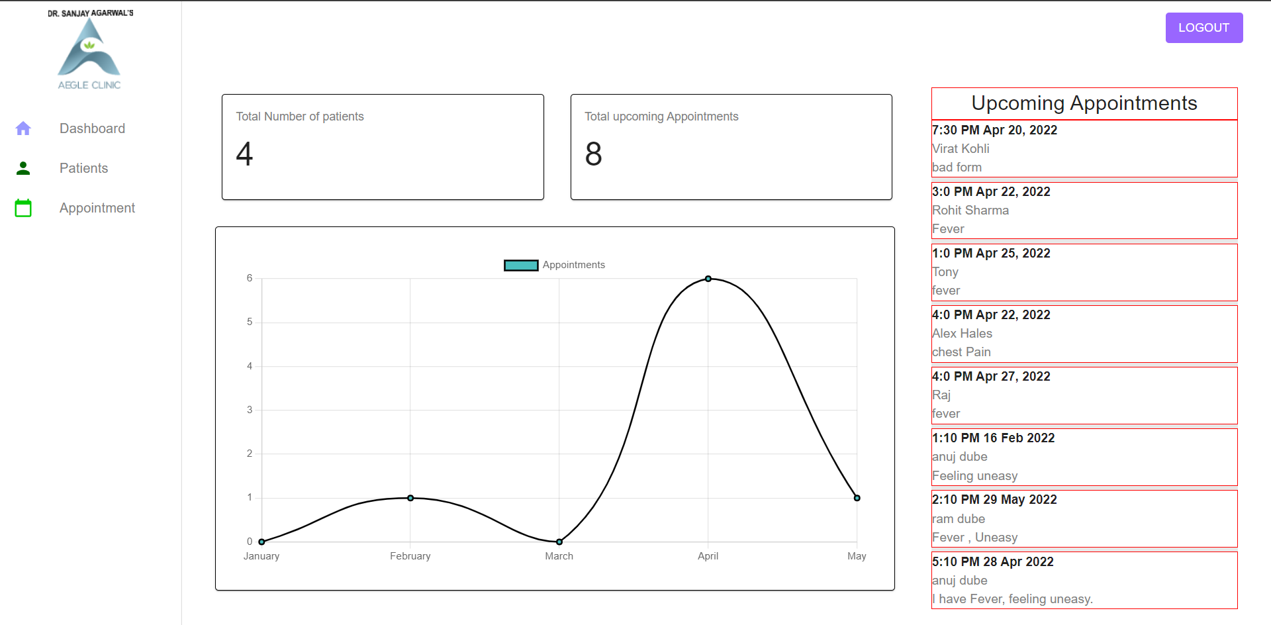
Implementation

Slide 9
working plan:
Week 1 | Deciding user-interface and features to implement and planning for dashboard, Identify the flaws in the previous version of app
Week 2 | Implementing front-end of dashboard
Week 3 | Implementing front-end of dashboard
Week 4 | Implementing front-end of dashboard
Week 5 | Deciding implementation of backend so backend of android app and dashboard is same but they are not introducing error in each other.
Week 6 | Implementing back-end and front end
Week 7 | Implementing back-end and front end
Week 8 | Adding more features as basic back-end and front-end is ready.
Week 9 | Adding more features
Week 10 | Doing changes in app and dashboard according to feedbacks
Week 11 | Doing changes in app and dashboard according to feedbacks
Week 12 | Hosting dashboard on web hosting like firebase hosting/netlify

Slide 10
Thank You

