Slide 1


Department of Computer Science and Engineering
Name of Student:-
1. Sangamsinh Mansing Shinde. 2167571242009
2. Salman Alamgir Pathan. 2167571242031
3. Muskan Firoj Sayyad. 2167571242035
4. Shreyash Vaibhav Nikam. 2167571242037
Name of Project Topic:- “Image Forgery Detection”

Slide 2
Problem statement
The project aims to detect image forgery by comparing original and forged images using Structural Similarity Index (SSIM) for similarity measurement. It highlights differences between the images to visually identify forgeries, facilitating automated verification of image authenticity.
INTRODUCTION
The Image forgery detection is crucial in ensuring the authenticity and integrity of digital images, especially with the rise of manipulated media in various domains such as journalism, security, and social media. This project focuses on detecting image forgeries by comparing original and forged images using the Structural Similarity Index (SSIM). SSIM measures the perceptual similarity between two images, providing a quantitative score that highlights even subtle differences. The goal is to automatically identify discrepancies between original and altered images, making it easier to detect tampering and ensuring the reliability of visual content in digital platforms.

Slide 3
KEY CHALLENGES
1. Subtle Manipulations: Forgers often make minor changes to images that are hard to detect using traditional methods, such as slight adjustments in lighting, shadows, or textures, which can lead to false negatives.
2. Variability in Image Quality: Differences in resolution, compression artifacts, or noise between original and forged images can affect the accuracy of comparison methods like SSIM, leading to inconsistencies in detection.
3. Complex Forgery Techniques : Advanced forgery methods such as deepfakes or seamless cloning can be difficult to detect, as they aim to make alterations appear as natural as possible.
4. Large Dataset Requirement : A large number of images, both original and forged, is needed to train and test detection models effectively. Collecting a sufficiently diverse and representative dataset is often time-consuming and resource-intensive.
5. Real-Time Detection: Implementing forgery detection in real-time, especially in high-resolution images or videos, requires high computational power, which can be a significant challenge in practical applications.

Slide 4
In machine learning, image forgery detection uses computers to automatically spot fake or edited images. By training the computer with many examples of both real and fake images, the machine learns to find patterns that show when an image has been changed. This can include using advanced techniques like deep learning, where the computer looks at different parts of the image to understand if it’s been tampered with. This area is important for things like checking news photos, online content, or any place where it's important to know if an image is real or not..
DOMAIN:- Machine Learning.

Slide 5
Problem Identification:
Rising Image Manipulations: Increased use of fake images in media and social platforms.
Subtle Changes: Hard to detect minor edits like lighting or texture adjustments.
Variable Image Quality: Differences in resolution and compression affect detection accuracy.
Advanced Forgery Techniques: Methods like deepfakes are difficult to spot.
Lack of Automation: Need for fast, accurate, and scalable forgery detection.

Slide 6
OBJECTIVES
Develop an Automated Detection System: Create a system that automatically identifies forged images using machine learning.
Improve Accuracy: Enhance the detection of subtle image manipulations like lighting changes, cloning, and deepfakes.
Utilize SSIM for Comparison: Use Structural Similarity Index (SSIM) to compare original and forged images and measure visual differences.
Highlight Forged Areas: Visualize and highlight manipulated regions in forged images for easy identification.
Provide Scalable Solutions: Ensure the system can process large datasets efficiently and in real-time.

Slide 7
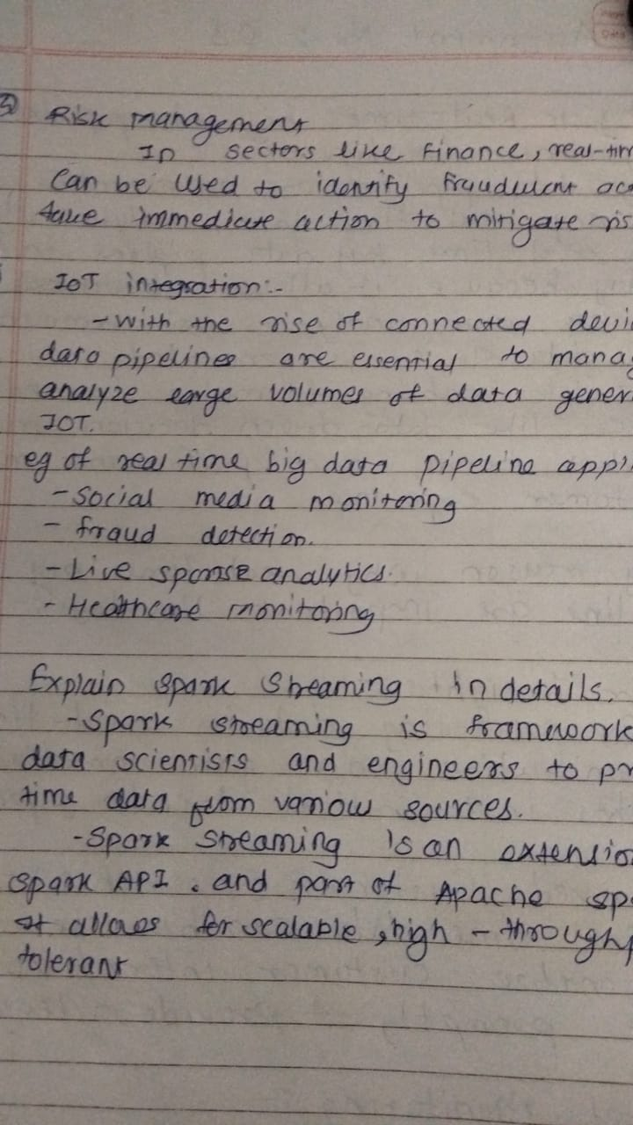
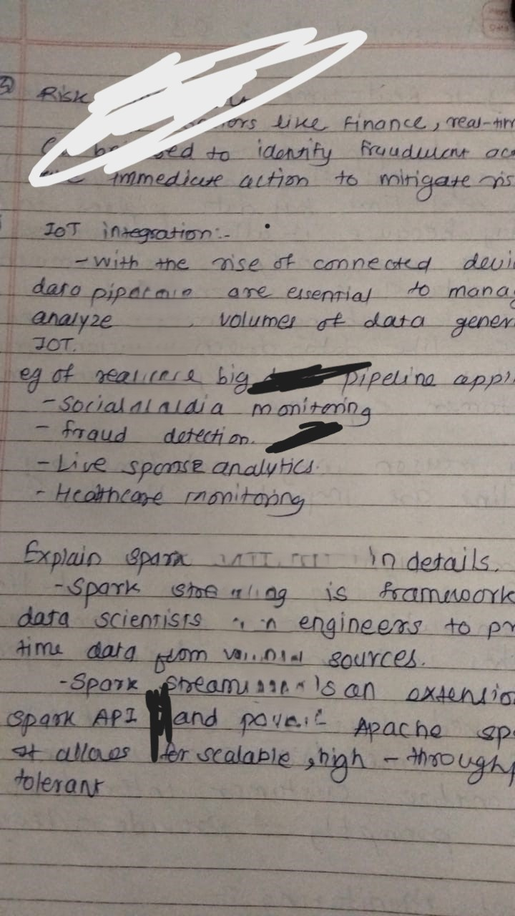
Raw Image:
Forged Image:

Slide 8
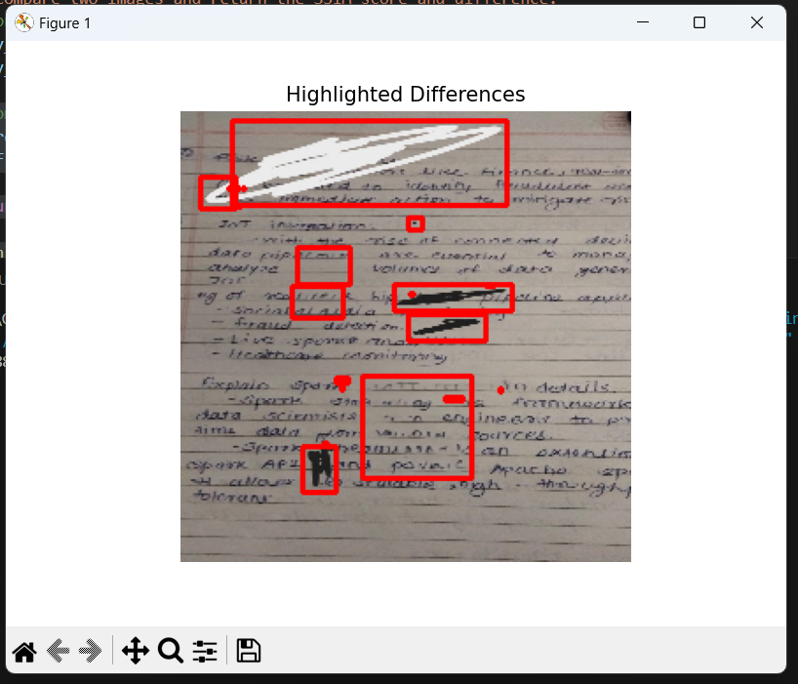
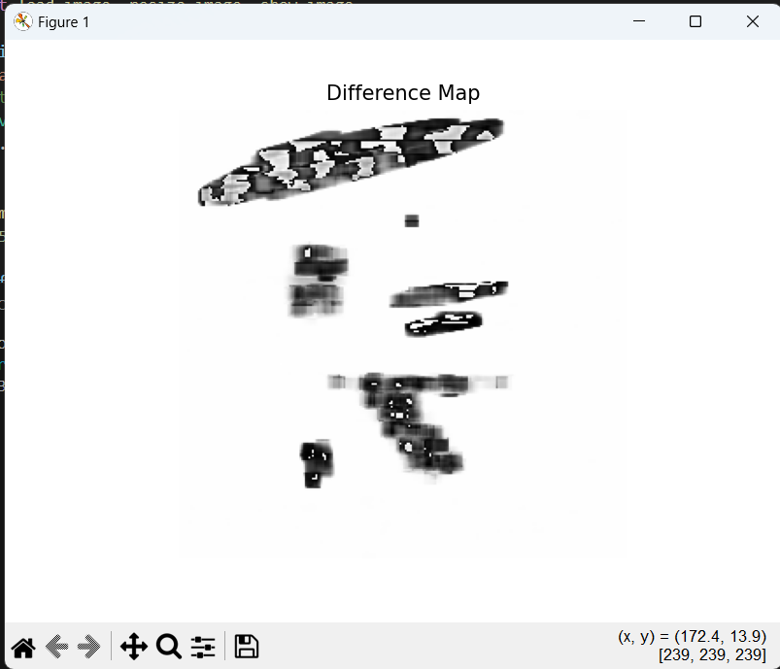
Snap-Shot of Project:

Slide 9
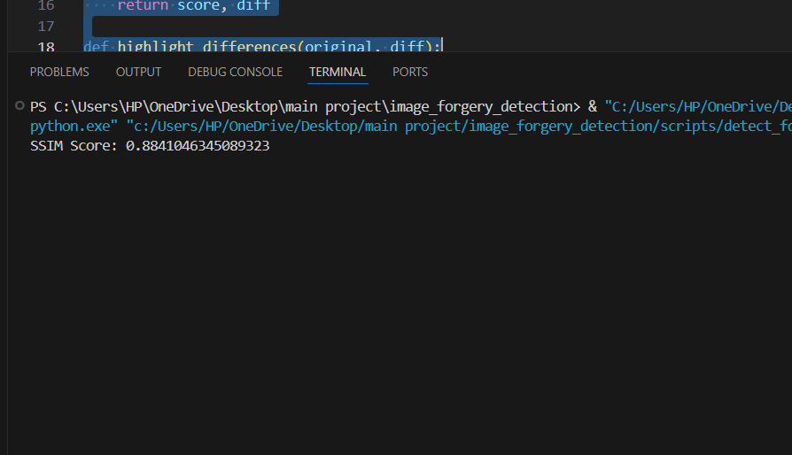
SSIM Score:

Slide 10
THANK YOU !!!

