Slide 1
OpenIoT:
Open Source Internet-of-Things in the Cloud
- Researchgate Publication by Prem Prakash Jayaraman and Ivana Podnar Zarko
A summary.
Presented by :
Sangramsingh Kardekar

Slide 2

Agenda
OpenIoT Overview - The what and why
The OpenIoT platform
OpenIoT ontology
Features and capabilities
The OpenIoT IDE and successful applications

Slide 3
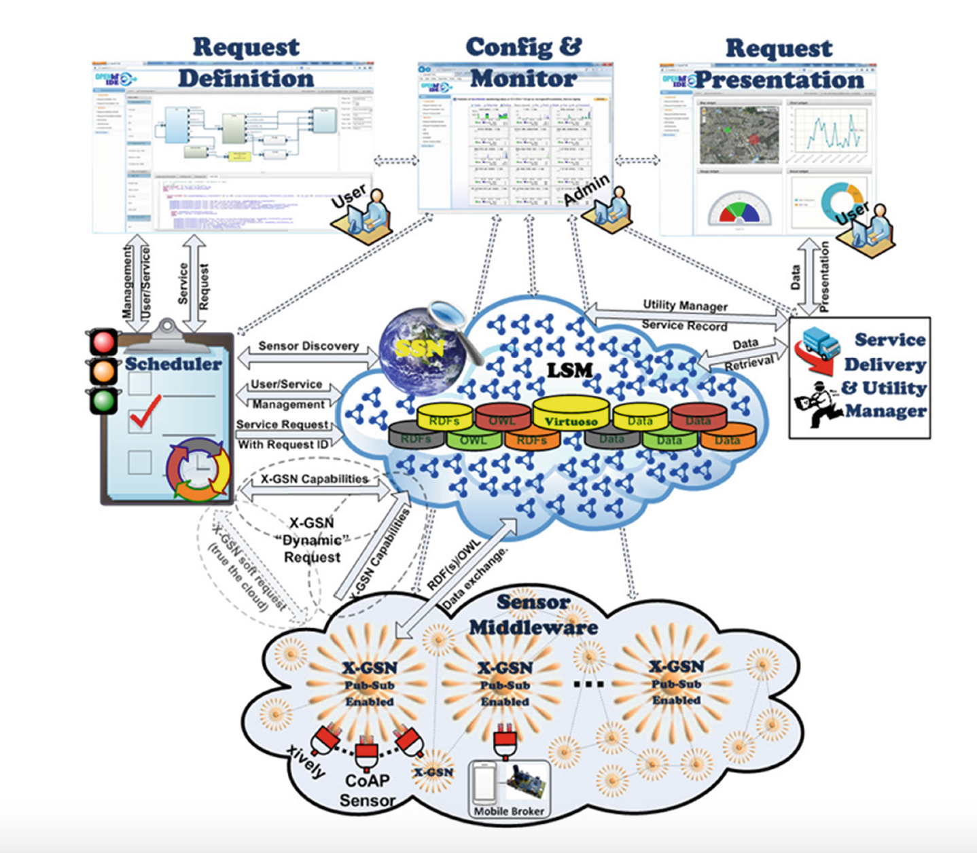

Slide 4
Openiot ontology
A sensor is not just a physical device.
It is anything that can estimate or calculate the value of something.
OpenIoT Ontology thus links together the device, what it measures and the functions + processing
This is what makes it middleware.
Data from virtual sensors is stored as linked data in RDF and queried using SPARQL.

Slide 5
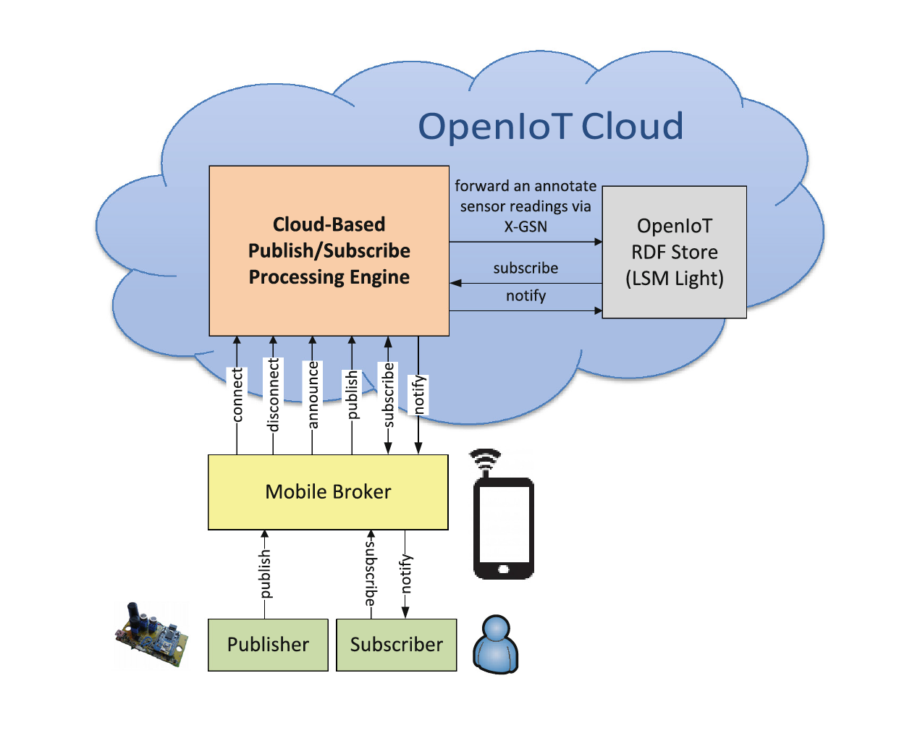
publish/subscribe architecture

Slide 6
IDE and quality management
The OpenIoT IDE is a zero-programming environment.
CUPUS seamlessly manages mobile sensors by making th sensors announce their data sources each time they enter a new geographic area
It can also create a new virtual sensor each time the mobile device enters a new geographic area.
OpenIoT addresses quality concerns (energy efficiency, network resource consumption, latency etc).

Slide 7
p-o-c applications
The phenonet experiment needed real-time data collection and annotation.
The urban crowd sensing application involved people wearing sensors moving around a city. OpenIoT’s inbuilt supports for mobile sensors facilitated this.
OpenIoT helped the Smart Campus application converge all static data and sensor data into one cyber-physical context.

Slide 8
OpenIoT is thus currently the best and most streamlined platform for IoT application deployment and management; at both a small and a large scale.
With its seamless integration of the cloud and sensors, it is future-proof and is here to stay.
Conclusion

