Slide 1
Portfolio Diversifier
Sangram Singh, Rodrigo Monge, Dylan Bowsky, George Kraft,

Slide 2
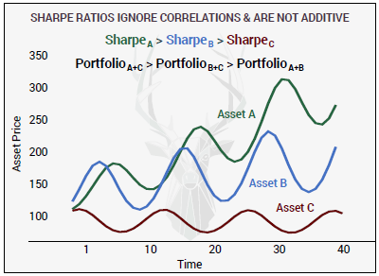
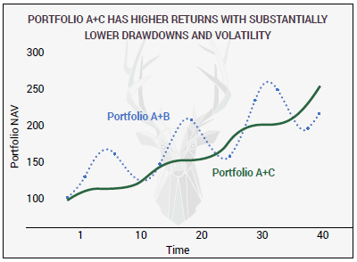
Why not Sharpe?

Slide 3
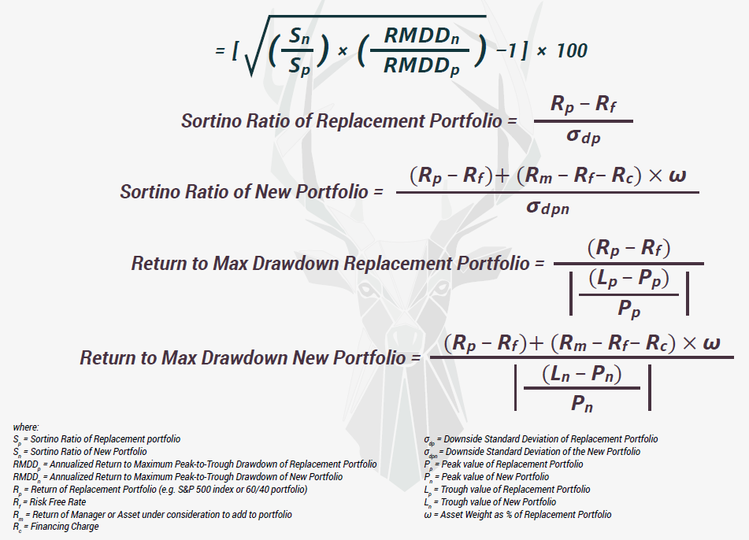
WARP Win Above Replacement/Base Portfolio (courtesy Artemis Capital Management)

Slide 4

WARP™ IS EASY TO USE
WARP™ > 0
ASSET IS IMPROVING YOUR PORTFOLIO BY INCREASING:
1. Return to Downside Volatility;
2. Return to MAX Drawdown;
3. Or BOTH.
WARP™ < 0
ASSET HURTS YOUR PORTFOLIO BY REPLICATING EXISTING EXPOSURES AND/OR INCREASING DRAWDOWNS AND VOLATILITY.

Slide 5
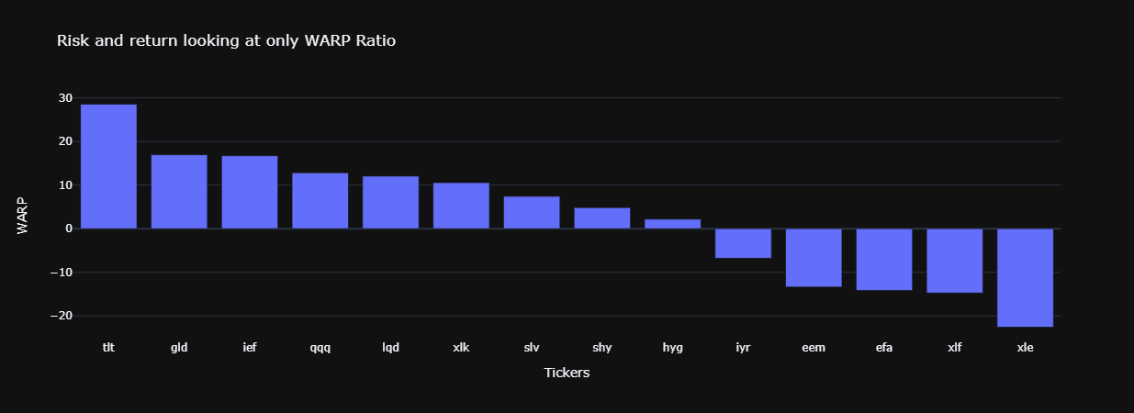
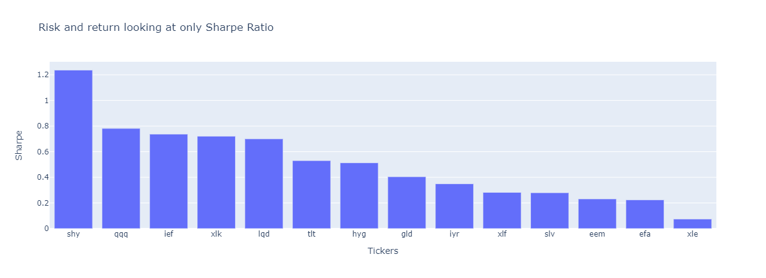

Slide 6
Diversifiers Idenitified
tlt 20+ Year Treasury bond ETF
shy 1 to 3 Year Treasury bond ETF
gld Gold ETF

Slide 7
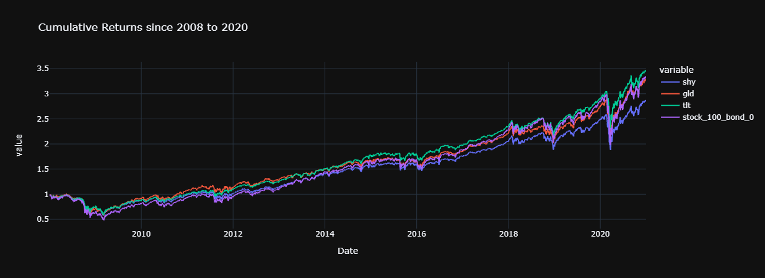

Slide 8

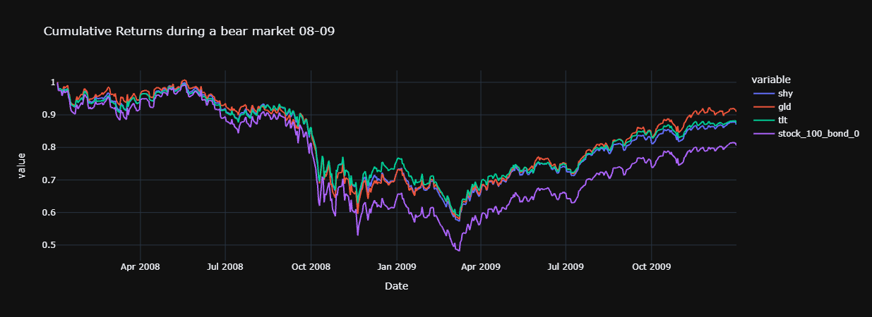

Slide 9
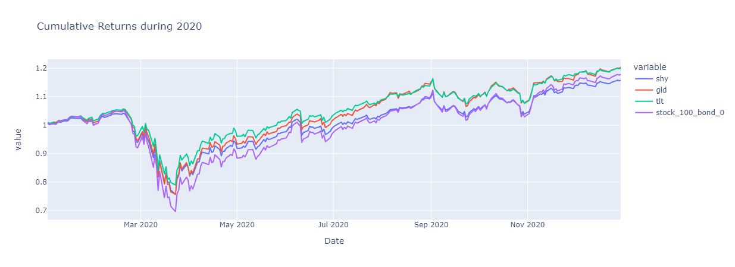

Slide 10
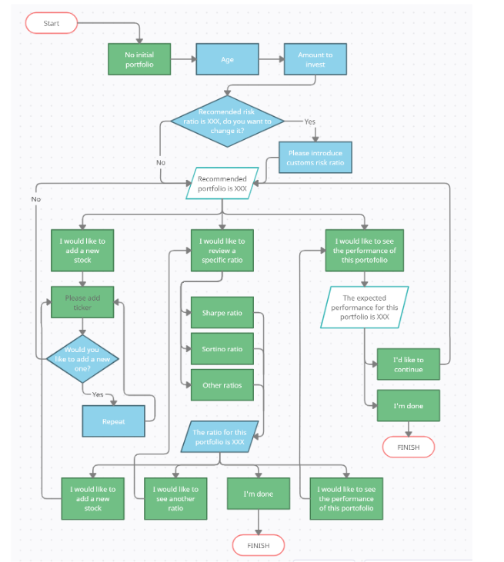
UI Flow

Slide 11
Application UI Demonstration

Slide 12
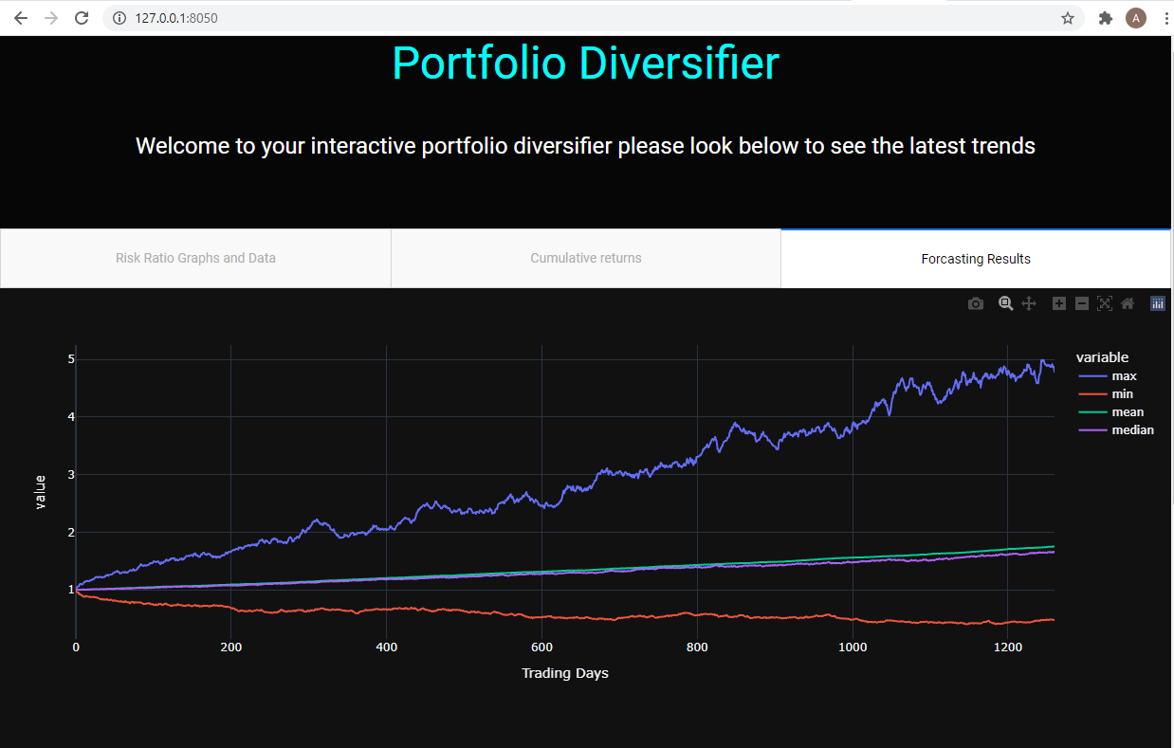
Visualize Output through Dash

Slide 13

Dash next steps
Launching full web application
Integrating questions from our questionary
Making daily updates on ratios

Slide 14
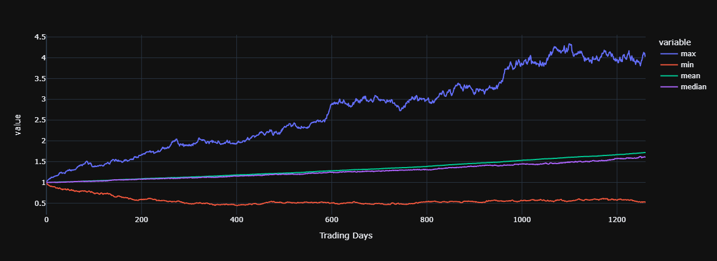
Forecasting of Portfolio consisting of 20%
tlt and 64% spy (stock) and 36% ier (bond)
using Monte Carlo
count 500
mean 1.523473
std 0.359308
min 0.823825
25% 1.264320
50% 1.498127
75% 1.737534
max 3.029722
95% CI -
Lower 0.943032
Upper 2.314443
There is a 95% chance that an initial investment of
$10,000 in the portfolio
Returns $9430.32 to $23144.43.

Slide 15
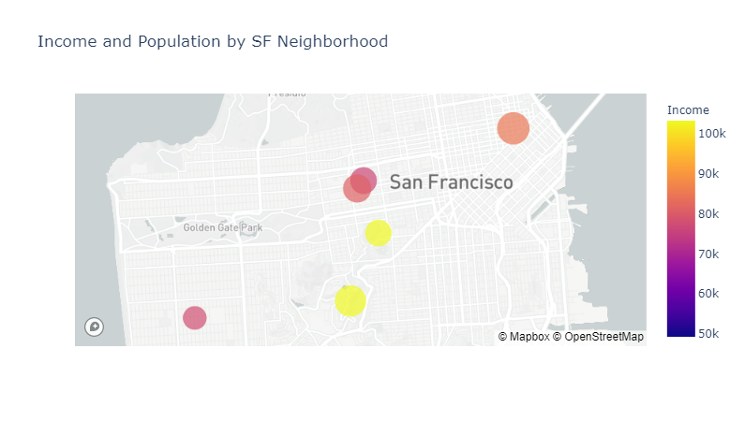
Identifying Target Customers San Francisco Neighborhoods by Income and Population

Slide 16
Future Enhancements

Slide 17
Q&A

Slide 18
Technology

