Slide 1
Portfolio Diversifier
Sangram Singh, George Kraft, Rodrigo Monge, Dylan Bowsky

Slide 2
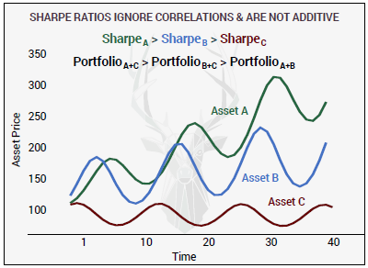
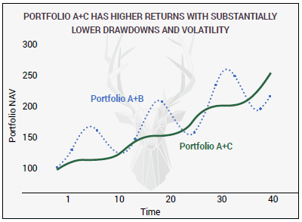
Why not Sharpe?

Slide 3
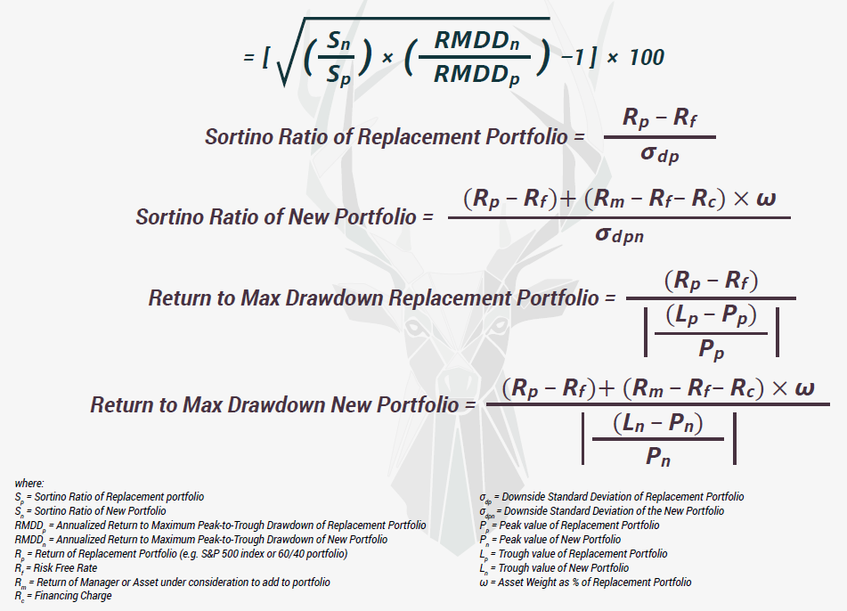
WARP Win Above Replacement/Base Portfolio (courtesy Artemis Capital Management)

Slide 4

WARP™ IS EASY TO USE
WARP™ > 0
ASSET IS IMPROVING YOUR PORTFOLIO BY INCREASING:
1. Return to Downside Volatility;
2. Return to MAX Drawdown;
3. Or BOTH.
WARP™ < 0
ASSET HURTS YOUR PORTFOLIO BY REPLICATING EXISTING EXPOSURES AND/OR INCREASING DRAWDOWNS AND VOLATILITY.

Slide 5
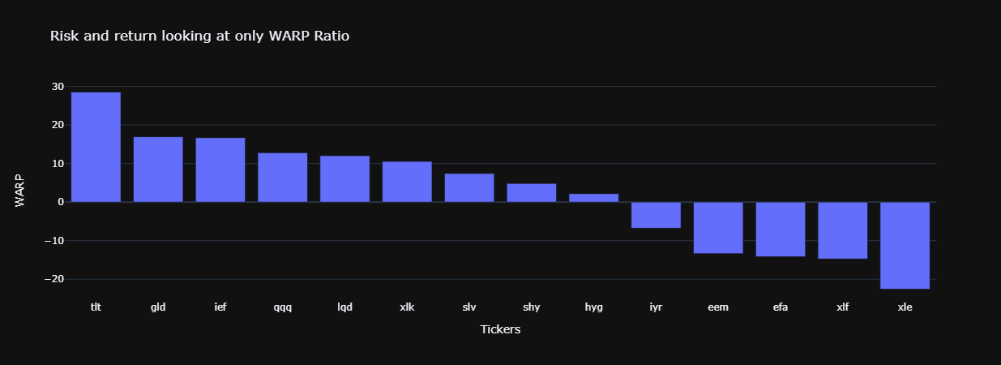
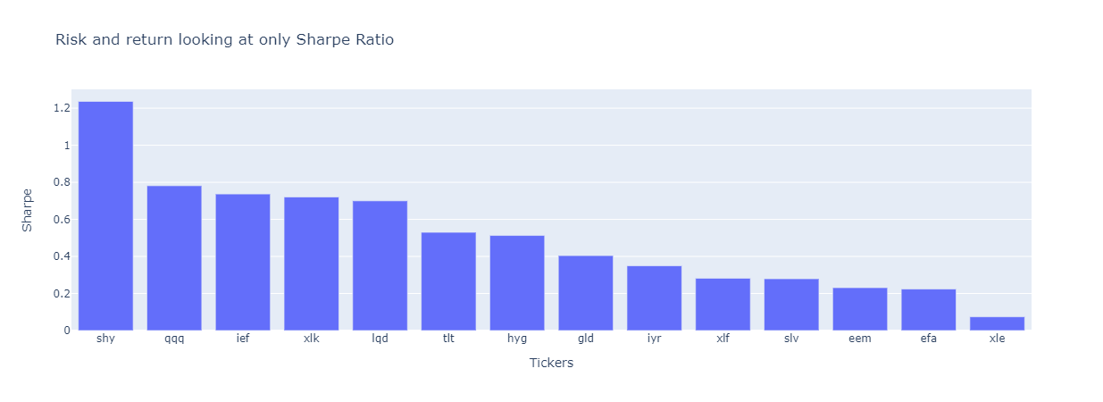

Slide 6
Diversifiers Idenitified
tlt 20+ Year Treasury bond ETF
shy 1-3 Year Treasury bond ETF
gld Gold ETF

Slide 7
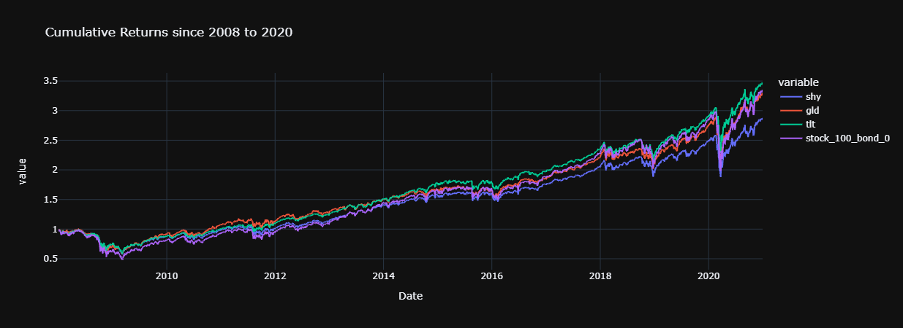

Slide 8

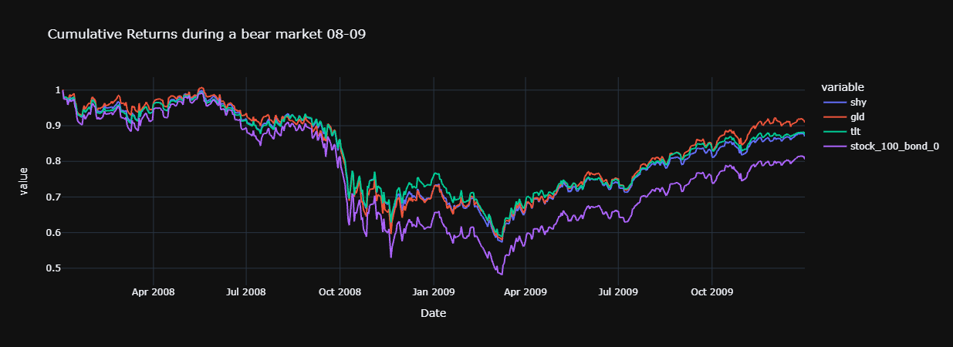

Slide 9
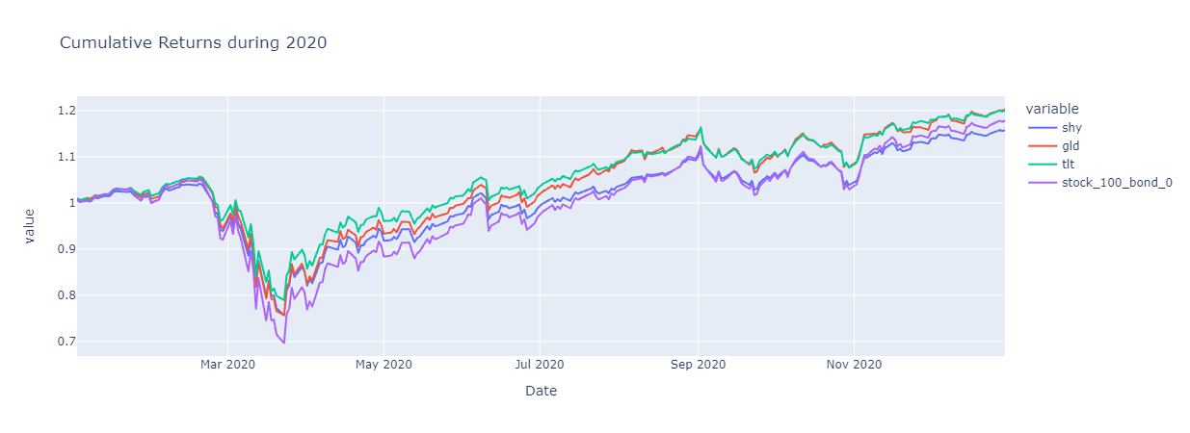

Slide 10
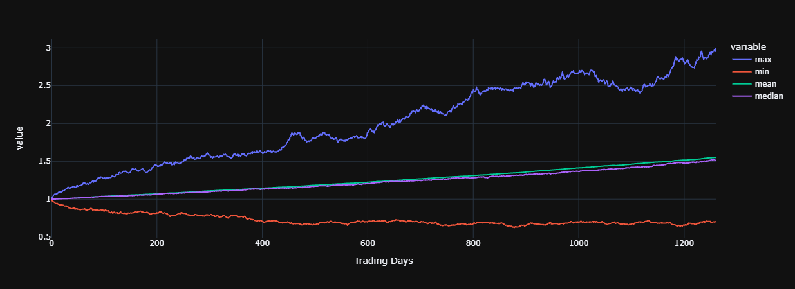
Portfolio consisting of 20%
and 48% spy (stock) and 32% ier (bond)
Monte Carlo
Forecasting of
tlt (diversifier)
using
count 500
mean 1.55
std 0.37
min 0.69
25% 1.29
50% 1.51
75% 1.76
max 2.95
95% CI -
Lower 0.91
Upper 2.41
There is a 95% chance that an initial investment of
$10,000 in the portfolio
Returns $9071.96 to $24128.53.

Slide 11
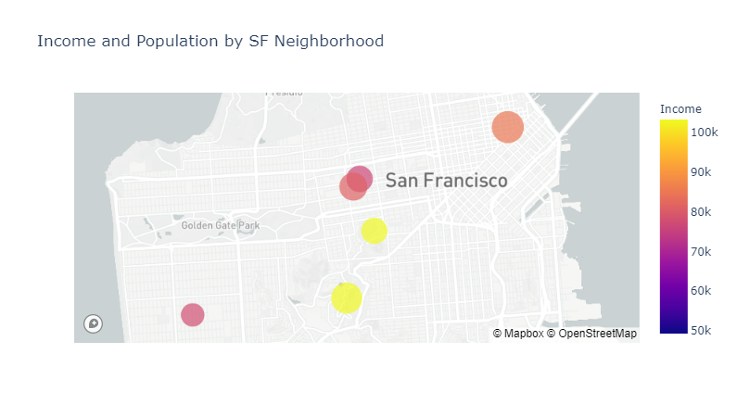
Identifying Target Customers San Francisco Neighborhoods by Income and Population
Buena Vista Park
Clarendon Heights

Slide 12
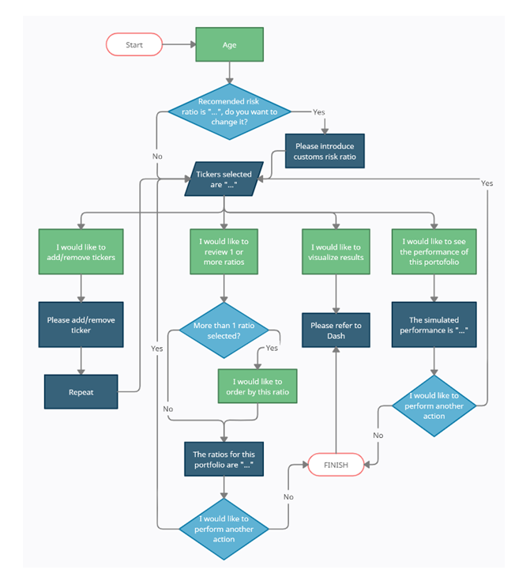
UI Flow

Slide 13
Application UI Demonstration

Slide 14
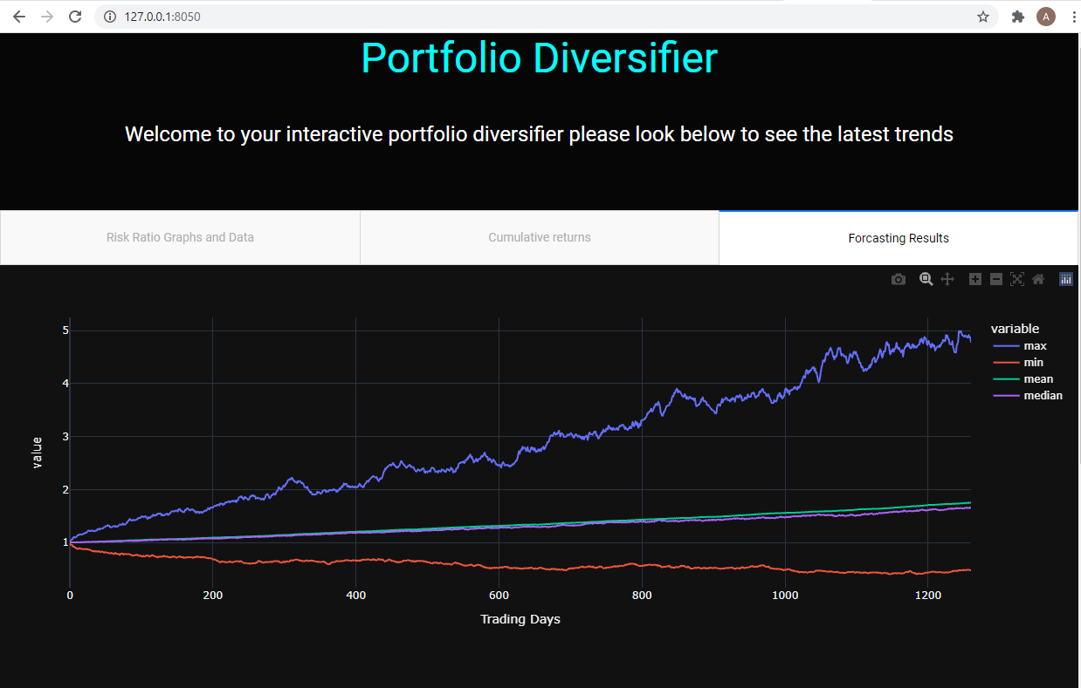
Visualize Output through Dash

Slide 15
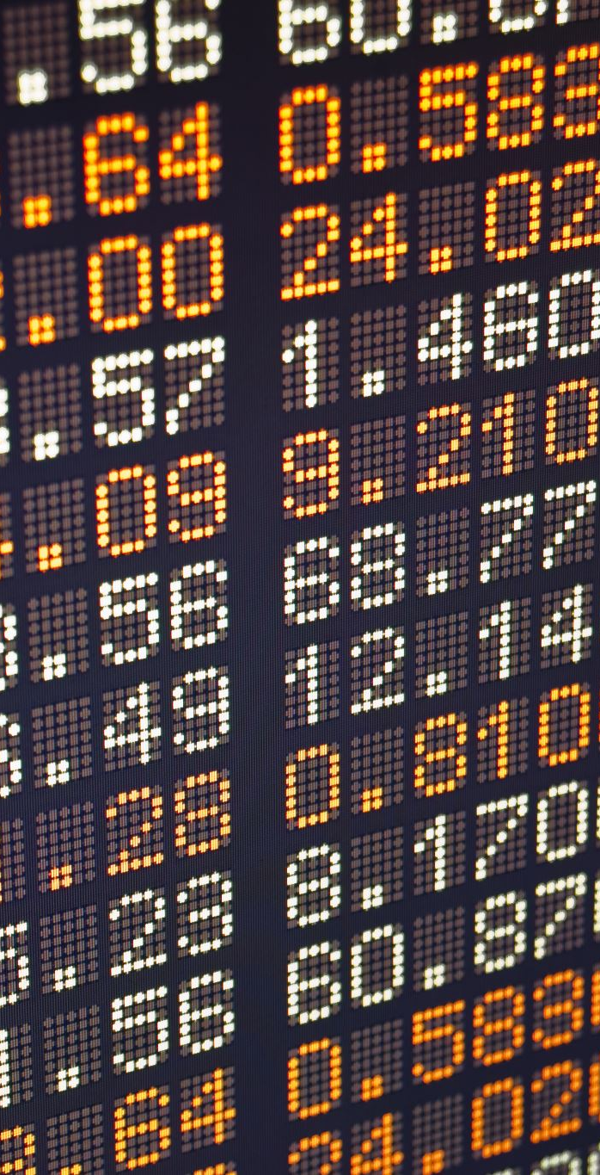
Dash next steps
Launching full web application
Integrating questions from our questionary
Making daily updates on ratios

Slide 16
Conclusions
tlt is the best diversifier
WARP allows us to easily identify a good diversifier and does not suffer from some of the flaws of common ratios such as Sharpe
Diversifier identified by WARP allows us to perform better than the market in both the bull and bear periods.

Slide 17
Future Enhancements
Release the MVP to the early adopters
Productize the MVP & Make it web based
Provide Daily and Monthly Rebalancing of Portfolios
Provide Optimization of Portfolio based on tickers selected.
Flexibility with adding tickers
Add Customized Portfolios & recursively add portfolios
Integrate UI with Dash
Tiered Pricing with Premium Personal & Specialized Support
Add options to change portfolio weights
Add Treynor, Information ratio and other diversification metrics for comparison
Explore Long Volatility and other funds as diversifiers

Slide 18
Q & A

Slide 19
Technology Used
Python 3.7
Visual Studio Code
Jupyter Lab
Github
Yfinance
Mapbox
Dash
Monte Carlo
Pathlib
Fire
Plotly
Pandas
Matplotlib
External Style Sheets
Questionary

