Slide 1
Portfolio Diversifier
Identify potential diversifiers based on standard and cutting edge ratios
Analyze the impact of these diversifiers
Sangram Singh, Dylan Bowsky, George Kraft, Rodrigo Monge

Slide 2
Diversifiers Analyzed
tlt 20+ Year Treasury bond ETF
shy 1 to 3 Year Treasury bond ETF
gld Gold ETF

Slide 3
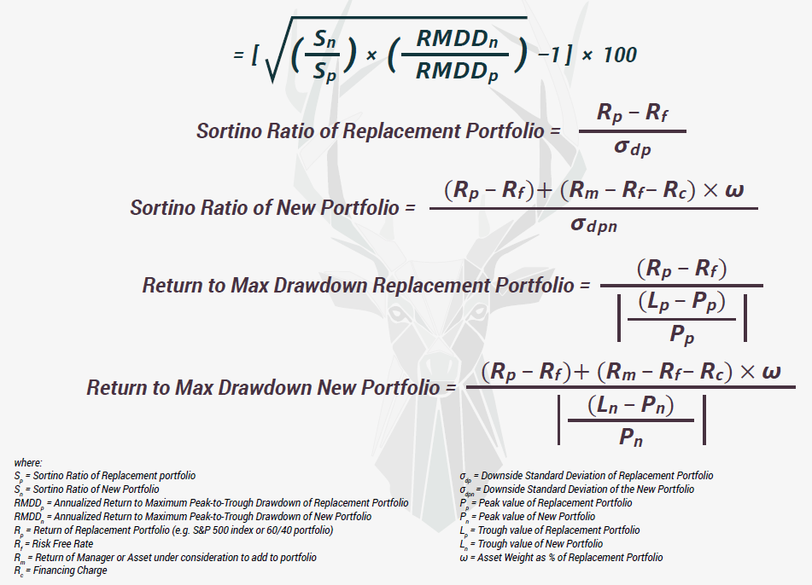
WABP – Win Above Base/Replacement Portfolio (courtesy Artemis Capital Management)

Slide 4
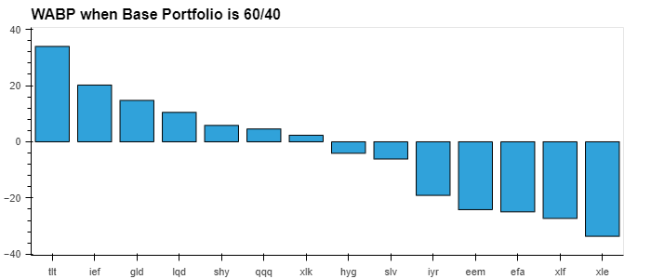

Slide 5
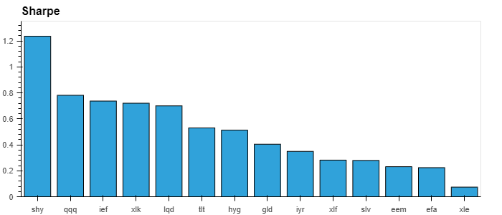

Slide 6
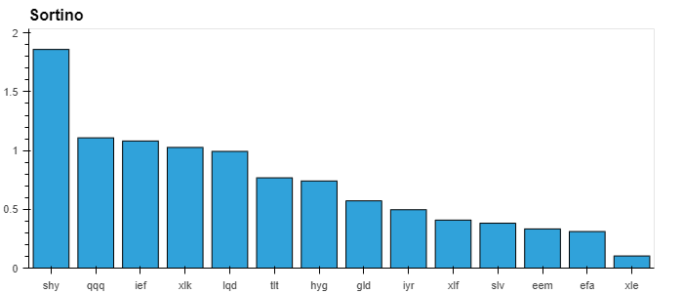

Slide 7
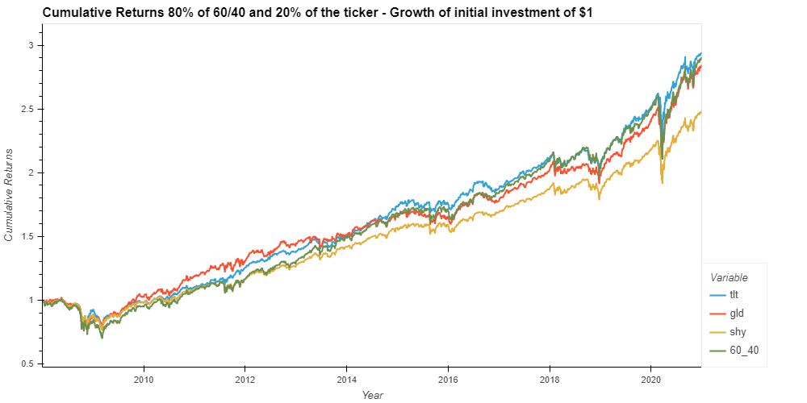

Slide 8
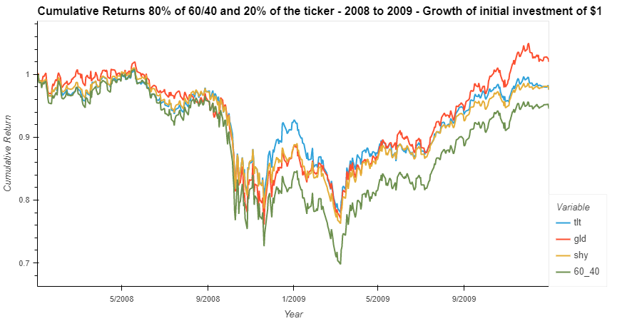

Slide 9
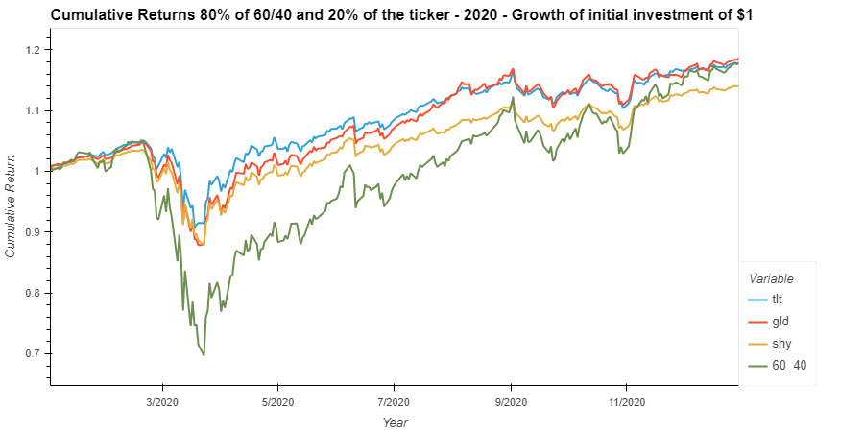

Slide 10
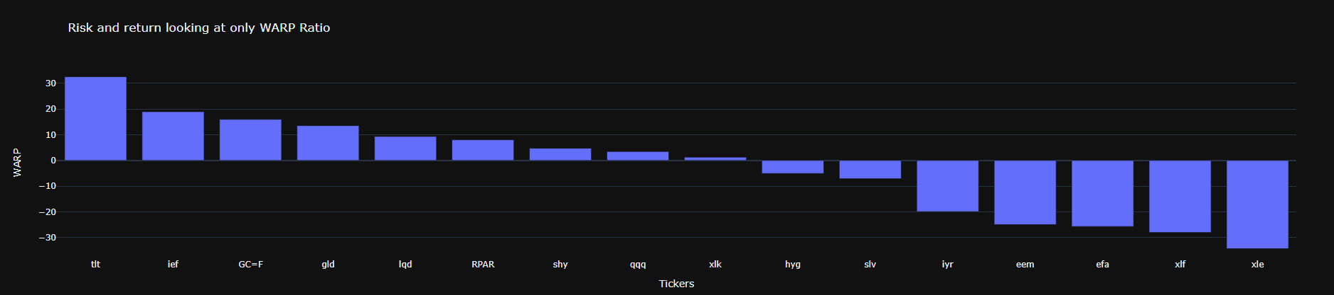
Welcome to your dashboard

Slide 11

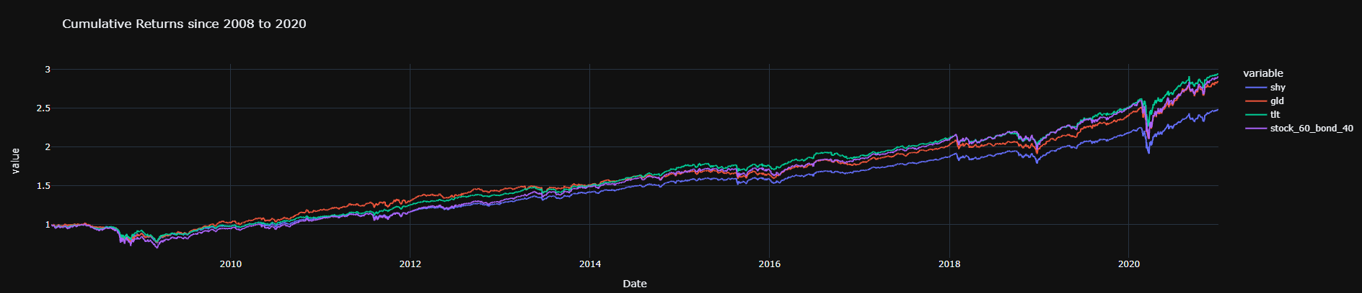
Cumulative Returns

Slide 12
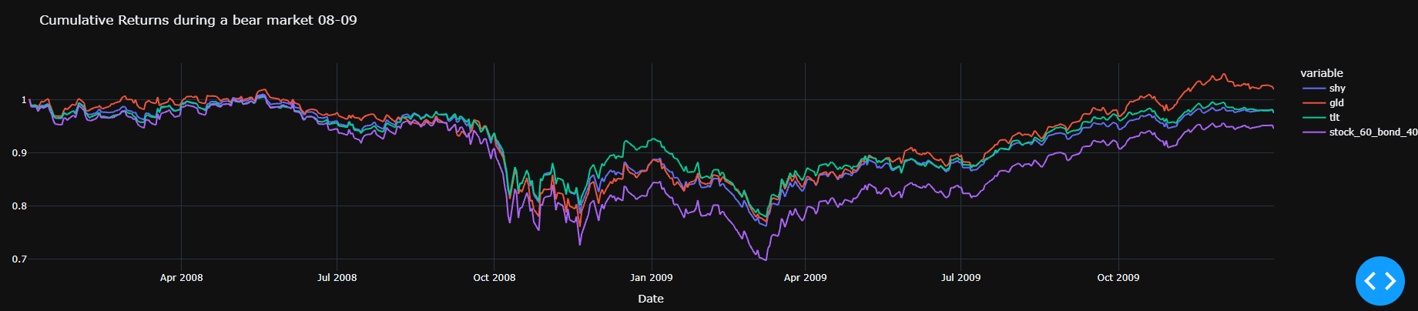

08 crash

Slide 13
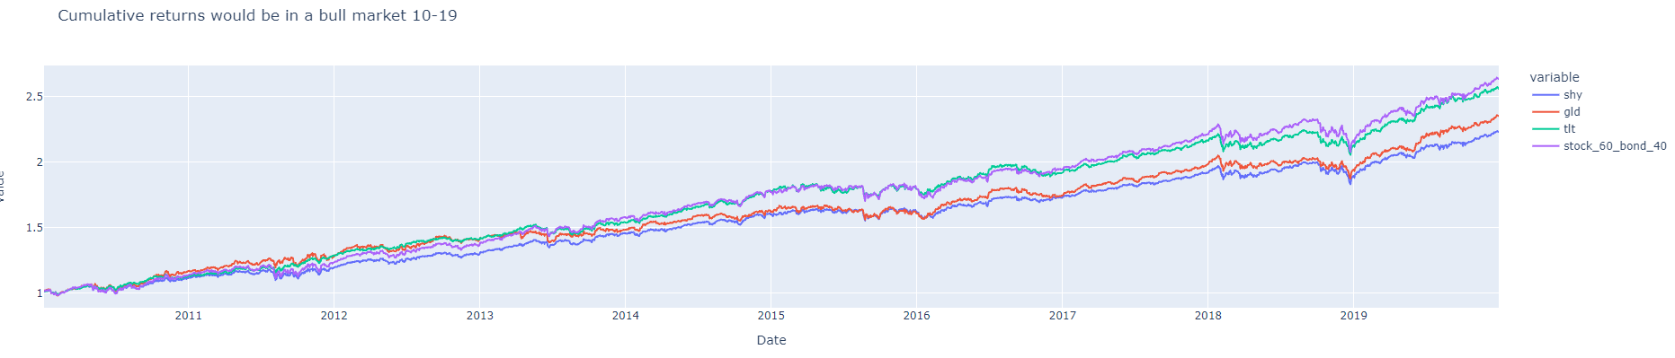

Bull Market

Slide 14
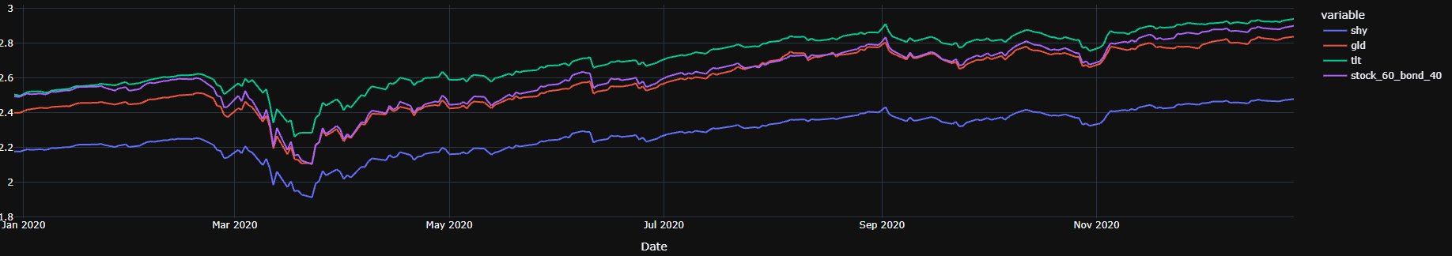

2020 insight

Slide 15

Dash next steps
Launching full web application
Integrating questions from our questionary
Making daily updates on ratios

Slide 16
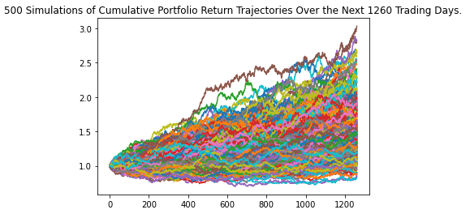
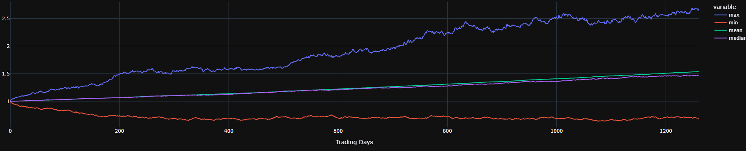
Forecasting for the next five years internal graph vs clients graph
Internal
Client Facing

Slide 17
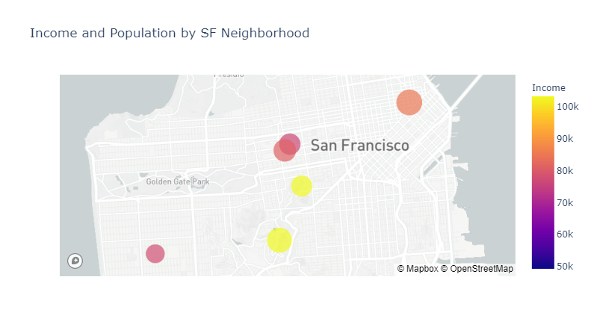
Identifying Target Customers San Francisco Neighborhoods by Income and Population

Slide 18
