Slide 1
Portfolio Diversifier
Identify potential diversifiers based on standard and cutting edge ratios
Analyze the impact of these diversifiers
Sangram Singh, Dylan Bowsky, George Kraft, Rodrigo Monge

Slide 2
Diversifiers Analyzed
tlt 20+ Year Treasury bond ETF
shy 1 to 3 Year Treasury bond ETF
gld Gold ETF

Slide 3
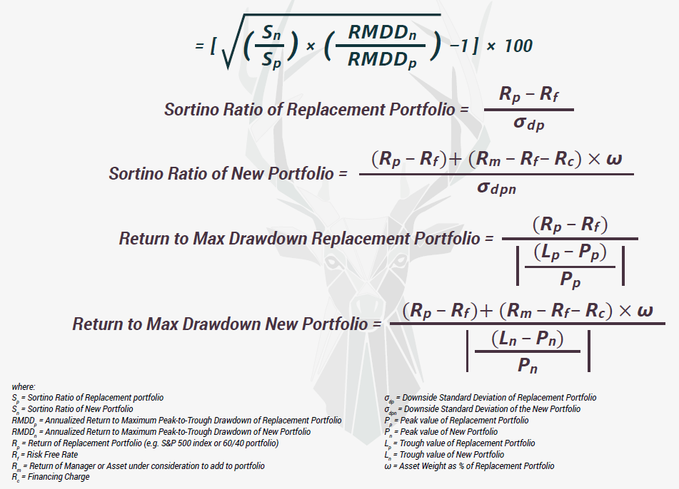
WABP – Win Above Base/Replacement Portfolio (courtesy Artemis Capital Management)

Slide 4
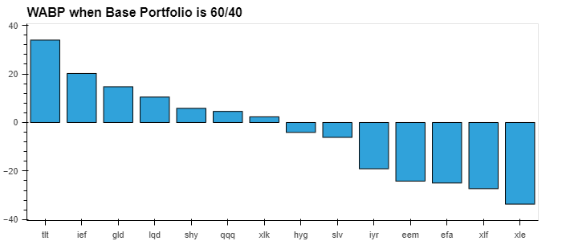

Slide 5
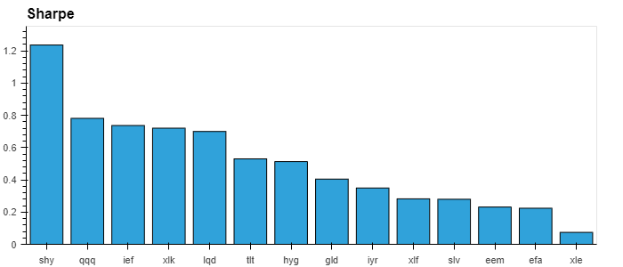

Slide 6
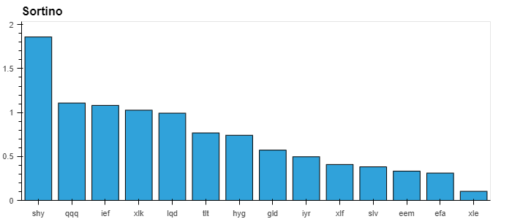

Slide 7
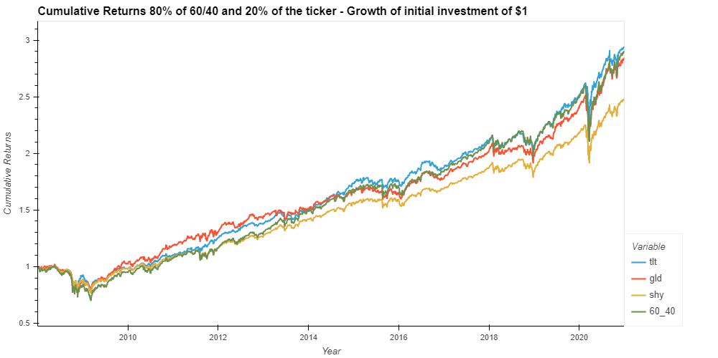

Slide 8
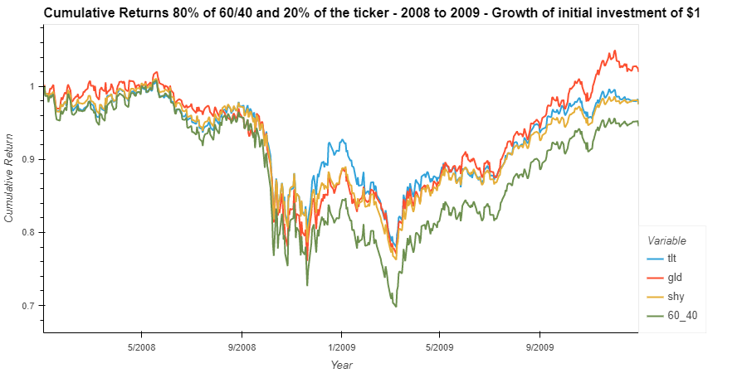

Slide 9
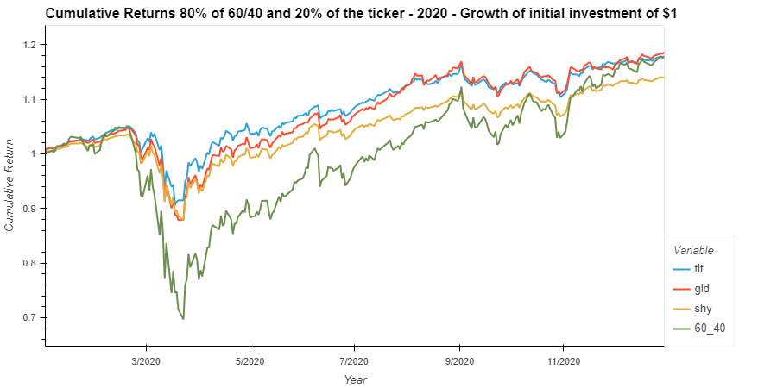

Slide 10
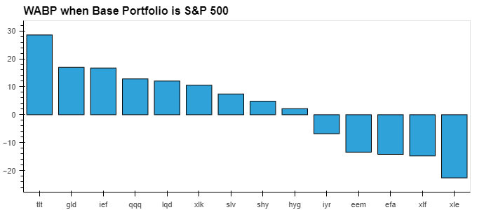

Slide 11
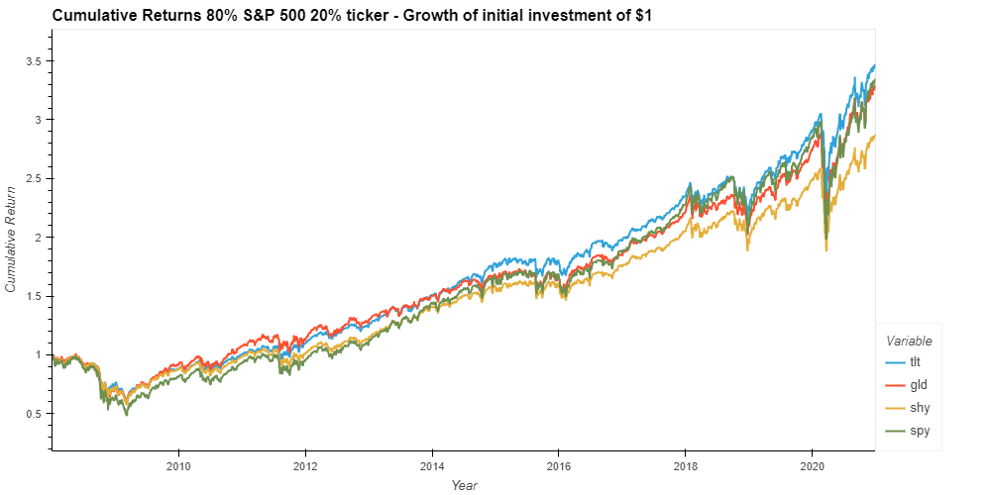

Slide 12
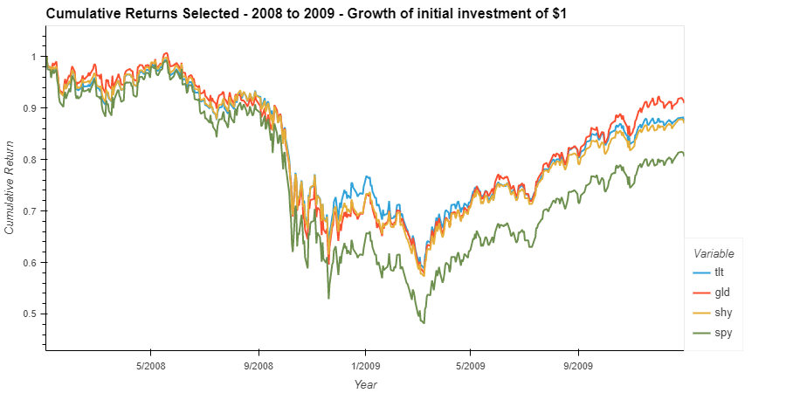

Slide 13
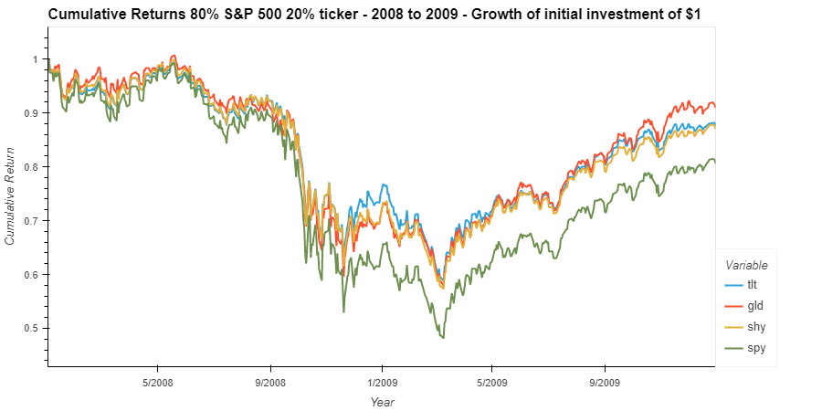

Slide 14
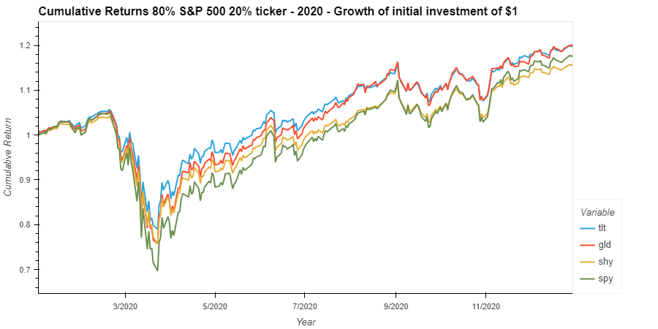

Slide 15
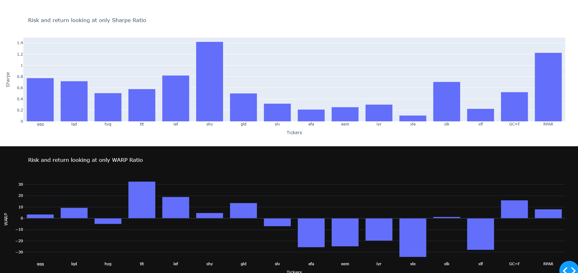
Dash Output

Slide 16
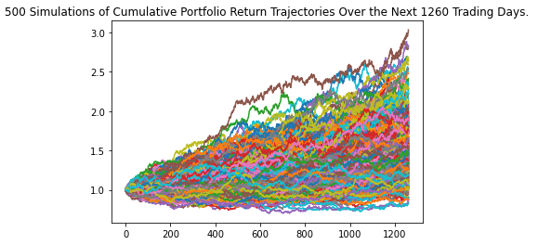
count 500.000000
mean 1.523473
std 0.359308
min 0.823825
25% 1.264320
50% 1.498127
75% 1.737534
max 3.029722 95%
CI Lower 0.943032 95%
CI Upper 2.314443
There is a 95% chance that an initial investment of $10,000 in the portfolio $9430.32 and $23144.43.

Slide 17
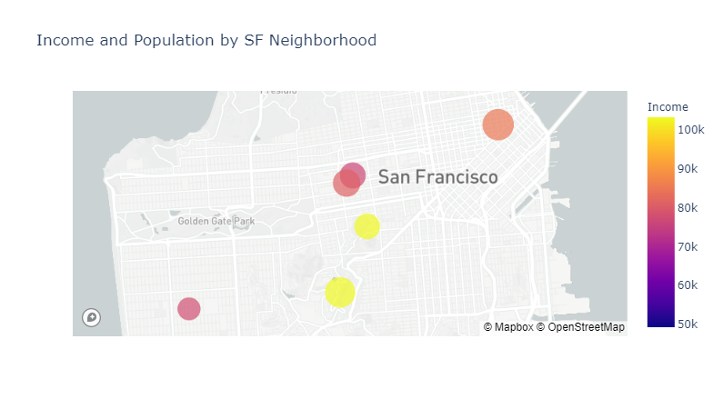
Identifying Target Customers San Francisco Neighborhoods by Income and Population

Slide 18
