Slide 1
Portfolio Diversifier
Sangram Singh, George Kraft, Rodrigo Monge, Dylan Bowsky

Slide 2
Executive Summary and Project Goals
Identify the best tool to pick tickers for diversification
Show why using Sharp is not a good idea to pick tickers for diversification
Introduce WARP and show how easy it to use and why it is better than Sharpe
Pick tickers using WARP and Sharpe and compare them
Analyze the data from 2008 to 2020 to show that WARP performs better than Sharpe and provides more protection in bear markets and downturns
Identify the best ticker for diversification based on the historical analysis and the best available tool.
Use Monte Carlo to Forecast the performance of a portfolio based on the best ticker identified
Identify Target Customers for the application
Use questionary and Dash to provide a seamless UI for the customers to easily navigate their diversification needs with a guided interface which provides recommendations

Slide 3
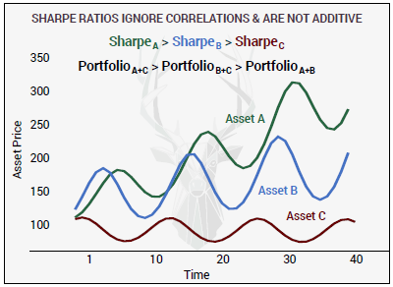
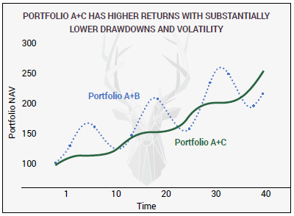
Why not Sharpe?

Slide 4
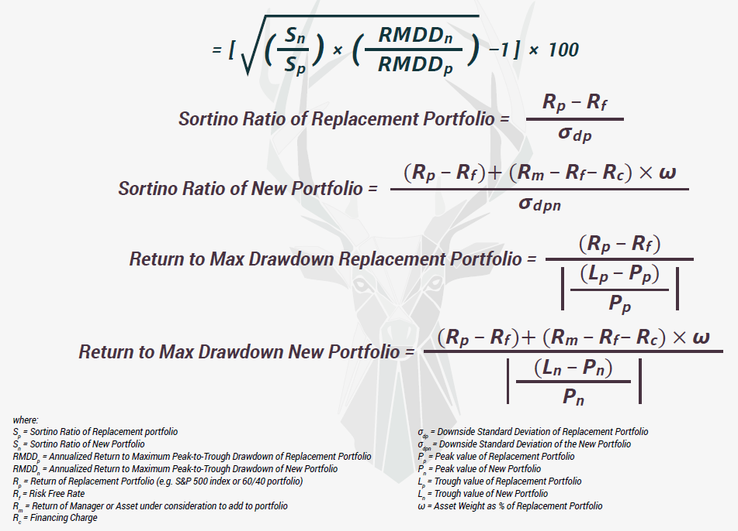
WARP Win Above Replacement/Base Portfolio (courtesy Artemis Capital Management)

Slide 5

WARP™ IS EASY TO USE
WARP™ > 0
ASSET IS IMPROVING YOUR PORTFOLIO BY INCREASING:
1. Return to Downside Volatility;
2. Return to MAX Drawdown;
3. Or BOTH.
WARP™ < 0
ASSET HURTS YOUR PORTFOLIO BY REPLICATING EXISTING EXPOSURES AND/OR INCREASING DRAWDOWNS AND VOLATILITY.

Slide 6
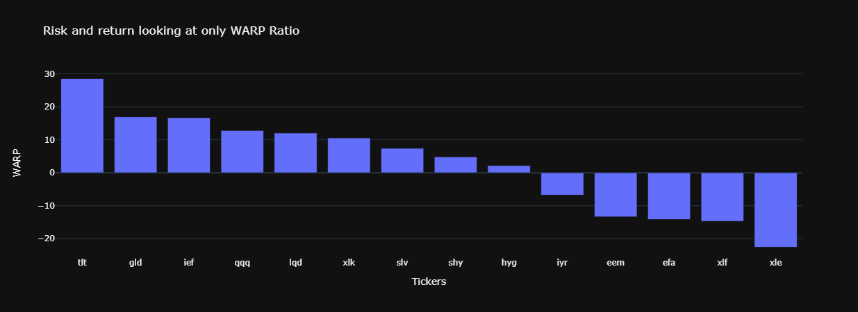
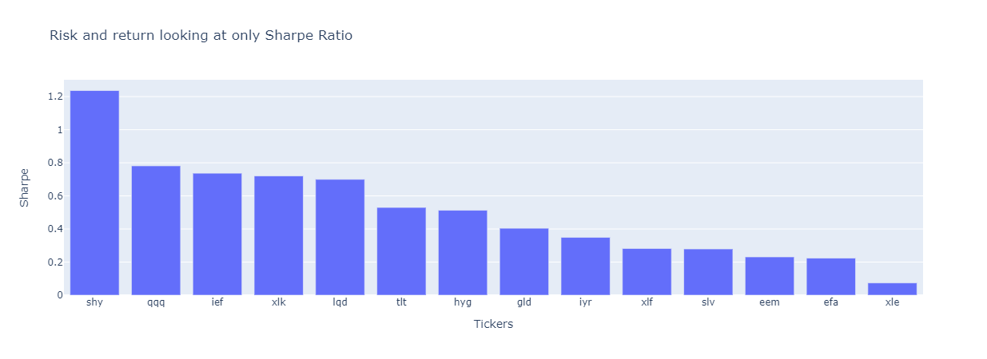
WARP suggests tlt and gld are the best diversifiers
Sharpe suggests shy is the best diversifier

Slide 7
Diversifiers Identified using WARP and Sharpe
tlt 20+ Year Treasury bond ETF (WARP)
shy 1-3 Year Treasury bond ETF (Sharpe)
gld Gold ETF (WARP)

Slide 8
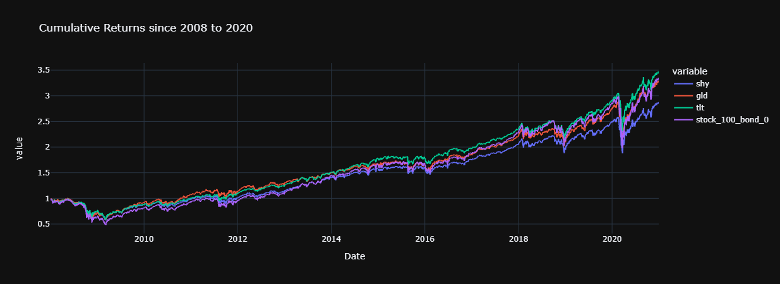
portfolio with tlt (WARP) as the diversifier performs better than the market and portfolio with shy (Sharpe) performs the worst

Slide 9

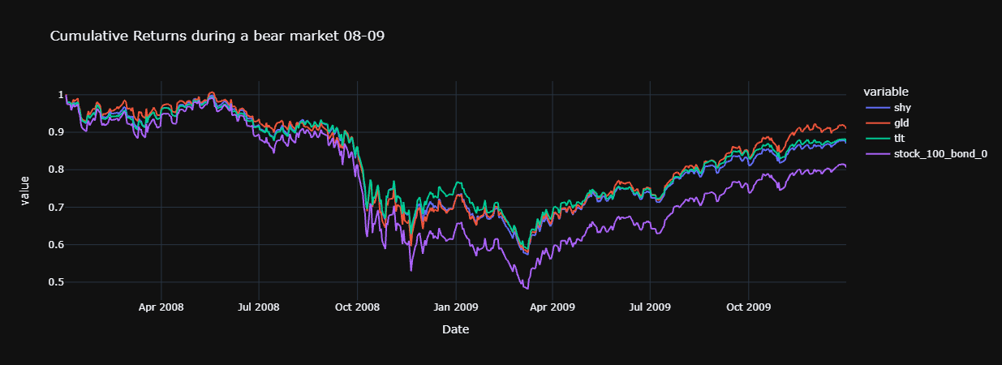
portfolio with tlt (WARP) and gld (WARP) as the diversifier performs better than the market and provide more downside protection

Slide 10
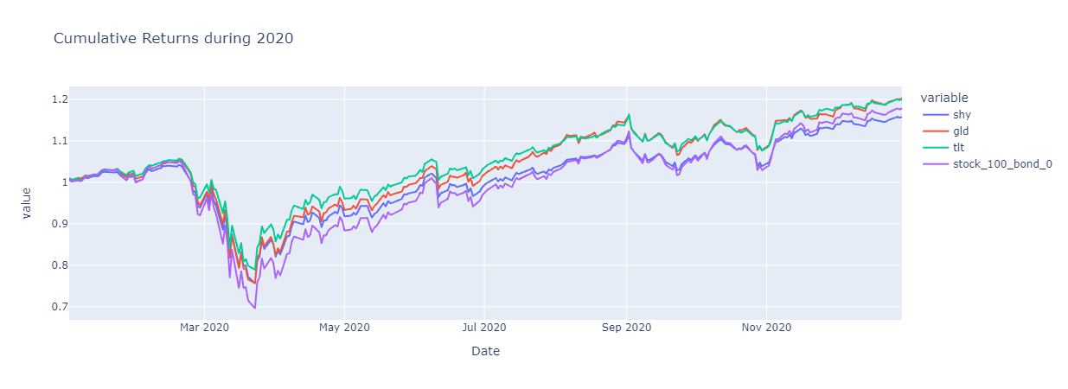
portfolio with tlt (WARP) and gld (WARP) as the diversifier performs better than the market and provide more downside protection and better recovery in the Pandemic than the portfolio with shy (Sharpe)

Slide 11
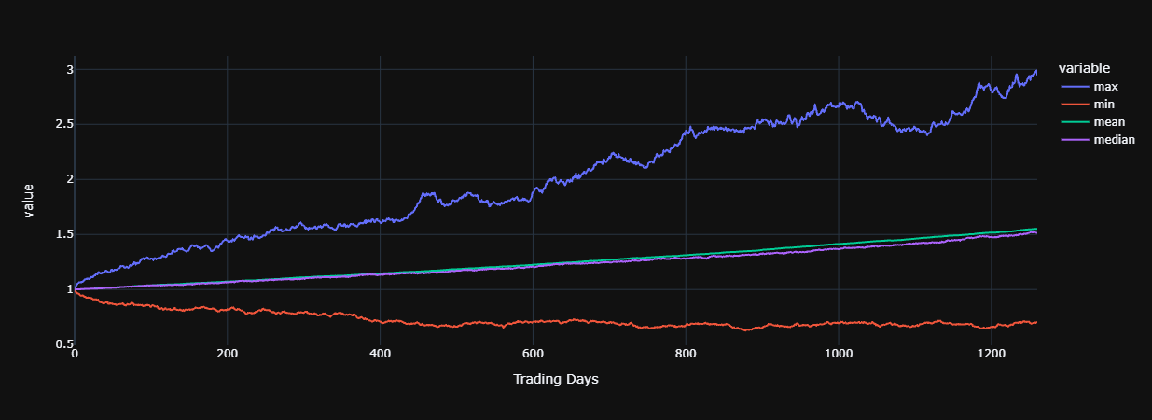
Forecasting of portfolio
from historical analysis)
using
consisting of 20% tlt (best diversifier
and 48% spy (stock) and 32% ier (bond)
Monte Carlo
count 500
mean 1.55
std 0.37
min 0.69
25% 1.29
50% 1.51
75% 1.76
max 2.95
95% CI -
Lower 0.91
Upper 2.41
There is a 95% chance that an initial investment of
$10,000 in the portfolio
Returns $9071.96 to $24128.53.

Slide 12
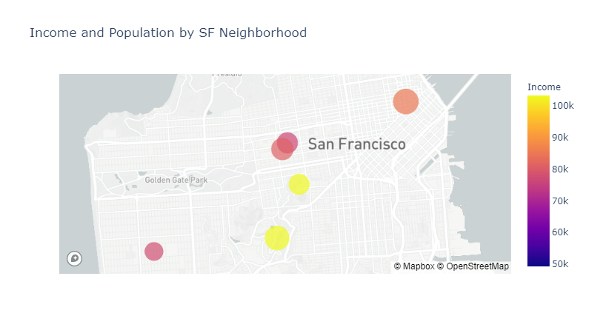
Identifying Target Customers San Francisco Neighborhoods by Income and Population
Buena Vista Park
Clarendon Heights

Slide 13
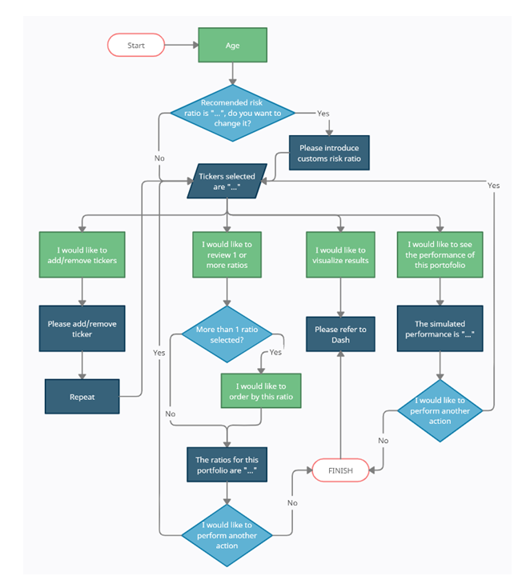
UI Flow

Slide 14
Application UI Demonstration

Slide 15
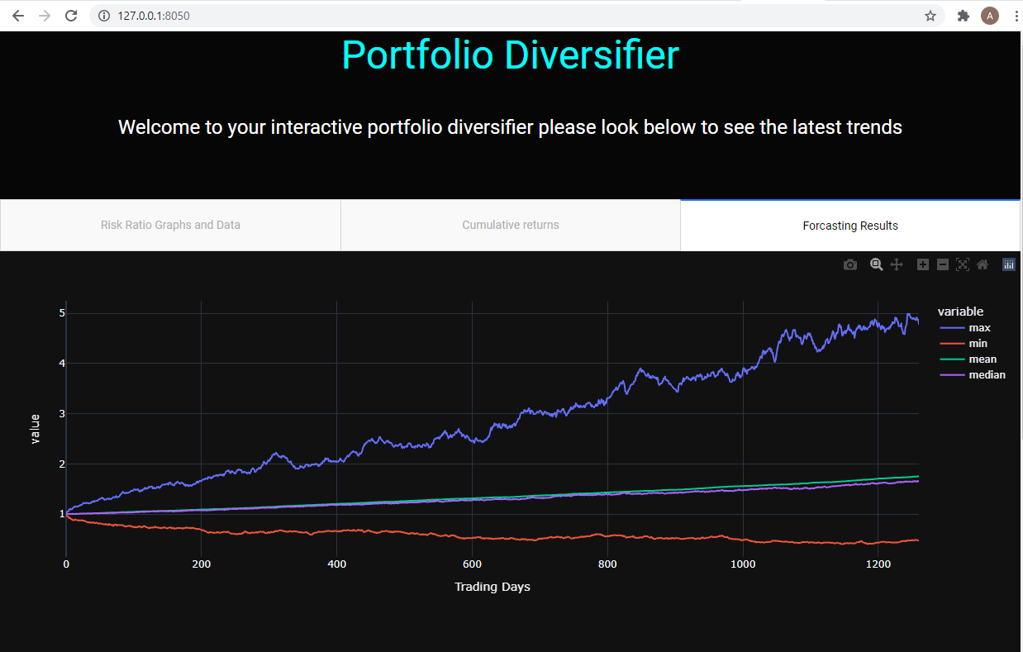
Visualize Output through Dash

Slide 16
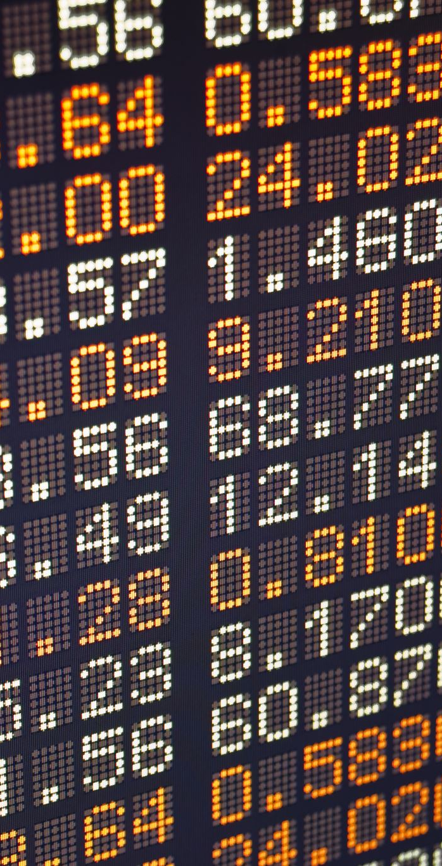
Dash next steps
Launching full web application
Integrating questions from our questionary
Making daily updates on ratios

Slide 17
Conclusions
tlt is the best diversifier out of the list of known diversifiers
portfolio mixing 20% tlt (picked based on WARP) with 80% spy performs better than portfolio mixing 20% shy (picked based on Sharpe) with 80% spy
WARP allows us to easily identify a good diversifier and does not suffer from some of the flaws of common ratios such as Sharpe
Diversifier identified by WARP allows us to perform better than the market and the diversifiers identified using other ratios (such as Sharpe, etc.) in both the bull and bear periods.
Sharpe is not a good way to identify tickers for diversification.
Buena Vista Park and Clarendon Heights in San Francisco are ideal initial neighborhoods to target customers for this application.
Questionary and Dash provide a seamless UI/Front end experience for customers to easily navigate through their diversification requirements and provide a guided experience with recommendations.

Slide 18
Future Enhancements/Next Steps
Release the MVP to the early adopters
Productize the MVP & Make it web based
Provide Daily and Monthly Rebalancing of Portfolios
Provide Optimization of Portfolio based on tickers selected.
Flexibility with adding tickers
Add Customized Portfolios & recursively add portfolios
Integrate UI with Dash
Tiered Pricing with Premium Personal & Specialized Support
Add options to change portfolio weights
Add Treynor, Information ratio and other diversification metrics for comparison
Explore Long Volatility and other funds as diversifiers

Slide 19
Q & A

Slide 20
Technology Used
Python 3.7
Visual Studio Code
Jupyter Lab
Github
Yfinance
Mapbox
Dash
Monte Carlo
Pathlib
Fire
Plotly
Pandas
Matplotlib
External Style Sheets
Questionary

