Slide 1

Department of Computer Science and Engineering
EMBEDDED PROGRAMMING
CHARGE LINK
Presentation by
S T Mithun
Nanthiswaran S P
Supervisor
EMBEDDED PROGRAMMING PROJECT FIRST- REVIEW

Slide 2
CONTENTS
Introduction
Problem Statement
Project Description
Aim and Scope of the Proposed work
Literature Survey
Hardware Component
Block Diagram Design
Future Scope
EMBEDDED PROGRAMMING PROJECT FIRST- REVIEW

Slide 3
Introduction
Modern smartphones support multiple fast-charging technologies such as USB-PD, PPS, QC, VOOC, Warp Charge, HyperCharge and other proprietary protocols.
Although chargers may provide high output power, phones from different manufacturers often cannot utilize the maximum supported charging capability because each ecosystem follows different communication methods and charging policies.
The proposed Smart Bypass Charger is an inline smart device placed between the charger and the phone. It aims to improve charging compatibility where technically feasible, while also providing real-time charging analysis, monitoring, and data logging.
EMBEDDED PROGRAMMING PROJECT FIRST- REVIEW

Slide 4
Problem Statement
Modern smartphones support high-speed charging using various fast-charging technologies. However, each smartphone manufacturer often implements its own charging communication protocol. As a result, even if a charger and a phone both support the same power rating, they may not negotiate the highest charging mode when used across different brands.
EMBEDDED PROGRAMMING PROJECT FIRST- REVIEW

Slide 5
Project Description
The Charge Link is a portable inline device that is connected between a charger and a smartphone. It is designed to monitor charging communication, analyze charging parameters, and explore compatibility optimization between different fast-charging protocols.
The system identifies the connected charger and smartphone, records charging behavior, and measures real-time voltage, current, power. It also provides charging analytics, battery wear estimation, and maintains charging profiles for future compatibility improvements
EMBEDDED PROGRAMMING PROJECT FIRST- REVIEW

Slide 6
Aim and Scope of the Proposed work
Aim
Develop a smart inline charging device for charging analysis and compatibility optimization.
Monitor charging parameters in real time.
Explore protocol-aware charging optimization.
Scope
Charger & phone detection
Voltage, current, power & temperature monitoring
Charging communication analysis
Compatibility optimization
Battery wear estimation
Offline operation with future firmware updates
Expandable platform for app and cloud support
EMBEDDED PROGRAMMING PROJECT FIRST- REVIEW

Slide 7
Literature Survey
Paper | Author(s) | Limitation | How Charge Link Overcomes It
USB Type-C Power Delivery for Portable Devices | USB Implementers Forum (USB-IF), IEEE referenced standard | Focuses on USB-PD negotiation only; does not analyze charging behavior or battery health. | Charge Link adds real-time monitoring, charging analytics, battery wear estimation, and charging profile management.
A Smart Battery Management System for Lithium-Ion Batteries | M. Chen, G. A. Rincón-Mora (IEEE) | Focuses on battery protection and State-of-Charge estimation; does not address charger–phone compatibility. | Charge Link combines battery analysis with charger compatibility optimization and charging communication analysis.
Design of a USB Type-C Power Delivery Controller for Fast Charging Applications | H. Kim et al. (IEEE) | Limited to implementing USB-PD controller hardware without user analytics or data logging. | Charge Link integrates ESP32-based monitoring, OLED display, data logging, and future firmware-based profile updates.
An IoT-Based Battery Monitoring System for Portable Devices | S. Kumar et al. (IEEE) | Monitors battery parameters remotely but lacks charging protocol analysis and optimization. | Charge Link performs inline charging analysis, protocol-aware monitoring, and compatibility optimization while charging.
Battery Health Estimation Using Charging Profile Analysis | J. Zhang et al. (IEEE) | Estimates battery health but does not optimize charging communication or support cross-device compatibility. | Charge Link combines battery wear estimation with charging communication analysis and compatibility enhancement in one portable device.
EMBEDDED PROGRAMMING PROJECT FIRST- REVIEW

Slide 8
Literature Survey
Consumer Product | Manufacturer | Limitation | How Charge Link Overcomes It
ChargerLAB POWER-Z KM003C | ChargerLAB | Displays charging parameters but does not optimize charging or store device profiles. | Provides real-time monitoring along with charging profile management and compatibility analysis.
AVHzY CT-3 USB Tester | AVHzY | Measures voltage, current, and power only; cannot analyze charging communication. | Analyzes charging behavior and explores compatibility optimization between chargers and smartphones.
FNIRSI FNB58 USB Tester | FNIRSI | Supports protocol detection but offers limited charging analytics and no intelligent optimization. | Combines protocol analysis, battery wear estimation, charging analytics, and future profile updates.
Anker Prime Charger | Anker | Delivers fast charging but relies on standard protocol negotiation without analyzing device compatibility. | Acts as an intelligent inline device that monitors charging sessions and optimizes compatibility where technically feasible.
UGREEN Nexode Charger | UGREEN | Provides multi-device fast charging but lacks charging analysis, logging, and battery health estimation. | Adds live monitoring, data logging, charging analytics, and battery wear estimation alongside fast charging.
EMBEDDED PROGRAMMING PROJECT FIRST- REVIEW

Slide 9
Hardware Component
ESP32
INA219/INA226 sensor
OLED display module
USB-PD controller
USB-C connectors
EMBEDDED PROGRAMMING PROJECT FIRST- REVIEW

Slide 10
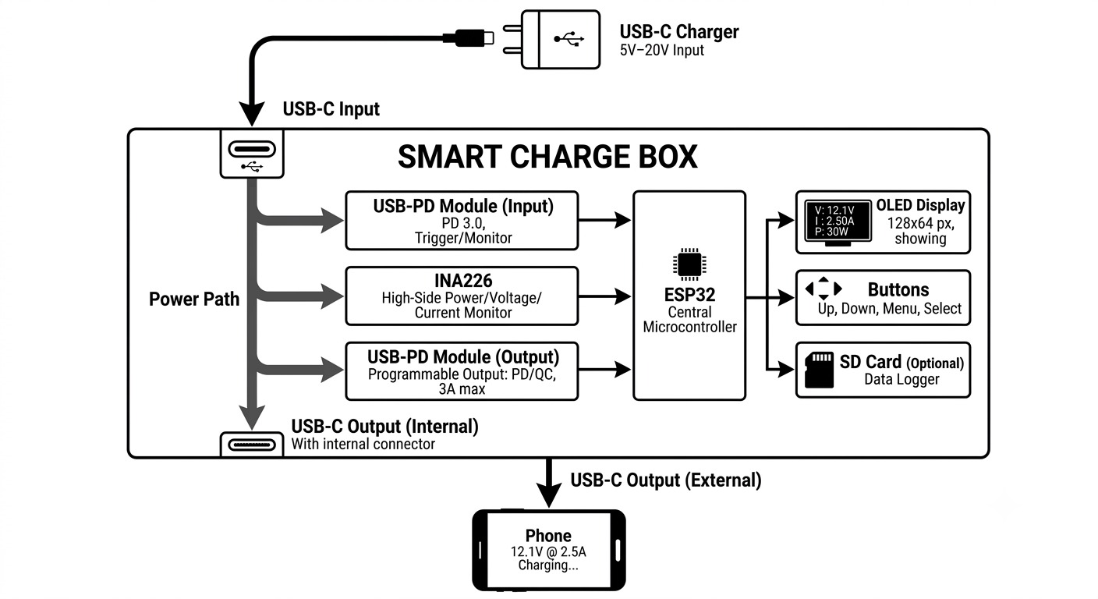
Block Diagram Design
EMBEDDED PROGRAMMING PROJECT FIRST- REVIEW

Slide 11
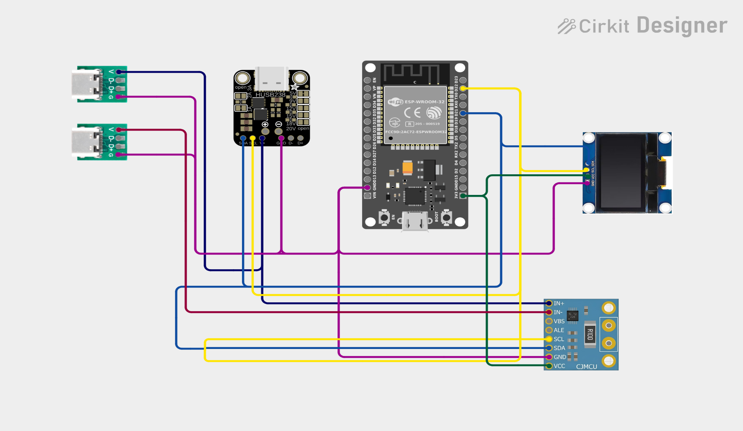
PIN Layout
EMBEDDED PROGRAMMING PROJECT FIRST- REVIEW

Slide 12
Future Scope
Develop support for additional fast-charging protocols such as PPS, Quick Charge (QC), VOOC, and AFC.
Integrate a mobile application for live charging analytics, alerts, and charging history.
Enable cloud synchronization for storing charging profiles and firmware updates.
Implement AI/ML-based charging optimization using historical charging data.
Add battery health prediction and personalized charging recommendations.
Design a compact PCB and portable enclosure for commercial deployment.
Expand compatibility with laptops, tablets, power banks, and other USB-C devices.
Introduce OTA (Over-the-Air) firmware updates to support new charging protocols and devices.
These points are concise, technically realistic, and suitable for an engineering project presentation.
EMBEDDED PROGRAMMING PROJECT FIRST- REVIEW

