Slide 1


THE JEBO PROJECT
MIDTERM / CUSTOMER DISCOVERY
A Cleaner Dorm.
A Happier Home.
JEBO | Making dormitory cleaning easier, fairer and less stressful
20-MINUTE ENGLISH PRESENTATION
01 / 19
Notes:
Estimated speaking time: 0:40.
Good morning, everyone. Today we are presenting JEBO, a student service concept focused on a familiar problem: keeping a shared dormitory clean without creating tension between roommates. Our central idea is simple. A cleaner room should not come at the cost of friendships, time, or peace of mind. During this presentation, we will walk through what we observed, the evidence we collected, what our early findings actually show, and the test we plan to run next. Importantly, JEBO is still a concept being validated, not an established business.
Sources and clarification: Project overview in CEM pre.docx.

Slide 2
OUR STORY
From an everyday problem to a testable idea
Five steps in our customer discovery journey
01
02
03
04
05
→
→
→
→
The problem
Our customers
The JEBO idea
The evidence
What comes next
Our question: can we solve this better than informal arrangements?
JEBO / MIDTERM PRESENTATION
02 / 19
Notes:
Estimated speaking time: 0:50.
We have organized today's presentation into five parts. First, we will introduce the problem as it appears in shared dormitories. Second, we will identify who experiences this problem most strongly. Third, we will look at evidence from our questionnaire, interviews, and previous research. Fourth, we will explain how JEBO might help. Finally, we will present the next experiment and explain what still needs to be proved. As we move through these parts, please keep one question in mind: does our proposed platform solve something that students cannot already solve through existing informal arrangements?

Slide 3

OBSERVED PROBLEM
When the trash belongs to no one…
A small household chore can turn into a shared-living conflict.
01
Customer
Roommates who always end up cleaning
02
Scenario
In a dirty public areas of the dorm
03
Problem
Take the responsibility to clean
JEBO / MIDTERM PRESENTATION
03 / 19
Notes:
Estimated speaking time: 1:10.
Imagine a dormitory with several roommates. The common area becomes dirty, but nobody is clearly responsible for cleaning it. Each student may think somebody else should do it. Eventually, the roommate who cares most about cleanliness cannot stand the situation and does the work. This student loses personal time and may feel treated unfairly. The others may not even realize that a conflict is developing. Over time, this can damage the atmosphere in the dorm. This is the core observed problem described in our research notes. It is not just about dust or rubbish. It is also about unclear responsibility, unequal work and the emotional cost of living together.
Sources and clarification: CEM pre.docx: Observed problem. This slide is an illustrative scenario, not a verbatim interview quote.

Slide 4
OBSERVED PROBLEM
Find the reason behind the phenomenon
Why do dormitory common areas remain dirty?
01
Lack of responsibility
02
No habit of keeping clean
03
Lack of time for cleaning
JEBO / MIDTERM PRESENTATION
04 / 19
Notes:
Estimated speaking time: 1:10.
Imagine a dormitory with several roommates. The common area becomes dirty, but nobody is clearly responsible for cleaning it. Each student may think somebody else should do it. Eventually, the roommate who cares most about cleanliness cannot stand the situation and does the work. This student loses personal time and may feel treated unfairly. The others may not even realize that a conflict is developing. Over time, this can damage the atmosphere in the dorm. This is the core observed problem described in our research notes. It is not just about dust or rubbish. It is also about unclear responsibility, unequal work and the emotional cost of living together.
Sources and clarification: CEM pre.docx: Observed problem. This slide is an illustrative scenario, not a verbatim interview quote.

Slide 5
TARGET CUSTOMER
For the roommate who always ends up cleaning
Our focus is not everyone in a dorm—at least not yet.
Lost time
Unfair burden
Cleaning replaces studying, resting or socializing.
Shared mess, but responsibility falls on one person.
The hygiene-conscious
roommate
Awkward conversations
Wants a clean space without having to confront friends.
Requesting help can feel like starting a fight.
JEBO / MIDTERM PRESENTATION
05 / 19
Notes:
Estimated speaking time: 1:05.
Instead of trying to serve every student immediately, we chose a specific target customer. Our primary user is the hygiene-conscious student who repeatedly cleans shared areas because other roommates are less motivated or responsibilities are unclear. For this student, the cost is broader than the cleaning task itself. There is a time cost, since cleaning can interrupt studying or rest. There is a fairness cost, because one person carries more work than others. And there is a relationship cost, since asking roommates to do their share can be uncomfortable. A focused target customer helps us test whether JEBO creates real value. Other users might benefit too, but this is our starting segment.
Sources and clarification: CEM pre.docx: Targeted Customer and Observed problem.

Slide 6
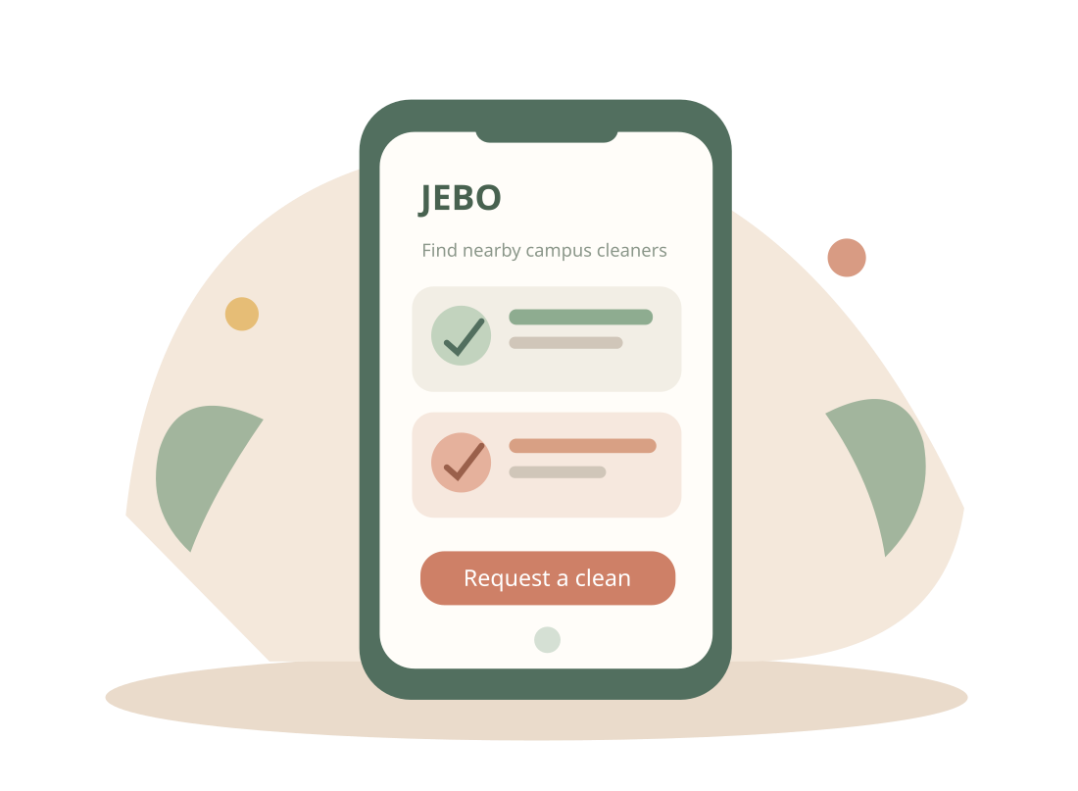
JEBO / PROPOSED VALUE
One place to find trusted cleaning help
A concept for making the process simple and transparent.
Discover
1
See available campus cleaning staff.
Compare
2
Understand price, scope and availability.
Coordinate
3
Make a clear request with roommates.
Feel reassured
4
Know who is coming and what to expect.
Product concept, not yet launched. Core source: JEBO value proposition in CEM pre.docx.
JEBO / MIDTERM PRESENTATION
6 / 19
Notes:
Estimated speaking time: 1:25.
Our proposed solution is JEBO, a platform that brings information about campus cleaning staff into one accessible place. Students could discover available cleaners and see clearer information about the scope and cost of different services. Based on the interviews, we would also want visible credentials or other trust signals, because students care about who enters their living space. We may introduce roommate coordination features, such as collecting approval or sharing a request, but these are still proposed design directions rather than built or validated functionality. The value proposition is to reduce the time spent searching for help and the tension caused by unequal cleaning work. Our long-term goal is not simply a booking screen; it is to make shared dormitory cleaning easier to arrange fairly.
Sources and clarification: CEM pre.docx: Value proposition; added discovery/compare/coordinate directions are clearly labeled as proposals.

Slide 7
PUBLISHED RESEARCH
The problem is bigger than our interviews
Earlier studies highlight coordination and inconsistent routines.
2018 | Student cleaning survey
2014 | Dormitory duty routines
35%
struggled to coordinate
with roommates
≈33%
32%
of all dorms both had
and strictly followed a duty roster
were too busy to clean
Different campuses, years and samples—not population estimates.
Sources: Ying et al. (2018), n=165; Long et al. (2014), calculated as 55.6% × 58.9%.
JEBO / MIDTERM PRESENTATION
07 / 19
Notes:
Estimated speaking time: 1:05.
We also reviewed previous research to check whether our observation is reasonable beyond our own project. A 2018 questionnaire of 165 college students found that coordination with roommates was the most common reported cleaning difficulty, at 35 percent. Another 32 percent said they were too busy. A separate 2014 study reported that 55.6 percent of dormitories had a rotating duty system. Within this group, 58.9 percent strictly followed it. Multiplying these percentages suggests that approximately one third of all surveyed dormitories both had and followed a duty roster. These figures do not describe our own campus or one representative national population. Other studies, including Zhou's 2016 study, report higher adoption of cleaning routines. That variation is exactly why we still need customer-specific evidence.
Sources and clarification: Numbers drawn from 论文调查数据.docx, studies 1–3. Derived ≈32.8% is 55.6% × 58.9%.

Slide 8
CUSTOMER DISCOVERY
We listened before building
Different sources answer different questions.
37
26
3
survey responses
interviews
paid-cleaner cases
Our own dorm cleaning questionnaire
Small qualitative interview set
Detailed records of existing paid use
Questionnaire
Interviews
Behavioral cases
We also reviewed published research to compare our observations.
Source: CEM pre.docx and embedded questionnaire results (n=16). Cases overlap with the interview work.
JEBO / MIDTERM PRESENTATION
08 / 19
Notes:
Estimated speaking time: 1:05.
Our team did not rely on a single method. First, we had sixteen valid responses to a dormitory cleaning questionnaire. This gives us numerical patterns, but it is a small convenience sample, so we should not generalize its percentages to all universities. Second, one qualitative interview set included six participants. Four described difficulty arranging cleaning staff or said their common areas had never been cleaned because contact channels were missing. Third, our notes include three detailed cases of students who already used paid cleaners through private channels. These cases provide useful behavior evidence, but they are not an additional independent survey sample. Finally, we reviewed published research to understand how these findings compare with existing literature.
Sources and clarification: CEM pre.docx: interviews and named cases; embedded screenshot: valid survey n=16. Note: cases are not counted as independent population samples.

Slide 9
SURVEY FINDING / N = 16
How do dorms currently get cleaned?
Paid help exists. So does the “whoever gives in” pattern.
Regular paid cleaners
48.65%
Whoever cannot bear the mess
29.73%
Rotating duty
16.22%
Other arrangement
5.4%
Half already hire cleaners; almost one-third rely on individual tolerance.
Our dorm cleaning questionnaire, Q3; 16 valid responses. Categories are mutually exclusive.
JEBO / MIDTERM PRESENTATION
09 / 19
Notes:
Estimated speaking time: 1:05.
Our questionnaire asked students how their dormitory cleaning is currently managed. Half of the sixteen respondents said they regularly call cleaners. About 31 percent reported a very different pattern: there is no regular cleaning, and the person who can no longer tolerate the mess eventually cleans it. Only 12.5 percent said cleaning duties rotate among roommates. One response fell under another arrangement. The first pattern is encouraging for the underlying paid-cleaning market, because some students are already paying. The second pattern supports our original problem statement about unequal responsibility. But we must be careful: use of any cleaning service is not evidence that students want a new platform. We will investigate that distinction in later slides.
Sources and clarification: Questionnaire screenshot, Q3, n=16.

Slide 10
SURVEY FINDING / N = 16
Three major cleaning difficulties
The survey points to workload, coordination and hard-to-clean spaces.
54.05%
64.86%
48.65%
Hard-to-clean areas
Roommate coordination
Academic workload
Bathrooms, toilets and other difficult spots.
Different levels of motivation make planning hard.
Students lack enough time to clean regularly.
Our survey, Q4, n=37. Multiple responses were allowed; percentages do not add to 100%.
JEBO / MIDTERM PRESENTATION
10 / 19
Notes:
Estimated speaking time: 1:10.
When asked about difficulties during cleaning, 62.5 percent selected hard-to-clean areas, such as bathrooms. Another 56.25 percent selected difficulty coordinating roommates because people had different levels of motivation. Half of respondents said academic workloads left them too busy to clean. Since participants could select more than one difficulty, these percentages overlap and should not be added together. This finding refines our original idea. A useful service might have to do more than remind roommates to clean. It may need to provide practical help with difficult tasks, remove coordination friction and save time. However, these survey responses still describe problems, not a firm purchase decision.
Sources and clarification: Questionnaire screenshot, Q4, n=16, multi-select.

Slide 11

INTERVIEW INSIGHT / N = 6
The access problem: cleaners can be hard to find
A service can exist without being easy to reach.
4 / 6
interviewees said their dormitory common areas had never been cleaned because they lacked a way to contact cleaning staff.
Inspiration:
Provide a service that makes it easy for students to contact cleaners.
Qualitative interview notes in CEM pre.docx; small, non-representative sample.
JEBO / MIDTERM PRESENTATION
11/ 19
Notes:
Estimated speaking time: 1:10.
One of our small interview sets revealed a second problem: access to cleaning staff. Four of the six people interviewed said their dormitory common areas had never been cleaned because there was no clear way to contact or communicate with cleaners. This is not a population statistic; six interviews cannot tell us the prevalence across a whole university. But it is useful as an early qualitative signal. Interestingly, in other dormitories, students had already found cleaners through private WeChat messages or phone calls. That difference suggests that the problem is not simply the absence of cleaning staff. It may be an information and coordination problem: students need a convenient, trusted way to discover what services are available and how to arrange them.
Sources and clarification: CEM pre.docx: Huang Junliang, four of six interviewees.

Slide 12
EXISTING BEHAVIOR
Students already have a workaround
Case A: a private WeChat cleaner, paid together.
CONTACT
SCHEDULE
TOTAL FEE
SHARED COST
→
→
→
Private WeChat
Every 2–3 weeks
¥80 / 2 hours
¥10 each × 8
This working alternative is our strongest competitor.
Interview record A in CEM pre.docx. One illustrative paid-cleaning case, not a typical market price.
JEBO / MIDTERM PRESENTATION
12 / 19
Notes:
Estimated speaking time: 1:15.
Here is one particularly useful case from our interviews. Eight students shared the cost of a cleaner arranged through private WeChat. The cleaner visited every two or three weeks. The reported payment was eighty yuan for two hours, or about ten yuan per roommate when split evenly. This matters because it is a real behavior rather than hypothetical interest. Students are already finding ways to solve the problem, and the per-person price can become low when roommates share the bill. However, it also presents a challenge to our business idea. If WeChat booking already works, why would students move to JEBO? A new interface alone may not be compelling. We have to show meaningful advantages, such as more reliable contact information, clearer scope, transparent pricing, or quality assurance.
Sources and clarification: CEM pre.docx: paid-cleaner Case A.

Slide 13
INTERVIEW INSIGHT / N = 6
3 Questions Raised
If students can accept a higher price? (over 80 yuan)
What kind of service has the most urgent need?
Will customers pay more if there is a guarantee of service quality?
Qualitative interview notes in CEM pre.docx; small, non-representative sample.
JEBO / MIDTERM PRESENTATION
Notes:
Estimated speaking time: 1:10.
One of our small interview sets revealed a second problem: access to cleaning staff. Four of the six people interviewed said their dormitory common areas had never been cleaned because there was no clear way to contact or communicate with cleaners. This is not a population statistic; six interviews cannot tell us the prevalence across a whole university. But it is useful as an early qualitative signal. Interestingly, in other dormitories, students had already found cleaners through private WeChat messages or phone calls. That difference suggests that the problem is not simply the absence of cleaning staff. It may be an information and coordination problem: students need a convenient, trusted way to discover what services are available and how to arrange them.
Sources and clarification: CEM pre.docx: Huang Junliang, four of six interviewees.

Slide 14
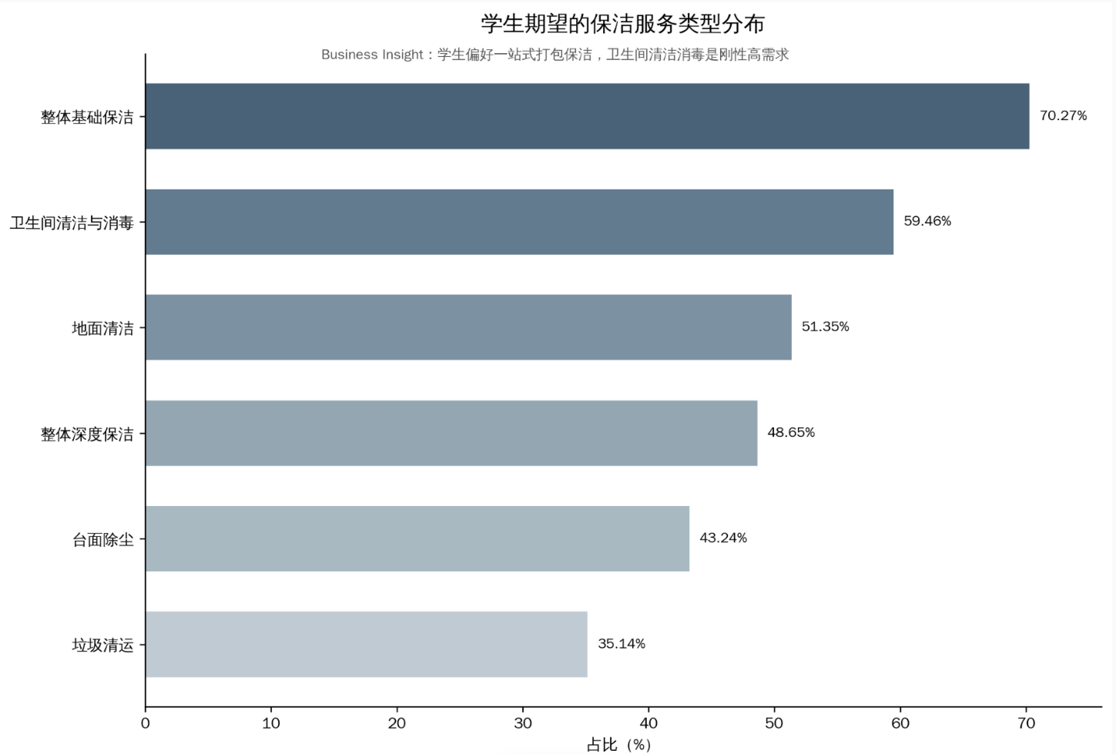
SURVEY FINDING / N = 37
What kind of cleaning do students want?
A basic package and bathroom cleaning stand out.
Our questionnaire, Q8, n=37; multiple selections allowed. Complete basic cleaning includes four basic tasks.
JEBO / MIDTERM PRESENTATION
13 / 19
Notes:
Estimated speaking time: 1:00.
Our survey also asked what types of service students would want from a dorm cleaning provider. Seventy-five percent selected an overall basic cleaning package. Almost 69 percent selected bathroom cleaning and disinfection. Floor cleaning was selected by 56 percent, while 50 percent selected deep cleaning. These results suggest that a basic package combined with more difficult bathroom work may be a reasonable starting point. They also support our earlier finding that students struggle with areas that are unpleasant or hard to clean. Because this was a multiple-choice question, students could select several services. We should not interpret the response percentages as confirmed bookings, and the small sample means we should use these results to design an experiment rather than finalize the entire product.
Sources and clarification: Questionnaire screenshot, Q8.

Slide 15
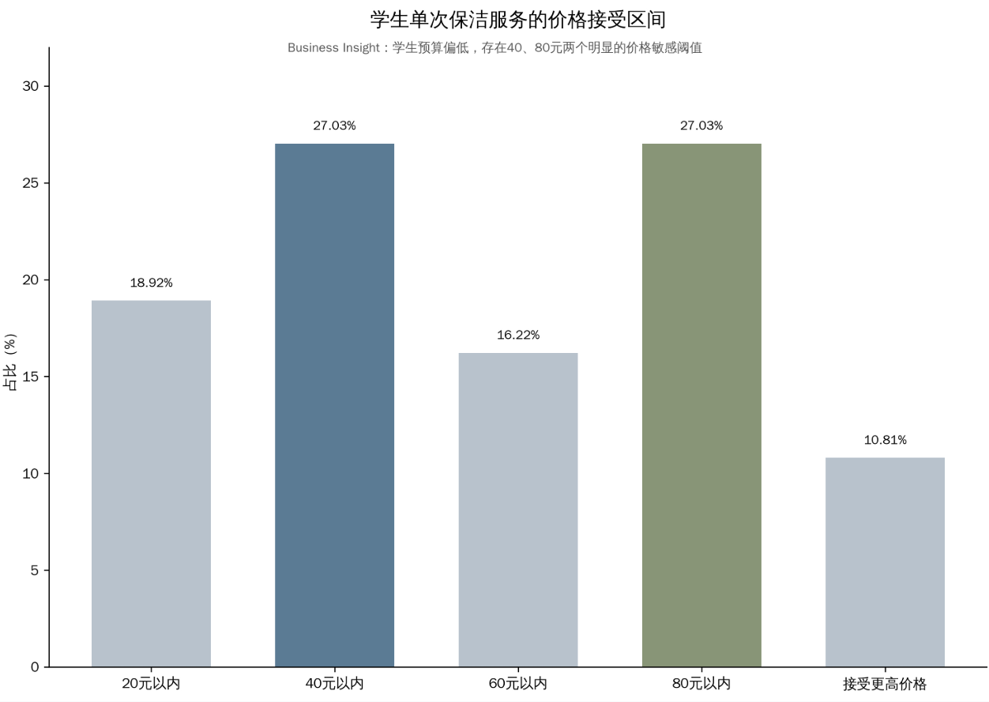
SURVEY FINDING / N = 37
Pricing is a shared decision
Students favor splitting the cost, but price sensitivity remains.
94.6%
prefer splitting the bill
among roommates
35 of 37responses
Only 10.81% of interviewees show willingness to accept a price over 80 yuan.
Our questionnaire, Q7 (budget categories) and Q11 (payment preference), n=37.
JEBO / MIDTERM PRESENTATION
13 / 19
Notes:
Estimated speaking time: 1:20.
Payment is closely linked to roommate coordination. In our survey, fourteen out of sixteen respondents preferred equal cost sharing among roommates. Only two selected a dormitory common fund, and none selected one person paying the full amount. We also asked about the maximum acceptable price per cleaning order. The most popular answer was forty yuan, chosen by 37.5 percent. Another 18.75 percent chose twenty yuan. Together, just over half placed their ceiling at forty yuan or less, while others selected higher brackets. This is a stated budget in our small sample, not proof of willingness to purchase at that price. We also know from interviews that actual shared expenses can differ, because price depends on the service duration and how many roommates share the bill.
Sources and clarification: Questionnaire screenshot, Q7 and Q11, n=16.

Slide 16
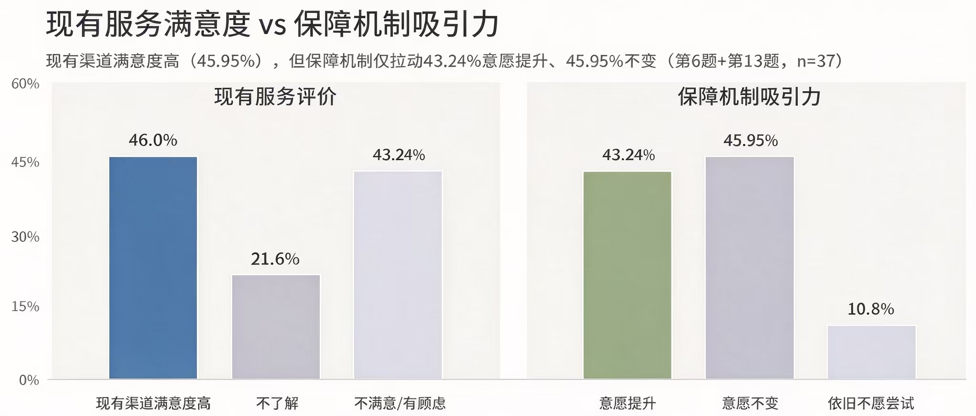
INTERVIEW INSIGHT / N = 6
Willingness to pay more?
46% interviewees are satisfied with current service
45.95% interviewees shows a remaining willingness
Qualitative interview notes in CEM pre.docx; small, non-representative sample.
JEBO / MIDTERM PRESENTATION
Notes:
Estimated speaking time: 1:10.
One of our small interview sets revealed a second problem: access to cleaning staff. Four of the six people interviewed said their dormitory common areas had never been cleaned because there was no clear way to contact or communicate with cleaners. This is not a population statistic; six interviews cannot tell us the prevalence across a whole university. But it is useful as an early qualitative signal. Interestingly, in other dormitories, students had already found cleaners through private WeChat messages or phone calls. That difference suggests that the problem is not simply the absence of cleaning staff. It may be an information and coordination problem: students need a convenient, trusted way to discover what services are available and how to arrange them.
Sources and clarification: CEM pre.docx: Huang Junliang, four of six interviewees.

Slide 17
VALIDATION / OPEN QUESTIONS
Real demand does not guarantee platform switching
The hardest test is changing an existing habit.
What we observed
What they requested
What is not proven
Existing users book and pay for cleaning via private contacts.
Clear prices, service scope, cleaner credentials and quality.
Two users expressed only conditional trial interest—subject to roommate approval.
43.24% said additional guarantees would increase interest (survey, n=37).
Sources: CEM pre.docx, Cases A–C; questionnaire Q13. Interest ≠ purchase or platform trial.
JEBO / MIDTERM PRESENTATION
15/ 19
Notes:
Estimated speaking time: 1:20.
At this point we can make a careful distinction. We have evidence that some students already pay for dorm cleaning. We also have requests for transparent prices, service scope, cleaner credentials and quality assurance. However, we have much weaker evidence that students would switch from a working private WeChat contact to our platform. Two documented users were open to a JEBO trial only if their roommates approved. That is conditional interest, not a confirmed trial, and there was no verified platform conversion in these notes. Our questionnaire also found that 56.25 percent reported greater willingness to participate if guarantees such as paying after use or getting a refund were offered. This suggests trust features may help, but it does not prove adoption. Our product has to earn its place between students and the solution they already use.
Sources and clarification: CEM pre.docx: Zhang Juntong cases; questionnaire screenshot Q13.

Slide 18

BUSINESS HYPOTHESIS
Could a cleaner serve more rooms at a lower fee?
Volume and proximity may improve the economics—but this is still untested.
More nearby rooms
↓
Less time between jobs
Hypothesis ≠ verified profit
CEM pre.docx: Next planned test; economics and supplier response not measured yet.
JEBO / MIDTERM PRESENTATION
16 / 19
Notes:
Estimated speaking time: 1:20.
JEBO still needs a sustainable business model. The next hypothesis we want to test concerns cleaning staff rather than just student demand. Suppose a cleaner is willing to charge slightly less per room if several nearby dormitories book services together. The cleaner might save travel or searching time, complete more jobs and potentially maintain or improve total earnings. Students, meanwhile, might receive a better price. This is only a hypothesis. We do not yet know cleaners' minimum acceptable compensation, their job capacity, travel time, material costs or whether routing between dormitories is practical. A lower price is not automatically beneficial to suppliers, and more bookings do not automatically create profit. Before making any financial claim, we need to ask cleaners directly and compare actual costs with realistic booking volume.
Sources and clarification: CEM pre.docx: Next planned test.

Slide 19
NEXT PLANNED TEST
Next, we talk to the cleaners
Can a lower per-room fee work when more rooms are booked together?
01
02
03
Willingness
Operations
Boundaries
Would you accept a lower rate per room for several nearby rooms?
How many rooms can you serve, and what takes the most time?
What are your minimum fee, safety needs and service limits?
Decision: continue, refine the model, or rethink the approach.
First interview objective comes directly from CEM pre.docx; specific questions are proposed test design.
JEBO / MIDTERM PRESENTATION
17 / 19
Notes:
Estimated speaking time: 1:30.
Our next planned experiment is to interview campus cleaning staff. The main question is whether cleaners would accept a lower per-room rate in exchange for cleaning more rooms. We plan to break that down into three parts. First, we will ask about willingness and conditions: would they actually accept such an arrangement, and at what rate? Second, we will ask about operating constraints: travel time, task duration, scheduling, equipment and maximum daily capacity. Third, we will explore safety and service boundaries. We must also compare these answers with student budgets and roommate approval. This is an important supply-side test. If the economics do not work for cleaners, we should not force the idea. We could change the pricing model, adjust the scope or refocus JEBO on discovery and trust rather than discounting.
Sources and clarification: CEM pre.docx: Next planned test. Additional questions are suggested next-step experiment design, not completed research.

Slide 20
WHERE WE STAND
What we know. What we still need to learn.
Evidence gives us direction—not permission to overclaim.
SUPPORTED SO FAR
STILL TO VALIDATE
✓ Cleaning duties can feel unfair
✓ Some students already pay
✓ Shared costs are preferred
? Will users change platforms?
? Will cleaners accept the model?
? Can both sides benefit?
JEBO / MIDTERM PRESENTATION
18 / 19
Notes:
Estimated speaking time: 1:05.
Here is our current conclusion. We have several encouraging signals. Cleaning responsibility can become unfair; coordination and time are real obstacles; some dormitories already use paid cleaners; and many survey respondents prefer dividing the fee across roommates. But we also have important unanswered questions. Most importantly, we do not know whether users of existing private booking methods will switch to JEBO, whether cleaners will accept our proposed arrangement, or whether the model can benefit both students and service providers financially. The next test is designed to reduce these uncertainties rather than simply collect more positive opinions. We believe that being honest about the limits of our evidence will help us make better decisions and build something genuinely useful.
Sources and clarification: Synthesis of own survey, interviews and next-test notes, not a claim of verified product-market fit.

Slide 21
THANK YOU
Small chores.
Better living.
Thank you for listening.
Questions & discussion
JEBO / MIDTERM PRESENTATION
19 / 19
Notes:
Estimated speaking time: 0:45.
To finish, JEBO started from a simple everyday frustration, but it led us to deeper questions about time, fairness, trust and cooperation in shared living spaces. We hope our next round of interviews will show whether we can create real value for both students and campus cleaners. Thank you for listening. We welcome your questions and suggestions.

Slide 22
SELECTED REFERENCES
Evidence and references
Sources used in the presentation
1. JEBO team. (2026). CEM midterm research notes and interview findings [Unpublished project document].
2. JEBO team. (2026). Dormitory cleaning questionnaire (n = 16) [Unpublished survey results].
3. Long, Z.-H., Zhang, L.-J., & Wang, N. (2014). Investigating report on dormitory culture: Shaanxi Normal University.
4. Ying, Q.-L., Wu, B., Huang, Z.-Y., Lai, H.-W., & Jiang, F. (2018). Student apartment cleaning demand survey.
5. Zhou, Q.-J. (2016). Dormitory culture at Jishou University. Journal of Jishou University, 37(2), 91–96.
6. American Cleaning Institute. (2022). 2022 college cleaning survey data (listed in supplied source notes; no numbers used).
Additional historical source in literature file: Shinohara & Sato (1961), a four-dorm study; not used for numerical claims.
JEBO / MIDTERM PRESENTATION
Notes:
Estimated speaking time: Reference slide (not included in the 20-minute speaking total)..
This final slide collects the key project files and published references behind the presentation. The evidence used for our own customer findings comes from the internal interviews and sixteen-response questionnaire. The published articles are contextual evidence and should not be treated as direct measurements of our proposed JEBO market. The American Cleaning Institute report was listed in the supplied literature file, but our slides do not present statistics from that report. Thank you again.
Sources and clarification: All bibliography details were derived from the provided 论文调查数据.docx.

