Slide 1
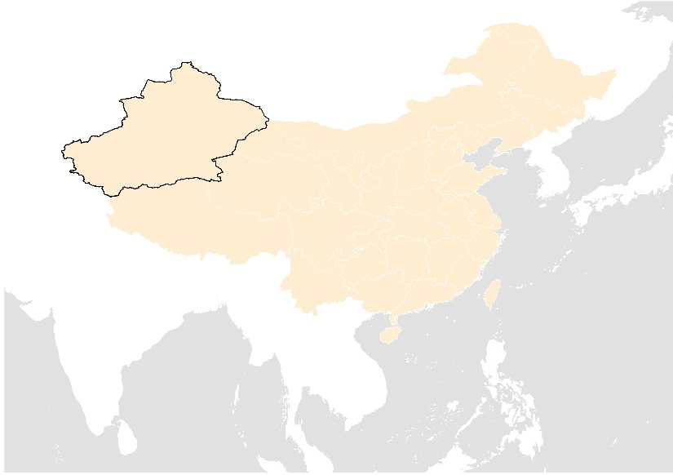
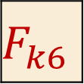

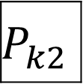
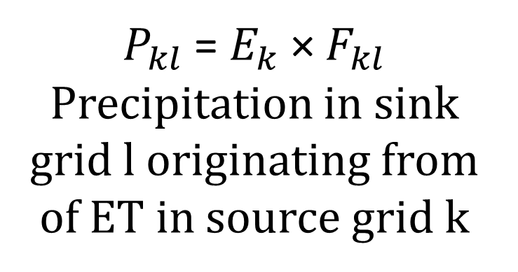
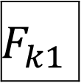
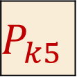

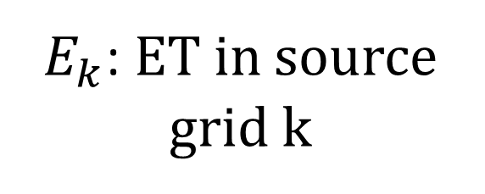
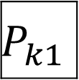
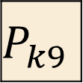

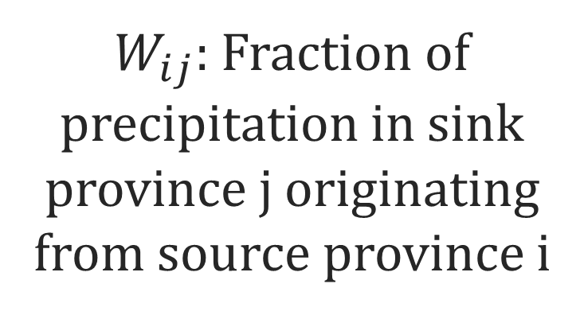
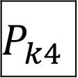
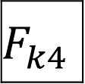
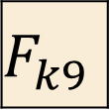

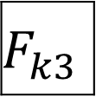

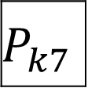
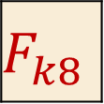
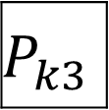
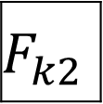
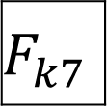
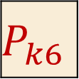
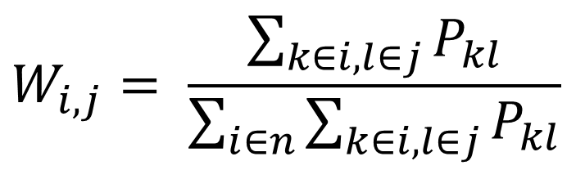
Step 1: Precipitation fraction calculation
ET data from ERA5
UTrack
$$F_{k1}$$
$$F_{k2}$$
$$F_{k3}$$
$F_{kl}$: Fraction of ET from source grid k that generate precipitation in sink grid l
$E_{k}$: ET in source grid k
$$E_{k}$$
$$F_{k4}$$
$$F_{k5}$$
$$F_{k6}$$
$$F_{k7}$$
$$F_{k8}$$
$$F_{k9}$$
$P_{kl}$ = $E_{k}$ × $F_{kl}$
Precipitation in sink grid l originating from of ET in source grid k
$$P_{k1}$$
$$P_{k2}$$
$$P_{k3}$$
$$P_{k4}$$
$$P_{k5}$$
$$P_{k6}$$
$$P_{k7}$$
$$P_{k8}$$
$$P_{k9}$$
Step 2: Aggregate grids to the province scale
$$W_{i,j}= \frac{\sum_{k∈i,l∈j}{P_{kl}}}{\sum_{i∈n}{\sum_{k∈i,l∈j}{P_{kl}}}}$$
$$w_{ij}$$
n is the province count
$W_{ij}:$Fraction of precipitation in sink province j originating from source province i
Within China mainland
Outside China mainland

