Slide 1


Duke Registrar
Recommender System
Vanessa Tang, Sangseok Lee, Yiran Chen
Duke Registrar Recommender
Notes:
Today we are presenting our capstone project on course recommendation system for Duke Registrar.

Slide 2

Project Overview
Duke Registrar Recommender
Notes:
The purpose of this project is to build a course recommendation system for Duke undergraduate students that will help students choose which classes to take.
This is important because the current course selection process is actually quite complex, and students often spend many hours trying to figure out which courses to take. Students take classes for a variety of reasons, including major or minor requirements, graduation requirements, timing, location, professors, or peer suggestion to name just a few contributing factors.
It is often difficult to determine which classes to take, so we aim to build a course recommendation system to facilitate this process. By recommending courses based on a student’s major, the system can help with course planning, order, and selection.

Slide 3
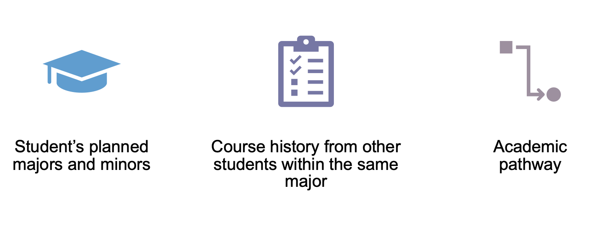
How?
Duke Registrar Recommender
Notes:
To do so, we aim to focus on building a recommender system based primarily on three things:
First is the student’s planned major
Second is the course history from other students within the same major
And last is the idea of an academic pathway. Though this can be defined in many ways, one intuitive way is tracking the most popular courses for each term within a specific major during a student’s time at Duke.

Slide 4
Challenges
No information on:
Graduation/Major requirements
Course: prerequisites, availability, ratings, professors
Success metric: career interests
Noise:
Students don’t have to declare until beginning of junior year
Major switching during the process
Time: course order matters
Separated two time frames: No explicit linkage
Duke Registrar Recommender
Notes:
One major challenge in this project is that we do not have graduation and major requirement information, course prerequisite information, course ratings or information about students’ success after graduation.
Another challenge is that students don’t have to declare majors until the beginning of junior year, and they can also change majors many times. This can create noise in the data.
Furthermore, course order matters, and factoring this temporal aspect into a recommender system is challenging.
Lastly, Duke renumbered courses in 2012, splitting our data into 2 time frames. Unfortunately, there is no explicit way to link pre-2012 courses to post-2012 courses.

Slide 5
Data
2000-2012 & 2013-2020
Multiple columns for each
E.g. Major1, Major2, Minor1, Minor2...
Calculation ID | Subject // Catalog | Descr | Grade | Class Year | Majors // Minors // Certificates // Secondaries | Enrollment // Graduation Year | College
2760.65 | Linguist 103 | Symbolic Logic | “4.0” | Senior | Economics (BS) // Linguistics (AB2) | 2005-2009 | Trinity
Normalize grade with respect to each student
Which year the class is taken in four-year time (proxy for course availability)
Duke Registrar Recommender
Notes:
Because we were able to obtain the data for the 2000-2012 segment first, we are focusing EDA and model-building on this segment of data which is cleaner and more complete.
Our final dataset includes de-identified student ID’s, graduation year, majors and minors, in addition to course descriptions, department, grades received, and the semester each course was taken.

Slide 6
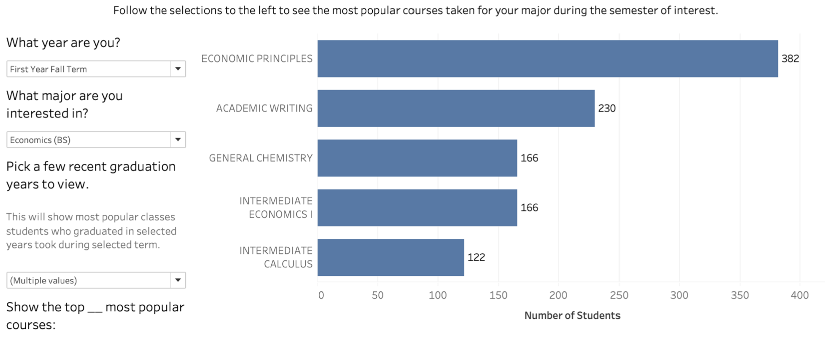
Popular Classes for Selected Major and Semester
Duke Registrar Recommender
Notes:
Based on this data, our EDA consisted mostly of identifying trends in course taking patterns to define a student’s academic pathway. First, we built a dashboard to show the most popular courses students of a specific major took in a specific semester. Here we can see the 5 most popular courses for Econ majors to take their Freshman Fall term. Based on this dashboard, one might recommend taking Economic Principles Freshman Fall in addition to the required academic writing course.

Slide 7
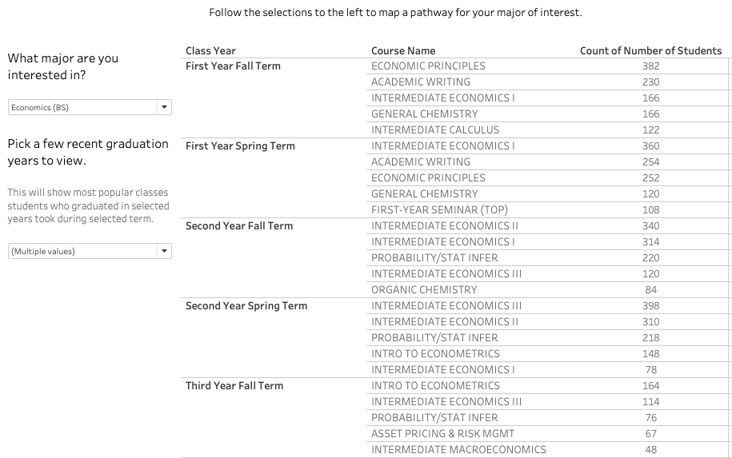
Pathway
Duke Registrar Recommender
Notes:
Next, we built a similar dashboard but tracking courses through the entire 4 years at Duke. This dashboard shows the top 5 most popular courses for Econ majors to take during all 8 semesters. This can help students plan their courses throughout all 4 years, which can help with course load planning and ensuring major requirements are met.

Slide 8
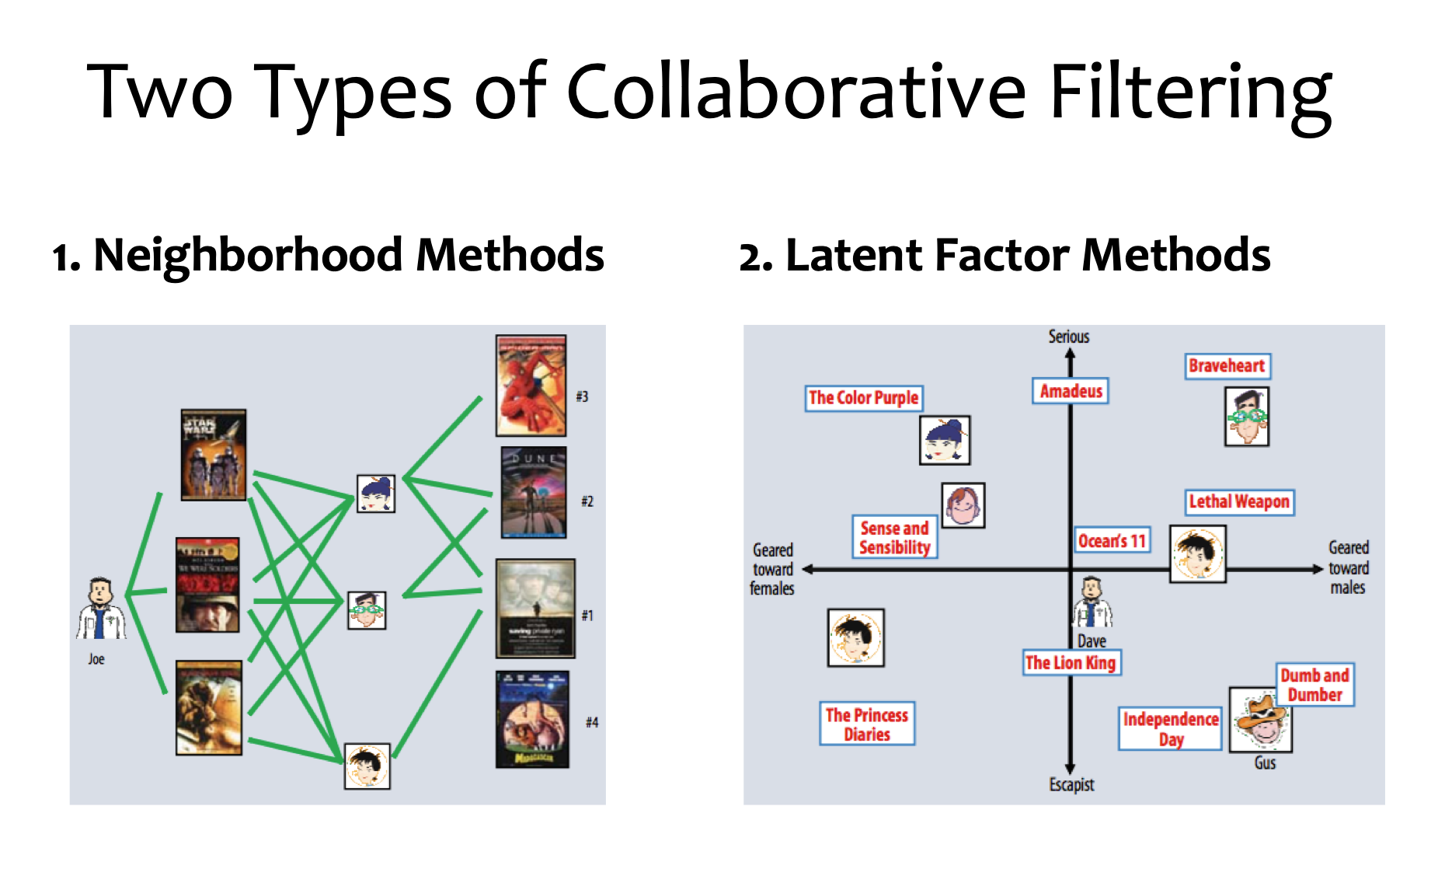
Modeling
Neighborhood Methods
User-based + Item-based
Latent Factor Methods (Matrix Factorization)
SVD
LightFM
Implicit
Duke Registrar Recommender
Notes:
For modeling part, we use two main approaches. First one is Neighborhood methods using user and item-based. And Second method is Latent factor methods including SVD, LightFM and Implicit method. We are going to explain each method.

Slide 9
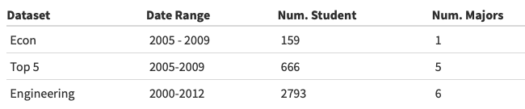
Modeling
Gauging model performance
Datasets used for modeling
Duke Registrar Recommender
Notes:
In order to assess our models performance, we use a form of accuracy. We calculate this by counting the number of courses actually taken in the top k recommendations divided by the total number of courses taken during the year of interest. For example, if a student took 4 of the recommended 15 courses and took a total of 8 courses that year, then the accuracy would be 4/8 or 50%.
We have also been modeling with three different dataset. The first reason for this is that we want to work with different sized datasets that may include different majors that can have different course taking patterns. Also, grouping similar majors like in the engineering dataset may theoretically help identify similar students.

Slide 10
Neighborhood Methods
Train test split: original method
X 1 X 2 X 3 X 4
Y
Train
Student 1
Test
Student 2
Student 3
Student 4
Duke Registrar Recommender
Notes:
Before I get into details about model, I would like to talk about train and test split. Unlike the traditional way, recommendation model in our case has to apply different concept of splitting train and test data because we have to consdier temporal aspect like year from 1 to 4 by each student.
To make it simple, let’s say that we have 4 studetns in our data. Usually, given several features like x1 to x4, we predict Y , orange circles. when we split the data, blue ones become train data and we train those features to predict Y. After training data, red ones become test data to predict Y, which is orange one.

Slide 11
Neighborhood Methods
Train test split (Recommender System)
Year 1 Year 2 Year 3 Year 4
Train
Student 1
Test
Student 2
Student 3
Student 4
Duke Registrar Recommender
Notes:
But in our recommender system using neighborhood method, dataset is a liitle bit different. Each student has temporal aspect like from year1 to 4 and each blue circle represents all courses that they took during each year (generally 8 courses on average?) , instead of just one feature like the previous slide. Not only features, but our target needs to be consdiered since if you want to predict the courses student 1 would take during year 4, every decision from year 4 is related to year 3 and the decision from year 3 is related to year 2. In other words, sequential order makes difference compared to the traditional way of splitting data.
To make it simple, Let’s say that we want to predict the courses student 1 would take during year 4, orange circles. We feed blue ones as our training data and predict classes at year 4. For test data, we feed training data and all classes student 4 has taken before year 4. The principle is the same but building codes behind the recommendation engine makes huge differnece.

Slide 12

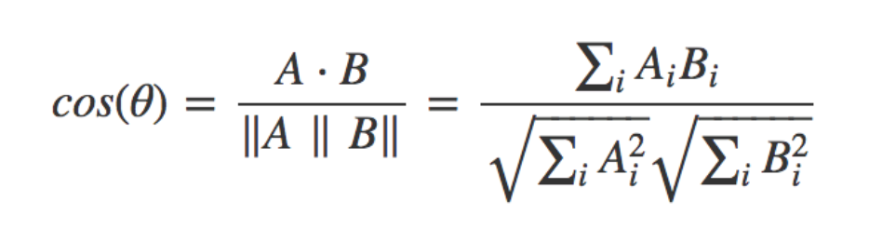
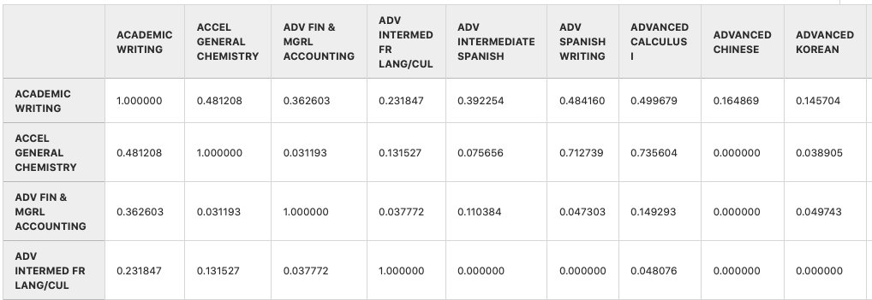
Neighborhood Methods
Duke Registrar Recommender
Notes:
Our collaborative filtering model combines both item and user based methods by creating a “neighborhood” of similar courses. Given our problem, item-based models depend on courses, and user-based models depend on students.
First, we calculate the cosine similarity between courses to construct a new item by item matrix, as shown.

Slide 13
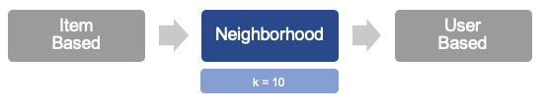
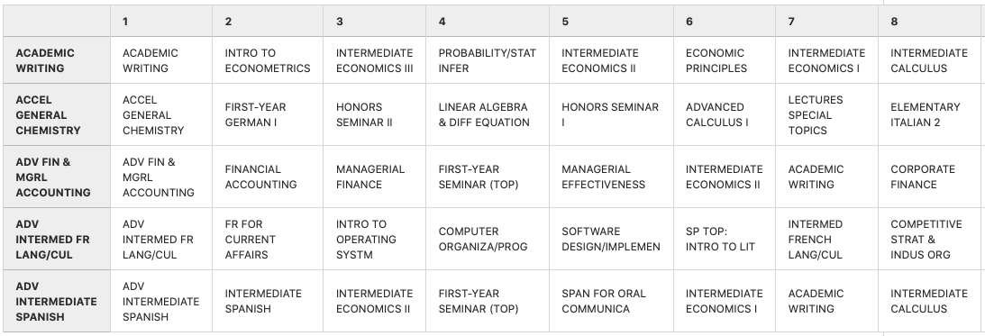
Neighborhood Methods
Duke Registrar Recommender
Notes:
After normalizing the cosine similarity scores for each class, we then take the top 10 courses with the highest scores to construct our neighborhood. Each row shows the most similar classes. This dataframe is referred to as the class-neighborhood. For this model, we will use the top 10 most similar classes to create the class neighborhood.

Slide 14
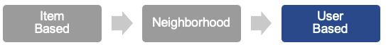
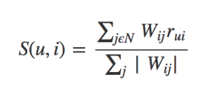
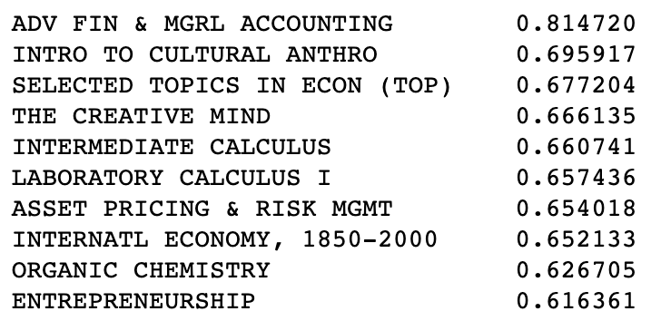
Neighborhood Methods
u = student
i = course
j = course taken
W = weights (0/1)
r = item-based matrix
Duke Registrar Recommender
Notes:
To calculate a score to recommend a course to a student, we look at the courses taken by the student and the item-based matrix. We can then take the top n courses with the highest score to recommend to the student. Here we show an example of the top 10 recommended courses for a given Econ student.
(To calculate a score for a particular user and item, we first define matrix Wij as a weights matrix consisting of binary indicator of 0 or 1 on whether one student took a particular course. Then, we sum these binary weights multiplied by the item-based matrix for all i courses that student u has taken. Lastly, we divide this by the sum of all the weights for item Wij. The courses with the highest scores indicate courses that a student’s nearest neighbor has taken.)
(Using the class neighborhood,which is r_ui on the right side at the numerator, we use user’s binary data, which is W_ij next to the r_ui, whether they actually have taken a particular course or not. Note that we only choose class j that a student N has taken. Here N is 10 in this case from the previous silde. If I summarize what’s happening on the numerator part again, We get the score for user u and item i by summing together all the weights for that item Wij, which are binary choice 0 and 1, multiplied with the item-based matrix. We then divide by the sum of all the weights for that item Wij. This step is basically normalizing step.
With this formula, we get a list of recommended classes. The highest score is the class that his/her nearest neighbor have taken)

Slide 15
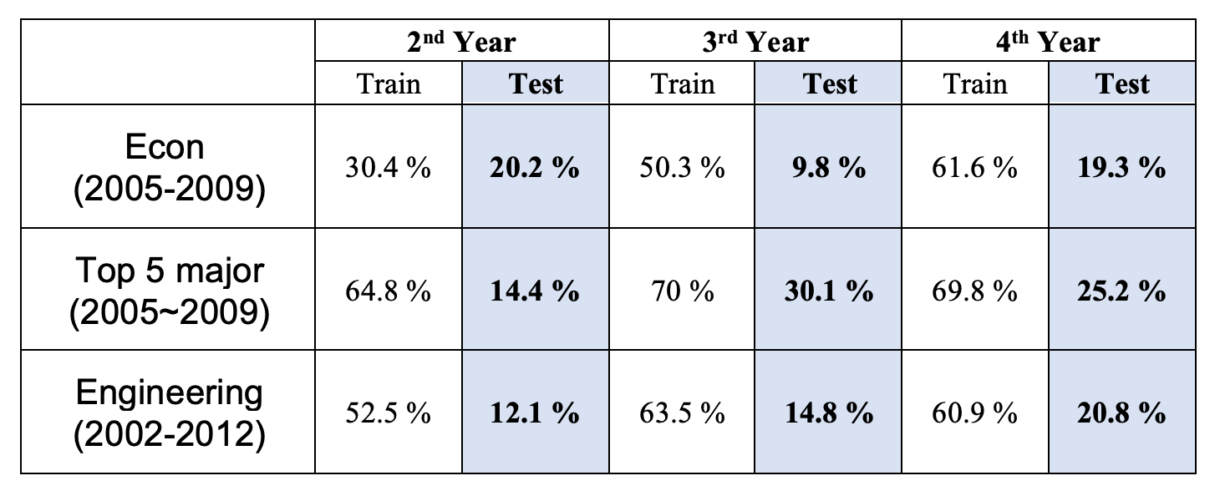
Neighborhood Methods: Results
Duke Registrar Recommender
Notes:
Here is the result of Neighborhood methods. The accuracy for training performed welll as we expect. bu

Slide 16
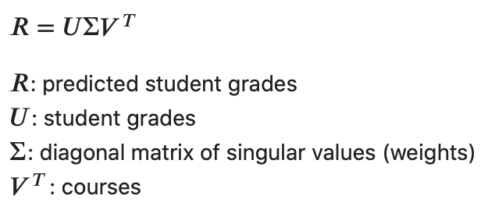
SVD
Singular Value Decomposition (SVD)
Creating training and testing datasets
4 yrs
Train Dataset
Train students
Yrs 1 and 2
Test students
Yrs 3 and 4
Test Dataset
Duke Registrar Recommender
Notes:
Other than neighborhood methods, another popular method commonly used in recommender systems is matrix factorization. One popular algorithm for matrix factorization is called singular value decomposition, where student grades can be predicted by multiplying U (the student grade matrix), sigma (the diagonal matrix of weights), and V transposed (all the courses).
Listening to feedback from others, we decided to try a different train test split method. We first split the students in 80% training students and 20% test students. For the training students, all 4 years of data were added to the training dataset. For the test students, years 1 and 2 were added to the training dataset and years 3 and 4 are left out and considered the test dataset. Thus, the matrix that is fed into SVD contains 4 years of data for 80% of the students and 2 years of data for 20% of the students. We can then test SVD performance on years 3 and 4 from the test students.

Slide 17
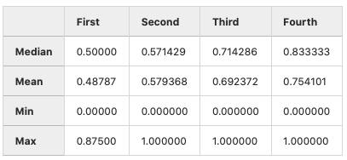
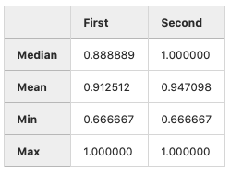
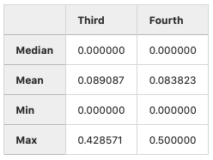
SVD Performance: Econ 2005-2009
Training Dataset
Testing Dataset
All Train Students:
4 Years
Test Students:
Years 1 and 2
Test Students:
Years 3 and 4
127
32
32
Duke Registrar Recommender
Notes:
Using this train test split method and the same accuracy metric as before, we can see the results for the training and testing datasets on our smallest subset of data, the econ 2005-2009 subset. Clearly, the model performs very well in the training set, correctly predicting a large percentage of classes for these years and these students. However, when looking at the performance on the test students for years 3 and 4, we can see the model struggles a lot, achieving a very low average accuracy of about 8 to 9%.

Slide 18
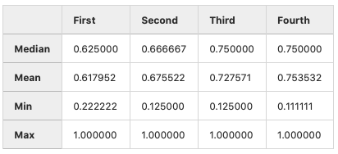
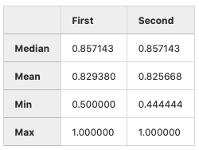
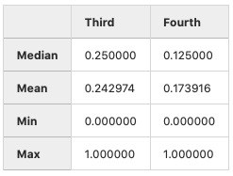
SVD Performance: Top 5 Majors 2005-2009
Training Dataset
Testing Dataset
All Train Students:
4 Years
Test Students:
Years 1 and 2
Test Students:
Years 3 and 4
533
133
133
Duke Registrar Recommender
Notes:
Now moving to a slightly larger subset of data, we tested SVD on students who enrolled in 2005 and graduated in 2009 with one of the top 5 majors. Again, we see really good performance on the training data, from 60 to 80%, and much lower performance on the test data. However, the test performance here of about 25% on the 3rd year and 15% on the 4th year is higher than that of the econ subset.

Slide 19
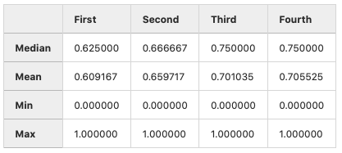
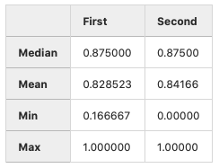
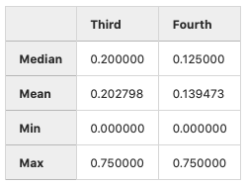
SVD Performance: Engineering
Training Dataset
Testing Dataset
All Train Students:
4 Years
Test Students:
Years 1 and 2
Test Students:
Years 3 and 4
2234
559
559
Duke Registrar Recommender
Notes:
Lastly, we tested SVD on an even larger dataset which contains all engineering students in the 2000-2012 dataset. We see a similar trend as before where training data performs really well around 60 to almost 90%, but the test data again performs poorly, with a 20% accuracy for year 3 and 13% accuracy for year 4.

Slide 20
SVD Summary
Training Set
All 4 years of data from Training Students
Years 1 and 2 from Test Students
Relatively really good performance
Accuracy increases over the years
First Year: 50-60%
Fourth Year: 70-80%
Test Set
Years 3 and 4 from Test Students
Much worse performance
Econ: 8-9%
Top 5 and Engineering Majors:
Third Year: 20-25%
Fourth Year: ~15%
Duke Registrar Recommender
Notes:
In summary, the training set for this SVD model consisted of 4 years of data from the training students and the first 2 years of data for the test students. Within this group, SVD performed relatively really well. Accuracy increased every year, with a 1st year accuracy of about 50-60% and a 4th year accuracy of about 70-80%.
The test set consisted of the last two years of data from the test students. This test set performed much worse. On the econ subset, accuracy for the 3rd and 4th years was about 8-9%. For the top 5 and engineering datasets, accuracy for the 3rd year was about 20-25% and for the 4th year was about 15%.
Despite the poor test set performance, we are looking to try filtering out courses from the recommendations to help narrow down the search space and eliminate recommendations that may not make sense.

Slide 21
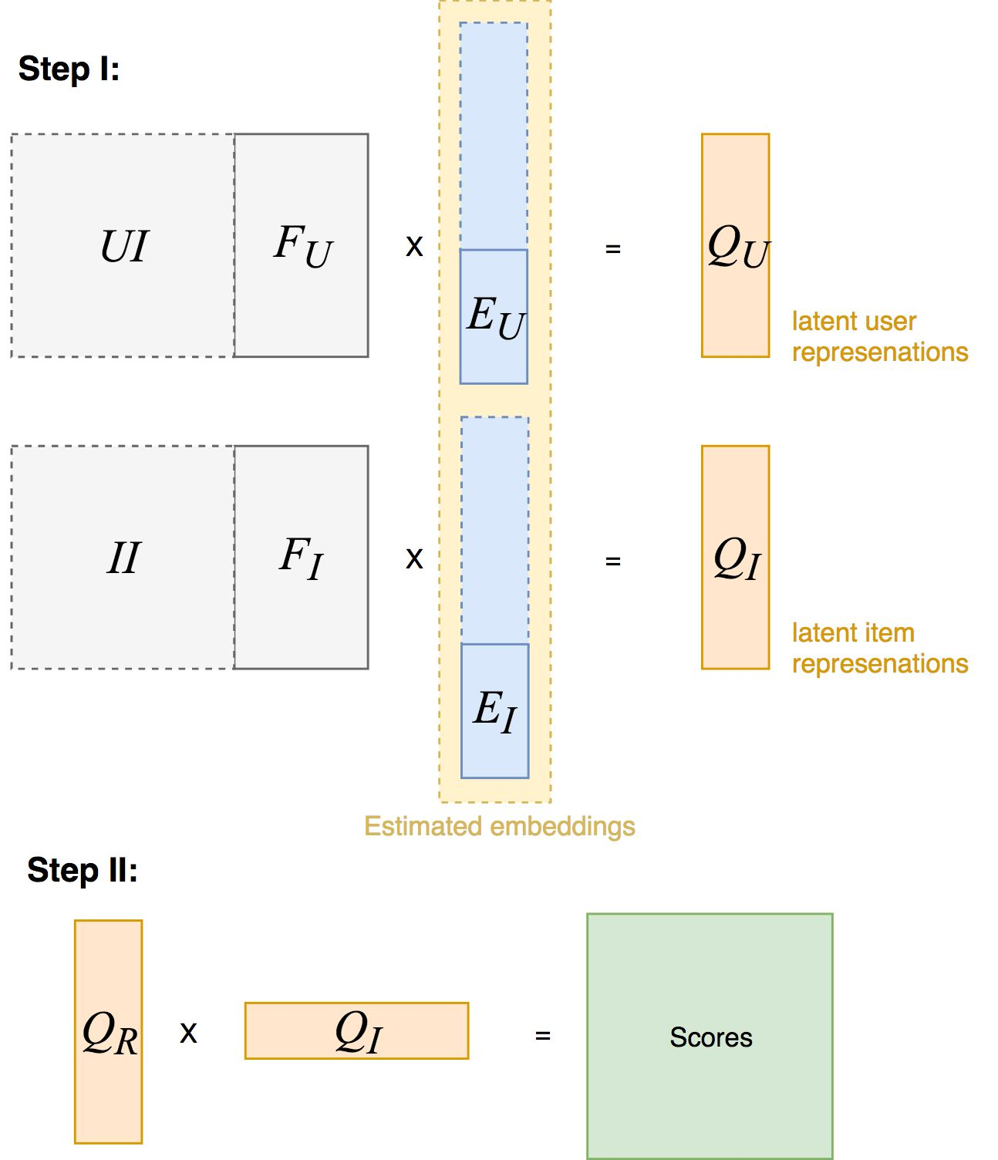
LightFM
Content-based:
User feature: major_1, minor_1, minor_2
Item feature: subject, class_year
Collaborative:
Interaction matrix: normalized grade
Learns embeddings for users and items that encodes user preferences over items
When multiplied together, these representations produce scores for every item for a given user
Duke Registrar Recommender
Notes:
Ref: https://www.datarevenue.com/en-blog/building-a-production-ready-recommendation-system
LightFM is one of the hybrid matrix factorization model that is able to integrate three pieces of information: the information on the student, the information on the course, and the interaction information of which students took which courses.
In the case of Light FM, we get the latent representation of each feature for every item and user. Following this idea, the latent representation of a item is just the sum of the latent representations of the item’s features. Similarly for users, we just add the latent representations of the user’s features to get the latent representation for a user. The score for a item-user pair is again the cosine similarity of the latent representations of the item and the user.

Slide 22
LightFM Results
Train/Test Split based on year of interest: Only use data up to that year
Avg Accuracy | Second Year | Third Year | Fourth Year
Econ_05-09 k=15 | 18.7% | 14.6% | 12.1%
Econ_05-09 k=30 | 32.1% | 23.7% | 21.1%
Top5_05-09 k=15 | 13.6% | 11.3% | 9.5%
Top5_05-09 k=30 | 29.6% | 22.0% | 19.4%
Duke Registrar Recommender

Slide 23
Model Comparisons: Econ
Number of Courses Taken in Top K Recommendations
Avg. Top K Accuracy =
Total Number of Courses Taken of the Academic Year of Interest
(k = 15) | Second Year | Third Year | Fourth Year
Neighborhood | 20.2% | 9.8% | 19.3%
SVD | x | 8.9% | 8.4%
LightFM | 18.7% | 14.6% | 12.1%
Duke Registrar Recommender

Slide 24
Model Comparisons: Top 5
Number of Courses Taken in Top K Recommendations
Avg. Top K Accuracy =
Total Number of Courses Taken of the Academic Year of Interest
(k = 15) | Second Year | Third Year | Fourth Year
Neighborhood | 14.4% | 30.1% | 25.2%
SVD | x | 24.3% | 17.4%
LightFM | 13.6% | 11.3% | 19.4%
Duke Registrar Recommender

Slide 25
Limitations
Low performance on test set from MF methods
Training set looking into the future
Not efficient latent representation
Lack of “negative” samples
Course grade information might have bias (e.g. need to separate courses with/without grades)
No constraints implemented yet (e.g. prerequisites, particular major requirements...)
Duke Registrar Recommender

Slide 26
Future Work
Separate recommendation for 1st year students
Narrow down search space for recommending courses
Create filters based on business rules
E.g. When recommending non-first year courses, exclude courses specifically intended for “first-year”
E.g. For apparent courses with prerequisites, we can exclude them from the recommended set
Better incorporate temporal aspect
Efficient vector representations for courses and students (Class2Vec)
Increase generalizability of the model
Integrate with Dataiku platform
Duke Registrar Recommender
Notes:
For future work, we would like to narrow down the search space for course recommendations. This can be achieved with further feature extraction, course clustering, or course filtering
Next, we want to incorporate the temporal aspect of courses taken for each student, and also try to find more effective vector representations of course information. For which, we can consider Word2Vec and BERT models for both purposes.
We will also incrementally use more data and apply to current course structure. In the end, we will also integrate with the Dataiku platform and have a dynamic dashboard.

Slide 27
Thank You!
Duke Registrar Recommender
Notes:
Thank you for listening!

Slide 28
Appendix
Duke Registrar Recommender
Notes:
1-3: Becky
4-7: Vanessa
8-15: Sangseok
16-20: Vanessa
21-26: Becky

Slide 29
Implicit
Alternating least squares (ALS)
Iterative optimization process where for every iteration try to arrive closer and closer to a factorized representation of the original data
Normalised grades used as “confidence” in terms of how strong the interaction was
Courses with a higher value of GPA by a student can carry more weight in the "ratings" matrix of normalized grade
MF (ALS)
User/Item Vector Norms
Similarity Scores
Recommendations
Duke Registrar Recommender

Slide 30
Data
Student level data including:
All courses taken at duke
Grade received
Department
Course number/name
Academic year taken
Major(s) // Minor(s) // Certificate(s) // Secondary
Academic year of graduation
Added the following features:
Enrollment year
Semester course taken (First Year Fall)
Numerical grades
Duke Registrar Recommender
Notes:
Because we were able to obtain the data for the 2000-2012 segment first, we are focusing EDA and model-building on this segment of data which is cleaner and more complete.
Our final dataset includes de-identified student ID’s, graduation year, majors and minors, in addition to course descriptions, department, grades received, and the semester each course was taken.

