Slide 1

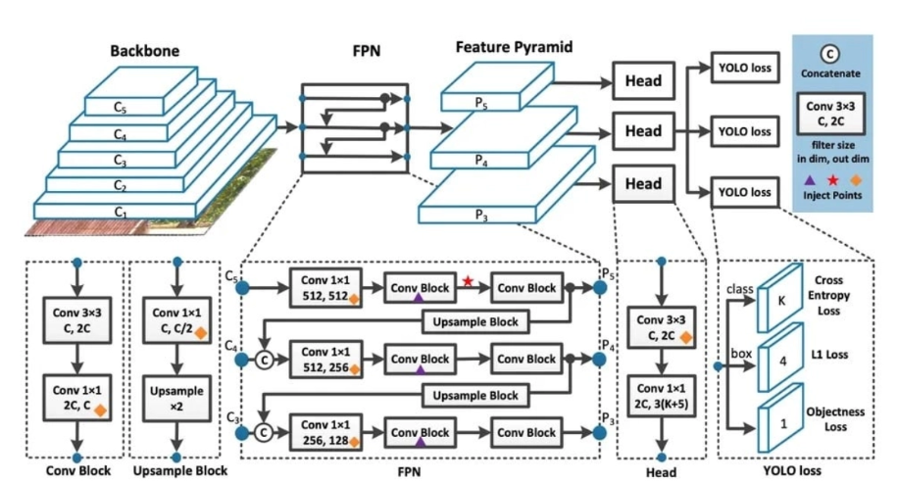
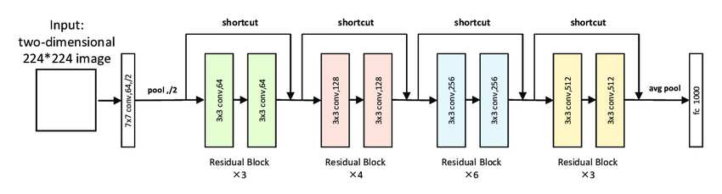
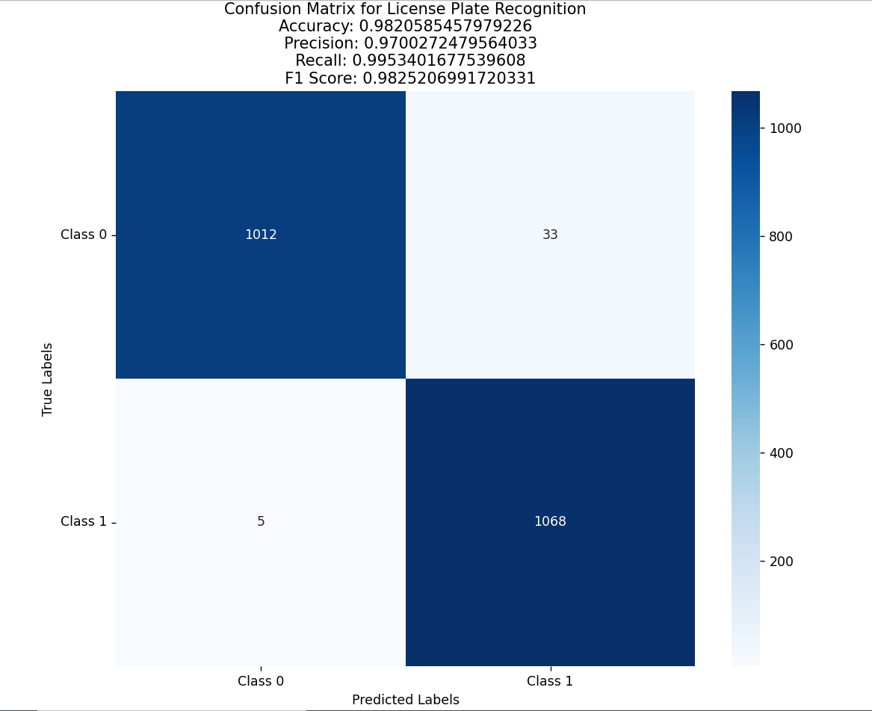
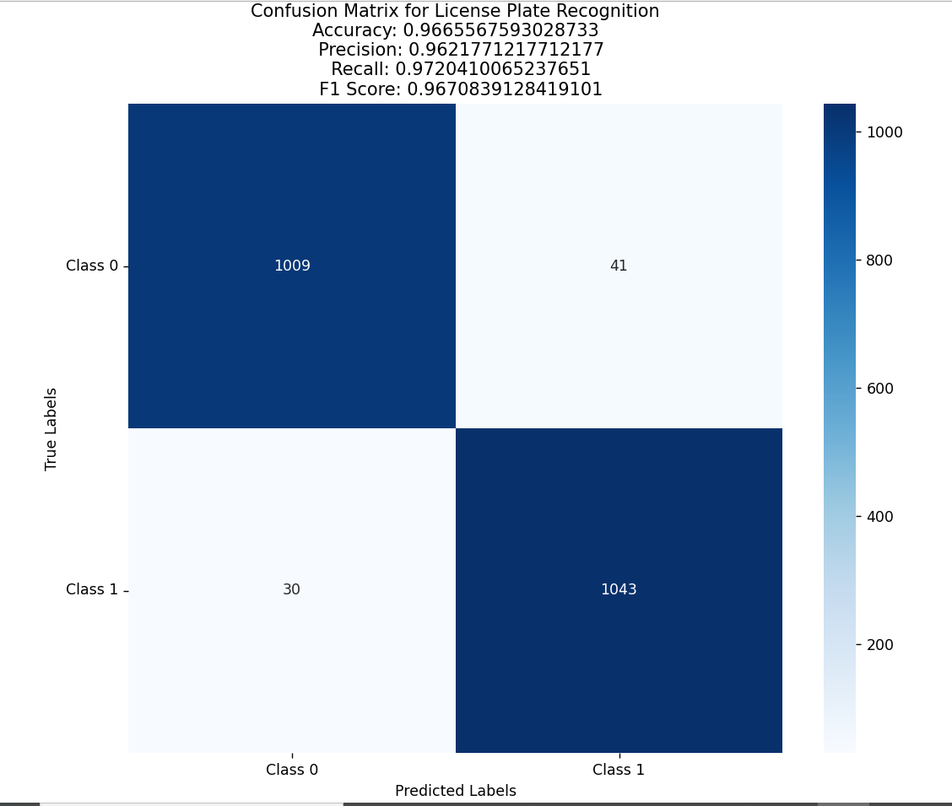
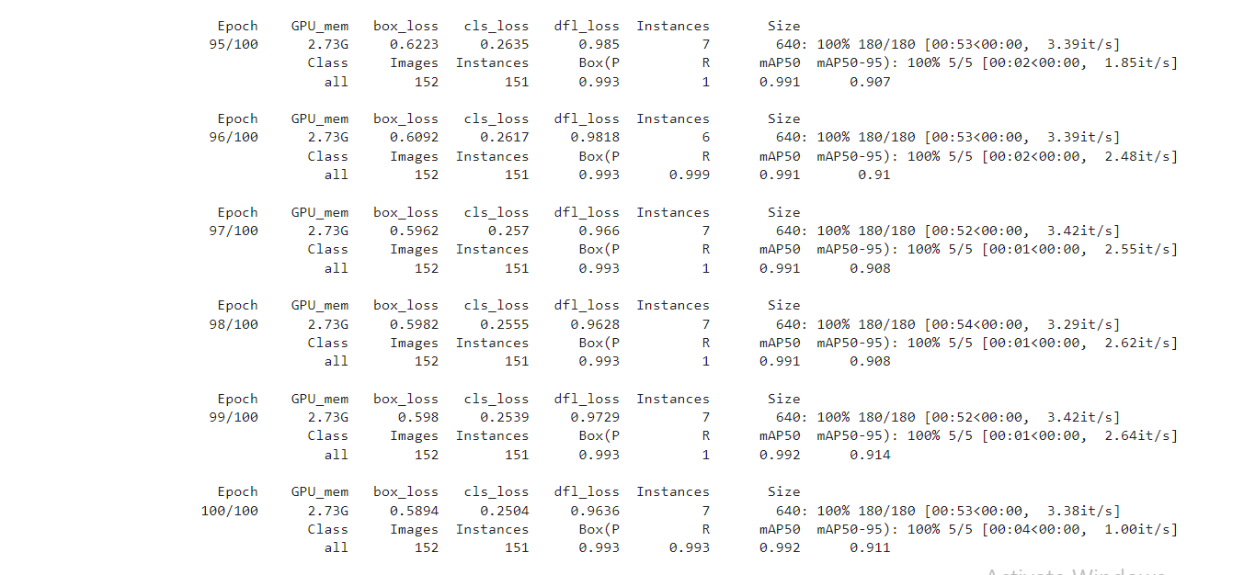
Vehicle license plate detection and classification system using Deep Learning
Nguyen Quang Sang¹
¹ Faculty of Information Technology, Hanoi University of Industry
* Email : sangsura002@gmail.com
INTRODUCTION
MATERIALS AND METHODS
With increasing vehicle usage, the need for effective traffic management and law enforcement also increases. Automatic license plate recognition (ALPR) systems have become essential in identifying and classifying vehicles based on license plate numbers. Our research focuses on developing a robust ALPR and classification system capable of real-time recognition and classification of license plates. The system includes a license plate detection module, an OCR engine, and a classification algorithm. The detection module uses advanced object detection techniques to locate license plates in images. The classification algorithm will then classify the license plate based on criteria such as blur and occlusion. The OCR engine extracts characters from quality plates, converting them into text. Our research highlights the system's scalability and easy integration into existing infrastructure, promising significant improvements in traffic management and security.
Fig 1. Model Yolov8 architecture
Fig 2. Model Resnet34 architecture
RESULTS AND DISCUSSION
The results in Fig 3. show that after the training process, the model has a box loss of 0.5894, a classification loss of 0.2504, and a learning direction feature loss of 0.9636. The results in Fig 4. show that, after training and evaluating the performance of the model on a test data set of 2,118 images, the accuracy of the blurred license plate classification model is 98.2%. , Precision reaches 97%, Recall reaches 99.5%. The results in Fig 5. show that, after the training process, evaluating the performance of the model on a test data set of 2,122 images, the accuracy of the obscured license plate classification model is 96.6%. , Precision reached 96.2%, Recall reached 97.2%
Fig 3. Evaluation results of license plate classification model (blurred and normal) using Resnet34 model
Fig 4. Evaluation results of license plate classification model (obscured and normal) using Resnet34 model
Fig 5. Evaluation results of the license plate detection model using yolov8
CONCLUSION
The project has successfully fulfilled the majority of its objectives, including the detection of diverse license plates, their classification, and the automatic recognition of license plate characters with high accuracy and low latency. To further enhance performance, plans for the future include utilizing specialized cameras, establishing a stable environment for capturing images, and exploring novel Deeplearning models.

