Slide 2
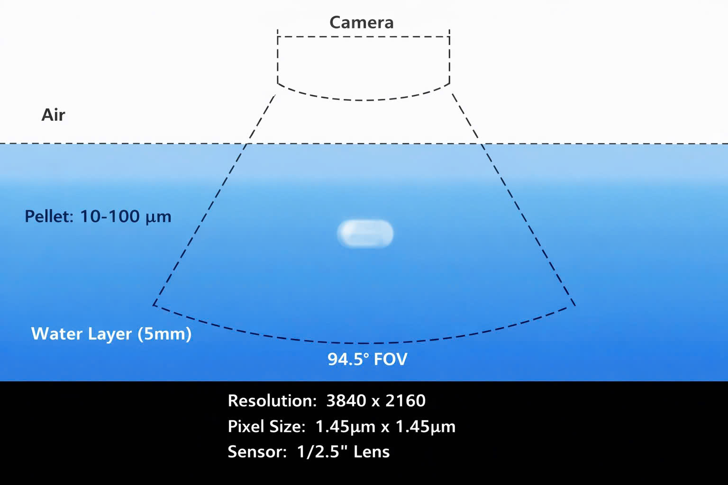
Simulation
+ 2.1/2.8/3.6/6/8/12mm lens
+ 1/2.5" là kích thước cái lens

Slide 3
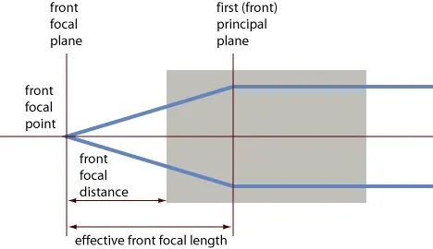
Focal plane
https://www.rp-photonics.com/focal_points_and_focal_planes.html

