Slide 1

Notes:
[Sources]
- User-provided reference image: C:\Users\Admin\mbca\TP2-3\storage\template_reference_20260901\1.png

Slide 2
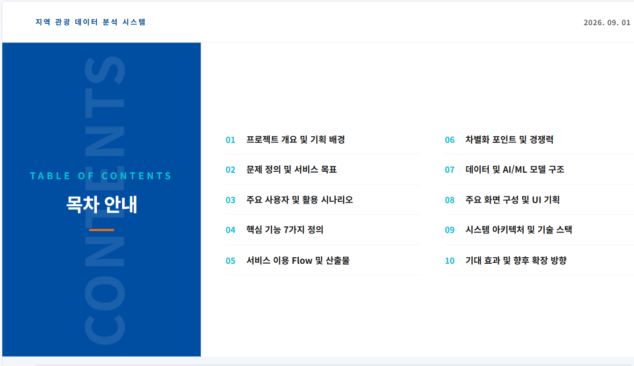
Notes:
[Sources]
- User-provided reference image: C:\Users\Admin\mbca\TP2-3\storage\template_reference_20260901\2.png

Slide 3
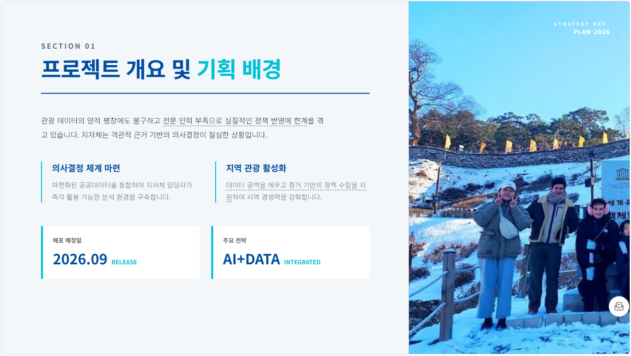
Notes:
[Sources]
- User-provided reference image: C:\Users\Admin\mbca\TP2-3\storage\template_reference_20260901\3.png

Slide 4
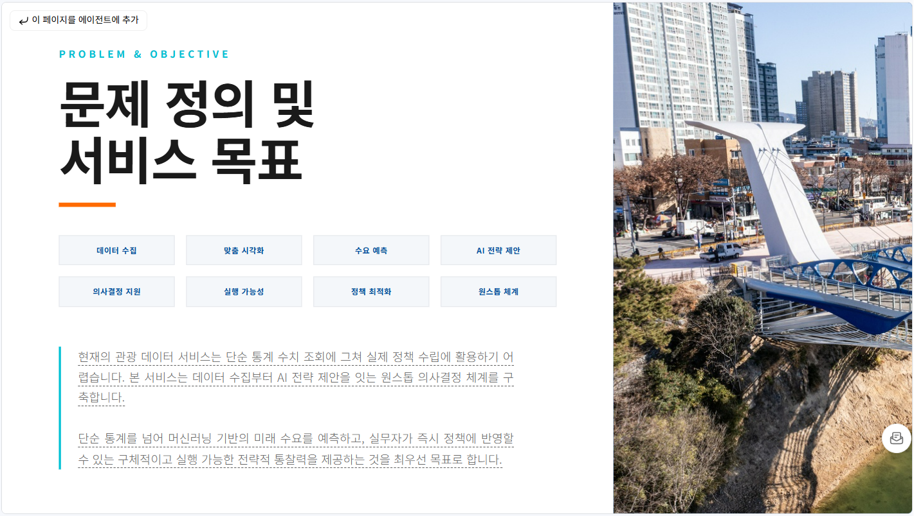
Notes:
[Sources]
- User-provided reference image: C:\Users\Admin\mbca\TP2-3\storage\template_reference_20260901\4.png

Slide 5
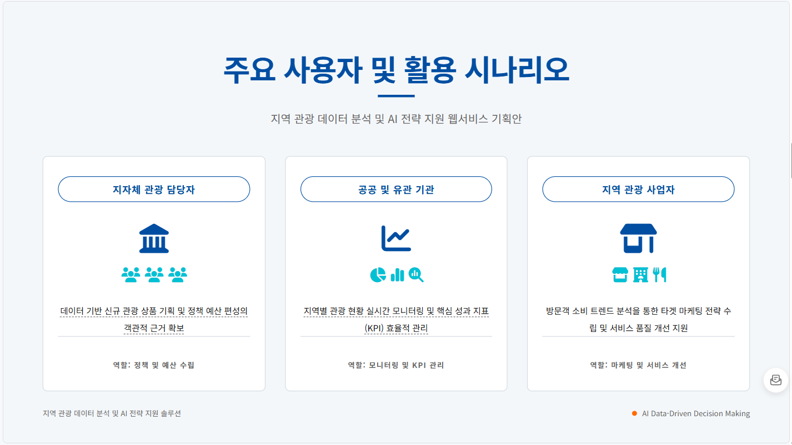
Notes:
[Sources]
- User-provided reference image: C:\Users\Admin\mbca\TP2-3\storage\template_reference_20260901\5.png

Slide 6
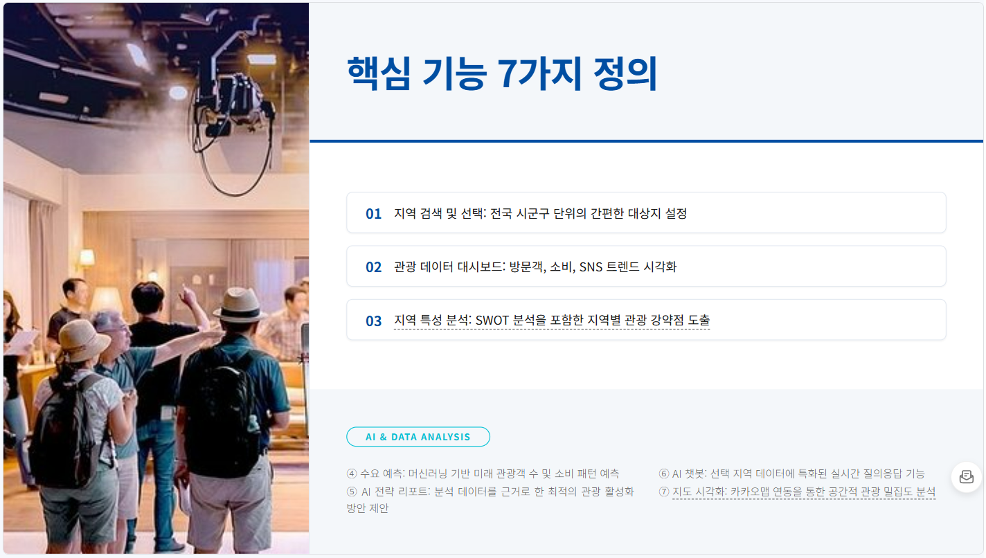
Notes:
[Sources]
- User-provided reference image: C:\Users\Admin\mbca\TP2-3\storage\template_reference_20260901\6.png

Slide 7
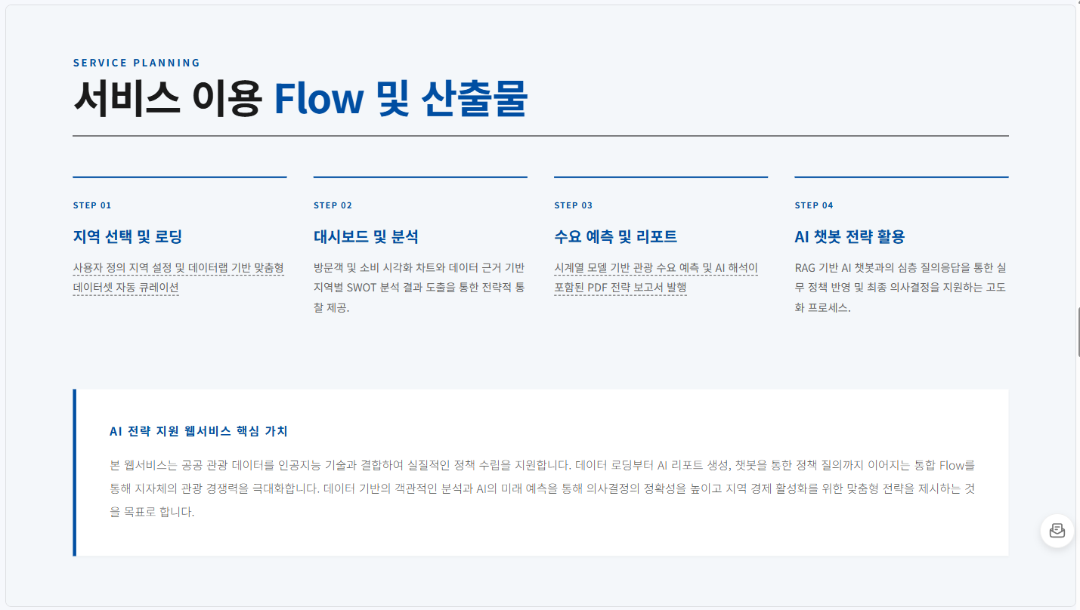
Notes:
[Sources]
- User-provided reference image: C:\Users\Admin\mbca\TP2-3\storage\template_reference_20260901\7.png

Slide 8
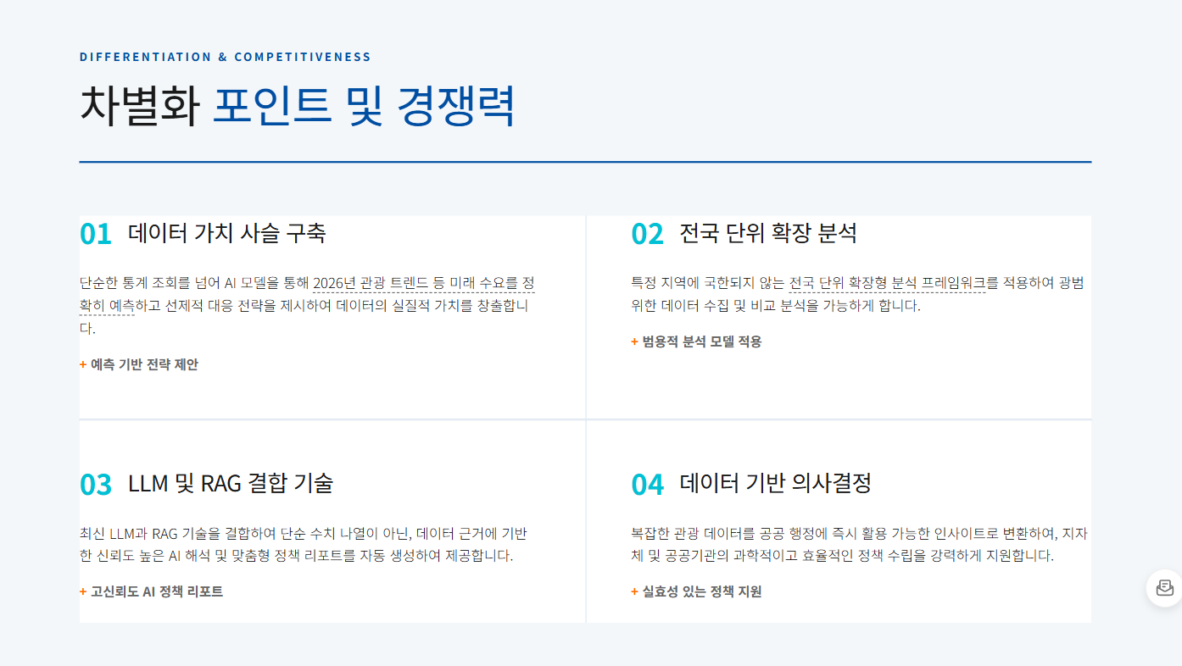
Notes:
[Sources]
- User-provided reference image: C:\Users\Admin\mbca\TP2-3\storage\template_reference_20260901\8.png

Slide 9
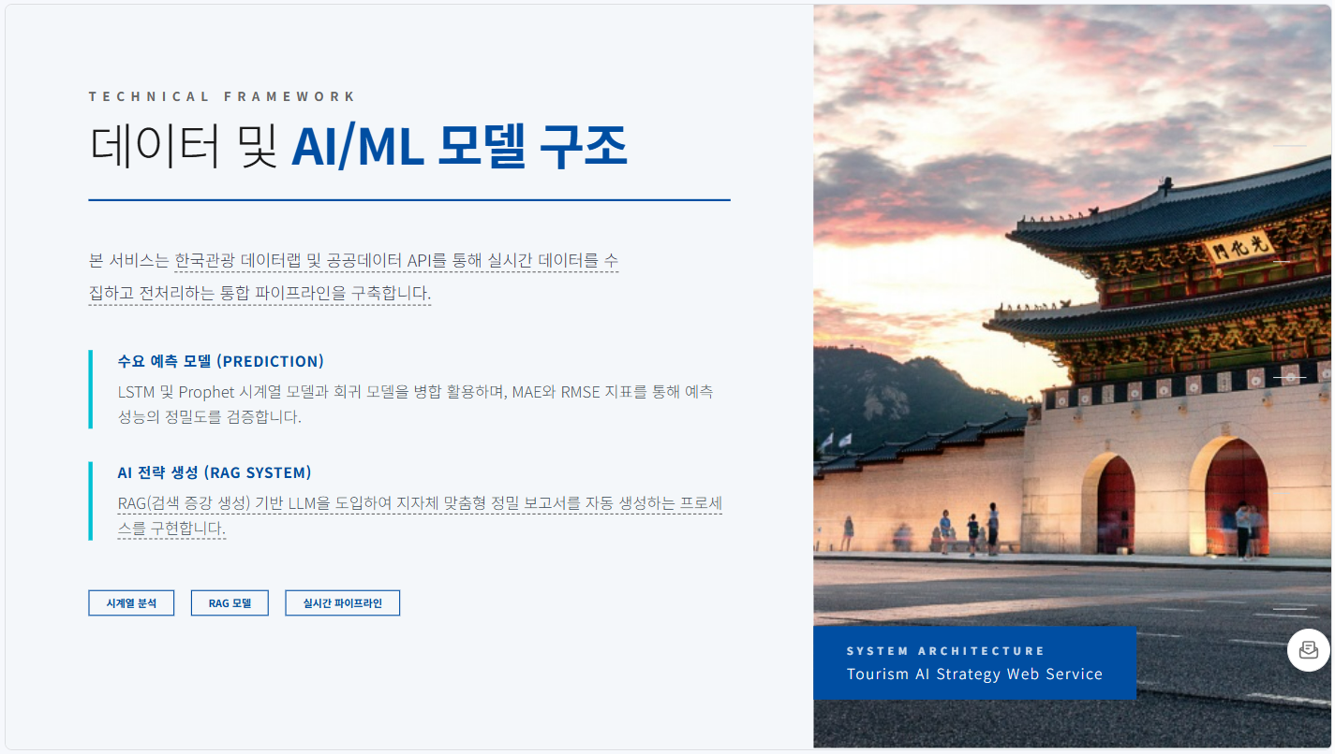
Notes:
[Sources]
- User-provided reference image: C:\Users\Admin\mbca\TP2-3\storage\template_reference_20260901\9.png

Slide 10
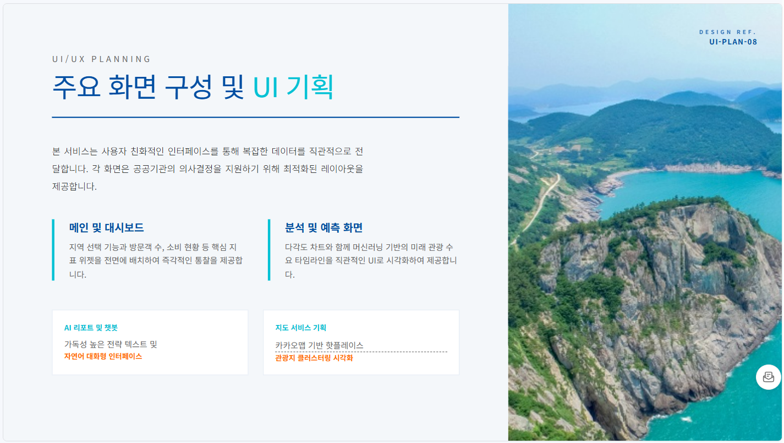
Notes:
[Sources]
- User-provided reference image: C:\Users\Admin\mbca\TP2-3\storage\template_reference_20260901\10.png

Slide 11
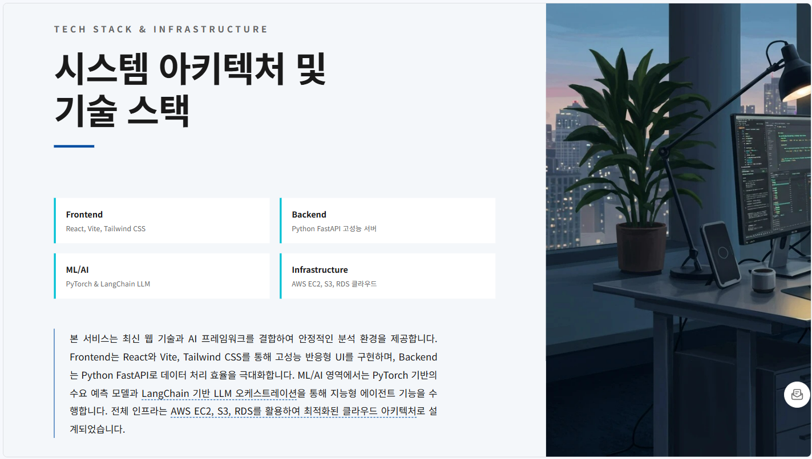
Notes:
[Sources]
- User-provided reference image: C:\Users\Admin\mbca\TP2-3\storage\template_reference_20260901\11.png

Slide 12
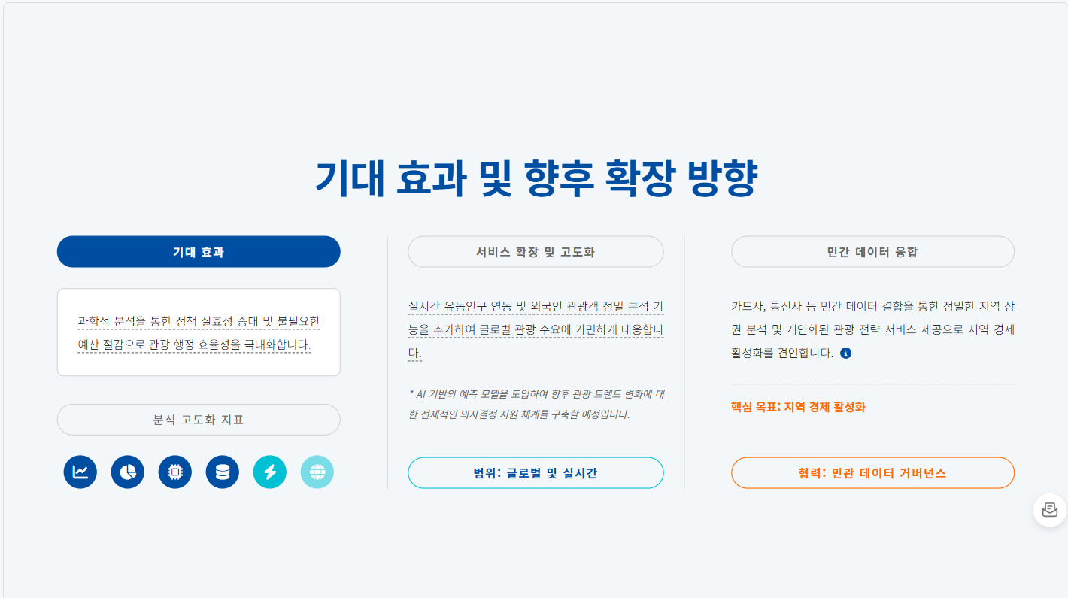
Notes:
[Sources]
- User-provided reference image: C:\Users\Admin\mbca\TP2-3\storage\template_reference_20260901\12.png

