Slide 1
Project Title: How to make a Phone Book using C programming project based on file handling
Team Member:
Sangya Sakha
Prashansa Himal
Bimala Shahi
Apsara Limbu

Slide 2
Project Overview: -Making Phone Book using C project Base on Filehandling.
In this project you will find a very good implementation of file handling using C programming. Below are some overview of this app below are the topic which I implement in this project.
serialization
storing and retriving block of data into a file
secure data by converting it into binary format
Pointers

Slide 3
Agenda of this project (objectives)
In this project we can save contacts and do these operations in it using file 1) view all contacts. 2) add a contact. 3) remove a contact. 4) search details of any contact number. 5) update details of any contact. 6) delete whole phonebook (delete all contacts present in phonebook) 7)exits Phonebook

Slide 4
Introduction
-**Introduction to C Projects**: It Introduces how to create a project in the C programming language, emphasizing the importance of practical implementation and problem-solving skills .
- **Project Ideas**: Various project ideas are suggested to help students understand the application of C programming concepts .
- **Basic Operations** The project involves operations such as adding, updating, and deleting contacts, which are fundamental tasks in many applications .
-**Function Implementation**:
Functions are crucial in structuring the code. Best practices include avoiding global variables and ensuring functions have clear arguments .

Slide 5
.
**User Input Handling**:
The program is designed to take user input effectively, ensuring that the system can handle various data types and formats .
**Data Management**:
Emphasis is placed on managing data efficiently, including storing and retrieving contact details, which is essential for any application dealing with user information .
- **Error Handling**:
Implementing error handling mechanisms is crucial to ensure the program runs smoothly and can handle unexpected inputs .
**Final Touches**:
The project concludes with the importance of testing and debugging to ensure the application works as intended, which is a vital part of software development .

Slide 6
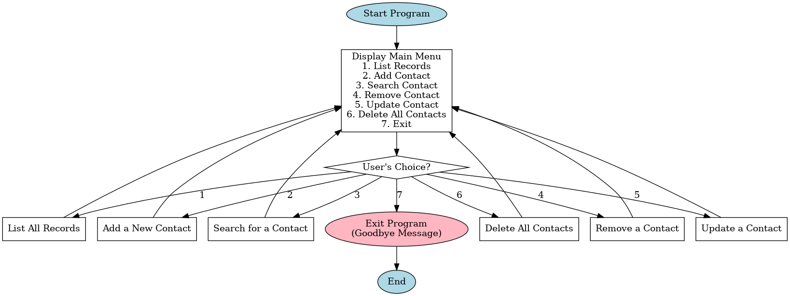
Flowchart

Slide 7
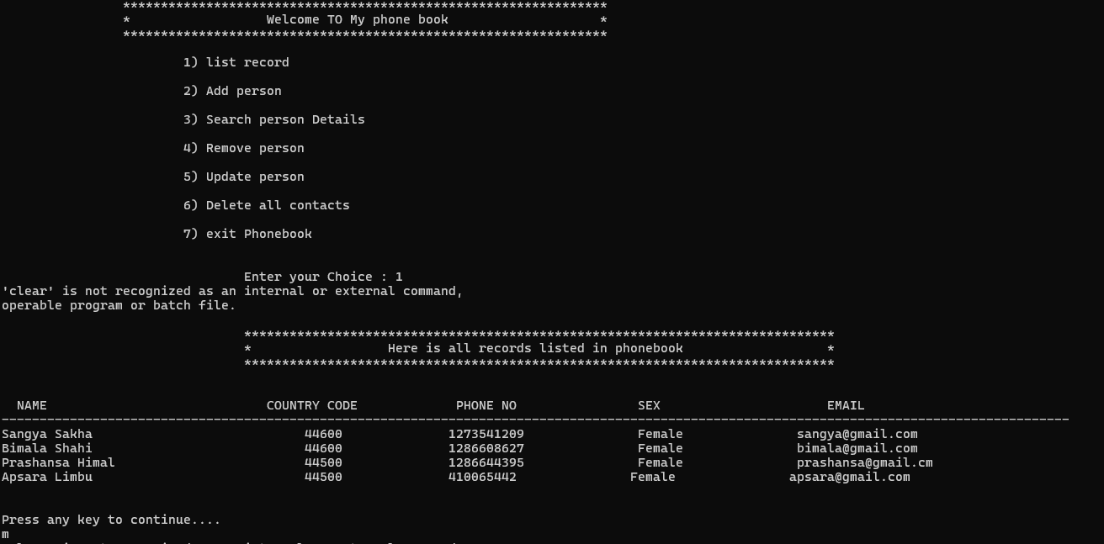
Front Interface You can select operation you want to perform.

Slide 8
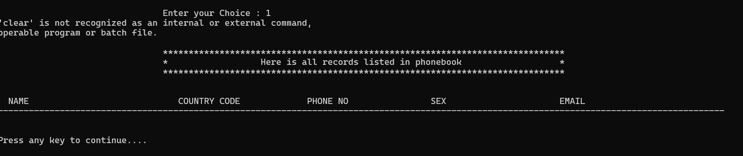
Listing data present in the phone book console app

Slide 9
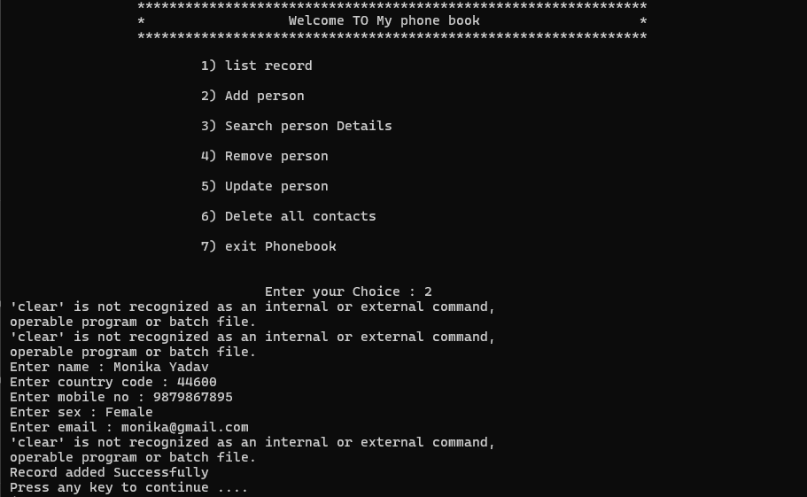
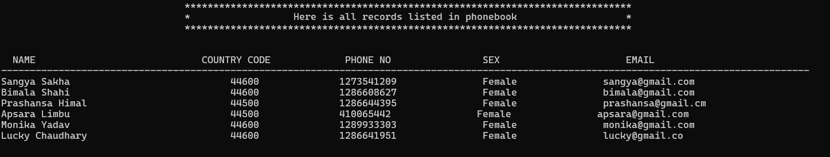
Adding data into the phone book
you can easily add any number of data here

Slide 10
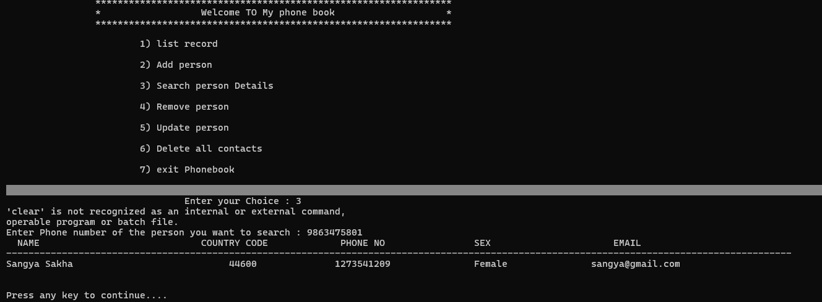
Searching by Phone number
you can easily search between any detail present into the file

Slide 11
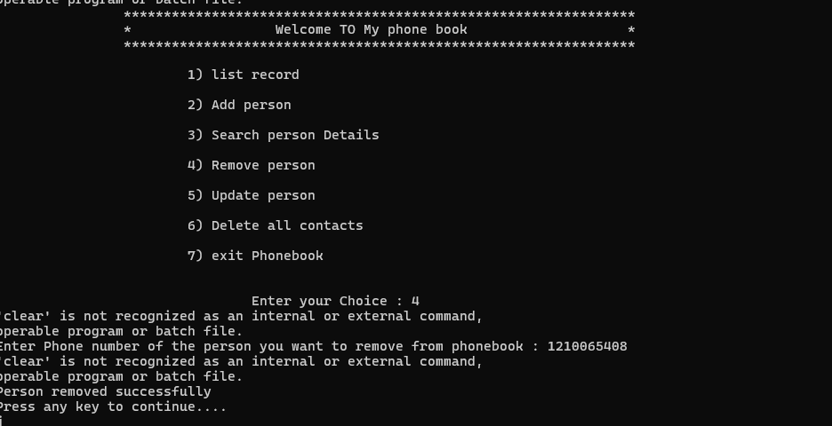
Remove person by phone number

Slide 12
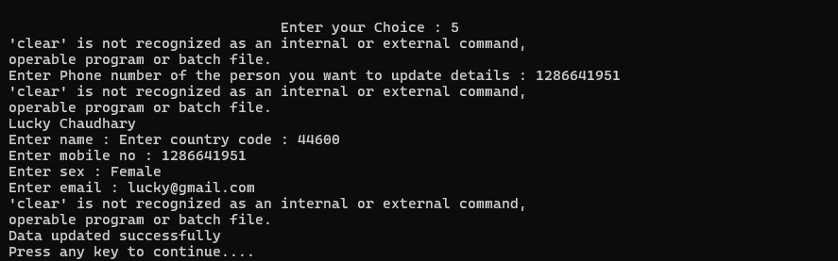
Update details of any contact.
Whenever you add any data it will store that data into a binary file so you can access it any time. You may also delete or update any person detail in it.

Slide 13
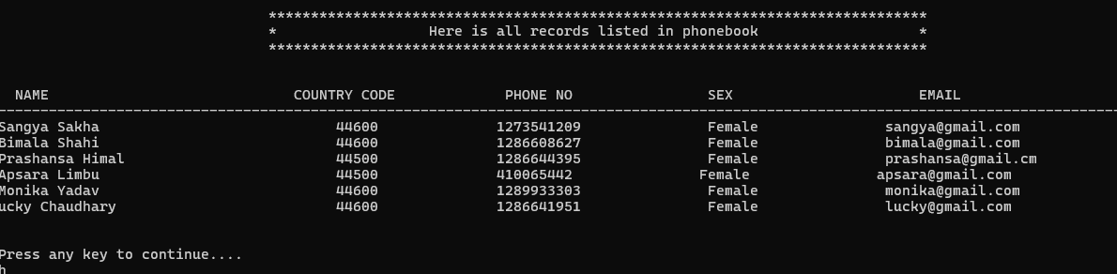
Outputs After updating the contact Already saved list
After Update

Slide 14
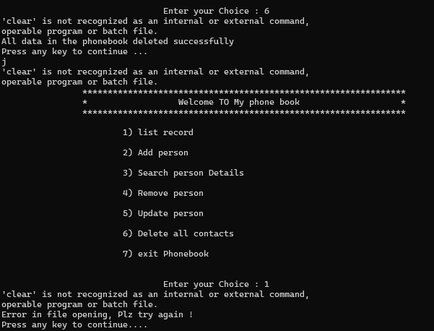
Delete whole phonebook(delete all contacts present in phonebook)

Slide 15
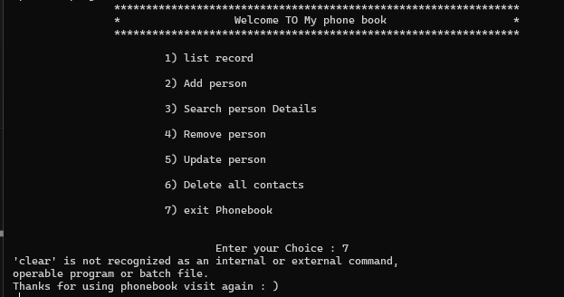
Exits Book Phone

Slide 16
Summary /Conclusion
The summary of the project highlights the key aspects of developing a C language application, focusing on practical skills, user interaction, and data management In this project I will explain how you can make a project in c language. This project is loosely coupled project (one function is not depend on another one ).
I use these things in my project
structures
file handling
string manipulation

Slide 17
Codes
#include <stdio.h>
#include <stdlib.h>
#include <string.h>
struct person
{
char name[30];
char country_code[4];
long int mble_no;
char sex[8];
char mail[100];
};
// Defining person data type.typedef struct person person; // All function declaration. void start(); void remove_all(); void print_menu(); void add_person(); void list_record(); void search_person(); void remove_person(); void update_person(); void take_input(person *p);
// Program starts here.
int main()
{
start();
return 0;
}
// This function will start our program.
void start()
{
int choice;
while(1)
{
print_menu();
scanf("%d",&choice);
switch(choice)
{
case 1:
list_record();
getchar();
getchar();
break;
case 2:
add_person();
getchar();
getchar();
break;
case 3:
search_person();
getchar();
getchar();
break;

Slide 18
case 4:
remove_person();
getchar();
getchar();
break;
case 5:
update_person();
getchar();
getchar();
break;
case 6:
remove_all();
getchar();
getchar();
break;
default :
system("clear");
printf("Thanks for using phonebook visit again : )\n");
getchar();
getchar();
exit(1);
}
}
}
// This will print main menu.
void print_menu()
{
system("clear");
printf("\t\t************************************** **************************\n");
printf("\t\t* Welcome TO My phone book *\n");
printf("\t\t****************************************************************\n\n");
printf("\t\t\t1) list record\n\n");

Slide 19
printf("\t\t\t2) Add person\n\n");
printf("\t\t\t3) Search person Details\n\n");
printf("\t\t\t4) Remove person\n\n");
printf("\t\t\t5) Update person\n\n");
printf("\t\t\t6) Delete all contacts\n\n");
printf("\t\t\t7) exit Phonebook\n\n\n");
printf("\t\t\t\tEnter your Choice : ");
}
// This function will add contact into phonebook.
void add_person()
{
{
system("clear");
printf("No record found for %d number\n",phone);
}
fclose(fp);
fclose(temp);
remove("phonebook_db");
rename("temp","phonebook_db");
fflush(stdin);
printf("Press any key to continue....\n");
}
}
// This function will update contact information.
void update_person()
{
system("clear");
long int phone;
printf("Enter Phone number of the person you want to update details : ");
scanf("%ld",&phone);
FILE *fp,*temp;
fp = fopen("phonebook_db", "rb");
temp = fopen("temp","wb+");

Slide 20
if (fp == NULL)
{
printf("Error in file opening, Plz try again !\n");
printf("Press any key to continue....\n");
return;
}
else
{
int flag = 0;
person p;
while (fread(&p, sizeof(p), 1, fp) == 1)
{
if(p.mble_no == phone)
{
take_input(&p);
fwrite(&p, sizeof(p), 1, temp);
system("clear");
printf("Data updated successfully\n");
flag = 1;
}
else fwrite(&p,sizeof(p),1,temp);
fflush(stdin);
}
if(flag == 0)
{
system("clear");
printf("No record found for %d number\n",phone);
}
fclose(fp);
fclose(temp);
remove("phonebook_db");
rename("temp","phonebook_db");
fflush(stdin);
printf("Press any key to continue....\n");
}
}
// This function will clear all the data of phonebook.
void remove_all()
{
char choice;
system("clear");
remove("./phonebook_db");
printf("All data in the phonebook deleted successfully\n");
printf("Press any key to continue ... \n");
}

