Slide 1
ㅇㅇㅇ

Slide 2
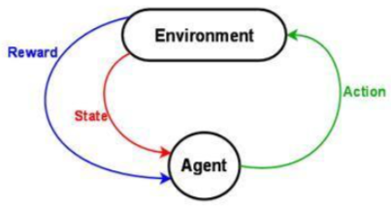
Motivation - RL의 한계
High-dimensional observation space
Sparse Reward
Optimal Policy를 찾음

Slide 3
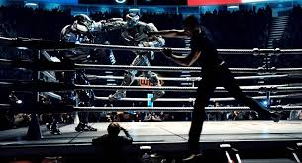

Goals - Imitation Learning

Slide 4
Imitation Learning의 분류
Behavioral Cloning
IRL: Inverse Reinforcement Learning
GAIL: Generative Adversarial Imitation Learning

Slide 5
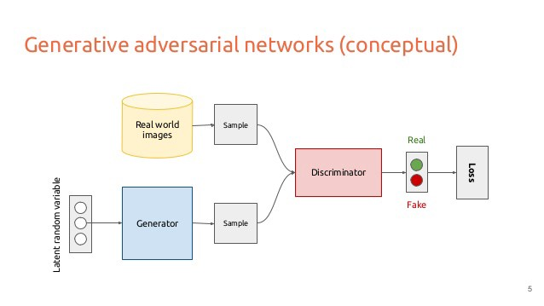
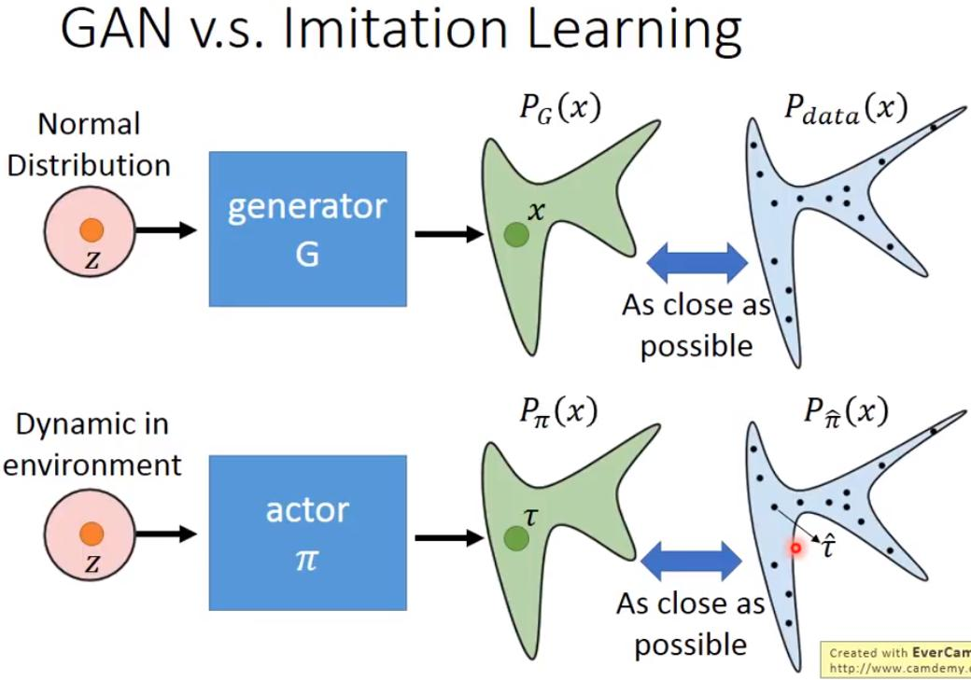
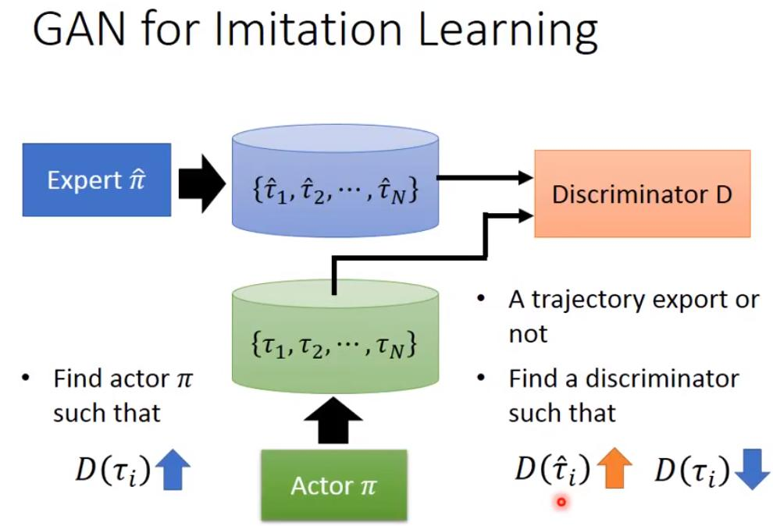
GAIL (Generative Adversarial Imitation Learning)

Slide 6
Base Algorithms
Algorithm: Original GAIL, InfoGAIL, RS-GAIL, SA-GAIL, MA-GAIL..
Agent: TRPO -> PPO
Cost Function: Vanila GAN -> WS GAN
Optimizer: Adam Optimizer -> COCOB Optimizer

Slide 7
COCOB: No Need leaning-rate Optimizer

Slide 8
Experiment #1 – Reward Based vs. E.T. Based
Pong Env.
PPO Agent by reward
Transfer Learning
By Export Trajectory
Using GAIL
대결
More Training
PPO Agent
By reward

Slide 9
Experiment #2
PPO Agent by reward
PPO Agent by reward
Copy
PPO Agent by reward
이긴 Agent의 Trajectory로 Agent Update
초기 Agent와
대결

