Slide 1
with GAIL

Slide 2
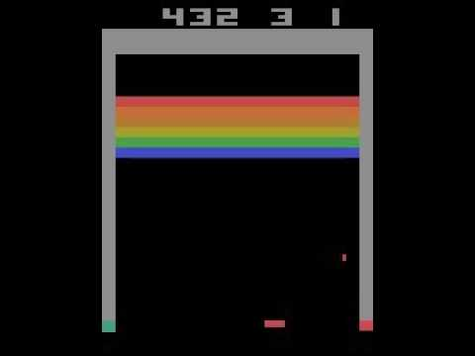
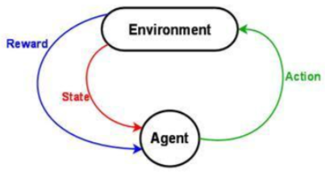
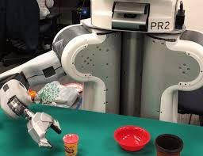

Motivation – Real-world에서 RL의 한계
Reward Function is essential for RL
Learn Policies
Real-world domains,
1. Reward/Cost often difficult to specify
- High-dimensional observation space
- Very Sparse Reward
2. Action Execution takes long, Safety Concerns

Slide 3
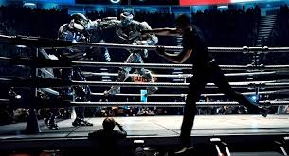

Goals – Apply Imitation Learning

Slide 4
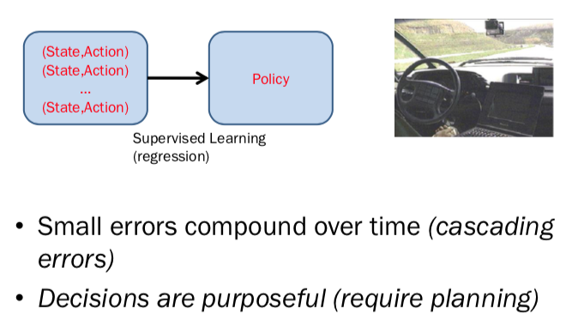
Imitation Learning의 분류
Behavioral Cloning
IRL: Inverse Reinforcement Learning
GAIL: Generative Adversarial Imitation Learning

Slide 5
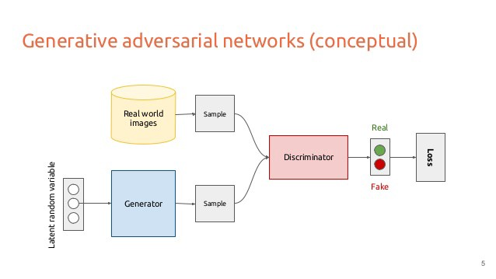
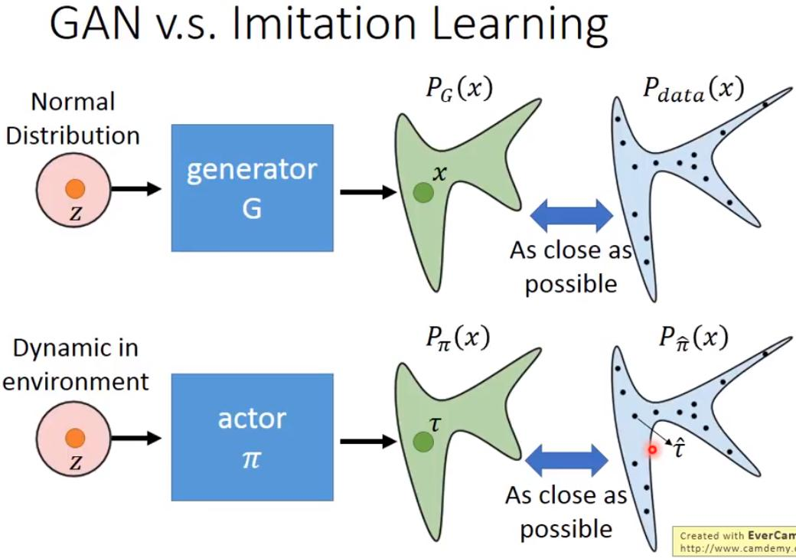
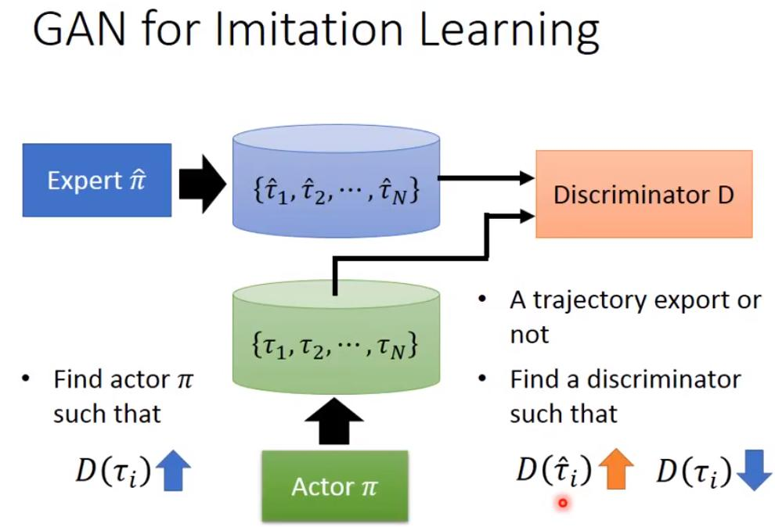
GAIL (Generative Adversarial Imitation Learning)

Slide 6
Base Algorithms
Algorithm: GAIL, InfoGAIL, RS-GAIL, SA-GAIL, MA-GAIL..
Training Agent: TRPO(True Region Policy Optimization) -> PPO(Proximal Policy Optimization)
Cost Function: GAN -> WGAN(Wasserstein Distance)
Optimizer: Adam Optimizer -> COCOB Optimizer

Slide 7
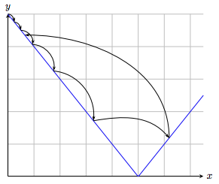
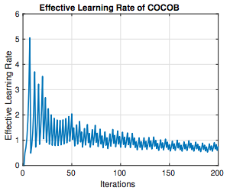
COCOB: Optimizer without Learning Rate
Training Deep Networks without Learning Rates Through Coin Betting, Francesco Orabona, NIPS 2017, arXiv:1705.07795

Slide 8

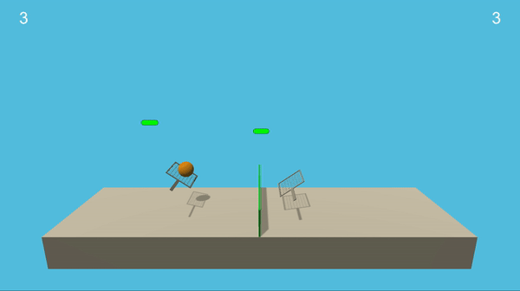
Environment

Slide 9
Experiment #1 – Reward Based vs. E.T. Based
Pong Env.
PPO Agent by reward
Transfer Learning
By Export Trajectory
Using GAIL
대결
More Training
PPO Agent
By reward

Slide 10
Experiment #2
PPO Agent by reward
PPO Agent by reward
Copy
PPO Agent by reward
이긴 Agent의 Trajectory로 Agent Update
초기 Agent와
대결

