Slide 1
SASS
What is SASS?
How to use?
Install & setup
Variables

Slide 2
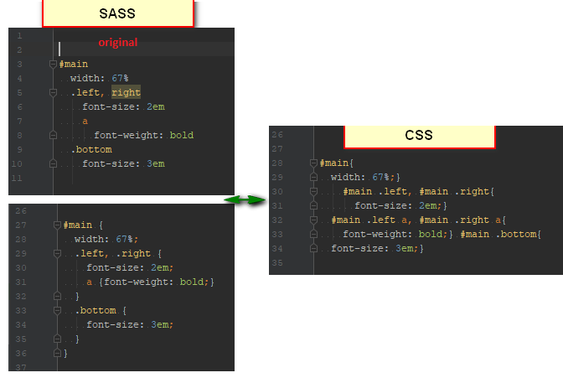
1. What is SASS?
Sass (Syntactically Awesome Stylesheets) is one of tools called CSS preprocessors. The same with LESS, PortCSS, Stylus
Why we you should use Sass?
Sass consists of two syntaxes: the indented syntax & Sassy CSS (extends CSS)

Slide 3
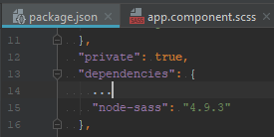
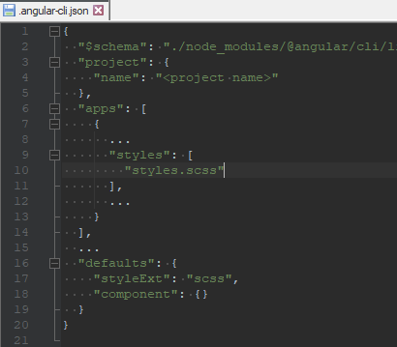
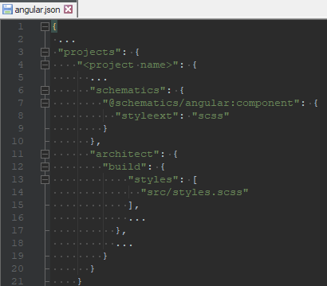
2. How to use? – Install & setup
Install:
Supported Node.js using command: npm install -g node-sass
Setup:
Angular CLI project: aready included node-sass

Slide 4
2. How to use? – Variables
Store infomation that you want to reuse: colors, font or any CSS value.
ariables begin with dollar signs
Data Types: Null, Booleans, Number, Strings, Colors, Lists, Maps
List: can use comma or space as delimiter between each item. Ex:
$buttonConfig: 'save' 50px, 'cancel' 50px, 'help' 100px;
Sass variables support the concept of scope.
Flag: !global, !default

Slide 5
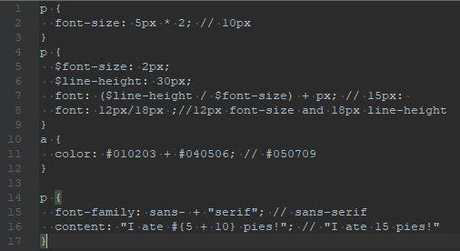
2. How to use? – Operators
Number Operations, Color Operations : +, -, *, /, %
*division :If the value, or any part of it, is stored in a variable or returned by a function.
Equality Operations: == , !=, >, >=, <, <=
String Operations: only +
Boolean Operations: and, or, not

Slide 6

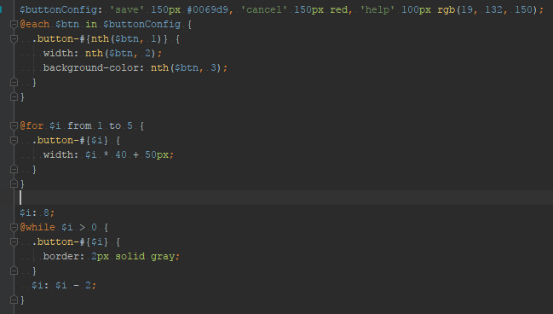
2. How to use? – Control directives
There are expression: @if, @Else, @for, @each and @while
@for have 2 options syntax:
‘through’ include <end>
<start> can less than <end>
@each $var in <list or map>, @each $var in <list of lists>

Slide 7
2. How to use? – Control directives
@import: merged together, used variables or mixins to compile.
Be considered as CSS: extension is .css, begins with http:// , url(), any media queries
@Extend: generate extending selector anywhere in the sheet (don’t care order)
Allow multi extend.
Allow extend another selector that in turn extends a third. @Media
@at-root
@Debug, @Warn: prints the value during compile.
@Error: throw exception, include stack trace. -> fail compile

Slide 8
2. How to use? – Mixins & Functions
A Mixin : accept input args or not. The output is CSS lines. Mixins are used more for includes, avoid writing repetitive codes
Systax: using @mixin directive to declare a mixin. Using @include <mixin’s name> to generate CSS.

Slide 9
2. How to use? – Compile

