Slide 1
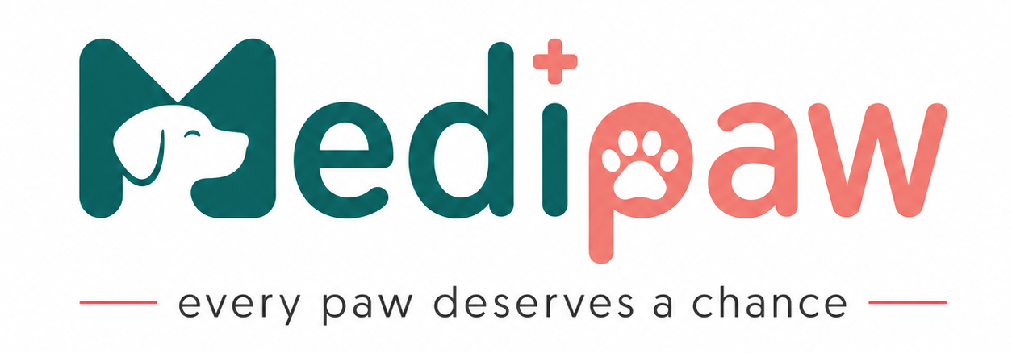
23CSE473
Neural Networks & Deep Learning
“MediPaw – Because every Paw deserves a chance”
GitHub URL: https://github.com/sanhithaac/MediPaw

Slide 2
Case study Review 1
Professor – T Senthil Kumar ( CSE)
ROLL NUMBER | NAME | EMAIL | MOBILE NUMBER | GITHUB URL
CB.SC.U4CSE23352 | N Uhashini | cb.sc.u4cse23352@cb.students.amrita.edu | 6383011825 | https://github.com/Uhashini
CB.SC.U4CSE23245 | Shaik Abdus Sattar | cb.sc.u4cse23245@cb.students.amrita.edu | 7032698579 | https://github.com/Seventie
CB.SC.U4CSE23206 | A.C Sanhitha Reddy | cb.sc.u4cse23206@cb.students.amrita.edu | 9949804994 | https://github.com/sanhithaac

Slide 3
1. Introduction
Animal shelters often receive numerous rescued animals requiring immediate medical attention.
Limited veterinary staff and resources make manual health assessment slow and challenging.
Delayed identification of critical cases can increase suffering and the risk of disease spread.
MediPaw is an AI-driven veterinary triage platform that analyzes images of rescued animals using deep learning models.
The system helps veterinarians prioritize treatment based on urgency, ensuring timely care for animals in need.
Designed as a decision-support tool, MediPaw improves efficiency while supporting animal welfare and shelter management.

Slide 4
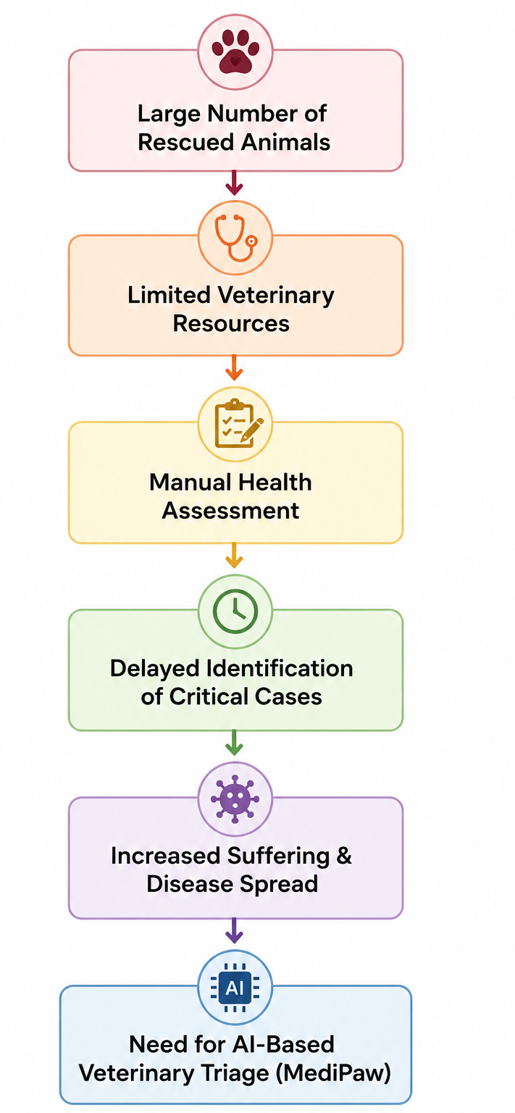
2. Problem Statement
Animal shelters and rescue organizations often care for large numbers of rescued animals with limited veterinary staff and medical resources. Manually assessing every animal is time-consuming, making it difficult to quickly identify those requiring urgent medical attention. Existing veterinary AI solutions mainly focus on individual disease detection and do not assist shelters in prioritizing treatment based on urgency.
MediPaw addresses this challenge by providing an AI-driven veterinary triage system that analyses images of rescued animals to detect visible skin diseases, wounds, and overall health conditions. By combining multiple deep learning models, it generates a treatment priority score, enabling veterinarians to identify critical cases faster, optimize resource allocation, and ensure timely care for animals in need.

Slide 5
3. Motivation
Animal shelters play a vital role in rescuing and rehabilitating injured and abandoned animals, yet they often struggle with limited veterinary resources and overwhelming caseloads.
Delays in identifying critical health conditions can significantly impact an animal's chances of recovery.
Every rescued animal deserves a fair chance at recovery, yet limited veterinary resources often delay life-saving care.
MediPaw is inspired by the vision of empowering animal shelters with AI-driven decision support, enabling veterinarians to identify critical cases early, prioritize treatment efficiently, and improve the quality of care for rescued animals

Slide 6
4. Research Questions & Gaps
Research Questions
Can AI accurately detect visible health conditions in rescued animals?
Can multiple deep learning models improve veterinary triage?
Can AI reduce the time required to identify critical cases?
How can AI optimize resource allocation in animal shelters?
Research Gaps
Existing AI focuses mainly on disease classification.
No comprehensive veterinary triage system for shelters.
Lack of multi-model integration for treatment prioritization.
Fragmented veterinary datasets limit real-world applicability.
Limited AI support for veterinary decision-making during rescue operations

Slide 7
5. Related Products
Product Name | Url | Features | Limitations
Petriage | https://petriage.com | AI symptom checker, teletriage, emergency guidance | Symptom-based; no image analysis or treatment prioritization.
Vetster | https://vetster.com | Online veterinary consultations, video appointments | Requires live veterinarians; no automated AI triage.
Vet-AI Symptom Checker | https://www.vet-ai.com/symptomchecker | AI symptom assessment, health recommendations | Questionnaire-based; no computer vision or severity analysis.
AI Vet Doctor | https://aivetdoctor.com | AI image analysis, disease suggestions | Focuses on disease detection; no shelter-oriented prioritization.
Whisker Wellness | https://whiskerwellness.com | Symptom checker, pet health tracking | Designed for pet owners; lacks multi-model AI and triage support.

Slide 8
SDG Mapping
6.1 SDG Identified
SDG 3 – Good Health and Well-being (Primary SDG)
Objective: Ensure healthy lives and promote well-being for all at all ages through improved healthcare systems, disease prevention, and early intervention.
Although SDG 3 primarily focuses on human health, the One Health approach recognizes that human, animal, and environmental health are interconnected. Early diagnosis, timely medical intervention, and the use of AI-driven healthcare technologies contribute to improving overall public and animal health. By assisting veterinarians in identifying critical health conditions at an early stage, MediPaw promotes efficient healthcare delivery and better medical decision-making.
SDG 15 – Life on Land (Secondary SDG)
Objective: Protect, restore, and promote the sustainable use of terrestrial ecosystems while conserving biodiversity and improving the welfare of terrestrial animals.
Animal shelters and rescue organizations play an essential role in protecting abandoned, injured, and vulnerable animals. Technologies that improve veterinary care and rehabilitation contribute directly to animal welfare and support responsible management of terrestrial life. MediPaw aligns with SDG 15 by enhancing the quality of healthcare provided to rescued animals and promoting responsible rescue and rehabilitation practices.

Slide 9
6.2 How the Case Study is related to the SDG
Contribution to SDG 3 – Good Health and Well-being
Enables AI-assisted early health assessment for rescued animals.
Detects visible skin diseases, wounds, and health abnormalities using deep learning.
Generates a treatment priority score to help veterinarians identify critical cases.
Reduces delays in medical intervention and supports faster decision-making.
Optimizes the use of limited veterinary staff and medical resources.
Contribution to SDG 15 – Life on Land
Promotes the health and welfare of rescued and abandoned animals.
Assists animal shelters in prioritizing animals requiring urgent care.
Reduces the risk of disease progression through early detection.
Supports efficient rescue and rehabilitation operations.
Encourages responsible and technology-driven animal healthcare practices.
SDG Mapping

Slide 10
7.1 Dataset Description
The proposed MediPaw system utilizes a multi-source veterinary image dataset created by integrating publicly available datasets from IEEE DataPort, Kaggle, Roboflow Universe, Mendeley Data, GitHub repositories, and published veterinary research datasets. Since no single dataset comprehensively covers all health conditions required for veterinary triage, images corresponding to skin diseases, wounds, body condition, and parasite infestations will be collected from multiple sources and merged into a unified dataset. The collected images will be standardized with consistent image resolutions, annotation formats, and class labels to create a comprehensive dataset suitable for training multiple deep learning models. This approach enables each module of MediPaw to be trained using relevant, high-quality data while representing a wider variety of real-world shelter conditions.
Dataset Details

Slide 11
Dataset Links
Skin Disease (CNN 1): Dogs Skin Diseases (Youssefmohmmed) | Dogs Skin Disease (Yashmotiani) | Animal Skin Disease Series (Roboflow)
Ocular Pathology (CNN 2): Dog Eyes Version 4 (Roboflow) | Dog Eye Problems Detection (Roboflow)
Mucous Membrane Color (CNN 3): Dog Dental Dataset (Roboflow) (Cropped for gum tissue)
Parasite & Trauma (YOLOv8 / U-Net): Tick Detection (Roboflow) | Animal Wound (Roboflow)
Triage Priority Head (ViT): Clinical mapping data mined from IEEE DataPort, Mendeley Data, and Zenodo.

Slide 12
7.2 Challenges Faced
Collection of images from multiple publicly available sources.
Standardization of image size, format, and annotation labels.
Removal of duplicate and low-quality images.
Class balancing using data augmentation techniques.
Image preprocessing including resizing, normalization, and contrast enhancement.
Introduction of synthetic noise (Gaussian noise, blur, varying illumination) to improve model robustness.
Creation of a unified dataset suitable for training multiple deep learning models
Organizing the dataset separately for CNN classification, U-Net segmentation, Vision Transformer severity assessment, and YOLO object detection.
Dataset Details

Slide 13
8. Novelty of the product
Unlike existing veterinary AI applications that focus only on disease detection or symptom checking, MediPaw is designed as an AI-assisted veterinary triage platform for animal shelters and rescue organizations. Rather than simply identifying a disease, the system evaluates multiple visible health indicators to determine the urgency of medical care.
Key Novel Features:
AI-driven veterinary triage instead of standalone disease classification.
Integrates multiple deep learning models (CNN, U-Net, Vision Transformer, and YOLO) for comprehensive health assessment.
Generates a treatment priority score (Low, Medium, High, Critical) to assist veterinarians.
Designed specifically for animal shelters and rescue organizations, where resources are often limited.
Uses a multi-source unified veterinary dataset, improving diversity and robustness compared to single-dataset approaches.
Supports near real-time image-based assessment for faster decision-making.
Functions as a decision-support tool, assisting veterinarians rather than replacing clinical expertise.

Slide 14
Thank You

