Slide 1


Baymax – AI Chatbot

Slide 2

Index:
Problem
Proposed Work
Existing Work
Real Time Usage
Requirements
Technologies
Using the bot
Future Goals

Slide 3
Problem:
When people are in extreme emotional states, they are often cast aside for being low. When not taken care of, these thoughts isolate the victim and end up eating them from inside – often resulting in suicides or depression. Its imperative that we take care of these people and prevent them from being isolated.
Not everyone has people who can look after them, hence there is a need for an assistant that could do the needful.
Ex: Students living far from their home.

Slide 4
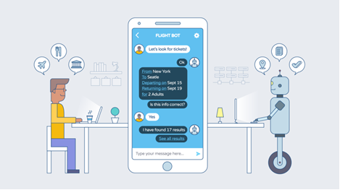
Proposed Work
The idea of the project was to Make a chatbot that helps a student cope during the extreme emotional phase – depression, anxiety, happiness etc.

Slide 5
Existing Work
We’ve created a bot that is well aware of emotions.
It can run a sentiment analysis to predict your current surge of emotions.
It contemplates your feelings and try the best possible song to get along with you.

Slide 6
Real Time Usage
Anti-depressant
Mood enhancer
Suicide Prevention

Slide 7
Requirements
A device with a good internet connection.
A Web Browser.
An emotionally broken down person.

Slide 8



Tech and PL’s
Technologies
Dialog-Flow
AWS Cloud – EC2
Apache Server
CGI
Database
NLP – Natural Language Processing
Sentiment Analysis
Platform - RedHat
Python Libraries
Textblob
SpotiPy
NLTK Data
Database
MariaDB
SQL
Languages Used
HTML
CSS
Python
Java Script
Jquery
Ajax

Slide 9
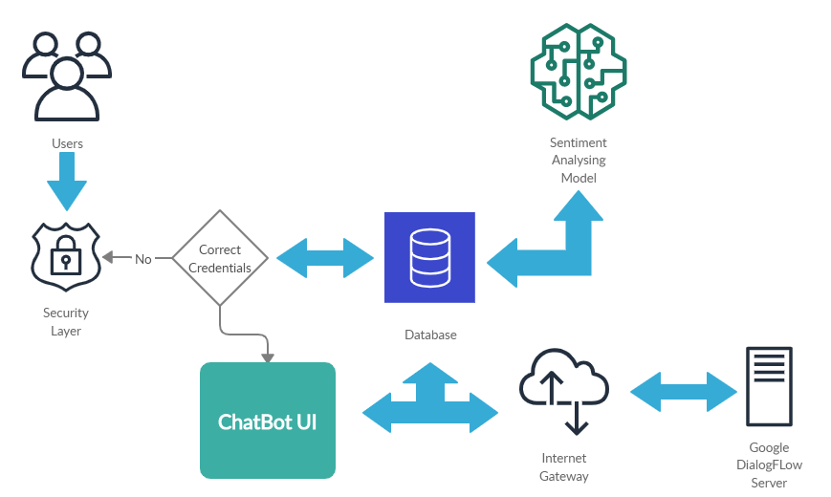
Flow of Data

Slide 10


How do I use it?
1) Enter mobile number and password.
2) Login.
3)Start chatting!!

Slide 11
Future Goals:
Integrate the following features:
Query Analyzer.
Cricket Live Score.
Scheduler.
Training for more personalized answers.
Increase security.

Slide 12
Thanks for Holding Up!!
Any questions?
Please let us know!!

