Slide 1
PROJECT REPORT | OBJECT-ORIENTED TECHNOLOGY
SmartCFP
A Mobile Application for Discovering and Tracking Academic Conference Calls for Papers
Submitted by: Saniya Sandesh Gaonkar (2645) and Renuka Veer (2639)
Group No: 05
Department of MCA, Goa Business School, Goa University, Taleigao
Academic Year 2026–2027

Slide 2
Problem Statement
Calls for papers are scattered across many websites with different layouts. Researchers spend time searching and comparing, and risk missing deadlines.
Time lost
Missed deadlines
Manual effort
Students and researchers visit several websites to find relevant conferences and CFPs.
Information is fragmented and changes often, so a deadline is easy to miss, and a missed one can mean waiting a year.
Existing directories need manual searching, filtering and tracking, with no personalization.

Slide 3
Our Solution: SmartCFP
A mobile-first platform that automatically collects, organizes and recommends research conferences and calls for papers in one app.
Auto data collection
Search and filter
Topic recommendations
Scrapes CFP websites and APIs into one format; duplicates are skipped
Keyword search and category chips such as AI & ML
Pick research tracks; get matching conferences
Save for later
Share and visit
Star conferences and open them from the Saved tab
Open the official website or share a conference

Slide 4
Competitor Analysis
Feature / Capability | WikiCFP | EasyChair CFP | IEEE / ACM | SmartCFP (Ours)
Mobile-first native experience | Web only | Web only | Limited | Android app
Automated multi-source collection | User posts | Hosted only | Single publisher | Scrapers + APIs
Personalized recommendations | None | Category tags | Keyword only | Topic-based matching
Alerts | No alerts | Email digests | No direct sync | In-app notifications
Presentation | Listed | Listed | Listed | Cards with save and share

Slide 5
Market Analysis
Market Dimension | Key Metric / Volume | Strategic Insight & Opportunity
Global Academic Market | $1.5B to $2.1B+ | Projected growth by 2027 with a strong 18% CAGR in academic events and digital discovery platforms.
Annual Global Events | 155,000+ | Massive volume of active Calls for Papers across Computer Science, Medicine, Engineering and Social Sciences.
Primary Addressable Users | 10M+ Researchers | PhD candidates, postdoctoral researchers and university faculty seeking publication venues.
Institutional TAM | 25,000+ Universities | Potential for institutional subscriptions, library integrations and research lab accounts.

Slide 6
Revenue Model
Free for students. Revenue comes from conference organizers, institutions and advertisements.
Revenue Source | Amount | How It Earns
Featured Conference | Rs 2,000 / event | Organizer pays to appear at the top
Sponsored Listing | Rs 5,000 / event | Organizer pays for highlighted promotion
Institutional Plan | Rs 25,000 / year | Colleges and universities pay for access
Advertisements | Rs 5,000 / month | Relevant academic ads generate income
Conference Partnership | Rs 10,000 / event | Organizers pay for promotional partnership
Example: 100 conferences x Rs 2,000 = Rs 2,00,000

Slide 7
Project Objectives
1
Collect CFP data from more than one source into one format
2
Avoid duplicate entries by comparing website addresses
3
Secure sign up and log in; passwords stored as BCrypt hashes
4
Android app to browse, search and view conference details
5
Open the official website and share a conference
6
Keep a saved list of conferences to view later
7
Let users select topics and recommend matching conferences
8
Layered design so new sources and features are easy to add

Slide 8
System Architecture and Database
Android App
Spring Boot API
MySQL
Java, Retrofit, RecyclerView
REST + JSON, services, BCrypt
JPA / Hibernate
CFP websites and APIs
users
user_topics
conference
id, email, name, password
user_id, topic
id, titles, location, deadline, website, source

Slide 9
Technology Used
Technology | Used for | Why this
Android (Java) | The mobile app: screens and conference lists | Native, smooth, uses phone features such as share
Retrofit | Calling the REST API; JSON to Java objects | Little code; calls run in the background
Spring Boot (Java 21) | REST API, services, import of data | Quick setup, built-in security and JPA
MySQL | Users, topics and conferences | Related data fits tables, keys and joins
Jsoup | Reading CFP web pages and JSON APIs | Simple CSS selectors; no heavy browser
BCrypt (Spring Security) | Password hashing | Salted and slow, so guessing is costly

Slide 10
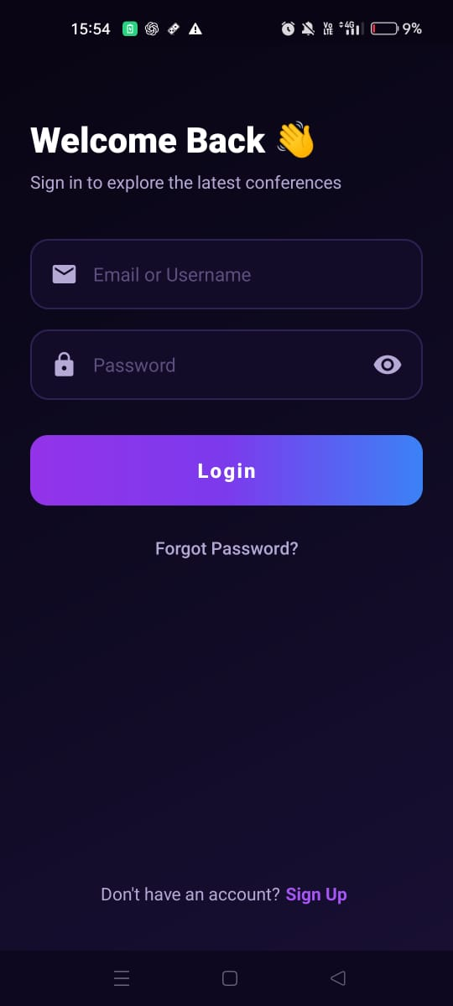
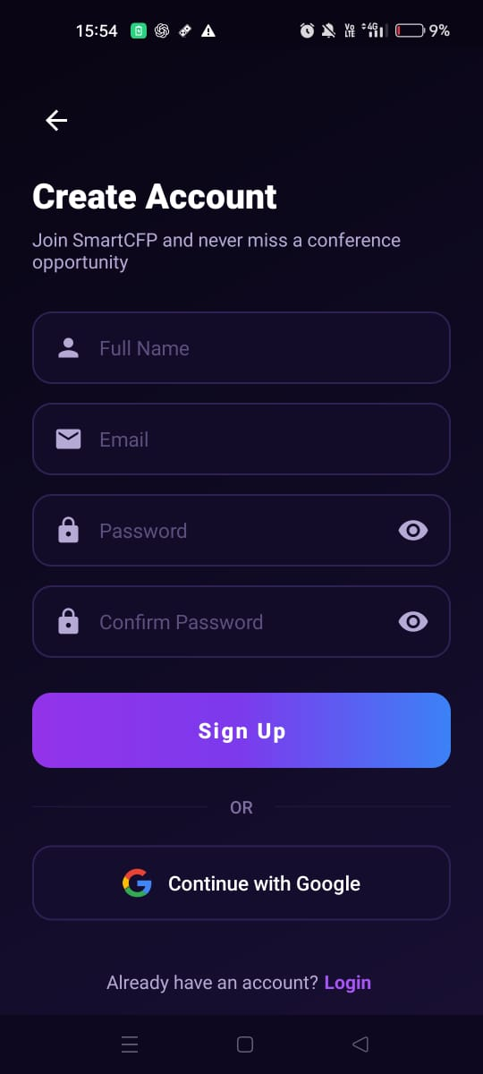
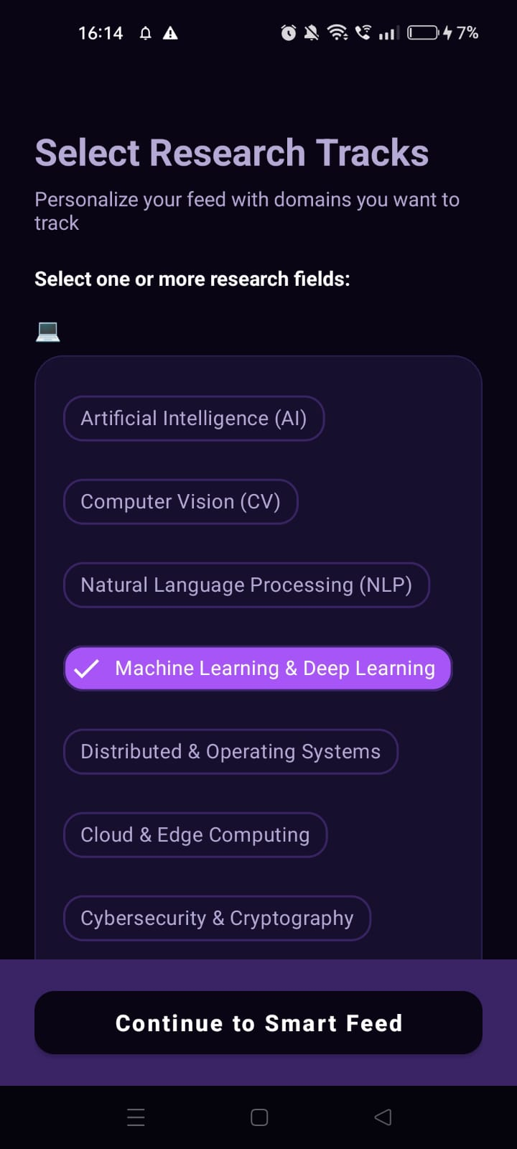
App Screens: Sign In, Sign Up, Topics
Sign In
Sign Up
Select Research Tracks
E-mail or username and password with show/hide. Fields are checked, then Home opens. Forgot Password and Sign Up links.
Name, e-mail, password and confirmation are validated before the server is called. Continue with Google is also offered.
Choose fields such as AI, Computer Vision, NLP and ML. The choice is saved on the server for recommendations.

Slide 11
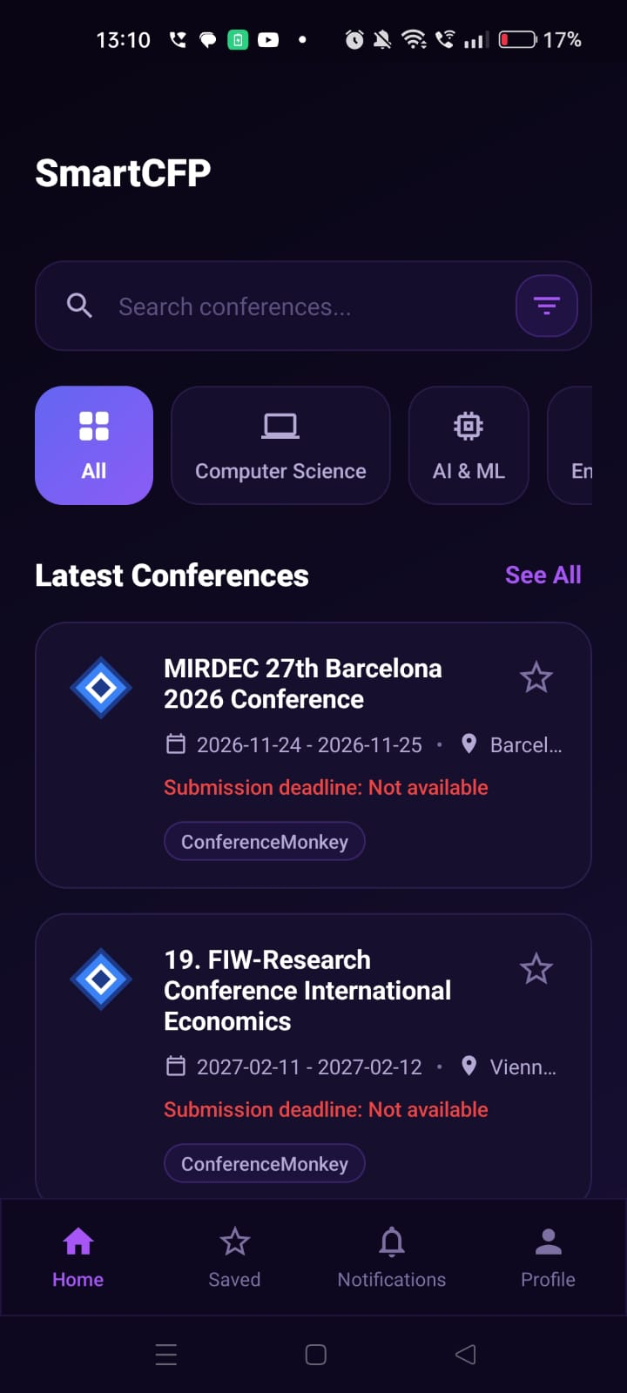
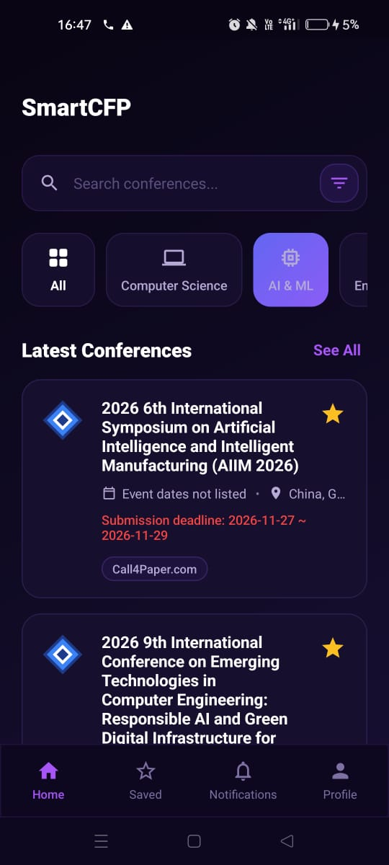
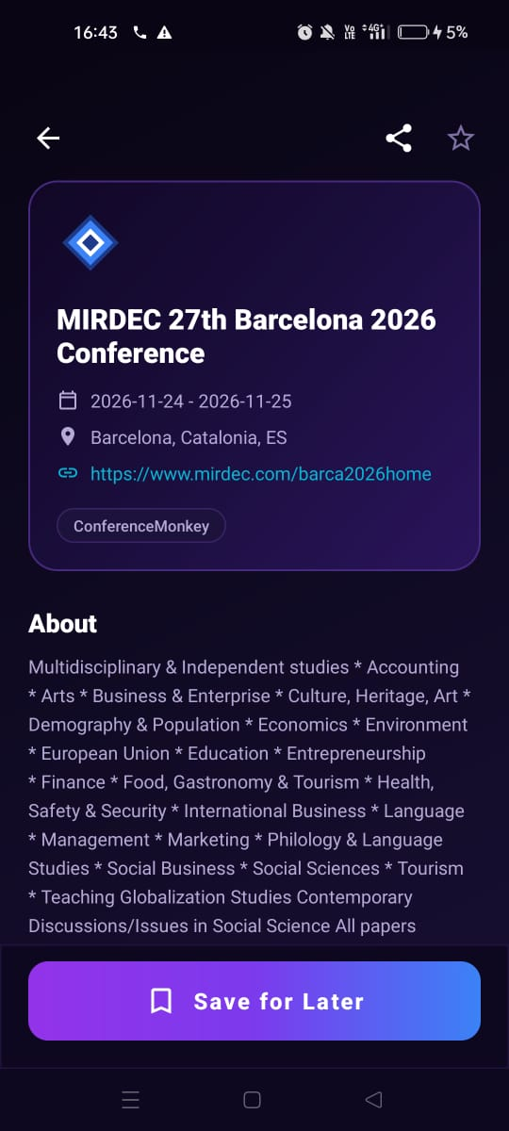
App Screens: Home, Filter, Details
Home
Category Filter
Conference Details
Search bar and filter, category chips and Latest Conferences cards with dates, location, deadline, source and a save star.
Chips such as AI & ML narrow the list. Saved conferences show a filled star.
Title, dates, location, website link, source and About. Share and star icons, plus Save for Later.

Slide 12
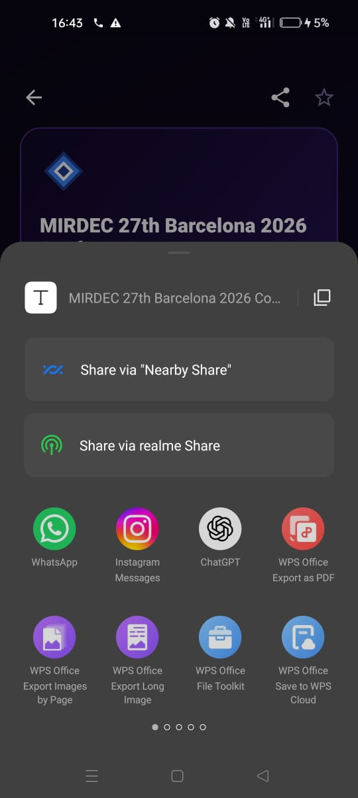
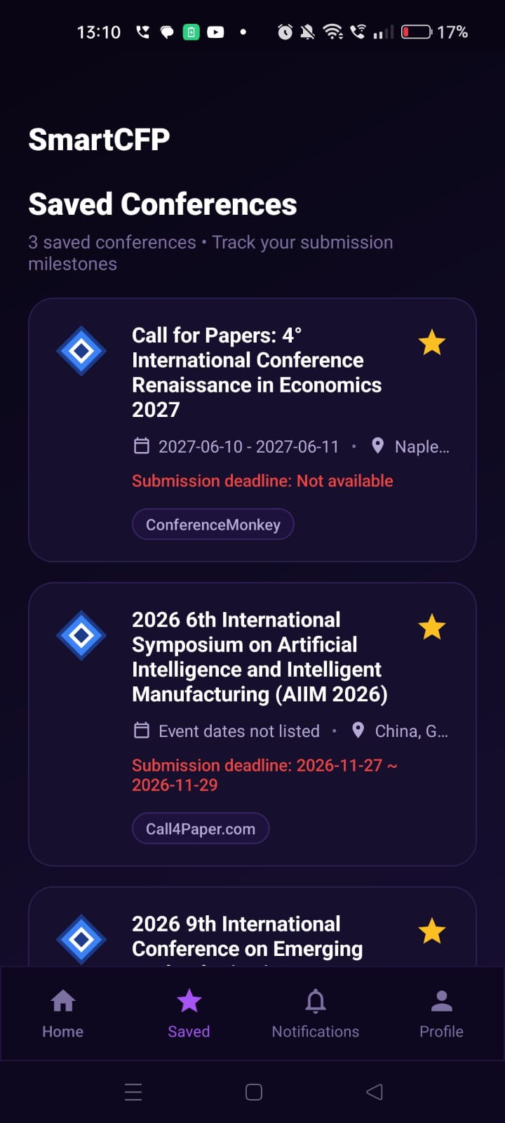
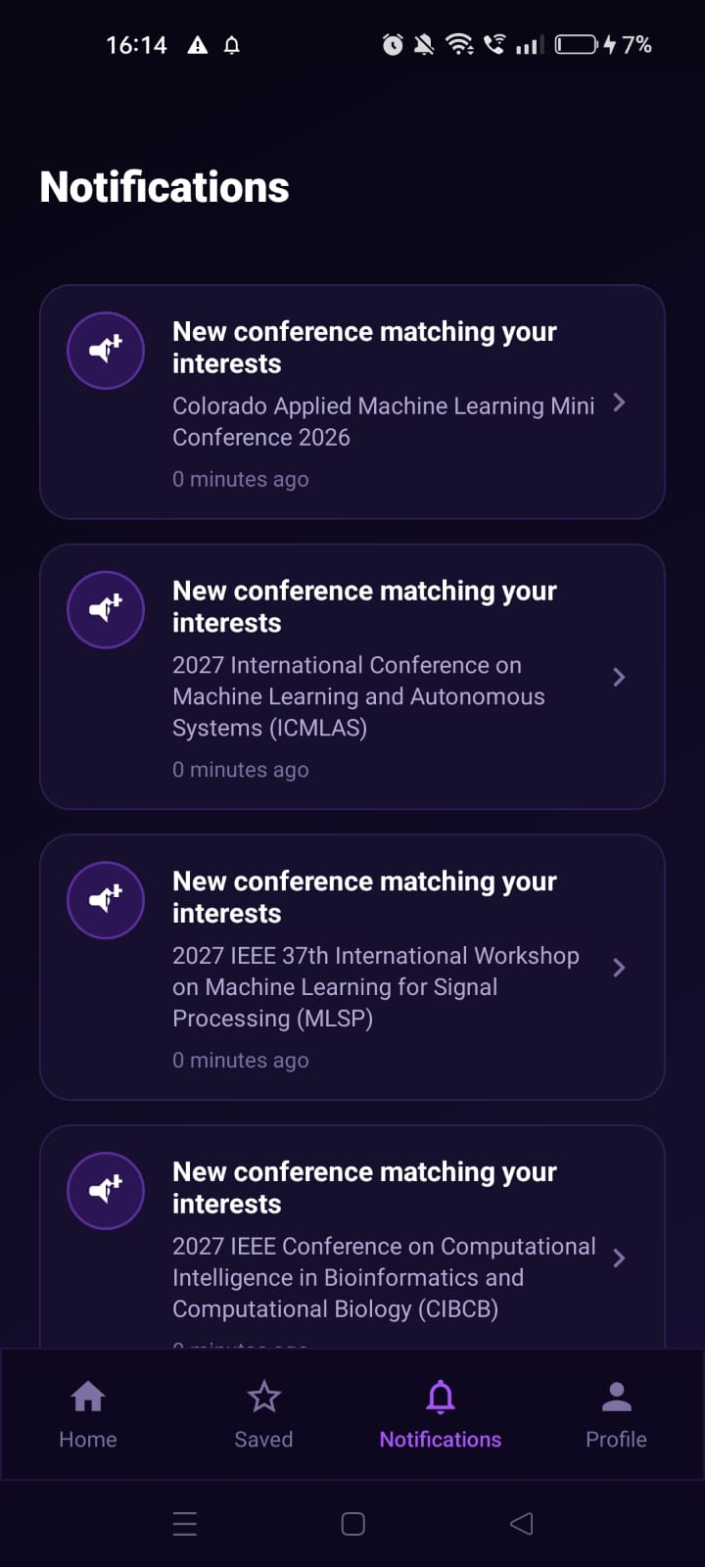
App Screens: Share, Saved, Notifications
Share
Saved Conferences
Notifications
The share icon opens the phone share sheet to send a conference through WhatsApp and other apps.
All starred conferences with a count, so the user can track submission milestones.
Alerts such as New conference matching your interests, with the conference name and time.

Slide 13
Future Scope
1
Push alerts before deadlines
2
Calendar integration
3
Token login (JWT) and admin roles
4
Smarter ranked recommendations
5
Saved conferences stored on the server
6
More sources and filters (location, deadline)

Slide 14
Conclusion
Problem solved
Sound design
Learning
CFPs from many websites now reach the researcher in one searchable mobile app.
Layered, object-oriented design; sources behind one interface; BCrypt passwords; a small REST API.
Applied OOP in Java, database design, client–server communication and the software engineering process.
SmartCFP helps researchers find the right conference before the deadline, and can grow with deadline alerts, smarter recommendations and more sources.

Slide 15
Thank You
Questions?
Saniya Sandesh Gaonkar (2645) | Renuka Veer (2639)

