Slide 1
BCSE316L | DESIGN OF SMART CITIES
Citizen Sentiment Analysis
of Municipal Services
Using Transformer-Based NLP
A reproducible civic intelligence pipeline
from open data to decision support
1.20M
311 service requests
Review-2 / Final Review Presentation
406.6K
RSAT responses
Vellore Institute of Technology • SCOPE
Guide: Dr. Kalaavathi B
Taher Panbiharwala • Sanidhya Bhandari • Chinmoy Deb
Project / Team 16
October 2026

Slide 2
EXECUTIVE STORY
NLP adds evidence beyond traditional operational KPIs
Core question
+0.0289
+0.0257
Does adding sentiment, topic, and grievance signals improve out-of-time prediction of resolution delay and repeat complaints?
Delay ΔR² | p = 0.00020
Repeat ΔR² | p = 0.733
16 / 16
884
The answer is target-specific: the corrected experiment supports a significant delay gain, while repeat-rate improvement remains an observed but uncertain signal.
Current automated tests passing
Integrated cells
What is ready for review
•
Audited multi-source data pipeline
•
VADER, LDA, BERTopic, ABSA, and DistilBERT experiments
•
Chronological model comparison with robustness analysis
•
Two-sided Streamlit dashboard for operations and residents
BCSE316L | Design of Smart Cities
02

Slide 3
PROBLEM AND MOTIVATION
Administrative closure does not equal citizen satisfaction
Traditional KPI
Citizen reality
•
Ticket volume
•
Was the issue corrected?
gap
•
Open-to-close time
•
Did the request recur?
•
Backlog and staffing
•
Was communication adequate?
•
Closed status
•
Was the work satisfactory?
Research opportunity
Use public survey ground truth and operational narratives to test whether citizen-perceived friction contains incremental predictive information.
BCSE316L | Design of Smart Cities
03

Slide 4
RESEARCH DESIGN
The study tests predictive value, not causality
Research question
Does augmenting structured operational indicators with NLP sentiment, topic, and aspect signals improve out-of-time prediction?
Hypotheses
H1 | Delay
H2 | Repeat rate
NLP-augmented features improve prediction of resolution delay.
NLP-augmented features improve prediction of 14-day repeat requests.
Interpretation rule
All findings are aggregate predictive associations at service × borough × month grain.
BCSE316L | Design of Smart Cities
04

Slide 5
DATA AND AUDIT
Two authentic NYC Open Data sources create complementary evidence
NYC 311 service requests
Resolution Satisfaction Survey
Socrata ID: erm2-nwe9
Socrata ID: 5ijn-vbdv
1,199,279 records
406,581 responses
•
Operational closure narratives
•
5-point satisfaction ground truth
•
Created and closed timestamps
•
Standardized dissatisfaction reasons
•
Delay and repeat-request outcomes
•
Borough and month fields
•
Top 20 service categories
•
Public free-text suppressed for PII
Audit decision
NLP is extracted from NYC 311 resolution narratives; RSAT supplies survey-level labels and satisfaction aggregates.
BCSE316L | Design of Smart Cities
05

Slide 6
DATA ARCHITECTURE
The join is privacy-safe and the evaluation is chronological
Robust cell grain
c = (service, borough, year, month)
No one-to-one survey-to-ticket join is claimed.
Chronological partitions
TRAIN
VALIDATION
OUT-OF-TIME TEST
2023 Jan–Aug
2023 Sep–Dec
2024 horizon
586 cells
213 cells
85 cells
BCSE316L | Design of Smart Cities
06

Slide 7
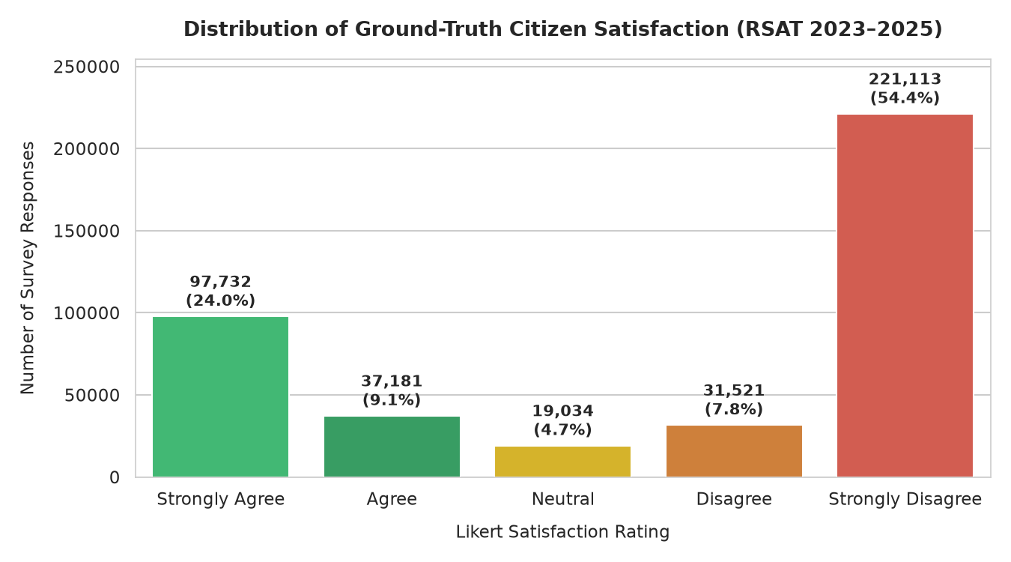
EXPLORATORY FINDINGS
The survey reveals a strongly negative satisfaction distribution
62.14%
of validated RSAT responses are dissatisfied
Issue correction is the largest standardized grievance aspect (42.7% of dissatisfied responses).
RSAT satisfaction distribution
This skew establishes a meaningful citizen-distress signal for later aggregation and modeling.
BCSE316L | Design of Smart Cities
07

Slide 8
NLP METHODOLOGY
The NLP stack moves from baselines to domain adaptation
VADER
LDA + BERTopic
ABSA
DistilBERT
Lexicon sentiment
Themes and clusters
Six grievance aspects
Transformer fine-tuning
Accuracy 0.655
Negative F1 0.800
Cᵥ 0.5100
14 semantic clusters
TF-IDF macro-F1 0.1723
Rule baseline 0.1295
Test macro-F1 0.3491
Accuracy 0.4148
Design boundary
Resolution narratives are agency text; RSAT provides the citizen-grounded labels and satisfaction aggregates.
BCSE316L | Design of Smart Cities
08

Slide 9
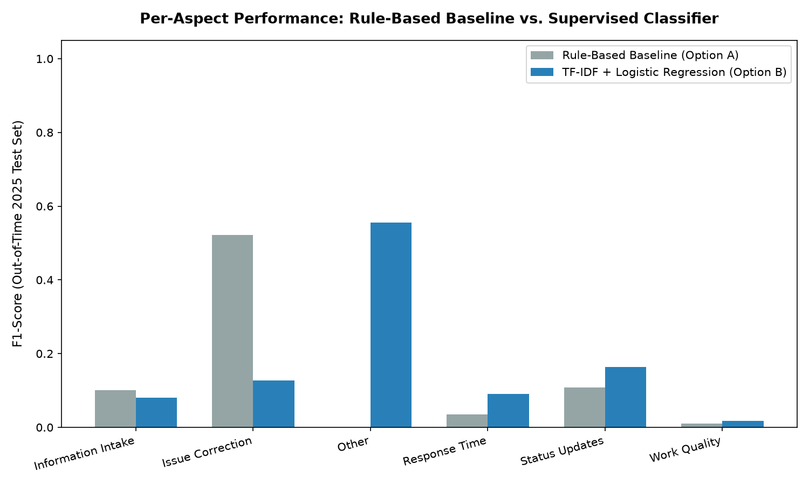
NLP RESULTS
Transformer adaptation improves grievance attribution
Transformer run
0.3491
Out-of-time macro-F1
+0.1768
Macro-F1 gain vs TF-IDF
Per-aspect F1 comparison
Kaggle Tesla T4 • 3 epochs • 2e-5 learning rate
41,746 chronological examples across train / validation / test
BCSE316L | Design of Smart Cities
09

Slide 10
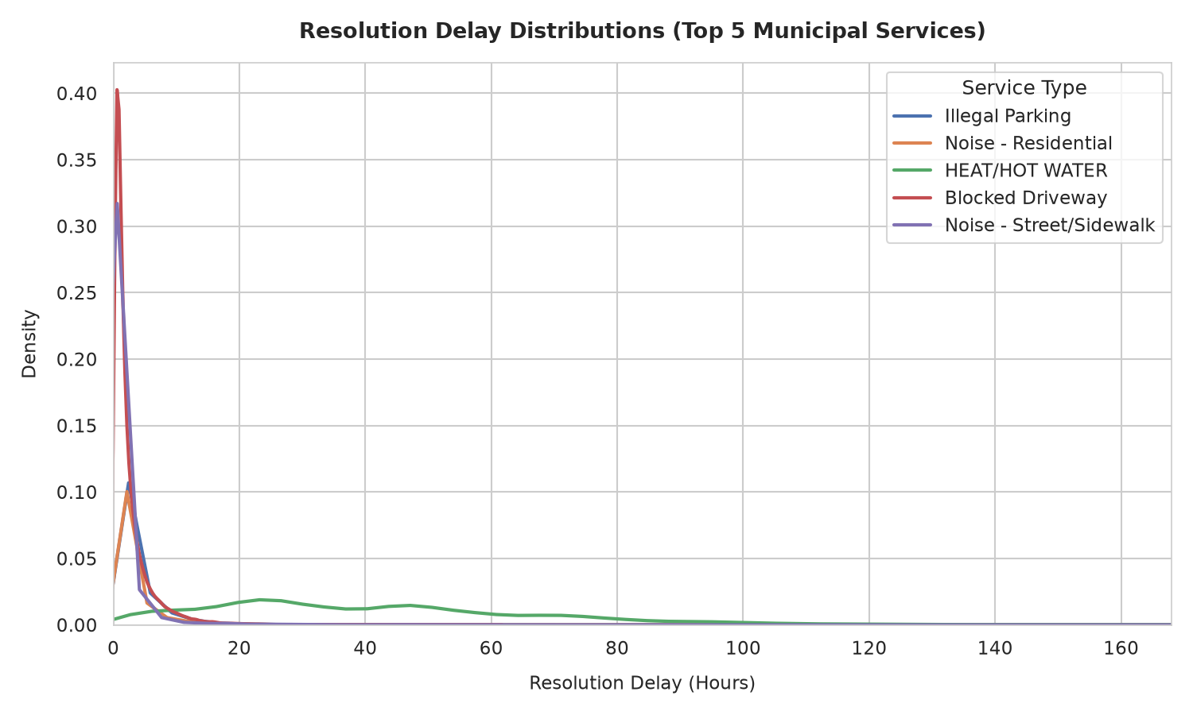
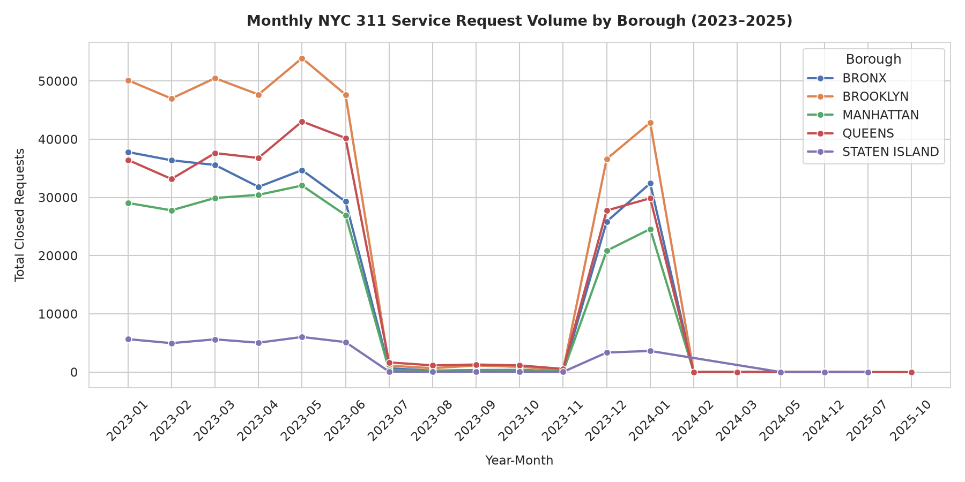
OPERATIONAL OUTCOMES
Operational outcomes quantify both delay and recurring demand
2.90 h
91.11 h
44.88%
50.52%
Median raw resolution delay
Mean winsorized delay
14-day repeat rate
30-day repeat rate
Delay is highly right-skewed; p99 winsorization cutoff = 2,454.96 hours.
Repeat rates rise with longer windows: 39.10% at 7 days → 50.52% at 30 days.
BCSE316L | Design of Smart Cities
10

Slide 11
PREDICTIVE MODELING
The experiment isolates NLP's incremental value
Structured baseline
NLP-augmented model
•
Service identity
•
All baseline features
•
Borough
→
•
VADER sentiment rates
•
Month seasonality
•
LDA / BERTopic features
•
Request volume
•
ABSA aspect proportions
•
RSAT satisfaction signals
Evaluation protocol
Ridge • Random Forest • LightGBM | validation-selected algorithm | one untouched 2024 horizon test
BCSE316L | Design of Smart Cities
11

Slide 12
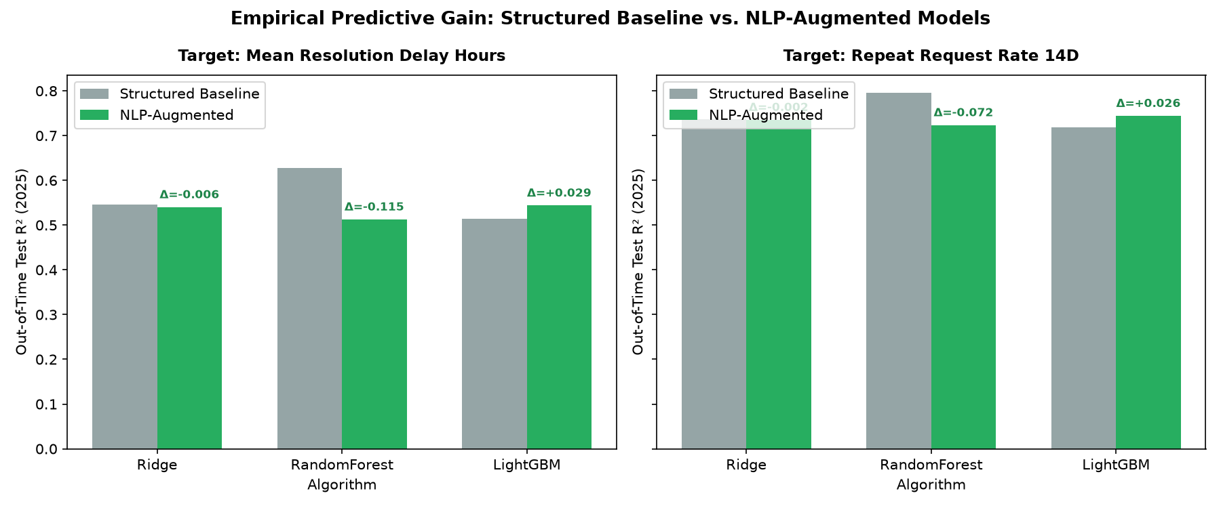
MAIN RESULTS
Delay gains are significant; repeat-rate gains are inconclusive
Target
Model
Base R²
Aug R²
ΔR²
p-value
Delay (h)
LightGBM
0.5149
0.5438
+0.0289
0.00020
Repeat 14d
LightGBM
0.7184
0.7441
+0.0257
0.733
Interpretation
Delay: confirmed incremental predictive association.
Repeat: positive observed gain, but not statistically significant.
2024 out-of-time R² comparison
BCSE316L | Design of Smart Cities
12

Slide 13
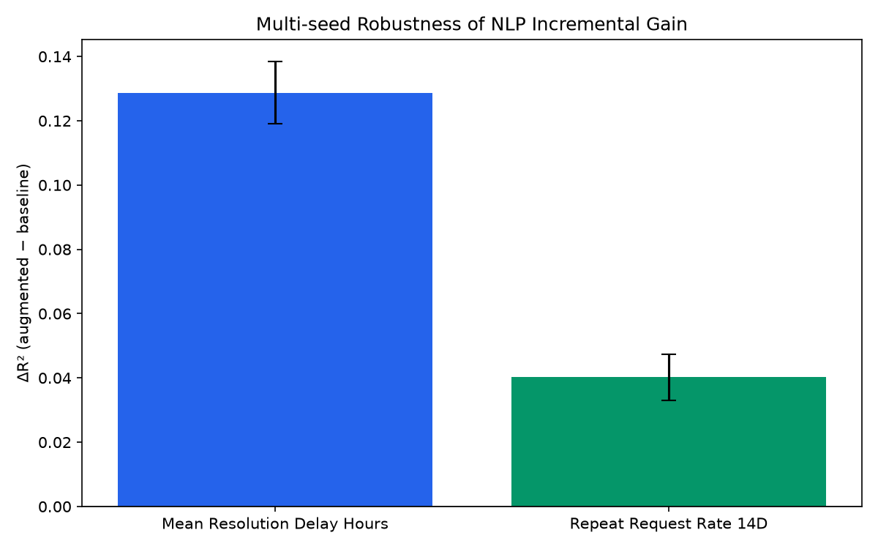
UNCERTAINTY ANALYSIS
Robustness confirms delay gains and qualifies repeat-rate gains
Delay
Mean ΔR² +0.1287 ± 0.0097
95% bootstrap CI [+0.0499, +0.2259]
Repeat rate
Mean ΔR² +0.0403 ± 0.0072
95% bootstrap CI [-0.0072, +0.0794]
The interval crossing zero is the key qualification.
Five seeds + 2,000 bootstrap resamples
BCSE316L | Design of Smart Cities
13

Slide 14
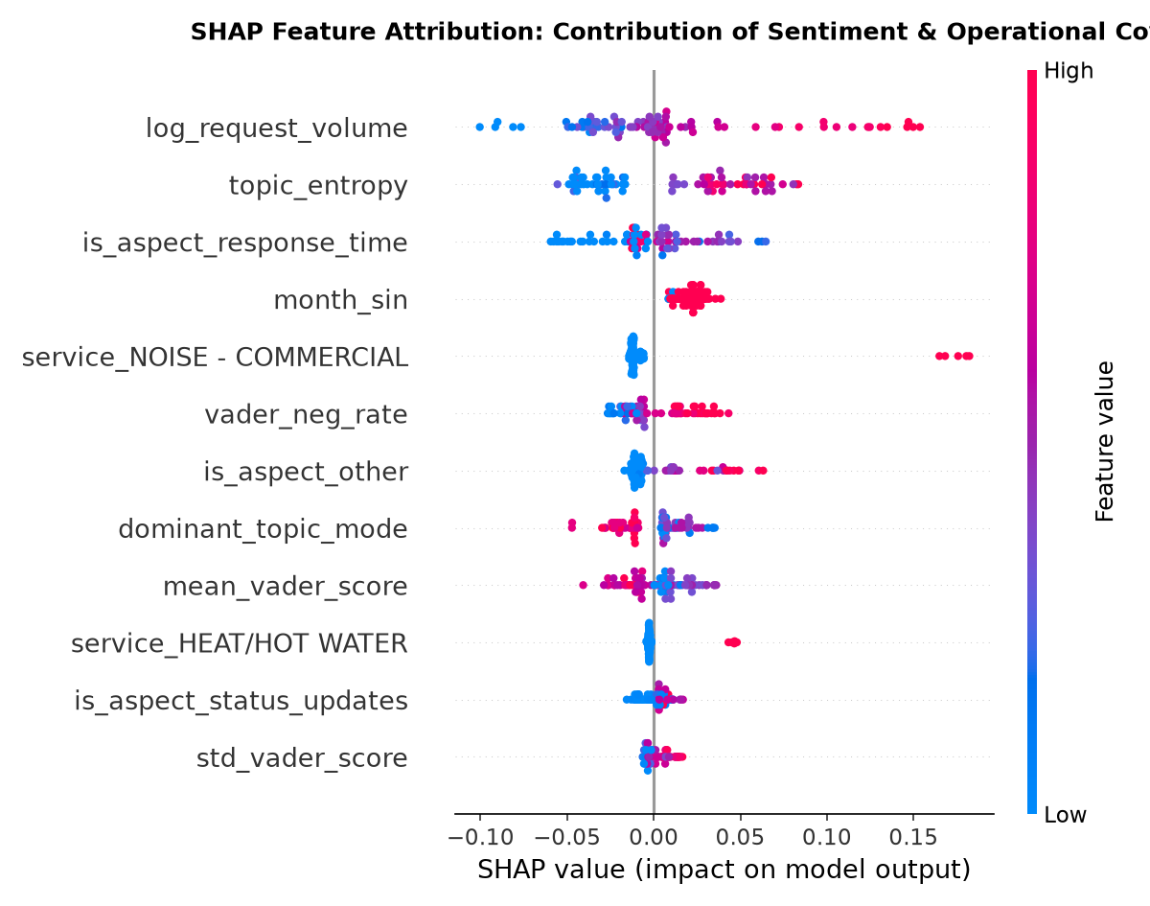
MODEL INTERPRETATION
SHAP links predictions to operational and language signals
Top contributors in the augmented delay model
•
log_request_volume
•
topic_entropy
•
response-time aspect
•
month seasonality
•
VADER negative rate
Meaning
The model uses both operational pressure and civic-language signals; the dashboard exposes these signals for review rather than hiding them behind a single score.
Global SHAP feature ranking
BCSE316L | Design of Smart Cities
14

Slide 15
INTERACTIVE DASHBOARD
The final system turns the analysis into two decision-support views
Municipal Operations
Resident View
•
Filter by borough, service, and period
•
Plain-language KPI summary
•
Priority queue with risk score
•
Historical delay and repeat trends
•
Trend and borough comparison charts
•
Citywide service comparison
•
Model evidence and SHAP view
•
Privacy-safe aggregate values
•
Downloadable priority queue
•
No names, addresses, or ticket text
Live local link
http://localhost:8501
Data grain: service × borough × month
BCSE316L | Design of Smart Cities
15

Slide 16
IMPLEMENTATION STATUS
All major pipeline phases are implemented with inspectable artifacts
Completed pipeline
01
02
03
04
05
06
Audit
Environment
Ingestion
EDA
NLP
Outcomes
07
08
09
10
11
12
Integration
Modeling
Transformer
Dashboard
Tests
Report
Current verification
16 / 16
108
2024
pytest checks passing
environment dependencies verified
operational out-of-time horizon
BCSE316L | Design of Smart Cities
16

Slide 17
LIMITATIONS AND NEXT STEPS
The project is submission-ready when its boundaries are stated clearly
What the evidence does not claim
Highest-value next steps
•
No causal effect is established.
•
Complete two-annotator 311 ABSA sample.
•
RSAT free-text comments are PII-suppressed.
•
Report Cohen’s kappa and human macro-F1.
•
ABSA is a domain-transfer evaluation.
•
Collect a longer out-of-time horizon.
•
Repeat-rate gain is not significant.
•
Validate transfer on another 311 city.
•
2024 is the local operational test horizon.
•
Monitor drift before deployment.
Academic position
Strong end-to-end engineering and reproducibility; conclusions are calibrated to the available evidence.
BCSE316L | Design of Smart Cities
17

Slide 18
FINAL TAKEAWAY
Municipal service quality is more than closure speed.
This project demonstrates a reproducible way to connect citizen dissatisfaction, civic text signals, and operational outcomes — with transparent limits and an actionable dashboard.
Key result
Significant incremental evidence for resolution-delay prediction; repeat-rate evidence remains a research opportunity.
Thank you • Questions and discussion
18

