Slide 1
FINAL REVIEW
Can language and satisfaction signals improve municipal prediction?
Evidence from NYC 311 service requests and satisfaction surveys
Taher Panbiharwala | Sanidhya Bhandari | Chinmoy Deb
BCSE316L Design of Smart Cities | VIT Vellore | Guide: Dr. Kalaavathi B
Team 16
10-slide speaking presentation

Slide 2
01 PROBLEM
Why this problem matters
Closed does not mean solved
Traditional KPIs are incomplete
Our research question
A ticket can be closed while the citizen still feels the problem was not solved.
Delay, volume and closure counts describe operations, but not citizen experience.
Do sentiment, topics, grievance aspects and satisfaction improve prediction of future service outcomes?
In simple words:
We tested whether adding language-based signals gives municipalities useful information beyond normal operational data.
Citizen Sentiment Analysis of Municipal Services | Team 16
02 / 10

Slide 3
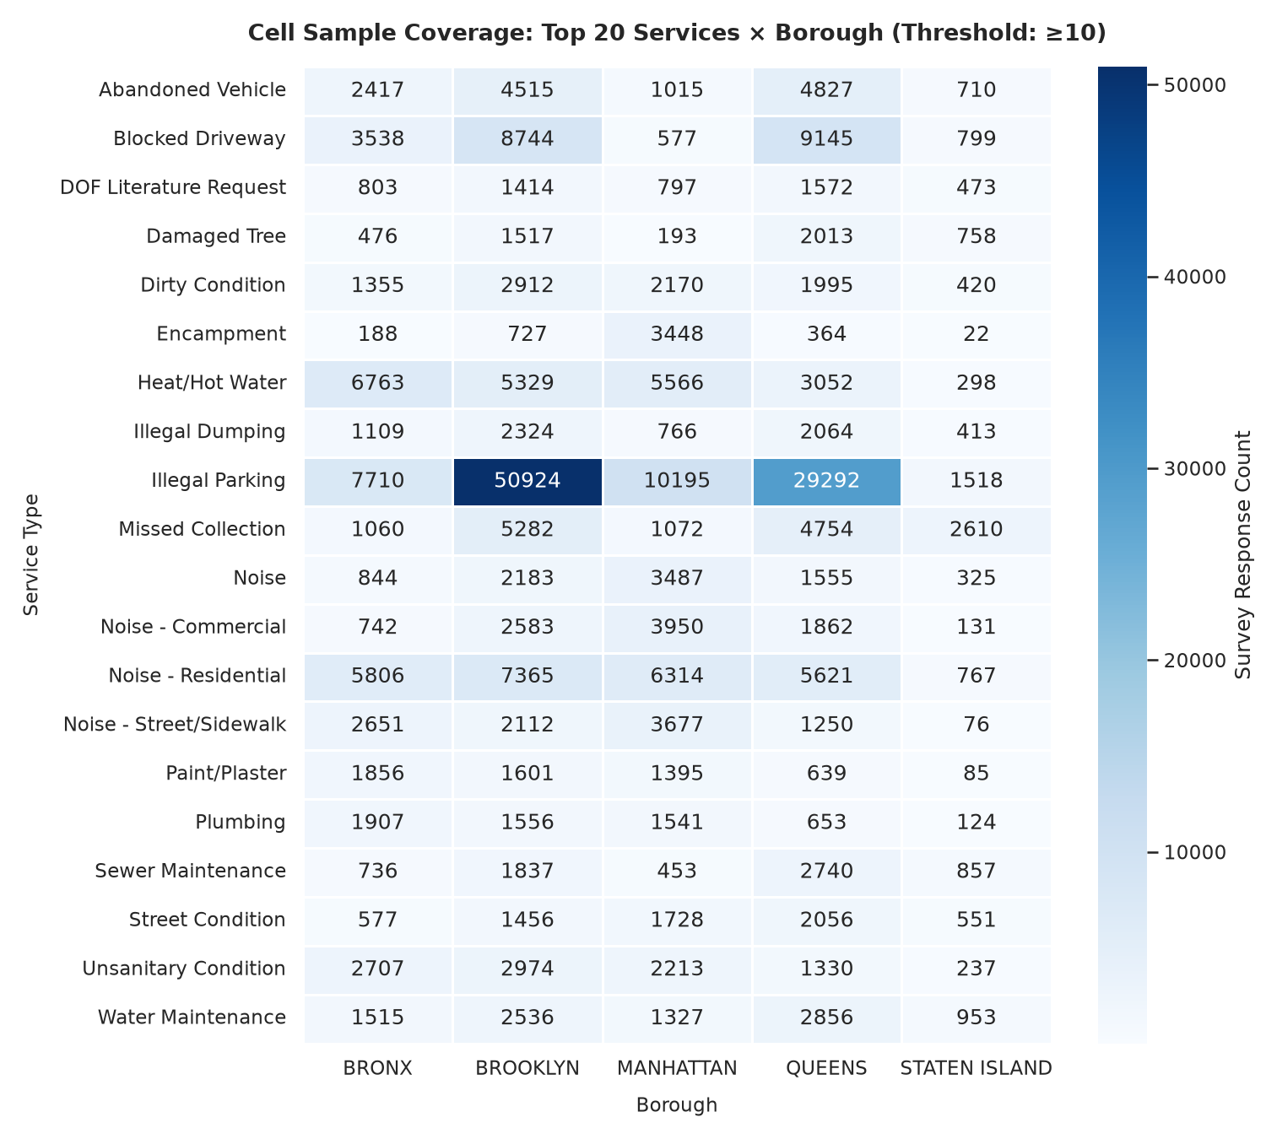
02 DATA
We combined two public NYC datasets
4.2M
406,581
884
1,885
NYC 311 service requests
clean satisfaction responses
original integrated cells
lagged evaluation cells
Privacy-safe integration
The survey has no request-level citizen text. Therefore, we joined the sources at a service x borough x year x month cell.
This avoids pretending that one survey response belongs to one ticket.
Citizen Sentiment Analysis of Municipal Services | Team 16
03 / 10

Slide 4
03 DESIGN
The study predicts the next month
Features from month t
Target in month t + 1
Out-of-time test
Volume
Delay history
VADER / topics / ABSA
Satisfaction signals
->
->
Train: 2023
Validate: 2024
Test: later 2024 cells
Mean resolution delay
14-day repeat-request rate
Important control:
Targets were shifted forward by one month, and lagged target values were not used as features.
Citizen Sentiment Analysis of Municipal Services | Team 16
04 / 10

Slide 5
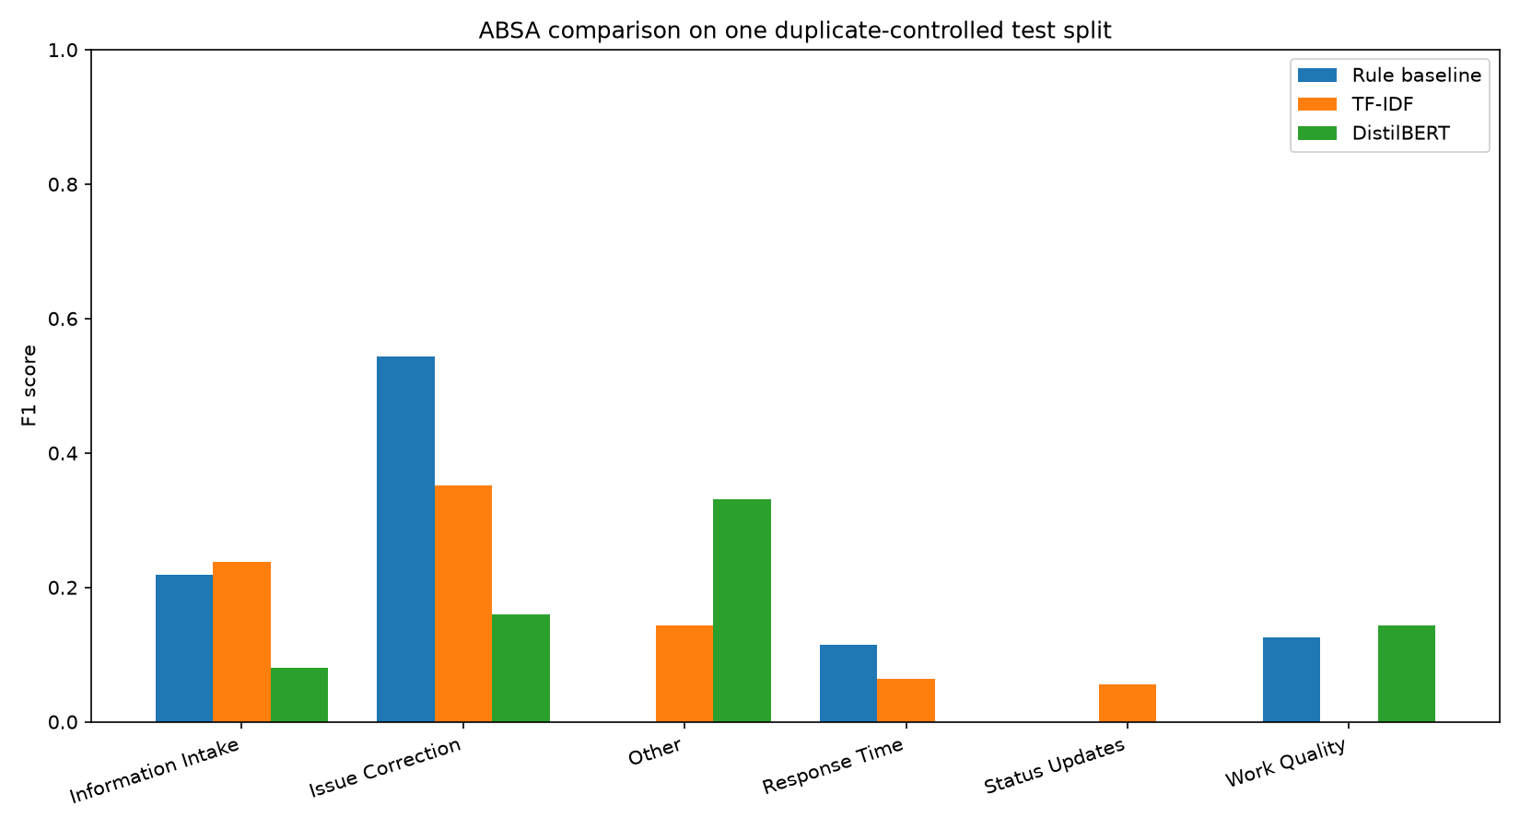
04 PIPELINE
The NLP pipeline was tested with controls
VADER
Topics
ABSA
RSAT
Lexicon sentiment and negative-ratio features.
LDA and BERTopic captured recurring service themes.
Three approaches assigned grievance aspects.
Satisfaction and dissatisfaction signals were aggregated.
Quality checks included:
- training-period topic fitting
- duplicate-controlled chronological ABSA evaluation
- five random seeds and 2,000 bootstrap replicates
ABSA remains difficult: macro-F1 was close to the six-class chance level.
Citizen Sentiment Analysis of Municipal Services | Team 16
05 / 10

Slide 6
05 MAIN RESULT
Persistence was stronger than the primary NLP model
Out-of-time R2 comparison
Higher is better. The simplest previous-value benchmark is included for context.
Resolution delay
Correct conclusion
Last-value persistence
0.884
The NLP features did not beat the strongest simple benchmark in this corrected lagged test.
Structured LightGBM
0.600
All augmented features
0.473
This is a useful research result because it prevents overclaiming.
14-day repeat rate
Last-value persistence
0.947
Citizen Sentiment Analysis of Municipal Services | Team 16
06 / 10

Slide 7
06 ABLATION
Feature groups gave mixed results
Incremental delta R2 versus structured model
Positive means the feature group helped; negative means it reduced test performance.
Delay
Repeat rate
VADER
VADER
-0.235
-0.027
Topics
Topics
+0.012
+0.005
ABSA
ABSA
+0.043
-0.050
RSAT satisfaction
RSAT satisfaction
+0.011
-0.000
Main message: there is no consistent gain across feature groups or outcomes.
Citizen Sentiment Analysis of Municipal Services | Team 16
07 / 10

Slide 8
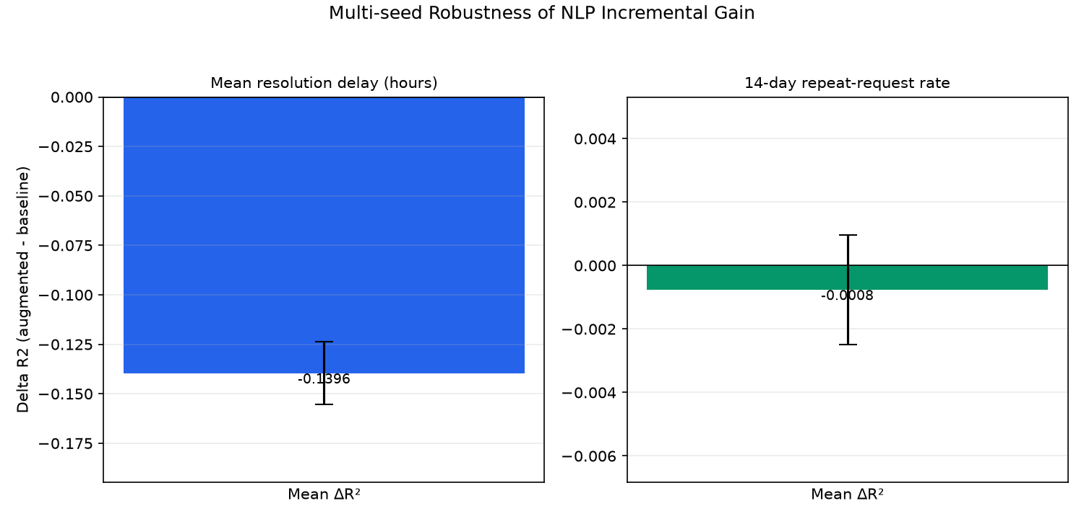
07 ROBUSTNESS
The result is stable enough to interpret carefully
Five seeds
Delay mean delta R2: -0.140 +/- 0.016
Repeat mean delta R2: -0.001 +/- 0.002
Bootstrap intervals
Delay: [-0.228, -0.040]
Repeat: [-0.007, +0.006]
The repeat-rate interval is close to zero. The delay result is negative across the tested resamples.
Statistical note: p-values come from paired absolute prediction-error tests, not a direct test of delta R2.
Citizen Sentiment Analysis of Municipal Services | Team 16
08 / 10

Slide 9
08 DASHBOARD
The dashboard turns evidence into an action queue
Municipal operations
Resident view
- rank service cells by priority
- compare boroughs and services
- inspect delay, repeat and dissatisfaction
- review model evidence before acting
- read the current service picture
- understand what each metric means
- see where attention is needed
- use plain language instead of model jargon
0.100
9.94x
0.859
The dashboard is a prioritisation tool, not proof that the model solves each individual case.
Precision@10
top-10 lift
NDCG@10
Citizen Sentiment Analysis of Municipal Services | Team 16
09 / 10

Slide 10
09 TAKEAWAY
What we can confidently say
NLP adds useful context, but it did not produce a consistent improvement over persistence in the corrected out-of-time test.
Three points to remember
1. The data integration and time split are reproducible.
2. The corrected negative / near-null result is more credible than an inflated positive claim.
3. The dashboard still helps municipalities review and prioritise service cells.
Next research step: validate on genuine citizen free text and another city before claiming generalisation.
Citizen Sentiment Analysis of Municipal Services | Team 16
10 / 10

