Slide 1

B.Tech. BCSE497J - Project-I
SHAP-GUIDED DRIFT DIAGNOSIS FOR ADAPTIVE ANOMALY DETECTION IN AWS CLOUDTRAIL
Team member:
SANIDHYA BHANDARI (23BCT0029)
Faculty guide:
Dr. Badrinath N
Review 3 | 28 October 2026

Slide 2

Project Direction and Current Scope
The project direction has been narrowed from general cloud remediation to a reproducible research study.
Scope now includes:
- real CloudTrail drift observation
- SHAP-guided diagnosis
- protected adaptation evaluation
- external transfer checking
The primary corpus is unlabeled, so real-data results are observational.

Slide 3
Aim
To develop and evaluate a label-free drift diagnosis protocol that combines feature-distribution drift with SHAP-attribution drift, so an unsupervised AWS CloudTrail detector can adapt selectively without treating every behavioural change as a security incident.

Slide 4
Abstract
Cloud behaviour changes over time because of new services, regions, identities, and automation.
This project studies whether feature drift and SHAP-attribution drift provide complementary evidence for deciding when adaptation is justified.
Dataset: 1,939,207 records | 45 monthly windows | no attack labels
Evaluation: controlled semi-synthetic benchmark plus independent temporal checkpoint.

Slide 5


Literature Review
Established building blocks
• Isolation Forest for unsupervised anomaly scoring
• SHAP for model-level feature attribution
• Unlabeled drift detection and normality shift
• Drift-type-aware and selective adaptation
• CloudTrail and security monitoring
Closest gap
Existing work does not establish a CloudTrail-specific evaluation of whether changed features are also driving changed detector attributions before adaptation.

Slide 6
Research Gap
A feature alarm only tells us that the observed distribution changed. It does not tell us whether the detector's decision logic changed in a security-relevant way.
Contribution:
1. CloudTrail-specific real-data drift protocol
2. Explicit separation of observational and controlled evidence
3. Attribution-feature coupling score
4. Protected adaptation and unnecessary-adaptation measurement
5. Label-free transfer calibration, reported separately from source-tuned thresholds

Slide 7


Objectives and Expected Outcome
1. Audit the real corpus and its temporal limitations.
2. Build a chronological 27 / 9 / 9 train-validation-test protocol.
3. Validate Isolation Forest and TreeSHAP behaviour.
4. Measure feature drift, SHAP drift, and coupling.
5. Compare static, periodic, feature-only, SHAP-only, dual, and coupled policies.
6. Report robustness, uncertainty, external transfer, and limitations.
SDG relevance: SDG 9 (resilient digital infrastructure) and SDG 16 (secure institutions).
Outcome: capstone research prototype, report, reproducible code, and journal-ready evidence package.

Slide 8
Framework / Architecture
Source audit
↓
Monthly windows and train-only encoding
↓
Isolation Forest anomaly scores
↓
TreeSHAP attribution distributions
↓
Feature drift + SHAP drift + coupling
↓
Diagnosis: stable / benign / security-relevant / review
↓
Protected adaptation simulation
↓
Metrics, uncertainty, and reporting

Slide 9
Functional Requirements
Functional
• Read-only dataset audit and manifest
• Chronological temporal split
• Train-only feature encoding
• Isolation Forest scoring
• SHAP additivity validation
• Feature, SHAP, and coupling drift
• Validation-only threshold tuning
• Protected retraining comparison
Safety and research constraints
• No attack labels used by the detector
• No production AWS/IAM enforcement
• Real-data claims remain observational

Slide 10
Modules
1. Dataset audit and temporal protocol
2. Event feature representation
3. Isolation Forest baseline
4. SHAP explanation validation
5. Feature and attribution drift monitoring
6. Attribution-feature coupling
7. Controlled diagnosis benchmark
8. Protected adaptation controller
9. Robustness and cost sensitivity
10. Independent external validation
11. Reproducible reports and artifacts

Slide 11
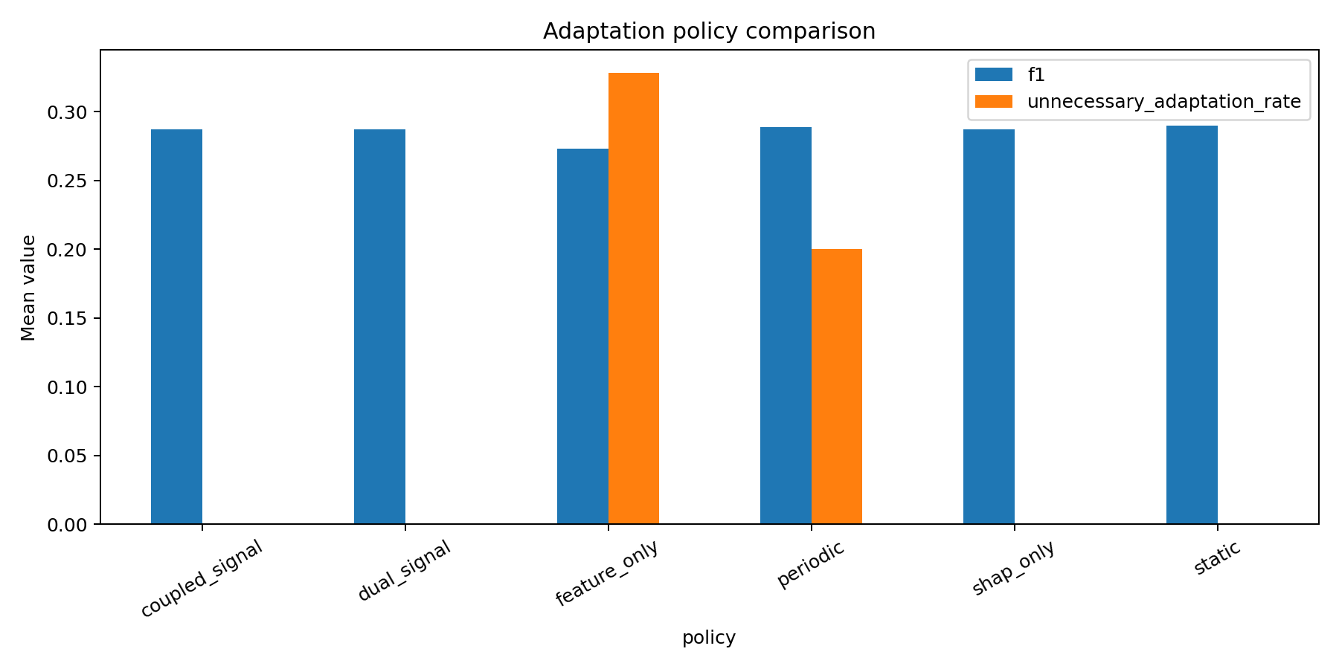
Experiments and Results
Verified results
Controlled diagnosis macro-F1: 0.7306
Dual vs static FPR difference: -0.0885
Dual vs static F1 difference: -0.0028
Unnecessary adaptation: 0.0000
Coupling was neutral in the controlled benchmark. Source-tuned external coupling had F1 0.1818; label-free largest-gap calibration reached F1 1.0000 on the small 12-window checkpoint.

Slide 12
Conclusion and Future Work
Conclusion
The project demonstrates a reproducible way to separate real-data drift observation from controlled diagnosis and adaptation evidence. Feature and attribution signals reduce unnecessary retraining in the defined benchmark, but the coupling extension is not universally superior.
Future work
• Multi-period external temporal validation
• Larger and more diverse perturbation families
• Independent post-adaptation recovery evaluation
• Human completion of PRISMA screening and risk-of-bias assessment
• Supervisor review and venue-specific formatting

Slide 13
Outcome Achieved
Completed technical outcome
• Reproducible CloudTrail drift-diagnosis pipeline
• Isolation Forest + TreeSHAP validation
• Attribution-feature coupling implementation
• Controlled benchmark and adaptation comparison
• Independent detector and temporal transfer checks
• 28 automated tests passing
• Research report, literature matrix, and GitHub repository
Journal outcome status
A research prototype and manuscript-ready evidence package are complete. Q1/Q2 acceptance is not guaranteed; human PRISMA review and stronger independent validation remain.

Slide 14
References
[1] Liu, Ting and Zhou, "Isolation Forest," IEEE ICDM, 2008.
[2] Lundberg and Lee, "A unified approach to interpreting model predictions," NeurIPS, 2017.
[3] Sethi and Kantardzic, "Reliable detection of concept drift from streaming unlabeled data," ESWA, 2017.
[4] Kuppa and Le-Khac, "Learn to adapt: Robust drift detection in security domain," CEE, 2022.
[5] Han et al., "Anomaly detection in the open world: Normality shift detection, explanation and adaptation," NDSS, 2023.
[6] Lee et al., "Explainable AI-based model drift detection," CMC, 2023.
[7] Varma and Ramya, "Explainable ML for AWS CloudTrail logs," ICNGN, 2025.
[8] AWS, CloudTrail and feature attribution drift documentation.
Full references and verification links are included in the report and repository.

