Slide 1
CAPSTONE / IDP JOURNAL OUTCOME
SHAP-Guided Drift Diagnosis
for Adaptive AWS CloudTrail Anomaly Detection
Research implementation, PRISMA evidence package, and Q1/Q2 journal plan
Project folder placeholder: Project_XX - replace XX with assigned number
Prepared for supervisor progress review | 21 October 2026

Slide 2
SHAP-GUIDED CLOUDTRAIL DRIFT DIAGNOSIS
The research problem is deciding when to adapt
Cloud activity changes for legitimate reasons: new services, regions, identities, and automation. A feature alarm alone cannot tell us whether the detector should be retrained.
Feature drift
The observed records changed
Attribution drift
The detector relies differently
Research question: does combining feature drift with SHAP-attribution drift reduce unnecessary adaptation without losing controlled security sensitivity?
Adaptation gate
Retrain only with evidence
Source: project artifacts | Status: research prototype and submission package

Slide 3
SHAP-GUIDED CLOUDTRAIL DRIFT DIAGNOSIS
The study separates observation from labelled evaluation
TRACK A - REAL CORPUS
TRACK B - CONTROLLED BENCHMARK
- 1,939,207 CloudTrail-style records
- 45 chronological monthly windows
- feature and SHAP drift timelines
- no attack labels -> observational claims only
- semantic benign/security perturbations
- validation-tuned thresholds
- held-out seeds and scenarios
- diagnosis and adaptation metrics
Source: data_manifest/real_cloudtrail_manifest.json; data/benchmark/*

Slide 4
SHAP-GUIDED CLOUDTRAIL DRIFT DIAGNOSIS
The real corpus is large, but the protocol respects its limits
1.94M
45
18
0
records
months
columns
attack labels
Chronological protocol
27 train months -> 9 validation months -> 9 held-out test months
The richer raw export confirms day/hour timestamps exist, but it is the same underlying corpus - not independent validation.
Source: project artifacts | Status: research prototype and submission package

Slide 5
SHAP-GUIDED CLOUDTRAIL DRIFT DIAGNOSIS
Dual-signal diagnosis gates protected adaptation
1
2
3
4
5
Encode
Detect
Explain
Monitor
Adapt
Train-only category maps
Isolation Forest anomaly score
TreeSHAP attribution vectors
Feature + attribution drift
Replay + normal-candidate retraining
Stable -> benign drift -> security-relevant drift -> review required
Source: project artifacts | Status: research prototype and submission package

Slide 6
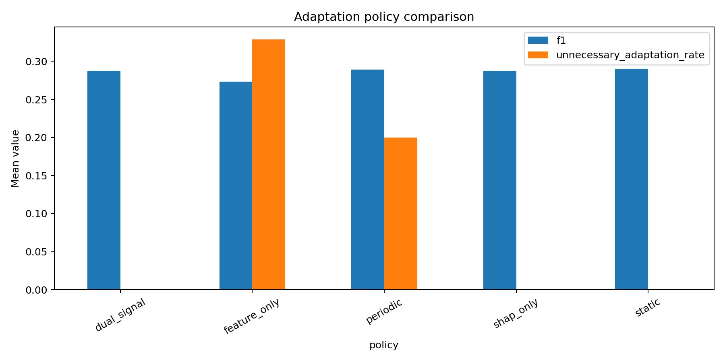
SHAP-GUIDED CLOUDTRAIL DRIFT DIAGNOSIS
The benchmark shows lower unnecessary adaptation, not universal F1 gains
Measured result
Dual-signal vs static:
F1 difference
-0.0028
False-positive-rate difference
-0.0885
BH-adjusted q = 0.00043
Source: results/paired_inference.csv; semi-synthetic benchmark only

Slide 7
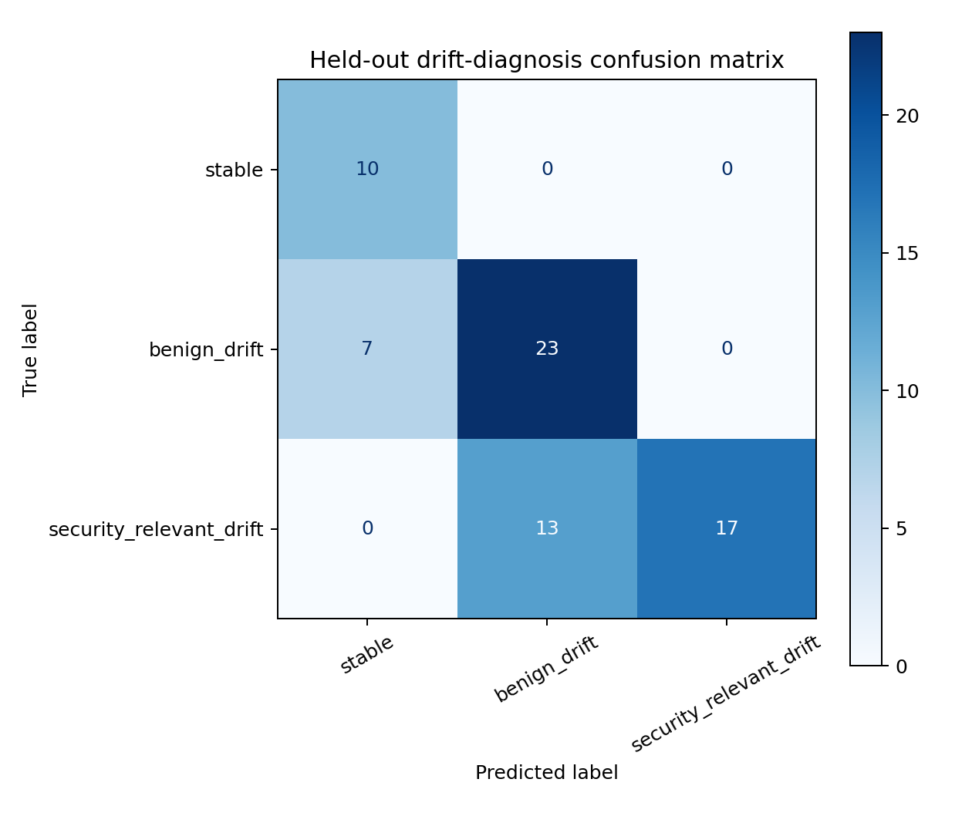
SHAP-GUIDED CLOUDTRAIL DRIFT DIAGNOSIS
Ablations expose detector and window-size sensitivity
Independent labelled CloudTrail validation
Isolation Forest: recall 0.7137 | F1 0.4519 | FPR 0.1738
LOF: recall 0.9954 | F1 0.5334 | FPR 0.2088
One-Class SVM: recall 0.0008 | F1 0.0015 | FPR 0.0042
External temporal checkpoint: all policies F1 0.9524; FPR 0.5000
Window-size ablation
Security recall: 100 rows = 0.0884
200 rows = 0.4918
500 rows = 0.4152
Source: data/robustness/*; data/external_validation/*

Slide 8
SHAP-GUIDED CLOUDTRAIL DRIFT DIAGNOSIS
The submission package is prepared; four actions remain
READY NOW
MANUAL BEFORE SENDING
[OK] Working implementation and results
[OK] 100-record 2022-2026 evidence set
[OK] PRISMA protocol and flow accounting
[OK] Consolidated Word review
[OK] Project report draft
[OK] Presentation and journal shortlist
1. Replace Project_XX with assigned number
2. Two-reviewer title/abstract/full-text screening
3. Recheck current Q1/Q2 status and author guidelines
4. Supervisor/team review and Google Drive upload
Working target: IEEE Transactions on Cloud Computing (Q1 in the attached 2023 JCR list)
The package is transparent about what is complete and what still requires human confirmation.

